Slide 1
CA$ha
Birkenstocks and socks
Peggy Anderson
Jonathan Baxter
Chris Penner

Slide 2
Low-fidelity Prototype
Paper Prototype
Results
Positioning of buttons
More labels
Missed some Functionality

Slide 3
Objective of Medium-Fidelity Prototype
Implemented Using html, css and javascript
Allowed us to automate the “wizard of Oz approach”

Slide 4
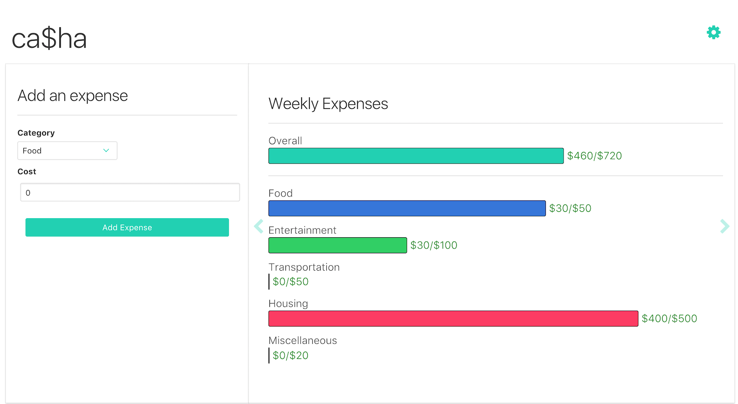
Medium-Fidelity Prototype

Slide 5
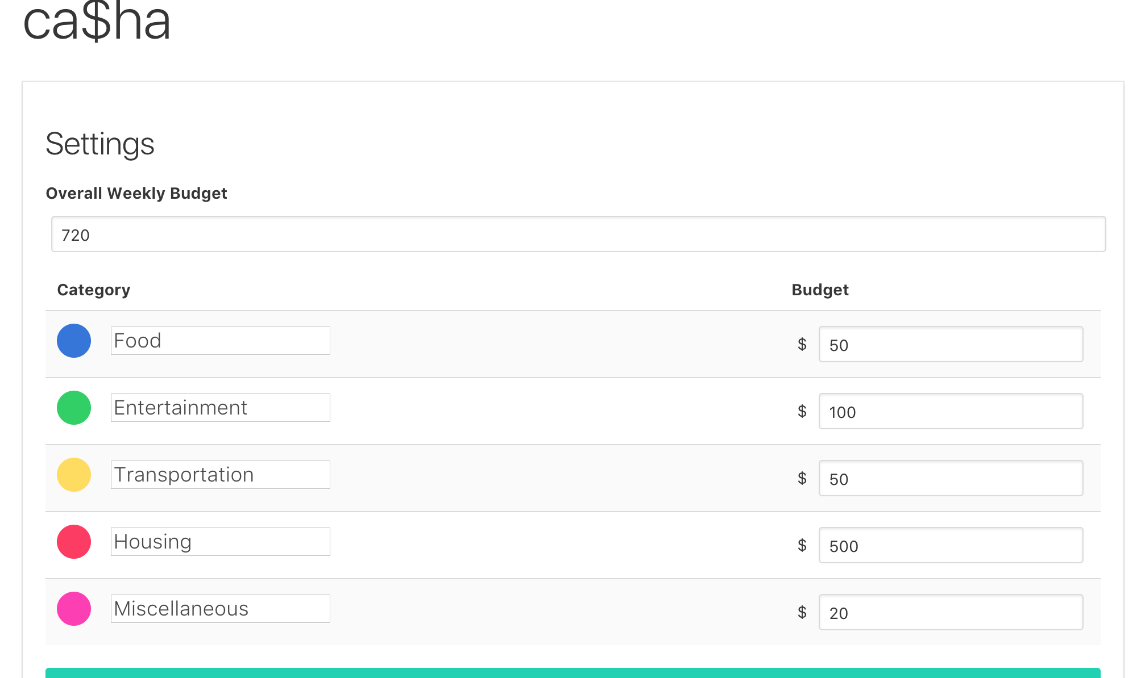
Medium-Fidelity Prototype

Slide 6
Evaluation
Used Interviews to conduct our evaluation
Interviews were Semi-structured

Slide 7
Results of Evaluation
Easy to add expenses
Easy to view spending
More in depth data
More customizable

Slide 8
Final recommendations
Valid approach with some minor tweaks

Slide 9
Questions?

