Slide 1
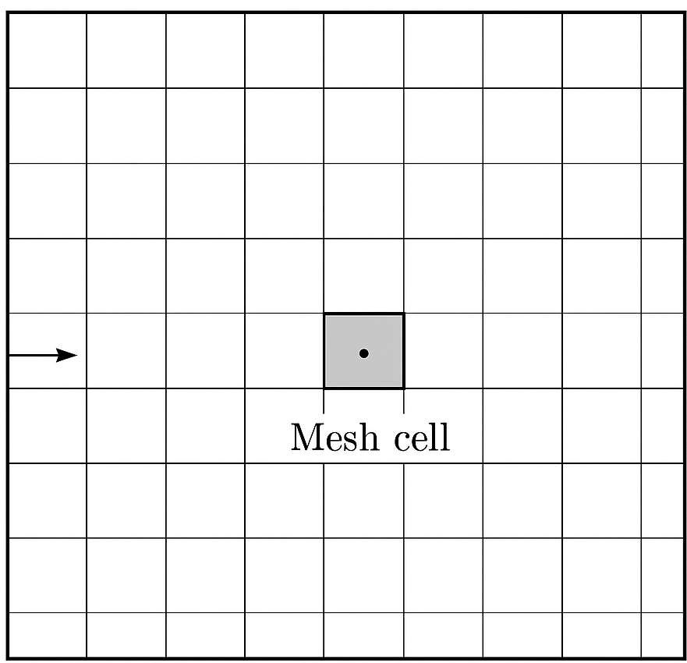
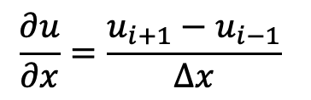




Prescribe boundary values (boundary conditions)
$$Δx$$
Solve for values inside the domain
$$\frac{∂u}{∂x}=\frac{u_{i+1}−u_{i−1}}{Δx}$$
Prescribe boundary values (boundary conditions)
$$u_{i−1}$$
$$u_{i}$$
$$u_{i+1}$$
Prescribe boundary values (boundary conditions)
Prescribe boundary values (boundary conditions)

