Slide 1
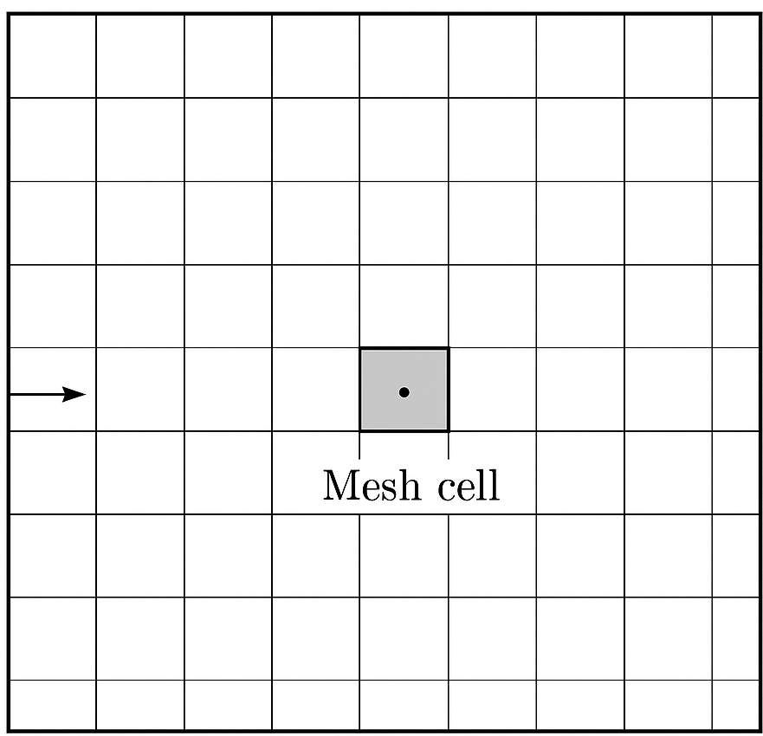
Prescribe boundary values (boundary conditions)
Solve for values inside the domain
Prescribe boundary values (boundary conditions)
Prescribe boundary values (boundary conditions)
Prescribe boundary values (boundary conditions)

