Slide 1
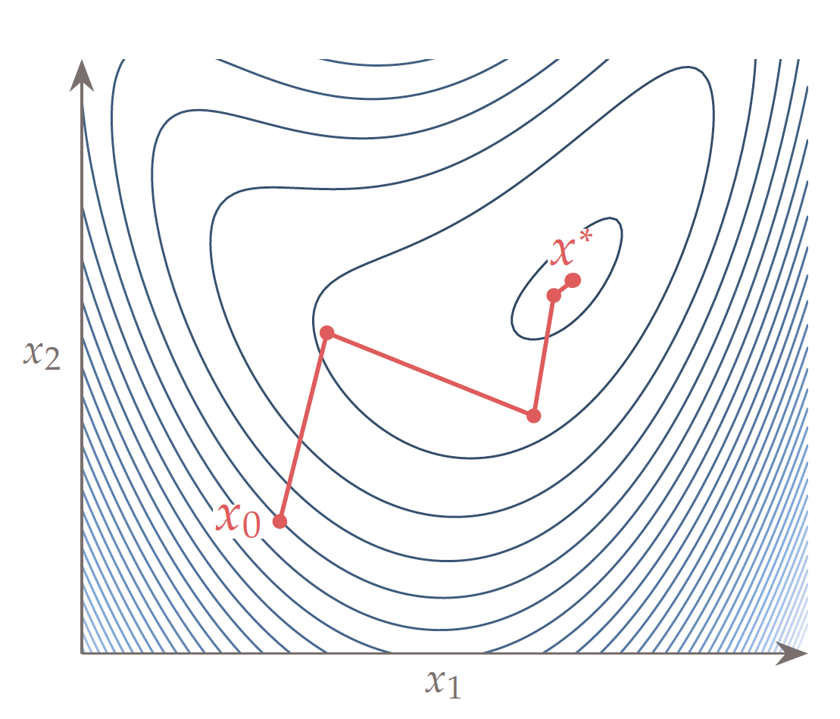
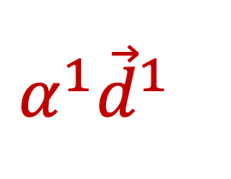
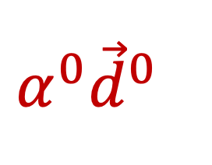
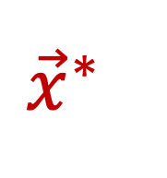
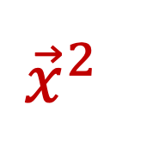
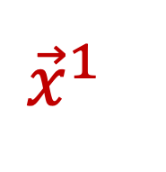
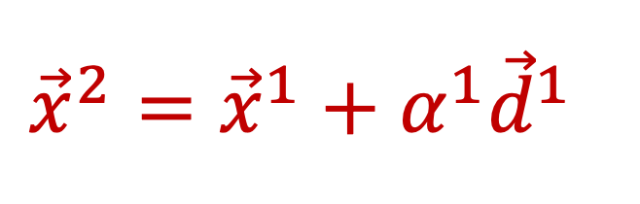
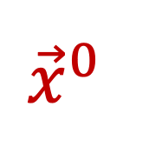
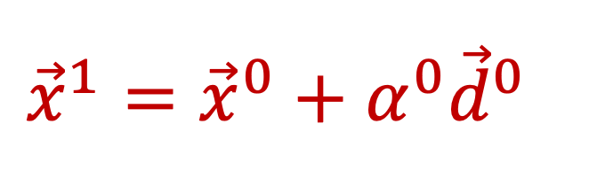
$${{{\vec{x}}^{1}={\vec{x}}^{0}+α}^{0}\vec{d}}^{0}$$
$${{{\vec{x}}^{2}={\vec{x}}^{1}+α}^{1}\vec{d}}^{1}$$
$${\vec{x}}^{∗}$$
$${\vec{x}}^{1}$$
$${α^{0}\vec{d}}^{0}$$
$${α^{1}\vec{d}}^{1}$$
$${\vec{x}}^{2}$$
$${\vec{x}}^{0}$$

