Slide 1
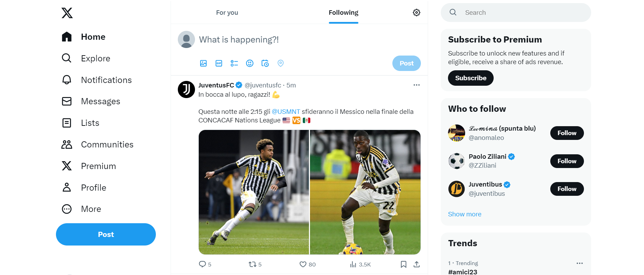
https://twitter.com/home

