Slide 2
Building Line of Business and Cross Platform Apps with Mobile Services
Chris Risner & Donna Malayeri
Evangelist & Program Manager
3-622

Slide 3
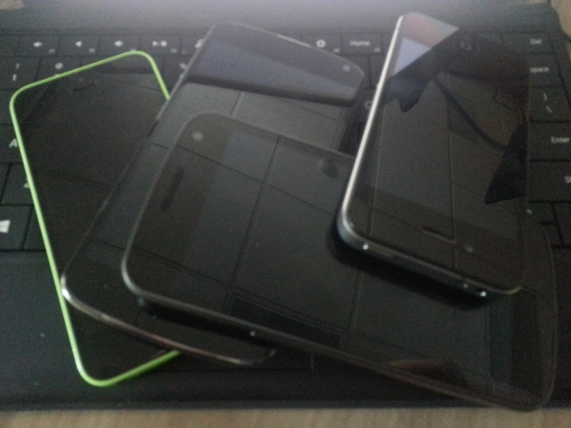
Agenda
Mobile Services
Offline
Going Cross Platform
Active Directory
Push Notifications
On-Premise Connectivity

Slide 4

What is Mobile Services?
Mobile Services
Identity
Data
Messaging
Logic
Notes:
This slide will be a brief overview of the capabilities of Zumo
Most people will already be aware so we don’t have to go super deep
Turn key way to add a backend to your application

Slide 5
Demo: Mobile Services Line of Business app

Slide 6
Why offline?
Field engineers/salespeople aren’t always online
Might even be primarily offline, but still need to be productive
“Occasionally connected” scenario
Want to have a local cache if lose network access
“Primarily online” scenario

Slide 7
Supporting Offline Data
Access data from Mobile Services tables even when app is offline
Keep a local queue of Create, Update, Delete operations and synchronize with server when app is back online
Detect conflicts when same item is changed both locally and on server

Slide 8
Goal of Offline Feature
Lightweight
Cross-platform
Currently support only .NET, but iOS and Xamarin are coming
Support both “occasionally-connected” and “primarily online” scenarios
Support multiple backend data stores
E.g., SQL, Azure Tables, Mongo, etc.
Support both Node.js and .NET backends

Slide 9
What Mobile Services Offline is Not
Not a database-to-database sync solution
Not intended to supplant full-featured sync frameworks
Often specialized to particular backend stores
Often specialized to particular client frameworks/languages
E.g., can use BreezeJS for JavaScript clients (demo later)

Slide 10
Current preview release
Geared toward occasionally-connected apps
Explicit model: app opts in to offline feature and chooses when to push and pull data from the server
SDK includes a local store based on SQLite
Feature is configurable, can substitute your own implementation
Can detect conflicts between client and server (more on this later)
.NET client library available today
Notes:
Opt-in on the CLIENT, not server

Slide 11
Demo: Adding Offline Support

Slide 12


Optimistic Concurrency
Device 1
Server
Device 2
Create
▲, 1
▲, 1
▲, 1
Fetch
▲, 1
▲, 1
▲, 1
Update
▲, 1
■, 2
▲, 1
■, 2
Update
✘
▲, 1
●, 2
■, 2
■, 2
Notes:
Mention the version, created, updated codes

Slide 13
Demo: Handling conflicts

Slide 14
Offline Data: recap
Lightweight
(Eventually) cross-platform
Preview for Windows Phone/Windows preview available today
Xamarin & iOS previews are coming soon
Detect conflicts using optimistic concurrency feature
Resolve conflicts using a sync handler
Can “grow into” more advanced sync frameworks
e.g., BreezeJS, Sync Framework, SQL Server Data Sync
Notes:
Mention Breeze.js

Slide 15
Going Cross Platform

Slide 16
Options for Cross Platform
Web Sites (not really apps)
PhoneGap / Cordova
HTML / JS
Cocoas2d-x
Games
Xamarin
.NET everywhere!
Notes:
Detail the different options for building cross platform apps:
Build web sites instead of apps (not really an option if you want to really run locally)
PhoneGap / Cordova
Let’s you build HTML / JS that runs in a wrapper
Same code base on every device
Not as fast as the built in browser on some platforms
Xamarin
What we’ll focus on today
Makes the .NET runtime usable “everywhere”

Slide 17
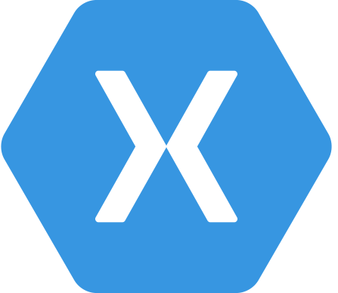
Xamarin
.NET Everywhere!
WinStore + WinPhone + iOS + Android
Created by Mono engineers
Support for bindings to native libraries
Visual Studio & Xamarin Studio
Quickly updated for new APIs / SDKs
PCLs for shared code!
Notes:
Offline support for Xamarin will go in PCL
Enables you to write and run .NET on Windows / WinPhone, iOS, Android
Created by the original Mono engineers who wanted to bring .NET to Linux
Can be connected to native libraries (.a / .jar) via binding projects (with steps on creating those bindings)
Apps can be built in Visual Studio or Xamarin Studio
Building iOS in Visual Studio still requires a Mac to handle build / deploy.
Can be done “easily” using the Xamarin.iOS Build Host
Xamarin typically releases updates to match new APIs very quickly
PCLs allow you to share code easily
A year ago it was more difficult and you had to link files or copy paste
With PCL support, you can much more easily share code
Mobile Services works as a PCL

Slide 18
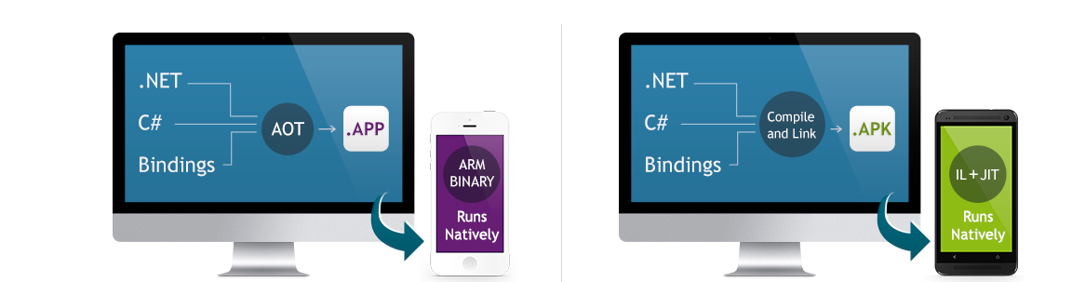
How does it work?
Xamarin.iOS does full Ahead Of Time (AOT) compilation to produce an ARM binary suitable for Apple’s App Store
Xamarin.Android takes advantage of Just In Time (JIT) compilation on the Android device
Notes:
For iOS and Android, .NET works a little different
Because you can’t use dynamic code in an iOS app, AOT compilation is used to create an ARM binary
For Android, JIT compilation is used

Slide 19
Demo: Creating a Cross Platform App with Xamarin
Notes:
Go to Portal
Show create new Mobile Services wizard
Go to existing XPlatDemo service
Go to QS, show downloads for different platforms and highlight Windows Store and Xamarin.IOS
Go to Visual Studio and open XplatDemo Solution
Run apps
-Remove component from iOS Project
-Remove nuget from Windows
-Add PCL project
-Add NuGet package to all projects
-remove system.io, system.runtime, system.threading.tasks from iOS project
-paste over app.config in ios project
-add code to PCL for TodoItem and MobileServiceHlper
-add reference to PCL from WinStore and iOS projects
-remove TodoItems from win store and iso projects
-alter code to use Mobile Service Helper
-rerun projects

Slide 20
Azure Active Directory
Easily tied to on-premise AD
All the benefits of Active Directory auth
Can be tied to other SAAS

Slide 21
Demo: Adding AD Auth with Mobile Services
Notes:
Git Checkout PreFullAppDemo
Switch to ChatDemo app
Launch app, show sending a message
Lock down message table
Show it not working
Add AD Auth

Slide 22
Notification Hubs
Hugely scalable push notifications
Cross platform
Independent of storing data in cloud
Tags and templates
Client and server registration
Notes:
Note: - the push code (for the register for push script) will get easier

Slide 23
Demo: Adding Push Notifications
Notes:
Drop in code to register for push notifications
Add call to server to register once user is authenticated
Add server script to handle registration
Alter message bit to deliver a push notification
Demo push notifications

Slide 24
On-Premise Connectivity
Service Bus Relay
On-premise resource registers relay
Mobile Service talks to relay
Relay passes through to on premise
Can be secured with Mobile Service auth
On-Premise could do anything
LOB app
Database Access
Etc

Slide 25
Demo: On-Premise with Service Bus Relay
Notes:
Go to Service Bus
Open Relay solution
Run relay
Show relay in portal
Connect to relay from App
Use contacts to display contacts in app

Slide 26
Recap
Mobile Services is becoming more LOB / Enterprise friendly
Great features will help make apps better
Offline data sync
AAD
Notification Hubs
Service Bus Relay
Xamarin makes it easy to reuse your .NET code for x-plat apps
Everything that was done in JavaScript can be done in .NET with Mobile Services

Slide 27
Further Resources
Windows Phone, offline, and NoSQL
Integrating a Mobile Service with Service Bus Relay
Push Notifications to Any Client with Notification Hubs
Powerful Mobile Apps with Mobile Services and ASP.NET Web API
Extending your On-Premises Network into Azure Securely
Notes:
Notes:
In service bus console, show the userid and auth token to show that we could authenticate the request again on premise

Slide 28
Contact Us
Donna Malayeri - @lindydonna
donnam@microsoft.com
Chris Risner - @chrisrisner
chrisner@microsoft.com

Slide 29

© 2014 Microsoft Corporation. All rights reserved. Microsoft, Windows, Windows Vista and other product names are or may be registered trademarks and/or trademarks in the U.S. and/or other countries.
The information herein is for informational purposes only and represents the current view of Microsoft Corporation as of the date of this presentation. Because Microsoft must respond to changing market conditions, it should not be interpreted to be a commitment on the part of Microsoft, and Microsoft cannot guarantee the accuracy of any information provided after the date of this presentation. MICROSOFT MAKES NO WARRANTIES, EXPRESS, IMPLIED OR STATUTORY, AS TO THE INFORMATION IN THIS PRESENTATION.

