Slide 1
Going Mobile with the Cloud
Chris Risner
Technical Evangelist
Microsoft
chrisner@microsoft.com
@chrisrisner

Slide 2

Introduction
Just a little bit about me
Windows Azure Technical Evangelist
@chrisrisner
Chrisrisner.com
Lives in Washington
Grew up near Detroit
iOS / Android developer for 4 years

Slide 3
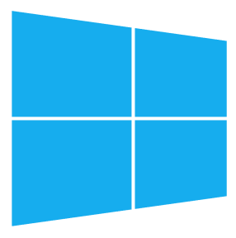
Agenda
Azure Overview
Sign-up and Getting Started
Features and Demos
Hands on with Features
Advanced Features
Questions and Resources
Official Break at 3pm
Notes:
Slide Objectives:
Overview of what the session will cover.
Transition:
n/a
Speaking Points:
Today we’ll speak about the following things:
Mobile Services
Features of mobile services including
Data Storage
Push notifications
Security and authentication
Scaling, etc
At the end we should have time for questions
Notes:

Slide 4
Why Consider the Cloud?
Speed
Scale
Economics

Slide 5























Azure Overview
^{app} ^{services}
cloud services
caching
identity
service bus
media
mobile services
web sites
integration
hpc
analytics
^{data} ^{services}
SQL database
HDInsight
table
blob storage
^{infrastructure} ^{services}
virtual machines
virtual network
vpn
traffic manager
cdn

Slide 6

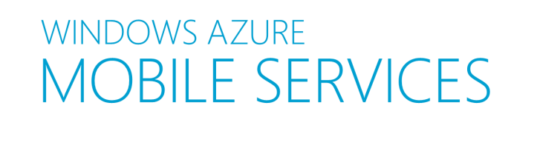

What is Mobile Services?
Auth
Server Logic
Notifications
Logging & Diag
Data
Scheduler
Scale
Notes:
Slide Objectives:
Explain what a Backend-as-a-service is
Explain the features (at a high level) that Mobile Services offers
Transition:
Let’s answer the question, what is Mobile Services?
Speaking Points:
Mobile Services is a Backend-as-a-Service (BaaS).
Instead of coding, testing, deploying, and maintaining your own backend, you spin up a Mobile Service and can instantly take advantage of a ton of great features.
These features include:
Data storage powered by SQL Database (but not requiring you to be a DBA)
Simple and easy to use push notifications
User authentication and data authorization
Server side logic so you can craft how your application will function on the server.
Scaling – so you can meet the demand of your mobile apps when they get featured
Logging and Diagnostics so you can get insight into how your Mobile Service is working
Backend processing using something called Scheduler
Notes:
You may want to mention at this time that support exists for other platforms as well (Win Store, Win Phone, Android, iOS, HTML/JS, Xamarin, etc)

Slide 7
Getting Started
Notes:
Slide Objectives:
Break into the first demo showing creating a mobile service and running the client code.
Transition:
n/a
Speaking Points:
Let’s take a look at creating a new Mobile Service and then get it running locally
Notes:
Jump to the portal and spin up a new Mobile Service
Make sure to comment on creating a table causing a REST API to be spun up
Follow the “create a new app” guide and download the client side code
Run the client app
Walk through the client source code
Mention Mobile Services using dynamic schematization to inspect your data and create new columns to store your data in

Slide 8
HOL: Getting Started
Create a new Mobile Service
Select a platform you want to work with
Download the quick start app
Run the quick start and walk through the code
Try adding more fields from the client
Try changing the query filters
Check out this: http://aka.ms/mdevcon

Slide 9
Structured Storage
Powered by SQL Database
Same DB – Multiple Mobile Services
Data management in
Windows Azure Portal
SQL Portal
SQL Management Studio
REST API
CLI Tools
Notes:
Slide Objectives:
Explain how Mobile Services is backed by SQL Database and how that data is accessible
Transition:
We just saw a great example of how our apps can make use of the data storage capabilities of Mobile Services
Speaking Points:
Without having to do more on the server side than say we wanted a table named TodoItem, we were able to start storing data in our database
We created a new DB for this Mobile Service, but, we can use the same database for multiple mobile services. This is possible because each table created has it’s schema (sort of like a prepended name) set to the name of that mobile service.
We just saw in the portal that you can see your data. You can also delete individual rows or clear out (truncate) whole tables. Additionally you can access the data from:
The SQL Portal – a silverlight tool used to do DB administration
SQL Management Studio – the windows based DB administration tool
The REST API – automatically used by the Mobile Services SDK, can also be accessed from anything capable of doing HTTP calls
Command Line Interface tools – we’ll look more at these later.
Notes:

Slide 10
The REST API
Base REST API Endpoint URL
https://Mobileservice.azure-mobile.net/tables/*
Data Operations and their REST Equivalents
Action | HTTP Verb | URL Suffix
Create | POST | /TodoItem
Read | GET | /TodoItem?$filter=id%3D42
Update | PATCH | /TodoItem/id
Delete | DELETE | /TodoItem/id
Notes:
Slide Objectives:
Explain the REST API
Continue to point out that the REST API allows anything capable of HTTP to talk to your Mobile Service even if there isn’t an SDK
Transition:
Let’s talk more about the REST API
Speaking Points:
Whenever you generate a table, the REST API is auto created for you
Each of the operations for your table are available from https://yourmobileservice.azure-mobile.net/tables/*
Operations match up like so:
Create – POST
Read – GET
Update – PATCH
Delete – DELETE
For reading items, you can use the SDK to generate a filter (as we did to filter out completed items) which will automatically be converted to an ODATA filter in the query string and then to a SQL query on the server side.
Notes:

Slide 11
A Word about Optimistic Concurrency
Let’s draw on the board
Notes:
Slide Objectives:
Explain how Mobile Services is backed by SQL Database and how that data is accessible
Transition:
We just saw a great example of how our apps can make use of the data storage capabilities of Mobile Services
Speaking Points:
Without having to do more on the server side than say we wanted a table named TodoItem, we were able to start storing data in our database
We created a new DB for this Mobile Service, but, we can use the same database for multiple mobile services. This is possible because each table created has it’s schema (sort of like a prepended name) set to the name of that mobile service.
We just saw in the portal that you can see your data. You can also delete individual rows or clear out (truncate) whole tables. Additionally you can access the data from:
The SQL Portal – a silverlight tool used to do DB administration
SQL Management Studio – the windows based DB administration tool
The REST API – automatically used by the Mobile Services SDK, can also be accessed from anything capable of doing HTTP calls
Command Line Interface tools – we’ll look more at these later.
Notes:

Slide 12
PostMan

Slide 13
JSON to SQL Type Mappings
JSON Value | T-SQL Type
Numeric values (integer, decimal, floating point) | Float(53)
Boolean | Bit
DateTime | DateTimeOffset(3)
String | Nvarchar(max)
Notes:
Slide Objectives:
Explain how Mobile Services maps data types sent over as JSON to SQL types when it uses dynamic schematization to create new columns
Transition:
Let’s talk about how Mobile Services creates new DB columns next
Speaking Points:
As we said before, Mobile Services uses Dynamic Schematization to inspect the data you send over to create new columns
This is the mapping it uses:
Numbers are stored as float(53)
Booleans are stored as a bit
DateTime are stored as DateTimeOffset(3)
Strings are stored as nvarchar(max)
Notes:
You may want to point out that we’re looking to add other types (i.e. GEO) in the future

Slide 14
Server Side Scripts
Customizing logic on the server
Node.js scripts
Intercept CRUD requests to tables
Passes through to SQL by default
Fully customizable logic flow
.NET backend Available (preview)
Notes:
Slide Objectives:
Start talking about server side scripts
Transition:
Speaking Points:
In addition to creating a REST API when you generate a table, Mobile Services also creates scripts which intercept CRUD requests against your table
As Mobile Services is built off of Node.js, these scripts are Node style scripts
By default these scripts just pass through whatever you have sent over to SQL DB
However, you can customize your own logic in these scripts to do whatever you want
Notes:

Slide 15
Node Modules
Extensibility through numerous included modules
request
push.*
sendgrid
console
mssql
pusher
statusCodes
azure
twilio
Notes:
Slide Objectives:
Mention some of the modules available out of the box in the server side scripts
Transition:
There is a ton of stuff you can do in the scripts and we’ve exposed several modules already to make doing things easy
Speaking Points:
Some of the modules available out of the box are
Request – for performing http requests to third party services
Push.* - for doing push notifications with APNS, GCM, WNS, MPNS
Console – for logging information
MSSQL – for performing custom SQL queries and calling stored procedures
statusCodes – for returning a status code other than what is expected
Azure – for getting access to Windows Azure Table and Blob storage, queues, service bus, etc
We also have several partners in the Windows Azure store who offer you other abilities
Sendgrid – allows sending emails
Pusher – facilitates web socket style real time communication down to mobile apps and websites
Twilio – sends SMS messages and offers some other voice capabilities
Notes:

Slide 16
Adding Server Scripts
Notes:
Slide Objectives:
Continue where the first demo left off by adding data validation when saving a todo item
Transition:
n/a
Speaking Points:
Let’s add some server scripts to validate our todo item before we send it
We’ll make it so the data will only be saved if the todo item’s text is at least 5 characters
Notes:
Return to the portal
Open the todo item table and go to the script tab
Show that the default script is just calling request.execute() which sends the request to the SQL DB
Alter that to return a BAD_REQUEST and error message if the todo item’s text is less than 5 characters
Return to the client app and attempt to insert invalid data
Rerun app (if necessary) and show that saving data still works by saving invalid data

Slide 17
HOL: Using Scripts
Add data validation to your scripts
Try adding new columns using scripts
Change how the app displays errors
Check out this: http://aka.ms/mdevcon

Slide 18
Push Notifications
Client
Mobile Services
Register for push notifications with provider
Send your identifier to Mobile Service
Send push from server scripts
Provider delivers notification to device
App
(2)
(3)
(4)
(1)
Provider
Notes:
Slide Objectives:
Review how push notifications work
Transition:
n/a
Speaking Points:
Now let’s move into setting up push notifications
No matter which mobile platform you’re working with, Push Notifications are handled the same way
First your app registers for push notifications with a provider
The provider returns a piece of information identifying the device and app (registration ID, token, channel URI)
Your app can then send that up to your Mobile Service
Your mobile service can then use the PUSH module to request a push notification go to your app using that identifying info and a payload
The provider will then deliver that push to your device (provided the identity info and payload were valid)
Notes:
Make sure to highlight the specific platform you’re presenting for but mention that they are all the same essentially

Slide 19
Push Notifications
Notes:
Slide Objectives:
Continue the demos by setting up push notifications and delivering a push
Transition:
n/a
Speaking Points:
Now we’ll set up push notifications and get them working with our app
Notes:
Make sure you’ve practiced and are familiar with all the steps necessary for implementing push notifications
Due the the complexity involved, the steps aren’t documented here

Slide 20
HOL: Implement Push
Add push notifications to your app
Check out this: http://aka.ms/mdevcon
Also: Break for 10

Slide 21
Notification Hubs (enhanced push)
Highly scalable push notifications!
Cross-Platform
Tag based registrations
Template based registrations
Scalable
.NET SDK, Node SDK, REST API, Java SDK (unofficial)
Notes:
Slide Objectives:
Start talking about server side scripts
Transition:
Speaking Points:
In addition to creating a REST API when you generate a table, Mobile Services also creates scripts which intercept CRUD requests against your table
As Mobile Services is built off of Node.js, these scripts are Node style scripts
By default these scripts just pass through whatever you have sent over to SQL DB
However, you can customize your own logic in these scripts to do whatever you want
Notes:

Slide 22
Data Authorization
Per HTTP method authorization options:
App Key required
Shouldn’t be used in production
Everyone
Authenticated Users
Admins and other scripts
Requires the Master Key (from client)
401 / Unauthorized response if a call doesn’t pass

Slide 23
User Auth Flow (server)
GOOGLE
CREDENTIALS (via oAuth/WebView)
FACEBOOK
DEVICE
AUTH TOKEN
TWITTER
GRAPH ACCESS (LIMITED)
IDENTITY
MICROSOFT
MOBILE SERVICE
Notes:
Slide Objectives:
Review different authorization options for permissions on tables and custom APIs
Transition:
Let’s move into authentication and authorization
Speaking Points:
When you generate a table, you’re generating a REST API which then passes the request through to your scripts
However, there is also a security layer there
This security layer makes sure that you have the appropriate permission to make it through to the script layer
This permission is something you can set for each individual operation against a table (so insert can be different from delete, etc)
The first mode is “Everyone” this means you don’t need any additional checks to perform the operation, if the API endpoint is known, it can be called.
The second is App Key, this is where you send over an app key as a header with each request. If you have it and it’s correct, you make it htrough.
Note that this should only be used during the development stage because once your app is available, people can get access to the key
The third option is Admin / Scripts. This is similar to app key in that you pass the master key over as a header. If you’re sending the master key over, you by pass both the App Key and the Authenticated user restriction we’ll talk about next
Notes:

Slide 24
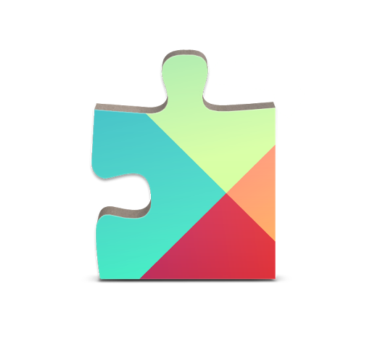
User Auth Flow (client)
CREDENTIALS (via native SDKs)
GOOGLE
AUTH CODE + TOKEN
FACEBOOK
DEVICE
GRAPH ACCESS
TWITTER
GRAPH ACCESS
AUTH CODE
MICROSOFT
IDENTITY
MOBILE SERVICE
Notes:
Slide Objectives:
Review different authorization options for permissions on tables and custom APIs
Transition:
Let’s move into authentication and authorization
Speaking Points:
When you generate a table, you’re generating a REST API which then passes the request through to your scripts
However, there is also a security layer there
This security layer makes sure that you have the appropriate permission to make it through to the script layer
This permission is something you can set for each individual operation against a table (so insert can be different from delete, etc)
The first mode is “Everyone” this means you don’t need any additional checks to perform the operation, if the API endpoint is known, it can be called.
The second is App Key, this is where you send over an app key as a header with each request. If you have it and it’s correct, you make it htrough.
Note that this should only be used during the development stage because once your app is available, people can get access to the key
The third option is Admin / Scripts. This is similar to app key in that you pass the master key over as a header. If you’re sending the master key over, you by pass both the App Key and the Authenticated user restriction we’ll talk about next
Notes:

Slide 25
The User object
User.level
Admin
Authenticated
Anonymous
User.userId
Provider:id or undefined
User.getIdentities()
UserId
Provider Access Token / Secret
Name, locale, picture, etc
Notes:
Slide Objectives:
Review what the User object gets you access to inside your scripts
Transition:
n/a
Speaking Points:
You may have noticed earlier that one of the parameters to my scripts is a user object
This user object has a few important properties and methods
First the level property tells us if the calling user is Anonymous, Authenticated, or an Admin
The userId will give us their ID which is either undefined or provider:id
Lastly, there is a method call getIdentites() which will give us both the User ID but also the provider access token / secret
So if you need to get the actual information back from the provider (i.e. Twitter) to do something (i.e. Tweet on behalf of the user) that method is how you would do it
Notes:

Slide 26
Adding Authentication
Notes:
Slide Objectives:
Continue the demos by up authentication
Transition:
n/a
Speaking Points:
Let’s add in authentication to our app and then restrict data access so everyones data is private to themself
Notes:
Change table permission to be Authed users only
Rerun app and show that you can no longer access data
Set up authentication with a provider
Put the provider auth info into the Identity tab in your Mobile Service
Add code on client to authenticate
Show authentication working and then getting data
Change insert script to add userId to each saved item
Save an item and show new column in db
Update Read script to add a where clause on userId
Rerun / refresh and show that only your data is available now

Slide 27
HOL: Using Auth
Lock down your table
Set up auth with a provider
Add auth to your client
Connect saved data to the user
Filter the data on the server for the user
Check out this: http://aka.ms/mdevcon

Slide 28
Command Line Tools
Scriptable control from PowerShell / Bash
Create / Delete Services
Inspect / Delete Table Data
Create / Update / Delete Tables and Permissions
Create, / Upload / Delete Scripts
Scale Up / Down Services
Much More!
Notes:
Slide Objectives:
Review the capabilities of the Command Line Tools
Transition:
Earlier I mentioned the CLI, let’s talk more about that now
Speaking Points:
The Azure CLI tools are available for both PowerShell on Windows and Bash on OS X / Linux
Some of the capabilities of the CLI are:
Create and delete services
Inspect and delete table data
Create, update, delete tables and permissions
Create, upload, delete scripts
Scale up / down services
Much more (especially with other areas of Azure)
Notes:

Slide 29
Using the CLI
Notes:
Slide Objectives:
Show CLI in action
Transition:
n/a
Speaking Points:
Let’s just see a couple things in action with the CLI
Notes:
Run a few different CLI commands such as:
Azure mobile list
Azure mobile config list <yourmobileservicename>
etc

Slide 30
Using the Scheduler
Execute scripts on a schedule
Execute scripts on demand
Frequency and length of execution based off of service level
Ideal for backend data processing
Notes:
Slide Objectives:
Review the scheduler
Transition:
If you want to do backend processing you can do that with Mobile Services as well
Speaking Points:
Scheduler allows you to generate scripts which can run either on a scheduled basis or on demand
The frequency and length of execution is based off of your service level
This is ideal for doing any sort of backend data processing or recurring server side functionality you need
Notes:

Slide 31
Custom API
Non-table based scripts
Accessible from
Get
Post
Put
Patch
Delete
Same permissions as tables
Notes:
Slide Objectives:
Review Custom API
Transition:
Sometimes you don’t want to hit a table because you’re not necessarily doing anything with SQL
Speaking Points:
This is easy to accomplish with Custom API
A Custom API is a non-table based script that is exposed by a REST API with the following methods:
GET
POST PUT
PATCH
DELETE
You can set permissions on these operations just like with table operations
Notes:

Slide 32
Scheduler, Custom API
Notes:
Slide Objectives:
Show CLI in action
Transition:
n/a
Speaking Points:
Let’s just see a couple things in action with the CLI
Notes:
Run a few different CLI commands such as:
Azure mobile list
Azure mobile config list <yourmobileservicename>
etc

Slide 33
HOL: Scheduler and APIs
Set up a scheduled job
Run it!
Create a custom API
Consume it from the client
Consume it from the browser
Check out this: http://aka.ms/mdevcon

Slide 34
Script Source Control
Handled through GIT repo
Access to table, scheduler, custom API, shared scripts, and permissions
Shared Scripts
Make scripts accessible from other scripts
Just like creating Node.js modules
NPM
Ability to use ‘npm install module’ to download NPM modules
Notes:
Slide Objectives:
Review Script Source Control, Shared Scripts, and NPM support
Transition:
When Mobile Services was launched, you were limited to editing scripts in the portal and using only the modules we made available
Speaking Points:
Thankfully now, we’ve opened things up so you can do so much more.
Script source control allows you to:
Create a Git repo where you can pull and push your table, scheduler, custom API scripts and permissions
Enables you to work on your scripts locally and push them to your Mobile Service
Shared Scripts enable you to:
Put functionality you need in several places into a single script which you then mark as exported
You can then require these scripts from your table, scheduler, and custom API scripts
Just like creating an NPM module
NPM support allows you to install from the vast array of NPM modules publicly available and then use from your other scripts
Notes:

Slide 35
Script Source Control
Notes:
Slide Objectives:
Show scheduler, script source control, custom API, NPM
Transition:
n/a
Speaking Points:
Let’s take a look at the features we just talked about
Notes:
Create a scheduled job, show the different options for scheduling it. Show it’s Run Now feature
Time permitting, activate Script Source control, clone the git repo, and show the contents. Time not permitting, just show where you turn it on at in the dashboard
Generate a Custom API and show how you export the functionality for each HTTP method
Time permitting, install an NPM module

Slide 36
HOL: Script Source Control
Enable Script Source Control
Clone your scripts locally
Make a change locally
Push your changes to your Mobile Service
Check out this: http://aka.ms/mdevcon

Slide 37
Diagnostics, Logging, Scale
API Calls, Devices, Data Out
Scale service based off of API Calls
Console logging from Scripts
Scale SQL DB / Server
Notes:
Slide Objectives:
Review diagnostics, logging, and scale
Transition:
n/a
Speaking Points:
Out of the box, Mobile Services gives you insight into the number of API calls, devices, and data out
Any uncaught errors will automatically be logged, you can also log information on your own
Scaling Mobile Services is based off of the number of API calls you use in a month (more on this in a second)
You can also scale your SQL DB and server
Notes:

Slide 38
Service Scale
Free
500K API calls per subscription per month
Basic
1.5M API calls per unit per month
Standard
15M API calls per unit per month
Notes:
Slide Objectives:
Review scale levels
Transition:
Let’s talk more about the scale options
Speaking Points:
First there is a free level of Mobile Services which gives you 500k API calls for your whole subscription per month
Standard is 1.5M API calls per unit in a month
Premium is 15M API calls per unit in a month
Notes:
Any notes go here

Slide 39
Diagnostics, Logging, Scale
Notes:
Slide Objectives:
Show diagnostics, logging and scale
Transition:
n/a
Speaking Points:
Let’s take a look at those three things
Notes:
Go to the dashboard and show the diagnostics
Go to the logging page and show any logs
Go to the scale tab:
Switch between free, standard, premium
Show Autoscale, talk about how that works
Show changing unit count
Show changing the DB scale

Slide 40
Mobile Services Tiers
usage & licensing
service level agreements
$
 | Free | Basic | Standard
Usage Restrictions | Up to 10 services, Up to 500 Active Devices* | N/A | N/A
API Calls | 500K (per subscription) | 1.5M (per unit) | 15M (per unit)
Scale | N/A | Up to 6 Standard units | Up to 10 Enterprise units
Scheduled Jobs | Limited | Included | Included
SQL Database (required) | 20MB Included, Standard rates apply for more capacity | 20MB Included, Standard rates apply for more capacity | 20MB Included, Standard rates apply for more capacity
General Availability 99.9%
*Active devices refers to the number of physical devices and emulators that make at least one call to or receive a push notification from your mobile service (reset daily).
Notes:
Slide Objectives:
Review tiers
Transition:
Let’s look at the tiers in more detail
Speaking Points:
Review each tier and how it differs
For SQL Database, explain there is a 20mb free DB you can use (one per sub) but SQL is charged SEPARATELY from Mobile Services
Notes:
Pricing has been left off of this slide in case of changes but you should have a good idea of what the pricing per unit should be going into this

Slide 41
Windows Azure Mobile Services
Auth
Server Logic
Notifications
Logging & Diag
Data
Scheduler
Scale
Notes:
Slide Objectives:
Highlight the features Mobile Services offered
Transition:
n/a
Speaking Points:
In Review
Mobile Services is a Backend-as-a-Service (BaaS).
Instead of coding, testing, deploying, and maintaining your own backend, you spin up a Mobile Service and can instantly take advantage of a ton of great features.
These features include:
Data storage powered by SQL Database (but not requiring you to be a DBA)
Simple and easy to use push notifications
User authentication and data authorization
Server side logic so you can craft how your application will function on the server.
Scaling – so you can meet the demand of your mobile apps when they get featured
Logging and Diagnostics so you can get insight into how your Mobile Service is working
Backend processing using something called Scheduler
Notes:
You may want to mention at this time that support exists for other platforms as well (Win Store, Win Phone, Android, iOS, HTML/JS, Xamarin, etc)

Slide 42
Samples
LensRocket: Android / iOS Picture and Video Sharing
Event Buddy: Storage, Auth, and Push
Service Bus Queues and Mobile Services
Handling GeoLocation with Mobile Services
Upload Files to Blob Storage
Monitoring your Mobile Service with New Relic
Notes:
Slide Objectives:
Provide additional resources
Transition:
I’ve got a few additional resources for you
Speaking Points:
Sign up for a free trial
Check out the Mobile Services dev center for lots of videos, tutorials, and more
The source code for all of the SDKs is available on GitHub and pull requests are accepted.
You can always contact mobileservices@microsoft.com
If you have a feature request, we have a user voice open where you can suggest and vote on future features
Notes:
You may want to put your contact info on this slide as well

Slide 43
More Samples
Using Twilio to do Voice and SMS
Real Time Communications with Pusher
Sending Emails with SendGrid
Lots of other stuff: http://aka.ms/commonsWAMS
Notes:
Slide Objectives:
Provide additional resources
Transition:
I’ve got a few additional resources for you
Speaking Points:
Sign up for a free trial
Check out the Mobile Services dev center for lots of videos, tutorials, and more
The source code for all of the SDKs is available on GitHub and pull requests are accepted.
You can always contact mobileservices@microsoft.com
If you have a feature request, we have a user voice open where you can suggest and vote on future features
Notes:
You may want to put your contact info on this slide as well

Slide 44
Resources
Get a Windows Azure Free Trial Account
http://www.windowsazure.com
Videos, Tutorials, and More
http://www.windowsazure.com/Mobile
Source code on GitHub
https://github.com/WindowsAzure/azure-mobile-services
Contact Details
chrisner@microsoft.com
@chrisrisner
Notes:
Slide Objectives:
Provide additional resources
Transition:
I’ve got a few additional resources for you
Speaking Points:
Sign up for a free trial
Check out the Mobile Services dev center for lots of videos, tutorials, and more
The source code for all of the SDKs is available on GitHub and pull requests are accepted.
You can always contact mobileservices@microsoft.com
If you have a feature request, we have a user voice open where you can suggest and vote on future features
Notes:
You may want to put your contact info on this slide as well

Slide 46
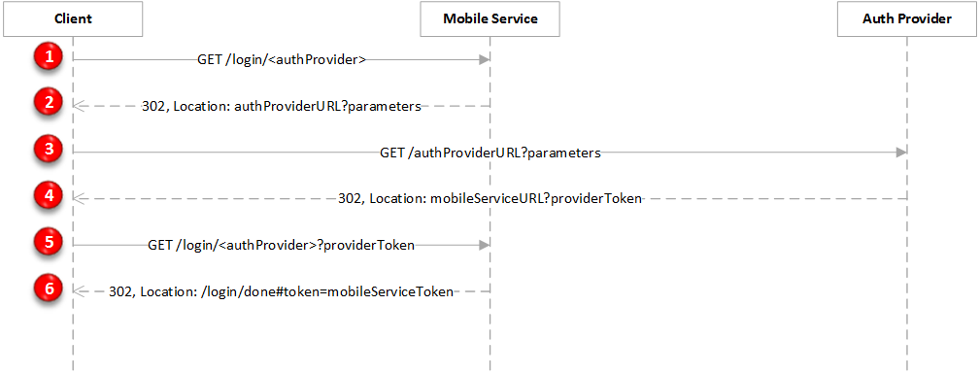
OAuth Authentication Flow
Notes:
Slide Objectives:
This is an appendix slide to explain the Oauth authentication flow

