Slide 1
Intro to Android
Chris Risner

Slide 2
About Me
Mobile Team Leader at Quicken Loans
Co-Founder of Detroit GTUG
Google+
@chrisrisner
http://chrisrisner.com

Slide 3
What We’re Going to Talk About
A brief history of Android
Getting set up for development
Development
Demo
Questions
Notes:
History of Android
Setting up for development
Development
Demo
Questions

Slide 4
Android
Created in 2003
Purchased by Google in 2007
OS of choice of the Open Handset Alliance
Runs on phones and tablets (and more)
“Open Source”
Regularly updated by Google
Notes:
Created in 2003
Purchased by Google in 2007
OS of open handset alliance
Runs on Phones, tablets, tvs, etc.
Open source – you can download and compile the code and even install it on a device (sort of).

Slide 5
Install Base
700k devices activated per day as of Dec 20, 2011
52.5% of the smartphone market share (by sales) in Q3 2011
Tablet sales, not so hot
Distributed on carrier-Google devices, Google devices, and on non-Googleized devices
Notes:
700k devices activated per day.
Over 50% of smart phone market sales.
Tablet sales aren’t great but, Google is rumored to be entering the tablet market with their own tablet
Explain that all the carriers release their branded versions, the Nexus devices, and non-google devices like the Kindles

Slide 6
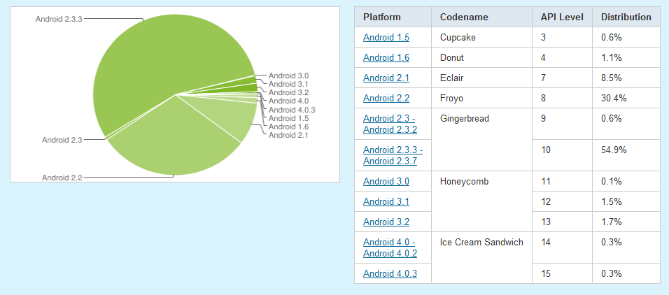
Market Share Per Version
As of January 2012
Notes:
As of today, Froyo (2.2) and above accounts for all but 10.2% of devices.
Honeycomb is small and will likely stay small as new tablets are released with ICS.
ICS should get bigger as everything else goes down.

Slide 7
Getting Set Up For Development
Notes:
Getting setup for development

Slide 8




The IDEs
Notes:
Eclipse
IntelliJ
NetBeans
VS (for monodroid)

Slide 9
Eclipse Setup
Install a Java Developer version from eclipse.org
Install Android SDK
Install Android Eclipse plugin
Install Android API versions
Create Android Virtual Devices (AVDs)
Notes:
First you need to install Eclipse for Java developers
Install Android SDK
Install the Android Eclipse plugin
Install API Versions (through Eclipse / Android SDK Manager)
Create AVDs

Slide 10
AVDs
Android Virtual Devices (AVDs) are emulated Android devices you can run on your computer.
AVDs actually emulate ARM architecture.
Slow and painful
Can target either Android APIs or Google APIs.
Works for testing but not good enough for A+ applications.
Notes:
AVDs are emulators
Actually emulate ARM architecture
Target either Android APIs or Google APIs (explain difference, Maps, C2DM)
Can be slow and painful, especially on old computers
Not guaranteed to be the same as device testing.
Possibly mention differences between this and simulators.

Slide 11
SDK Tools
AVD Manager
SDK Manager
DDMS
Hierarchy Viewer
ADB
LogCat
Layout Editor
Notes:
AVD Manager – create and set up AVDs
SDK Manager – Install different versions of Android / google APIs, samples, different device images.
DDMS – Device / emulator debugging, logging, file explorer, screenshots, etc
Hierarchy Viewer – Used to review layouts live on device / emulator
ADB – Command line tool for connecting / running tools on devices / emulators
LogCat – used to view logs from emulator and devices
Visual editor for XML layouts

Slide 12

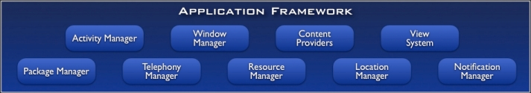
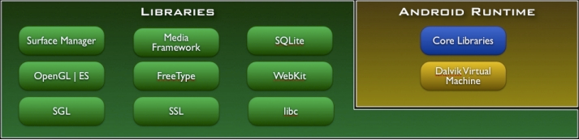
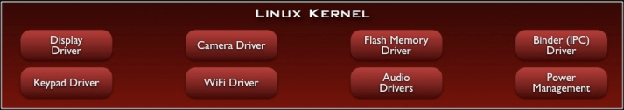
The Android Stack
Notes:
LinuxKernel – display, camera, memory, keyboard, network, audio, etc
Libraries – Surface, openGL, media, SSL, SQLite, WebKit, etc
Android Runtime – Core libs, Dalvik VM
App Framework – Activity manager, Window Manager, content Providers, Package Manager, Resource manager, location manager, notification manager
Apps – Home, contacts, Phone, Browser, your Apps

Slide 13
Dalvik Virtual Machine
Each app runs in its own VM.
DVM isn’t actually a JVM.
JIT compilation runs dex-code (created from Java Byte code).
Optimized for battery powered devices.
Notes:
Dalvik VM is what each app is run in.
Each app run in a separate DVM
JIT compilation runs dex-code which is created from Java Byte code.
DVM isn’t actually JVM
DVM is optimized for battery powered devices

Slide 14
Basic Building Blocks
Layouts | User interface (xml)
Activities | Code behind for a User Interaction element
Services | Background processes
Intents | Messaging system between apps and parts of an app
Content Providers | Shares data between apps
Broadcast Receivers | An intent processor for system messages
Notes:
Layouts – UI – xml
Activities – Code behind for UI element
Services – Background processes
Intents – messages sent between apps / parts of an app
Content Provider – share data between apps
Broadcast receivers – intent processor for system messages

Slide 15
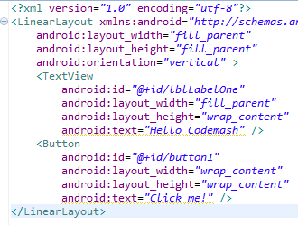
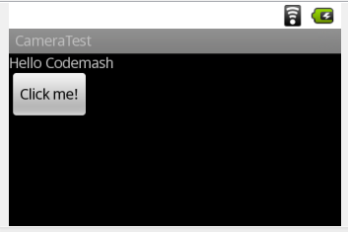
Layouts
XML files
Contains description of all UI elements
Can be specific to orientation, screen size, etc
Notes:
Layouts
Xml files
Contains description of UI elements
Can be specific to orientation, screen size, etc
Fly in XML
Fly in View

Slide 16
More Layouts
Linear Layouts
Content is in single row or column
Relative Layouts
Children are placed in relation to each other or parent.
Table Layout
Children are placed in rows and columns
Frame Layout
Used to display a single interchangeable element.
Grid Layout
New in 4.0. May “replace” linear layout and table layout.
Notes:
Explain some of the different containers you use in layouts. Any of these can be root element but layouts can contain layouts.
Linear Layouts
Relative Layouts
Table Layouts
Frame Layouts
Grid Layouts

Slide 17
UI Elements
TextViews – Read only labels
EditTexts – Textboxes
Buttons
Toggles
Radio Buttons and Checkboxes
Drop downs (Spinner)
Progress indicators
Sliders
Images
Video view
Date / Time Selector
SurfaceView
ScrollView
Notes:
TextViws
EditTexts
Buttons
Toggles
Radio Buttons and CheckBoxs
Drop downs (called spinners)
Progress indicator
Sliders
Images and video view
Date / time selector
ScrollView
SurfaceView

Slide 18
ListViews
Displays a list of scrollable items.
Can use a default template for each item or a custom layout.
Can be added to a layout or used with a ListActivity.
DON’T USE WITH SCROLLVIEW
Notes:
ListViews
-Scrollable list of items
-default template or custom layout for each
-Put in layout or use ListActivity
-Don’t use with Scrollview

Slide 19
Activities
Sets content to a layout or generates the UI in code.
Handles user interaction with elements in UI.
Follows a specific life cycle (more on this)
Notes:
Activities
Sets content to layout or generates UI
Handles user interaction logic
Follows a life cycle (more on this)

Slide 20
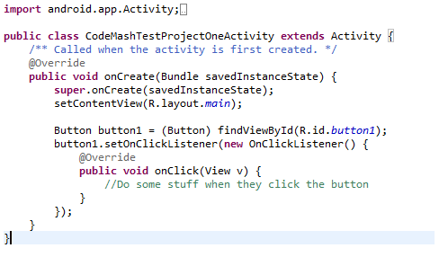
Activity Code
Notes:
Here we have an activity
Extends Activity class from Android SDK
Overrides the onCreate method
Set’s content view to a layout file
Gets access to visual elements using findViewById
Create anonymous methods to handle button click

Slide 21
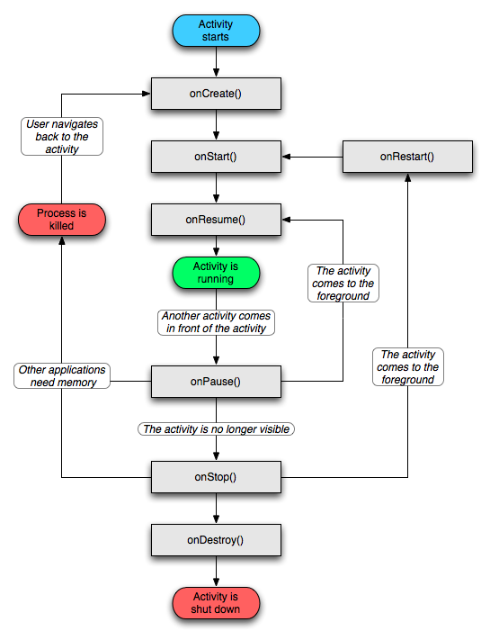
Activity Life Cycle
Notes:
Activity life cycle
onCreate
onStart
onResume
onPause
onStop
onRestart
onDestroy
ON SAVE INSTANCE STATE

Slide 22
Intents
A message used to communicate between apps or parts of an app.
Use startActivity to start a new activity or startActivityForResult to start an activity when you expect a result back.
Can be used to start and send messages to services as well as returning data from services.
Used to send broadcasts.
Can include unspecified data using Extras.
Notes:
Intents
Messages between apps or parts of app
Used to go from one activity to another
startActivity starts a new one
startActivityForResult starts a new one and expects a result back
Used to start / send messages to services
Used to send broadcasts
Can include data using Extras

Slide 23
What else can you do with Intents?
Make phone calls.
Send emails.
Sharing (using other installed apps).
Open websites.
Pull up an address on maps.
Create a new calendar entry.
Open up the market.
Trigger any application with an intent Android knows about.
Notes:
Make phone calls
Send emails
Sharing (using other installed apps)
Open websites
Pull up address on maps
Create new calendar entry
Open up market (search or specific app)
Fires any application / class with an intent Android knows about

Slide 24
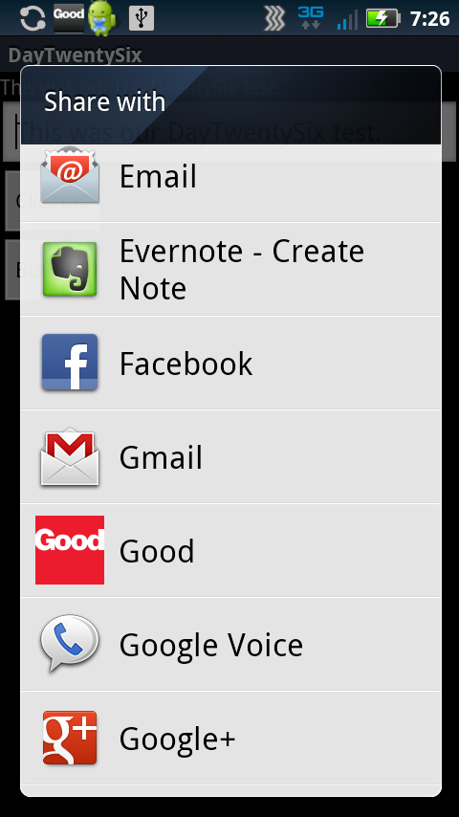




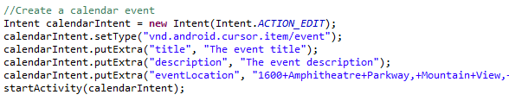

Intents!
Notes:
Make phone calls
Send emails
Sharing (using other installed apps)
Open websites
Pull up address on maps
Create new calendar entry
Open up market (search or specific app)

Slide 25
Services
Runs in the background.
Should be used for any long running background process or network access (really, ANY network access).
Updates UI by sending out messages.
Not actually a separate thread unless you define the service to use one.
Notes:
Services
Run in background
Used for long running background process or ANY NETWORK access
Updates UI by sending messages (intents) back to activities
Doesn’t use a separate thread unless you make it

Slide 26
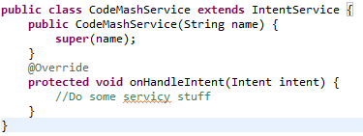

Service Example
Notes:
Service example
Extends IntentService
Must implement onHandleIntent method
Starting a service with an intent

Slide 27
Updating your UI
Create a class that extends ResultReceiver
Make your Activity implement the class.Receiver
Add an instance of that class to your Activity
Pass the receiver to your Service as an extra.
Add an onReceiveResult method to your Activity.
In your Service use the receiver to send a message back to the Activity.
Notes:
Updating UI
Create class that extends ResultReceiver
Make activity implement class.Receiver
Add instance of that class to your activity
Pass receiver to service as extra
Add onReceiveResult method to Activitiy
In Activity, use receiver ot send messages back to activity (to update UI)
There are other ways to accomplish background tasks but this is the approach I’ll recommend

Slide 28
Content Providers
Enables your apps to access shared data.
Allows you to share data to other apps.
Examples:
Contacts
Call logs
Images
Video
Music
Calendar (new in 4.0)
Accessible through SQL-like querying.
Notes:
Content Providers
Enable apps to access / update shared data.
Some already built in, you can also provider your own.
Contacts, Call Logs, Images, Video, Music, calendar (new in 4.0)
SQL-like queries

Slide 29
Broadcast Receivers
Processes intents sent by the system.
A picture has been taken.
A C2DM message has been received.
The screen has shut off.
You can send messages to the system / other applications.
A file has been downloaded and is ready to be opened.
Notes:
BroadCast Receivers
Processes intents sent by system
Ex: picture is taken, c2dm message has been received, screen has shut off
You can send messages to the system and other apps
Ex: a file has been downloaded and is ready to be opened.

Slide 30
The Manifest File
Lists ALL activities.
Lists intent-filters.
Lists services and receivers.
Lists all permissions required by app.
Lists minimum and target SDK versions.
Application version number.
Device limitations.
Notes:
Manifest File
-psuedo app config file
-activities
-intent filters
-Services and receivers
-permissions
-minimum and target SDK versions
-app version number
-device limitations (i.e. doesn’t support specific screen size, requires camera, etc)

Slide 31
Different Screen Sizes
Different buckets based off screen density (dots per inch)
LDPI
MDPI
HDPI
XHDPI
Different buckets based off of screen size
Small
Normal
Large
XLarge
Fragments.
Notes:
Devices with the same screen size don’t necessarily have the same density or resolution.
Similarly, devices with the same density may have different real pixel density.
Use these buckets for layouts and drawables
You don’t necessarily need to provide resources for EVERY screen size. Android will try to scale resources as needed, though this may introduce artifacts.

Slide 32
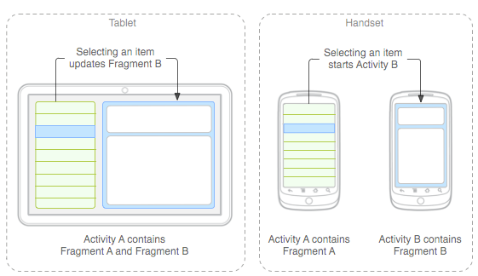
Fragments
Notes:
Fragments enable you to combine pieces of a User Interface on a larger screen and reuse that functionality on separate screens for smaller devices.
Common examples: email, news readers

Slide 33
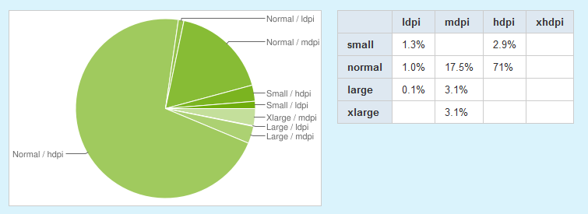
Screen Size Distribution
Notes:
As you can see on the chart, most screen sizes are normal with a density of HDPI.

Slide 34
Other Resources
Drawables (images)
Strings (text)
Colors (hex values)
Animations (xmls)
Others
Notes:
Other Resources
-Drawables (images)
-Strings (text) – used for localization
-Colors (hex values)
-Animations (xmls)
-Others (shapes, etc)

Slide 35
Natural Development Kit
Java development done through the SDK.
Natural Development Kit (NDK) allows you to develop in C and C++.
Apps are still packaged in an APK file and run in VM.
Not always a performance increase. Good for contained, CPU-intensive operations such as signal processing, physics simulations, etc.
Notes:
NDK
Java development is done through SDK
NDK allows you to make apps in C and C++
Apps still packaged in APK, run through VM
Not necessarily a performance increase
Good for CPU intensive processes
Signal Processing, Physics simulations

Slide 36
Java Native Interface (JNI)
Provides a way of merging the SDK and NDK.
Bulk of your application is done in Java.
JNI allows you to call into C/C++ code.
Notes:
JNI – Java Native Interface
Allows your app to be done in java and call into C / C++ code
Most of app should be in Java

Slide 37
Security
One app, one vm
App only files by default
External storage, not safe
Intents can specify app package / class recipient.
Apps need permissions
HTTPS
Encryption
Signed APK files
Installed apps are (mostly) internal
Notes:
Security
Apps run in own VM
Flies created are for app only by default
-external storage not safe
Intents can specify app package / class (to make sure it goes to specific one)
Apps must request and be granted permsissions
HTTPS
Encryption
APKs signed by certs
No access to installed apps, unless installed to external storage

Slide 38
Data Persistence
Shared Preferences
Internal / External storage
SQLite Databases
Network storage
Notes:
Shared preferences are key value pairs stored either per activity or by file name.
Internal and external storage is normal file IO. Private to your app by default but can be public. Public by default if written to external storage.
Android provides full support for SQLite and provides a method to handle upgrading your database on app version updates.
Network storage is any storage you use over HTTPS.

Slide 39
Getting your App to Market
http://market.android.com/publish
Must pay one time $25 fee (per publishing account, not app).
You need to generate a private key and a certificate.
You need to have this certificate in order to update your app.
Use the certificate / key to sign and generate a release APK.
Upload APK and media material to market.
Possible to create different APK versions for different API levels, screen sizes, etc.
Notes:
The one time fee must be paid using Google Checkout.
There are instructions on the Android Dev portal for generating the key / certificate. The tools to do so are part of the JDK.
YOU MUST KEEP THE CERTIFICATE! Otherwise you can’t upload a new app with the same package name.
Your package name must be unique to other apps.
Android Tools enable creation of your signed APK.
In addition to the APK, you need / can upload screenshots, high res icon, promotional graphic, promo video, description details, countries your app is available in, contact information.
You can also manually specify devices that aren’t eligible to install your app.
Lastly, you can specify different APKs for different API levels, screen sizes, and more by specifying information in your manifest.

Slide 40
Do you have to use the Marketplace?
No.
Other markets
Amazon Appstore, AppBrain, SlideME, etc
Install over the web
Notes:
You don’t need to register your device or pay for a development account for anyone to put an app on a device you have.
There are other markets available, some free, some at cost. In addition different ones pay different amounts to developers for app purchases.
Lastly, you can just provide links to your APK file. Users would need to enable install from unknown sources to get this to work.

Slide 41
Demo
Notes:
Generate a new AVD
Generate a new app
Look at the manifest file
Explain Activity
Explain launcher intent filter
Add a permission
Add a button to the main layout
Add a new activity to the application
Add activity to the manifest file
Add a new layout
Show ability to place specific filters on the layout
Tie the new layout to the new activity
Launch the new activity on button click
Show difference between finishing and not finishing first activity when Back is tapped
Show LogCat and DDMS

Slide 42
Further Reading
31 Days of Android on http://chrisrisner.com
Android Training at http://developer.android.com/training
Android Dev Site: http://developer.android.com
StackOverflow
Notes:
31 days of android
Android training
Android Dev Site
Stack Overflow

Slide 43
Questions

Slide 44
Versions
9 Major Releases in 3 Years
1.0 – September 2008
1.1 – February 2009
1.5 – April 2009 – Cupcake
1.6 – September 2009 – Donut
2.0 – October 2009 – Éclair
2.2 – May 2010 – Froyo
2.3 – December 2010 – Gingerbread - Handheld
3.0 – February 2011 – Honeycomb – Tablets Only
4.0 – October 2011 – Ice Cream Sandwich – Handheld and Tablet
Notes:
9 “Big” releases in 3 years.
Purchased in 2007, 1.0 release in 2008.
3.0 release to tablets only at end of 2010.
4.0 release this past October, merges Gingerbread (handheld) and 3.0 (honeycomb)

