Slide 2
Windows Azure and Android
Chris Risner
Windows Azure Technical Evangelist
Microsoft Corporation
@chrisrisner
chrisner@microsoft.com
http://chrisrisner.com

Slide 3
Agenda
What is Windows Azure Websites?
The old way of connecting
The new way of connecting
Where we’re going from here

Slide 4
Windows Azure Websites

Slide 5



Windows Azure Web Sites
start simple
code smart
go live
Notes:
*free offer of 10 web sites for Spring 2012 Preview
*Create new sites from the gallery or from scratch
*if your web site runs on Internet Information Services (IIS) 7, it will run on Windows Azure Web Sites

Slide 6
Start Simple
Get started with 10 free web sites
Create new sites in seconds
Easily manage and scale your sites
Automatic load balancing and shared storage across instances
Scale out or up to reserved instances for improved performance and scale

Slide 7
Code Smart
Use ASP.NET, ASP, PHP, or Node.js
SQL Azure or MySQL databases
Start with open source apps
Develop with VS and WebMatrix
Supports any Web development tool on any platform (Windows, OSX, Linux)

Slide 8
Go Live
Rapid deployment for quick iteration
Integrated source control with Team Foundation Server (TFS) and Git
Built-in monitoring of perf and usage data
Quick access to request logs, failed requests, and diagnostics

Slide 9
The Old Way of Connecting

Slide 10
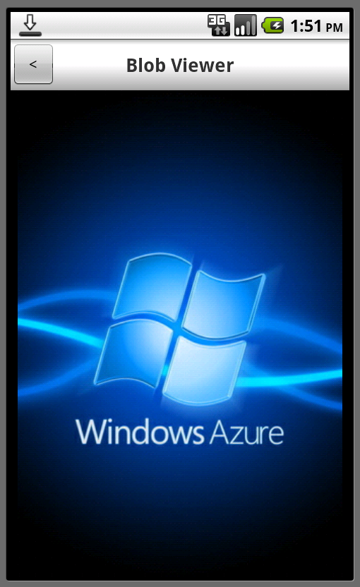
The Old Way of Connecting
Windows Azure Portal
Silverlight only
Android Toolkit
Cloud Ready Packages
Package and config utility

Slide 11
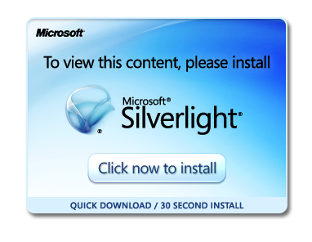
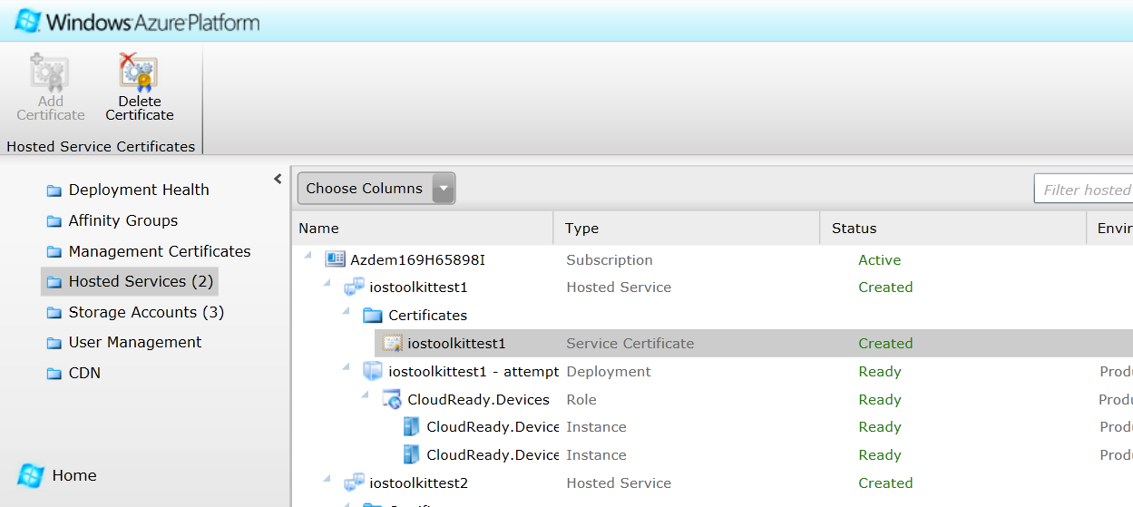
Windows Azure Portal

Slide 12
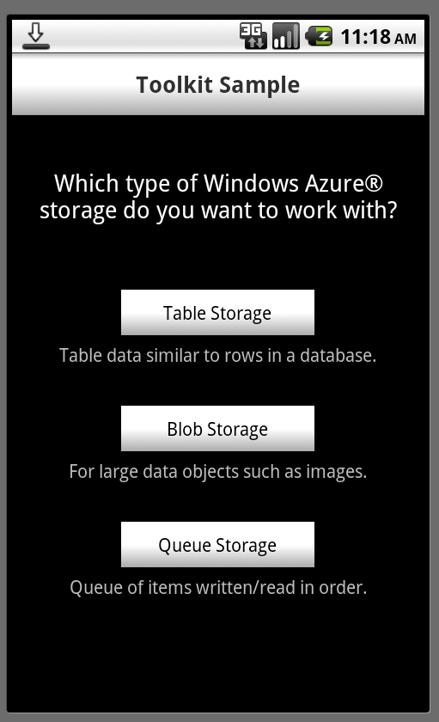
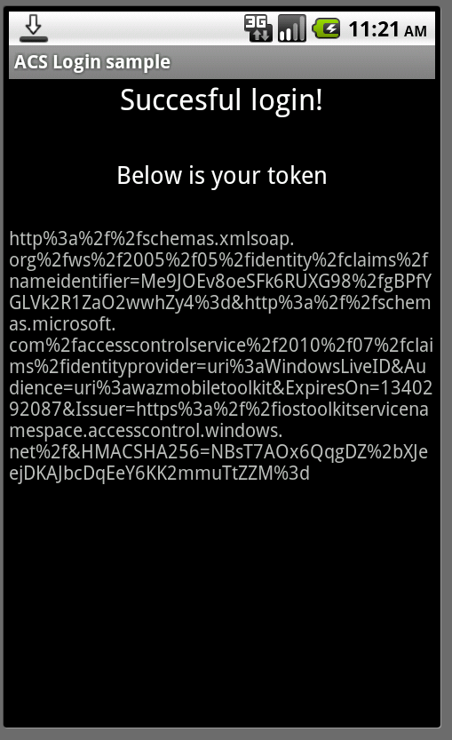
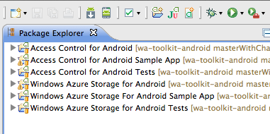
Android Toolkit for Windows Azure

Slide 13
Android Toolkit Continued
Access Control Service (ACS)
  Authenticate with Facebook, Google, Live, Yahoo!
  You “just use it”
Blob, Table, Queue Storage
  Can be used directly (key on device) or through SAS
  Easy “no set-up” data storage
Notes:
ACS:
Just use it meaning you don’t have to code going to facebook, google, live, yahoo
Storage:
no set-up meaning you don’t have to create schemas or tell the server what you’re going to send over

Slide 14
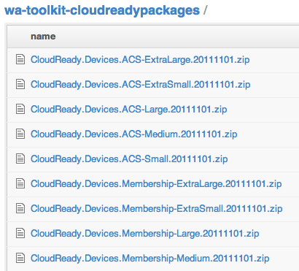
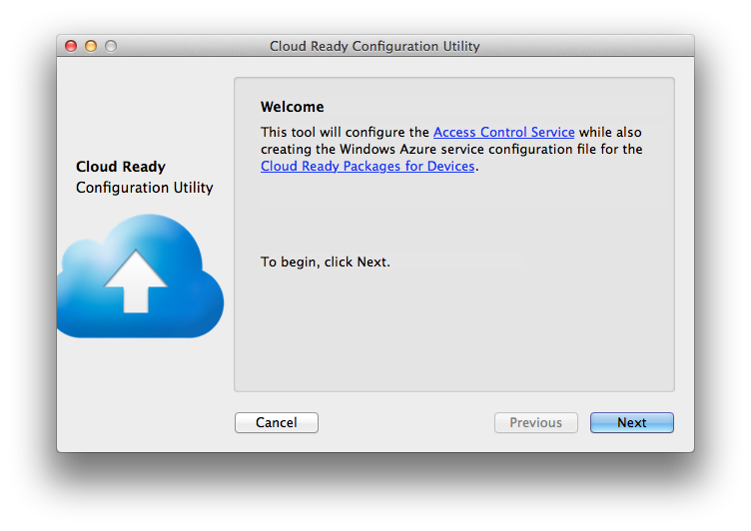
Cloud Ready Packages

Slide 15
…but before you can upload it
Create a new Windows Azure Storage Account
  Creates direct access key
Configure an ACS Namespace
  Specify which service providers to use
  Generates a signing token
Create Windows Azure Hosted Service
  Use the OSX config utility to create config file
  Upload Cloud Ready Package with config file

Slide 16
Extensible?
Built in .NET
Requires Visual Studio
Plus all of the Cloud SDKs
Old and New Portals
Some control available in new portal, some still in old
Notes:
ACS can’t be controlled from the New Portal at this time

Slide 17
The New Way of Connecting

Slide 18
The New Way of Connecting
Windows Azure Portal
HTML5
Web Service Layer
Buildable on Windows / OSX / Linux

Slide 19
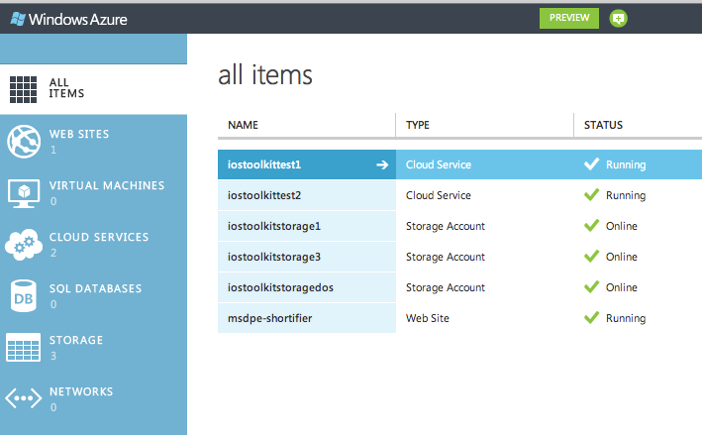
The New Windows Azure Portal

Slide 20
Web Service Layer
Use ASP.NET, ASP, PHP, or Node.js
SQL Azure or MySQL databases
Supports any Web development tool on any platform (Windows, OSX, Linux)
GIT and FTP Support

Slide 21
Setting up a PHP Site
demo

Slide 22
URL Shortener
demo

Slide 23
Geolocation
demo

Slide 24
Where We’re Going Next

Slide 25
Where We’re Going Next
Match capabilities of Cloud Ready Packages
  ACS for authentication
  Blog, table, queue storage
Push Notifications
  For iOS and Android (with C2DM and without)
What would help you?
  PHP service layer? Something else?

Slide 26
© 2012 Microsoft Corporation. All rights reserved. Microsoft, Windows, and other product names are or may be registered trademarks and/or trademarks in the U.S. and/or other countries.
The information herein is for informational purposes only and represents the current view of Microsoft Corporation as of the date of this presentation. Because Microsoft must respond to changing market conditions, it should not be interpreted to be a commitment on the
part of Microsoft, and Microsoft cannot guarantee the accuracy of any information provided after the date of this presentation. MICROSOFT MAKES NO WARRANTIES, EXPRESS, IMPLIED OR STATUTORY, AS TO THE INFORMATION IN THIS PRESENTATION.

