Slide 1
Final Assessment

Slide 2
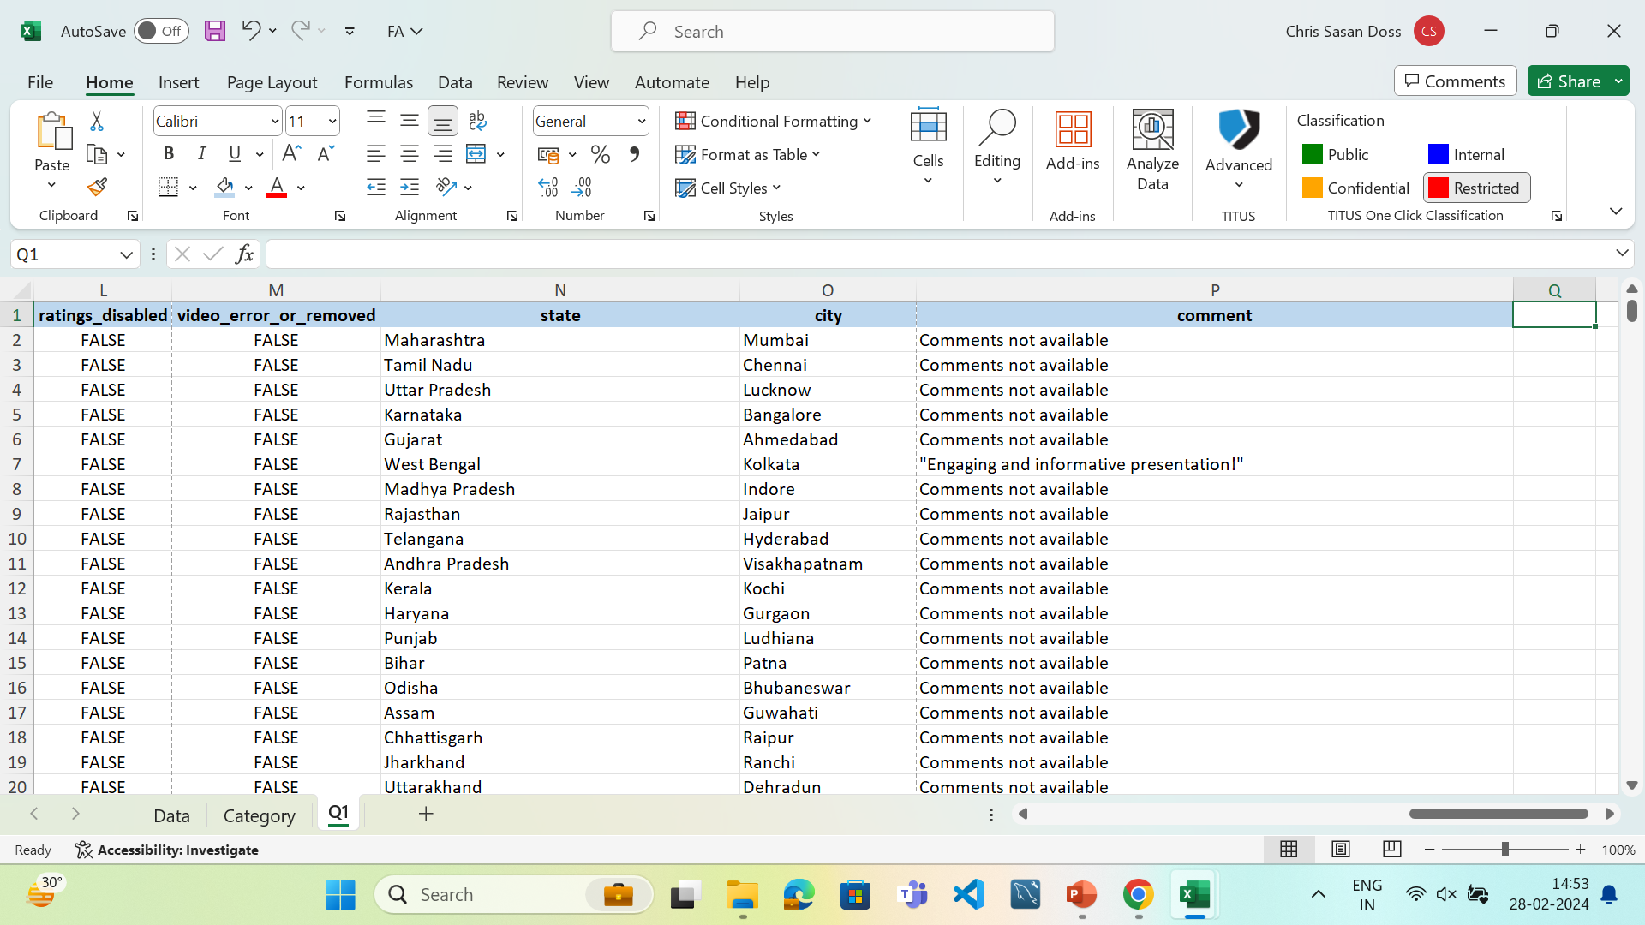
Q1
INFERENCE:
Only comment column had blank values. The state and city column were wrongly labelled as country and state.
FORMULA:
STEPS:
Used Find and Replace option to fill the blanks in comment column as “Comments not available”.
Changed country and state column title as state and city

Slide 3
Q2
Days_to_trend | Count of video_id
0 | 137
1 | 5117
2 | 5332
3 | 3103
4 | 1516
5 | 784
6 | 221
7 | 56
8 | 18
9 | 6
10 | 1
11 | 2
12 | 4
13 | 3
14 | 1
15 | 2
18 | 1
33 | 1
51 | 1
221 | 1
(blank)
Grand Total | 16307
INFERENCE:
Most of the videos usually trend during the first 4 days of its release. Only few videos trend after the first 4 days. The count decreases significantly after the first 4 days.
FORMULA:
Used Pivot table
STEPS:
Created a new column Days_to_trend by taking the difference of publish and trending date.
Created pivot table to find the count of videos according to the Days_to_trend column.

Slide 4
Q3
Category name | Average of views | Engagement Rate | Views+Engagement
Entertainment | 574766.2767 | 92805828 | 93380594.28
Music | 2017880.624 | 57550717 | 59568597.62
Comedy | 717054.7935 | 41921871 | 42638925.79
Film & Animation | 1800523.971 | 15504848 | 17305371.97
Science & Technology | 664622.3467 | 12948618 | 13613240.35
Sports | 1379353.406 | 10176041 | 11555394.41
People & Blogs | 450423.3628 | 9873597 | 10324020.36
News & Politics | 297358.62 | 6819339 | 7116697.62
Gaming | 3436401.95 | 2167038 | 5603439.95
Howto & Style | 826816.9331 | 4734619 | 5561435.933
Education | 92618.26474 | 3985136 | 4077754.265
Movies | 3862190 | 84643 | 3946833
Pets & Animals | 2490776 | 207691 | 2698467
Shows | 649225.5372 | 491453 | 1140678.537
Autos & Vehicles | 333265.3824 | 216108 | 549373.3824
Travel & Events | 192907.75 | 15284 | 208191.75
Religious | 56945.04348 | 134668 | 191613.0435
INFERENCE:
Entertainment category has highest average views and Engagement rate combined than other categories.
FORMULA:
SUMIF(Data!R:R,'Q3'!A2,Data!H:H)+SUMIF(Data!R:R,'Q3'!A2,Data!J:J)
STEPS:
Category column is created using lookups.
Pivot table is created and average is taken
Sumifs is used to sum both likes and comment count to form Engagement rate.

Slide 5
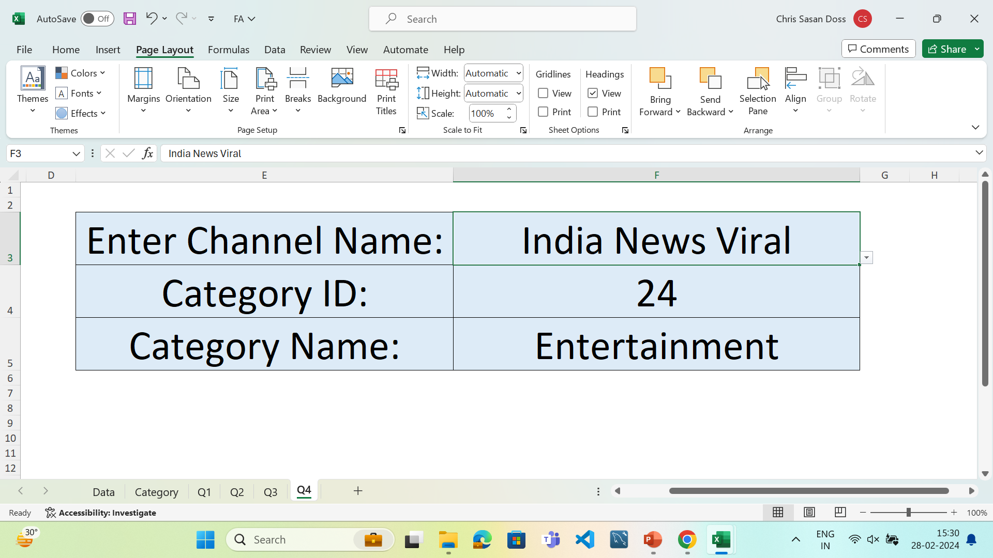
Q4
INFERENCE:
Category name and ID can be found using xlookup.
FORMULA:
XLOOKUP(F3,Data!D:D,Data!E:E)
XLOOKUP(F4,Category!A:A,Category!B:B)
STEPS:
Used Xlookup to find the category name and ID

Slide 6
Q6
INFERENCE:
None can comment when Comments are disabled. The average comments for the videos are 1538.
Comment_disabled | Average of comment_count
FALSE | 1537.61839
TRUE | 0
FORMULA:
Used pivot table
STEPS:
Used pivot table to get the average comment count with the Comment_disabled column

Slide 7
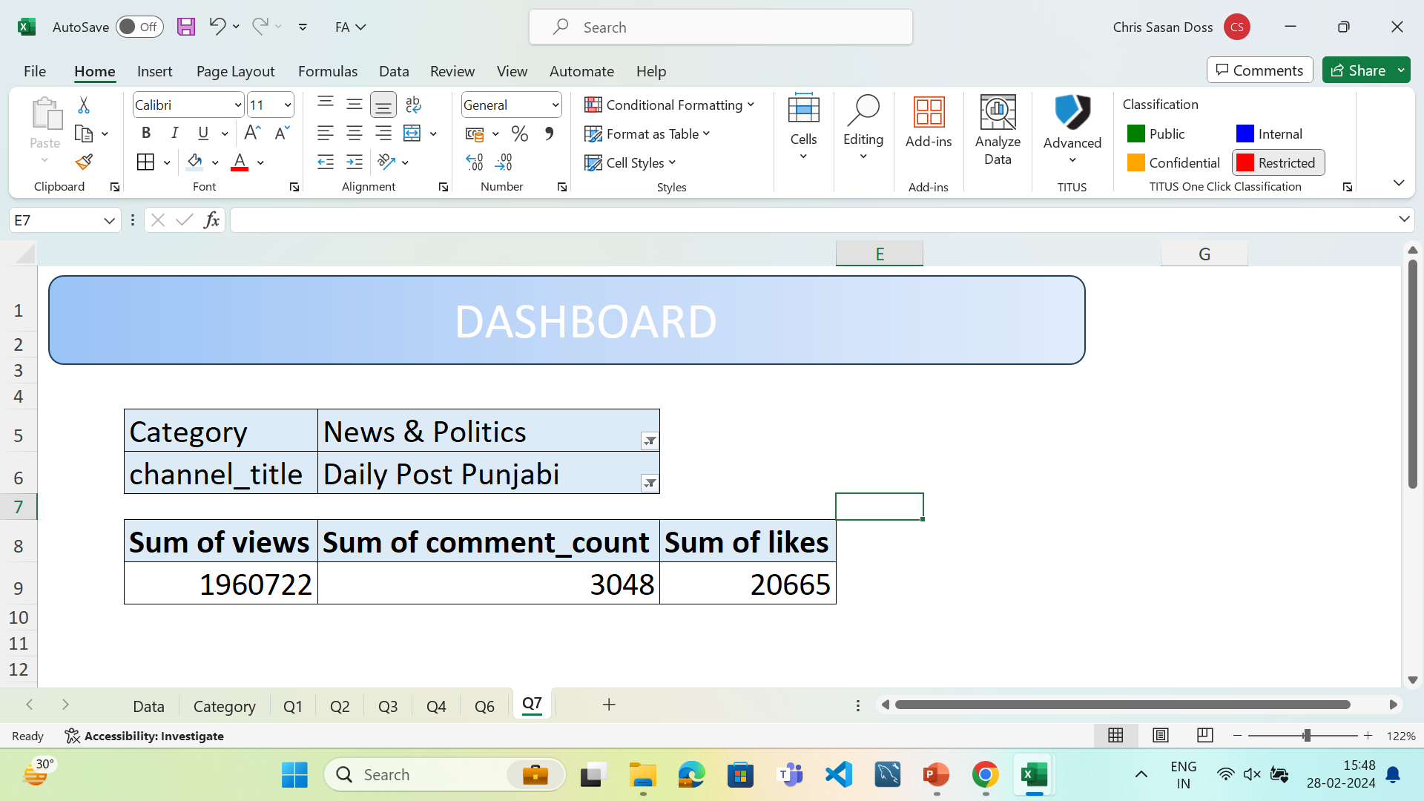
Q7
INFERENCE:
Sum of views,likes and comment count can be seen in the dashboard
FORMULA:
STEPS:
Used pivot table to calculate sum of views, likes and comment count.

Slide 8
Q7
Category | title | Sum of views | Sum of likes | Engagement_rate
Entertainment Total |  | 4337761090 | 83836195 | 83836961
Music Total |  | 2447689197 | 54100112 | 54100622
Film & Animation Total |  | 941674037 | 14308758 | 14309940
Comedy Total |  | 798799040 | 38804398 | 38805356
News & Politics Total |  | 744883343 | 5762909 | 5762914
People & Blogs Total |  | 554921583 | 8841134 | 8841134
Sports Total |  | 478635632 | 9389714 | 9389716
Howto & Style Total |  | 395218494 | 4322796 | 4322940
Science & Technology Total |  | 199386704 | 9566636 | 9566903
INFERENCE:
FORMULA:
STEPS:

Slide 9
Q9
Row Labels | Sum of views | Sum of comment_count
Mar | 1712342604 | 3209572
Dec | 1700861605 | 4143753
May | 1577221605 | 3268757
Feb | 1540024062 | 2749360
Jan | 1477413068 | 3164260
Apr | 1376758448 | 3028499
Nov | 999488217 | 2278620
Jun | 762207615 | 2320852
INFERENCE:
March is the highest interaction month followed by December. June has the least amount of vwies and comments.
FORMULA:
Used pivot table
STEPS:
Used pivot table to group the publish date according to months.
Added sum of views and comments column
Sorted both the columns using custom sort

Slide 10
Q10
INFERENCE:
Views, likes and comments increased significantly after one year.
Year | Sum of views | Sum of comment_count | Sum of likes | Growth_views | Growth_comments | Growth_likes
2017 | 2700407997 | 6422378 | 59063929
2018 | 8445909227 | 17741295 | 176409897 | 312.76% | 276.24% | 298.68%
FORMULA:
Used pivot table
=F4/F3
STEPS:
Used pivot table to group into years
Added sum of views,comments and likes columns.
Found growth by dividing previous year value by current year.

Slide 11
Q11
Months | Sum of views | Retention_rate
Jan | 1477413068
Feb | 1540024062 | 104%
Mar | 1712342604 | 111%
Apr | 1376758448 | 80%
May | 1577221605 | 115%
Jun | 762207615 | 48%
Nov | 999488217 | 131%
Dec | 1700861605 | 170%
INFERENCE:
The number of views has significantly increased after November. December has achieved the highest retention rate.
The number of views has significantly decreased after May. June has achieved the lowest retention rate.
FORMULA:
Used pivot table.
=B15/B14
STEPS:
Used pivot table to group into months.
Sum of views column is added.
Retention rate is calculated by dividing the previous month values by the current month.

Slide 12
Q12
INFERENCE: Rates are not provided
FORMULA:
STEPS:

Slide 13
Q13
Category | Sum of comment_count
Entertainment | 8969633
Music | 3450605
Science & Technology | 3381982
Comedy | 3117473
Film & Animation | 1196090
News & Politics | 1056430
People & Blogs | 1032463
Sports | 786327
Education | 455965
Howto & Style | 411823
Gaming | 178580
Shows | 64106
Autos & Vehicles | 26945
Pets & Animals | 21384
Religious | 7014
Movies | 4617
Travel & Events | 2236
INFERENCE:
Entertainment videos has the highest comment count and leads by a large margin. Travel and events has the lowest comment counts. People are more interested in entertainment and music rather than religions and travel.
FORMULA:
Used pivot table.
STEPS:
Used pivot table to calculate sum of comments according to the Category names.

Slide 14
Row Labels | Sum of views | Sum of comment_count | Sum of likes
Autos & Vehicles | 11331023 | 26945 | 189163
Comedy | 798799040 | 3117473 | 38804398
Education | 73816757 | 455965 | 3529171
Entertainment | 4337761090 | 8969633 | 83836195
Film & Animation | 941674037 | 1196090 | 14308758
Gaming | 68728039 | 178580 | 1988458
Howto & Style | 395218494 | 411823 | 4322796
Movies | 7724380 | 4617 | 80026
Music | 2447689197 | 3450605 | 54100112
News & Politics | 744883343 | 1056430 | 5762909
People & Blogs | 554921583 | 1032463 | 8841134
Pets & Animals | 2490776 | 21384 | 186307
Religious | 3929208 | 7014 | 127654
Science & Technology | 199386704 | 3381982 | 9566636
Shows | 78556290 | 64106 | 427347
Sports | 478635632 | 786327 | 9389714
Travel & Events | 771631 | 2236 | 13048
Q14
INFERENCE:
Every engagement metric of Entertainment, Music and Films are high whereas the Travel and events category is low in all the aspects.
FORMULA:
Used pivot table
STEPS:
Used pivot table to create sum of views,likes and comments according to the category.
Inserted stacked bar chart with respect to the table.

Slide 15
Q15
INFERENCE:
The views and likes are highly correlated. Likes and comments are low compared to views and likes. This says that views and likes are very dependent on each other.
Views and likes | Views and Comments | Likes and Comments
0.842435419 | 0.665026421 | 0.760620178
FORMULA:
=CORREL(Data!H2:H16308,Data!J2:J16308)
STEPS:
Used correl function to calculate the correlation.

Slide 16
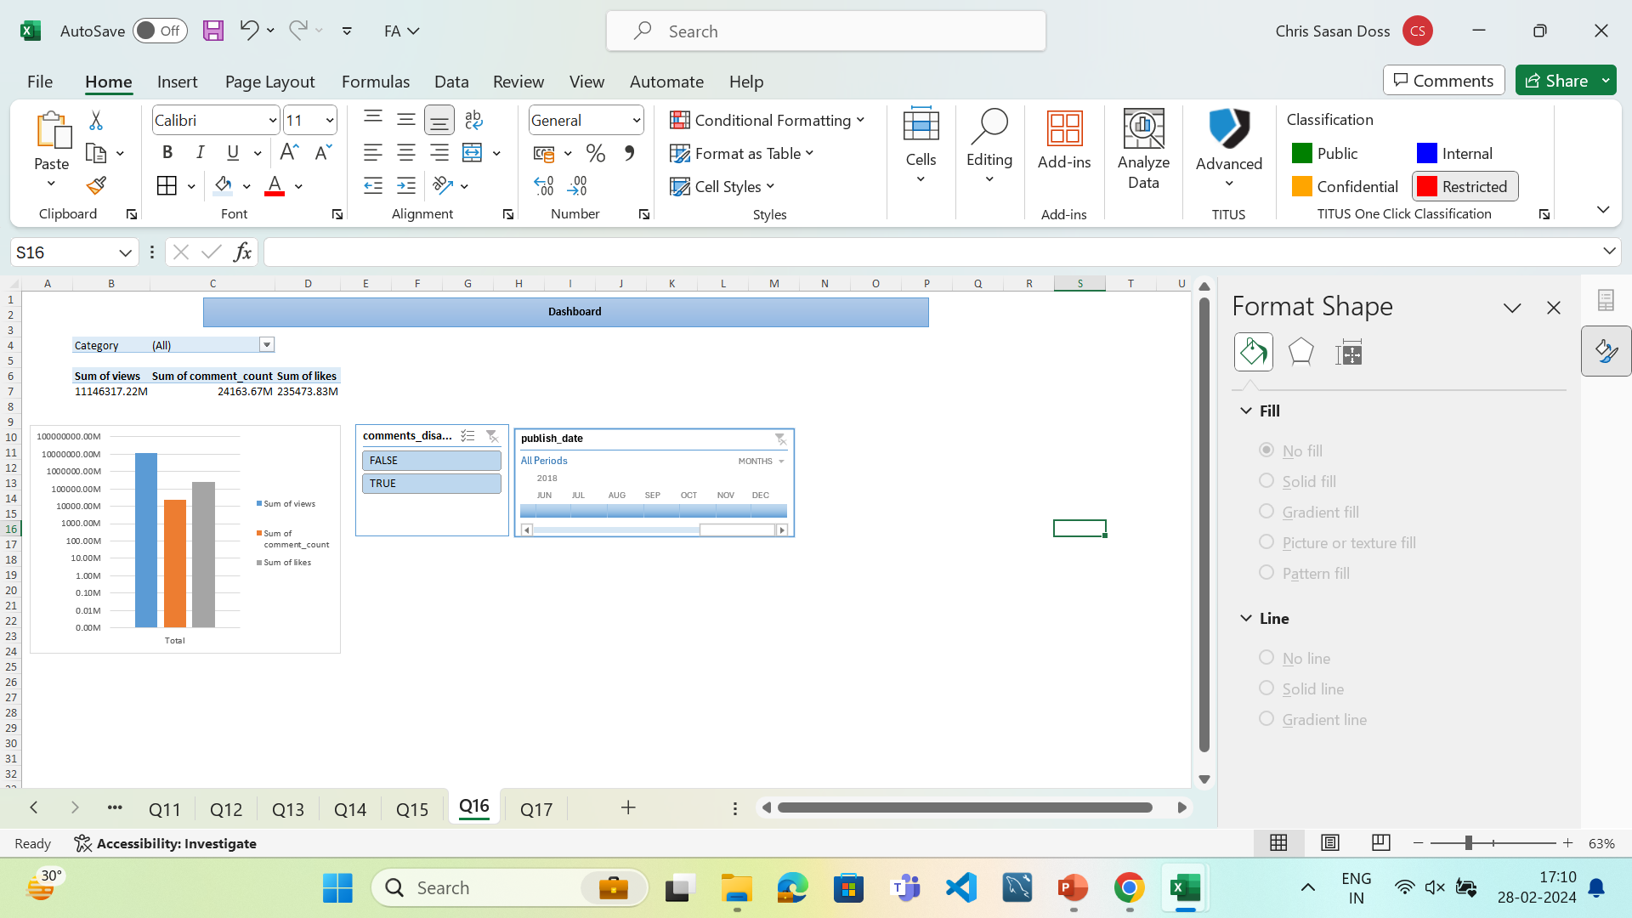
Dashboard
INFERENCE:
FORMULA:
STEPS:

Slide 17
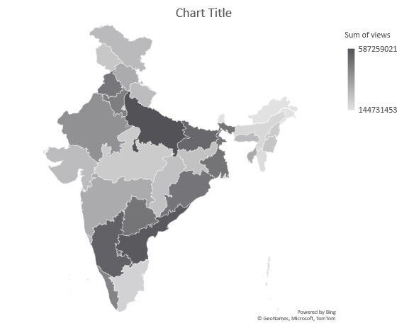
Q16
INFERENCE:
The states are highlighted using their views. Uttar Pradesh has the highest number of views.
FORMULA:
STEPS:

Slide 18
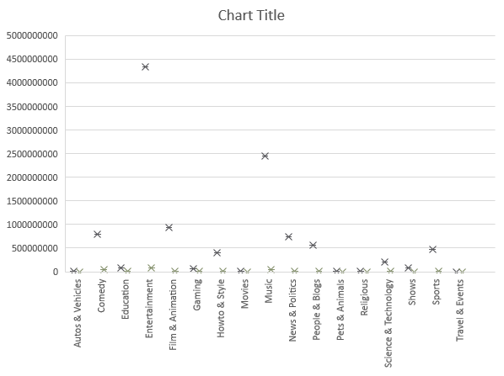
Q17
INFERENCE:
Entertainment category seems to have outliers but it’s the number of views so its not an outlier.
FORMULA:
STEPS:

Slide 19
Q18
INFERENCE:
In December the sum of dislikes ids higher than the likes. June has the highest likes to dislike ratio.
FORMULA:
STEPS:

Slide 20
Q19
INFERENCE:
The views are higher for all the months followed by likes and views
FORMULA:
STEPS:

Slide 21
Q20
INFERENCE:
June has the lowest retention rate and December has the highest retention rate.
FORMULA:
STEPS:

