Slide 1


An application that will connect you with people in your city that:
want to go exactly where YOU want to go to do what YOU want to do at the same time YOU want to do it
What the future holds
Chat functionality to populate a separate chat bubble specific to the location
Expand compatibility to Android and iOS
Create “Contact Us” , “About Us”, “FAQ”, “Intellectual Property”, “Social Media Icons” pages.
Possibly Coupons/Promotions for specific locations this could appear in the same bubble that you look at to see how many people want to do this activity.
Notes:
Using Google authorization with Firebase, the application requires google sign-in in order for the user to be able to use the chat functionality as well as to save their interests.
For first time users, google auth will assign them a UID. The website will already have 3 interests populated that they can choose and they can also add their own
For non-first time users, website will recognize UID and pull up previous interests and they can add more as well
One the user selects an interest button, Google API will ask if user will allow for them to access their location.
If yes, Google API will populate locations in their city that include their wanted activity.
When hovering over location, user can see the location’s information including their rating as well as how many people want to go to that location.
Chat functionality using Firebase, is how user will communicate with other users. Currently it is global but the idea is for it to also populate with the location bubble.

Slide 2
Technologies Used
Google Maps API
Firebase
Google Auth/Firebase
Lots of Git Pulls/Requests
Javascript
jQuery
Bootstrap
Heroku

Slide 3
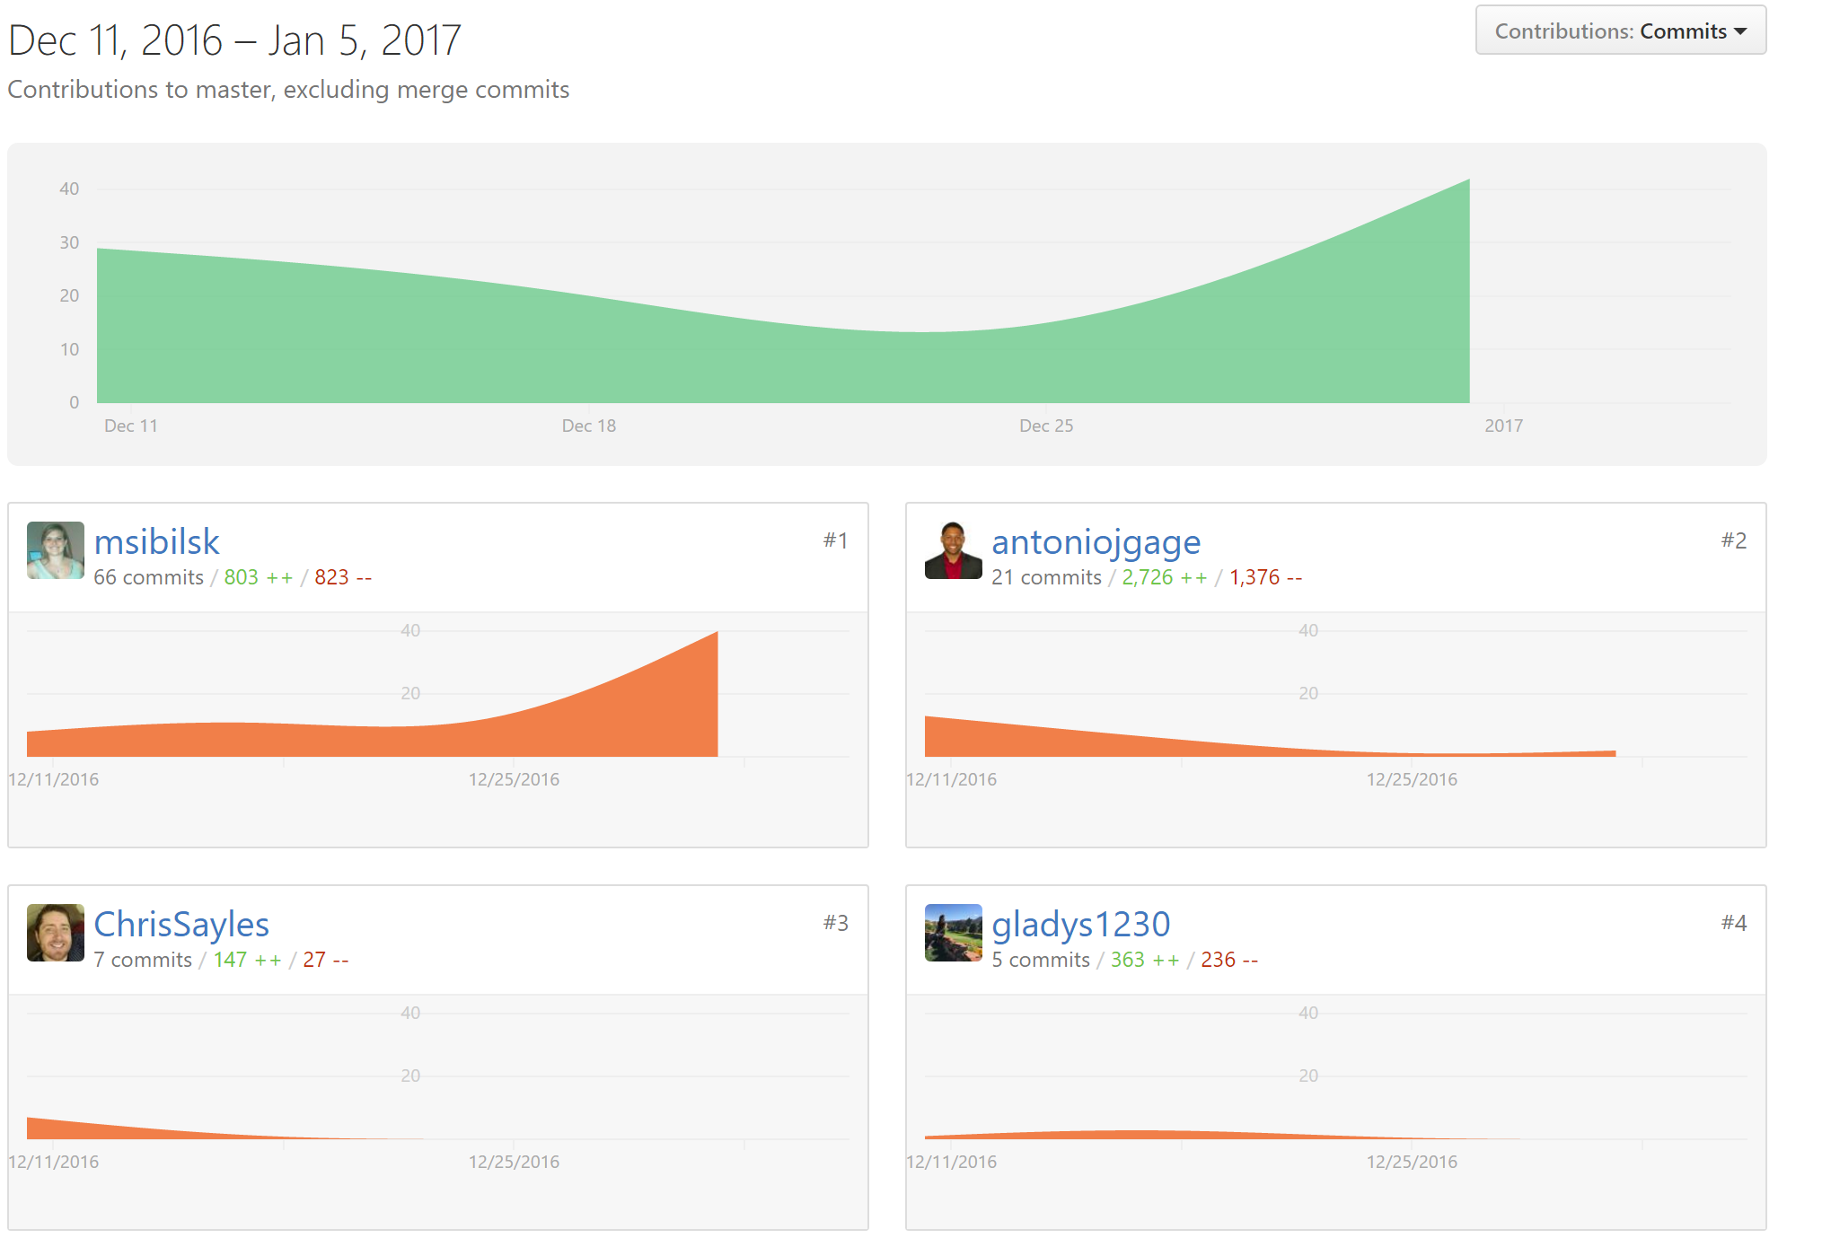


Slide 4
So how exactly does it work?
Using Google authorization with Firebase, the application requires google sign-in in order for the user to be able to use the chat functionality as well as to save their interests.
For first time users, google auth will assign them a UID. The website will already have 3 interests populated that they can choose and they can also add their own
For non-first time users, website will recognize UID and pull up previous interests and they can add more as well
One the user selects an interest button, Google API will ask if user will allow for them to access their location.
If yes, Google API will populate locations in their city that include their wanted activity.
When hovering over location, user can see the location’s information including their rating as well as how many people want to go to that location.
Chat functionality using Firebase, is how user will communicate with other users. Currently it is global but the idea is for it to also populate with the location bubble.

Slide 5
Presented by:
Kit Chan
Mary Willis
Antonio Gage
Christopher Sayles
Michelle Castellanos

