Slide 1
Intro to HW/SW Co-design
Yoav Etsion

Slide 2
Admin
Welcome to the course ☺
Grading:
Two home assignment (25%)
Project: Analyze workload and propose potential HW acceleration
Project is graded by:
Implementation and final report (45%)
Presentation (45%)
Projects will be given in the last month of semester
Presentations after MoedA period
Feel free to use whatever AI tools you want in the assignments and project
But you are responsible to fully understand all AI products!

Slide 3
Books
Classic books on HW/SW co-design focus on embedded systems
Tune hardware for application
Tune application for hardware
Not very relevant for this course
Some of the topics in the course are covered by Hennesey and Patterson, some by HW specs (e.g., PCIe, perf. counters), and many in recent literature
We will try to properly cite the papers so you can read them

Slide 4
The way we commonly see HW/SW boundary
We often split the computer system into SW and HW
We have “SW engineers” and “HW engineers”
Application
OS
SW
HW
CPU

Slide 5
The way we commonly see HW/SW boundary
We often split the computer system into SW and HW
We have “SW engineers” and “HW engineers”
Very few engineers have good understanding of both HW and SW
Ignorance breeds a blame game ☺
Application
OS
SW
HW
CPU

Slide 6
The way we commonly see HW/SW boundary
- “No hardware designer should be allowed to produce any piece of hardware until three software guys have signed off on it” - Prof. Andrew Tanenbaum (SW/OS person)
- “Computer theorists invent algorithms that solve important problems and analyze their asymptotic behavior (e.g. O(NlogN) or O(N³)). Computer architects set the constant factors for these algorithms…”
- Prof. Christos Kozyrakis (HW Architect)

Slide 7

System view: Look at the big picture

Slide 8
System view: Look at the big picture
Modern systems are humongous and complex
Typical events are handled by many servers, HW+SW
Different software layers (app, libs, OS, hypervisor)
Different hardware layers (CPU, GPU, memory)
Different networking layers (Ethernet, PCIe, DDRx, NVLink)

Slide 9
The goal of this course: Look at the entire system
We hope to give you a good understanding of HW/SW interplay
We will examine some of the evolving requirements and constraints of both HW and SW
Understanding the entire system makes you better engineers
Knowledge breeds job security ;-)
Application
OS
SW
HW
CPU / GPU / NIC / Switch

Slide 10
A different view of computer systems
Problem
Computers are built to solve problems
But all solutions have constraints
Both the problem and constraints are moving targets and are co-dependent
Algorithm
Software
Hardware/Arch.
VLSI flow
Devices
Physics

Slide 11
The rise of AI as a co-design example
Problem
Algorithm
AI is an example of how HW and SW helped shape the problem itself
Neural networks have been around for decades, but hardware could not support large nets
The ImageNet challenge triggered a change
Software
Hardware/Arch.
VLSI flow
Devices
Physics

Slide 12
ImageNet sets a challenge
Problem
Algorithm
In 2006 Prof. Fei-Fei Li of UIUC started curating a database of images to be used for research
Inspired by Princeton’s WordNet
In 2010 the first ImageNet challenge was presented: classify images to a set of predefined classes
e.g., cats, dogs, cars
Software
Hardware/Arch.
VLSI flow
Devices
Physics

Slide 13
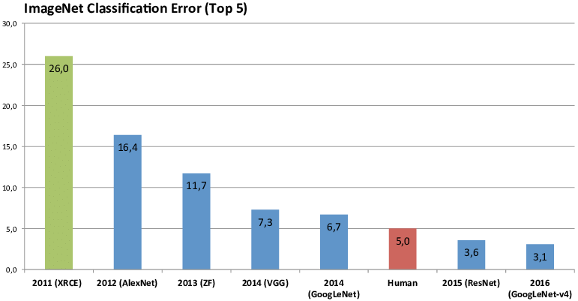
CNNs found to be a good match for GPUs
Problem
Algorithm
Software
Hardware/Arch.
VLSI flow
Error rate [%]
Devices
Physics
…
CNN on GPU
CNN on GPU
CNN on GPU
SVM on CPU
CNN on GPU

Slide 14
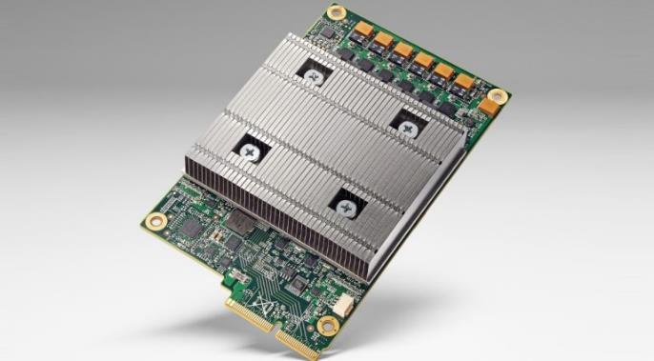
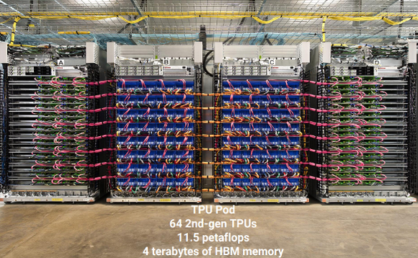
The first AI accelerator: Google TPU
Problem
Algorithm
Google engineers realized that Tensors are a fundamental primitive for AI
In 2015 they introduced the Tensor Processing Unit
aka, a matrix multiplier
Software
Hardware/Arch.
VLSI flow
Devices
Physics

Slide 15
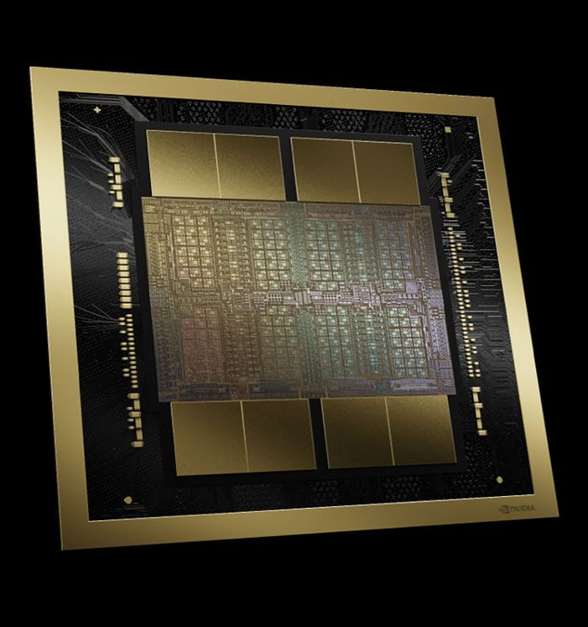






The AI HW/SW co-design boom
Problem
Algorithm
After that, AI drove many HW efforts
Software
Hardware/Arch.
VLSI flow
Devices
Physics

Slide 16
But it started with evolving constraints
Problem
Algorithm
Moore’s Law and Dennard’s scaling
Moore’s Law: Transistor size “The number of transistors/mm² doubles every 18mo.”
Dennard’s Scaling: Power density “The power of transistors/mm² remains constant” (i.e., transistor power scales with Moore’s Law)
Software
Hardware/Arch.
VLSI flow
Devices
Physics

Slide 17
Dennard’s scaling
Problem
Algorithm
Dynamic power consumed by a digital circuit:
P = α*C*V²*f
Dennard projection:
Voltage scales down
Capacitance scales down (smaller devices)
Frequency increases without consuming more power
It worked well, until it didn’t…
Software
Hardware/Arch.
VLSI flow
Devices
Physics

Slide 18
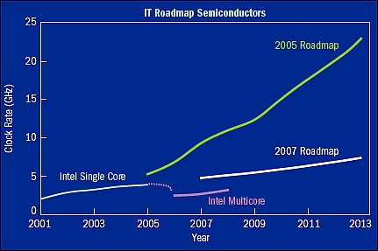
Dennard, Moore, and performance
Problem
Algorithm
Software
Hardware/Arch.
VLSI flow
Devices
Physics

Slide 19
Dennard, Moore, and performance
Problem
Algorithm
Software
Hardware/Arch.
VLSI flow
Devices
Physics

Slide 20
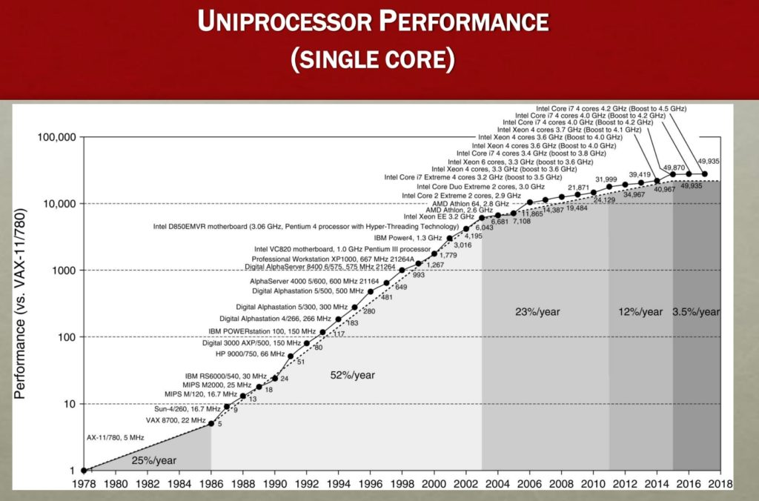
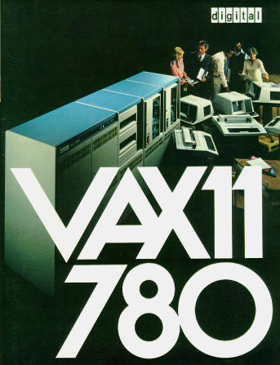
CPUs are limited
Problem
Algorithm
Software
Hardware/Arch.
VLSI flow
Devices
Physics

Slide 21
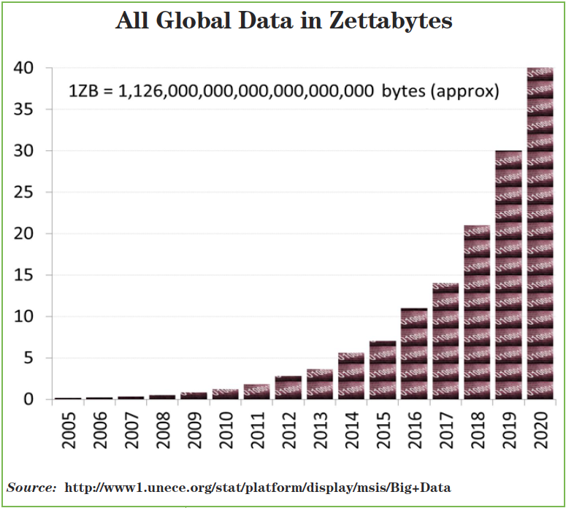
Data growth is killing us
Problem
Algorithm
Software
Hardware/Arch.
VLSI flow
Devices
Physics

Slide 22
Are accelerators always the answer?
Problem
Algorithm
No (even if we ignore the high manufacturing costs)
The complexity of HW designs is getting out of hand, and the broken VLSI tool flow cannot cope
Kernighan's Law on software: “Debugging is twice as hard as writing the code in the first place. Therefore, if you write the code as cleverly as possible, you are, by definition, not smart enough to debug it.”
Especially if the tool flow is broken
Software
Hardware/Arch.
VLSI flow
Devices
Physics

Slide 23
The broken VLSI tool flow: Verification
Problem
Algorithm
Hardware complexity is limited by our verification tools
Formal verification is limited
Hard to generate formal specification
Computation explodes very fast, especially if there’s state (SAT is NP-complete)
Functional verification still rules
Coverage is the major limitation of functional verification
Result: We need 2-4 verification engineers for each designer
Engineering cost is the major expense of HW design
Software
Hardware/Arch.
VLSI flow
Devices
Physics

Slide 24
The broken VLSI tool flow: Verification
Problem
Algorithm
How can we scale hardware verification to manage more complex designs?
Open question…
GenAI for coverage?
GenAI for formal spec (active research field)
We tend to try GenAI when we run out of algorithmic ideas…
Software
Hardware/Arch.
VLSI flow
Devices
Physics

Slide 25
The broken VLSI tool flow: The full flow
Problem
Algorithm
Software
Architect writes arch. Specification doc.
Hardware/Arch.
VLSI flow
Devices
Physics
Designer codes RTL
SW writes func+timing simulators
Verification engineer needs to understand both

Slide 26

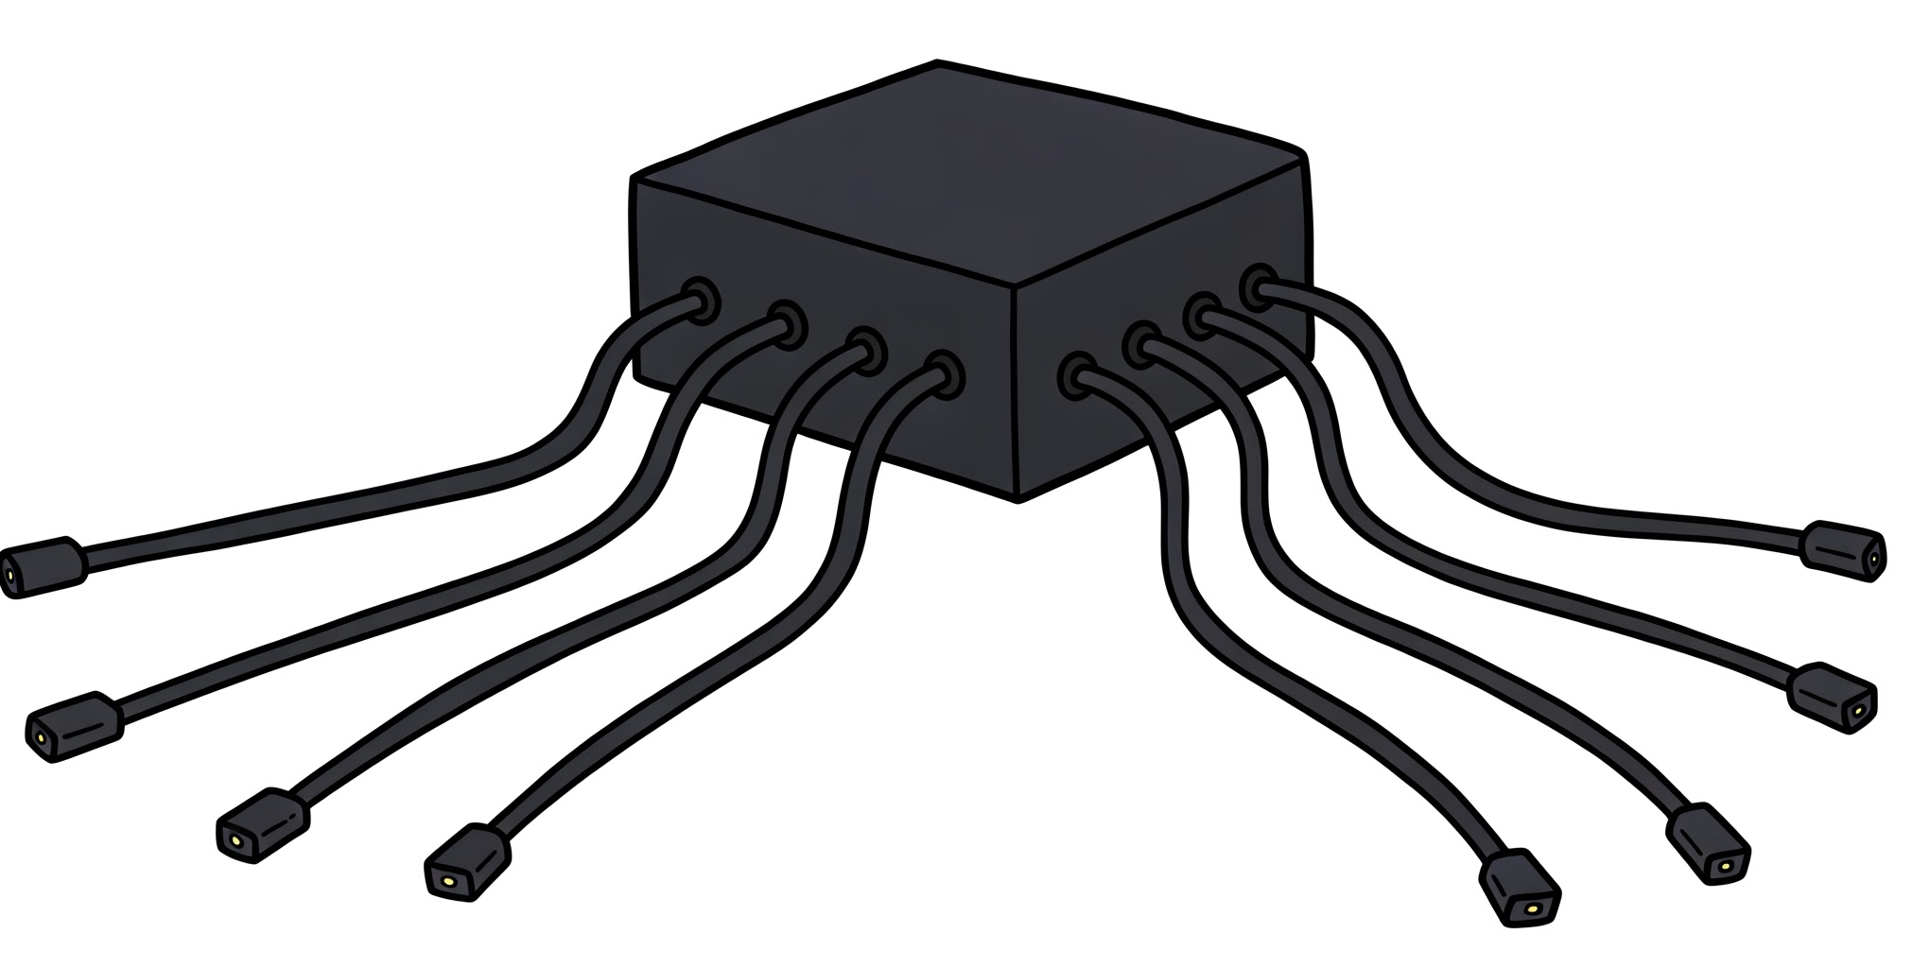
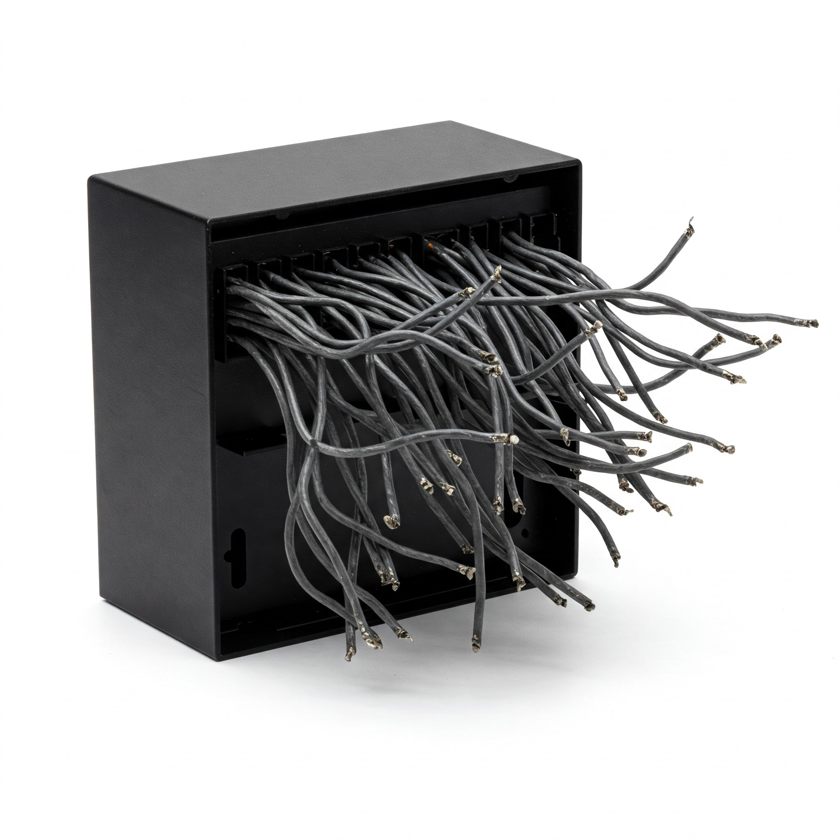
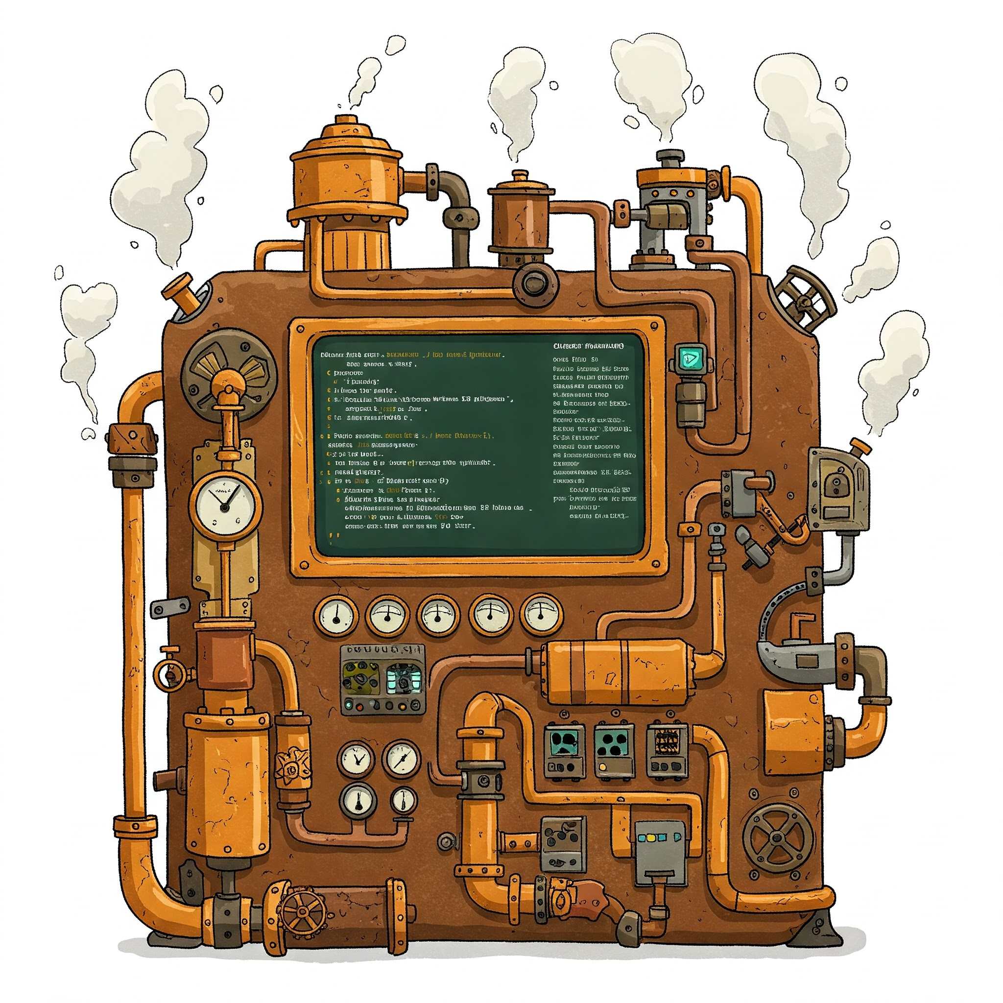
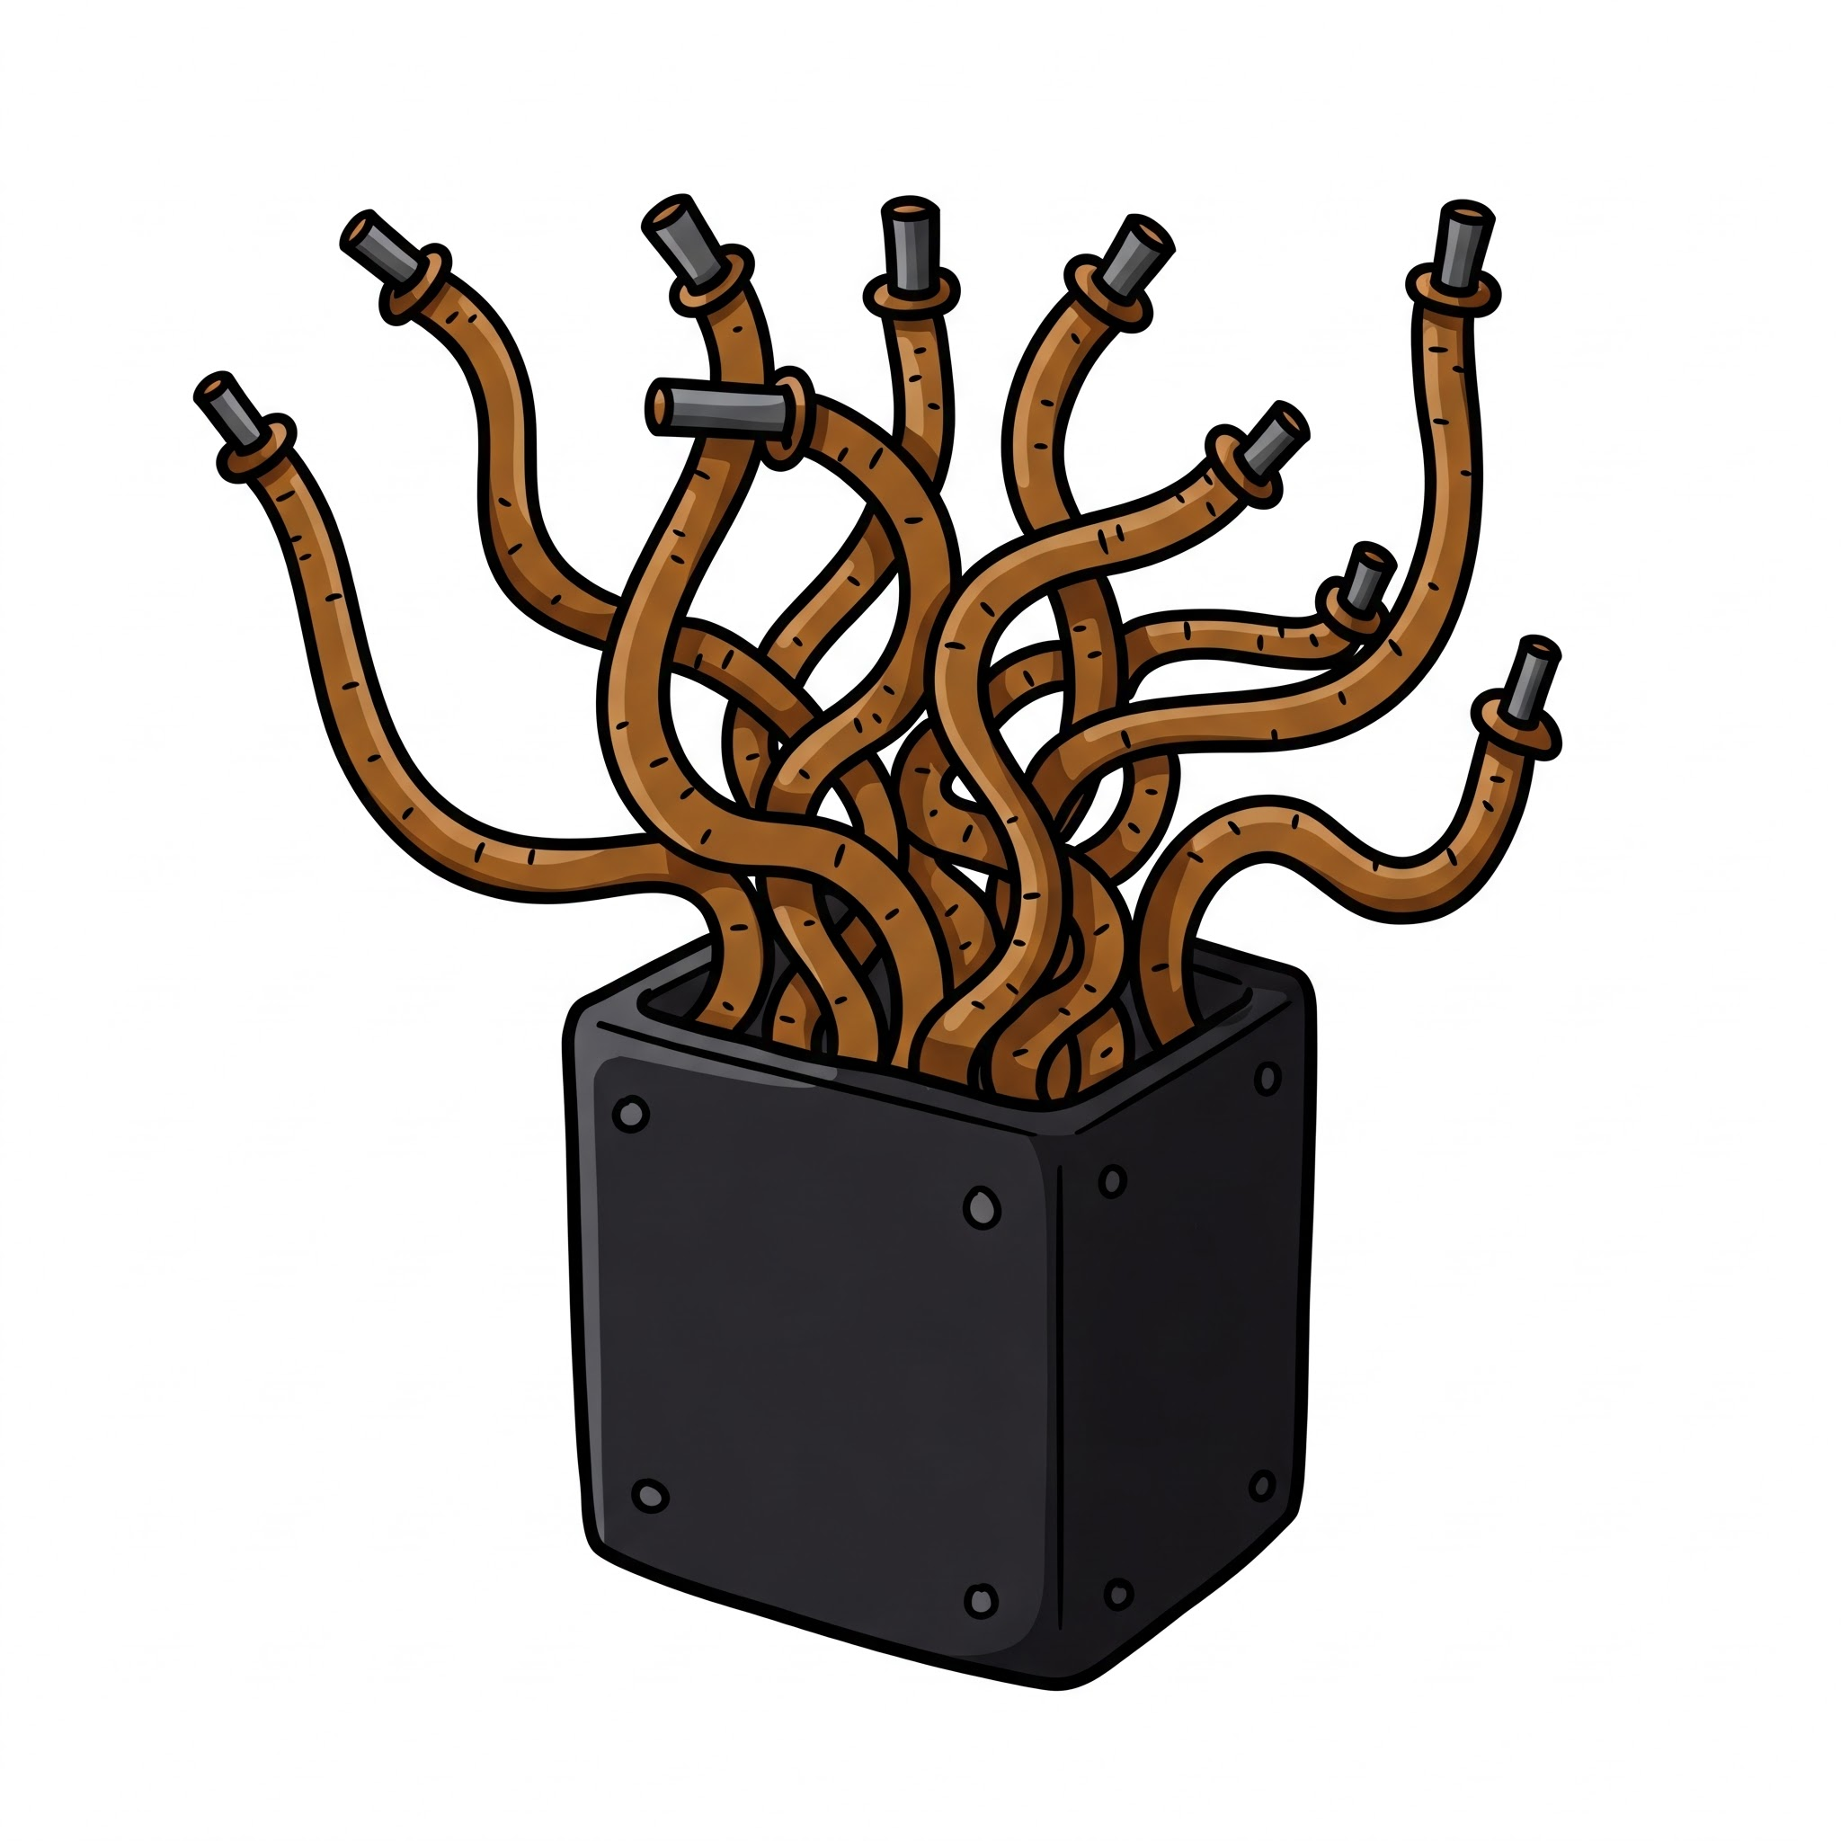
The broken VLSI tool flow: The full flow
Architect writes arch. Specification doc.
RTL SW simulator (~1000 cy/s)
IP model for simulator
External IP (gate-level)
Designer codes RTL
SW writes func+timing simulators
IP model for emulator
Verification engineer needs to understand both
Emulator (limited, ~100k cy/s)

Slide 27
The broken VLSI tool flow: The full flow
Architect writes arch. Specification doc.
RTL SW simulator (~1000 cy/s)
IP model for simulator
External IP (gate-level)
Designer codes RTL
SW writes func+timing simulators
IP model for emulator
Verification engineer needs to understand both
Emulator (limited, ~100k cy/s)

Slide 28

Some inalienable truths
RTFM
PEBKAC
Problem Exists Between Keyboard And Chair

Slide 29
The broken VLSI tool flow: Humans…
Problem
Algorithm
Architecture documents have bugs
Designs are manually coded and are therefore buggy
Simulators are manually coded and are therefore buggy
IP models are manually coded from IP spec. and are buggy
We found bugs in functionality, timing
RTL simulator/emulator too slow for complex test case
SW simulators are decoupled from RTL implementation
Limited use for functional/performance verification
Software
Hardware/Arch.
VLSI flow
Devices
Physics

Slide 30
The broken VLSI tool flow: RTL
Problem
Algorithm
The register transfer language (RTL) abstraction is too low level
Forces designers to focus on mapping functionality to registers and wires, not getting the functionality right
>80% of code is just connecting wires
Verilog, SystemVerilog, Chiesel, PyRTL, …
Akin to writing MS Office in assembly language
New High-level synthesis languages are no match either
Use incompatible SW constructs (e.g., arrays, loops) so abstractions are not consistent across transformations
E.g., Xilinx/AMD Vivado, Cadence Stratus, Synopsys Symphony
End result: Existing VLSI tool flow restricts HW complexity
Software
Hardware/Arch.
VLSI flow
Devices
Physics

Slide 31
Processing in-/near-storage: When the solution to the gap is unclear
Problem
Algorithm
Axiom 1: Most of the data resides in storage
Axiom 2: Moving data to the processor is expensive
Obvious solution: Let’s move the computation inside or near storage
But it turns out to be not so obvious
Software
Hardware/Arch.
VLSI flow
Devices
Physics

Slide 32
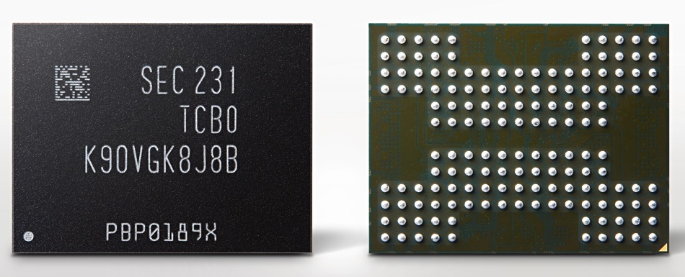
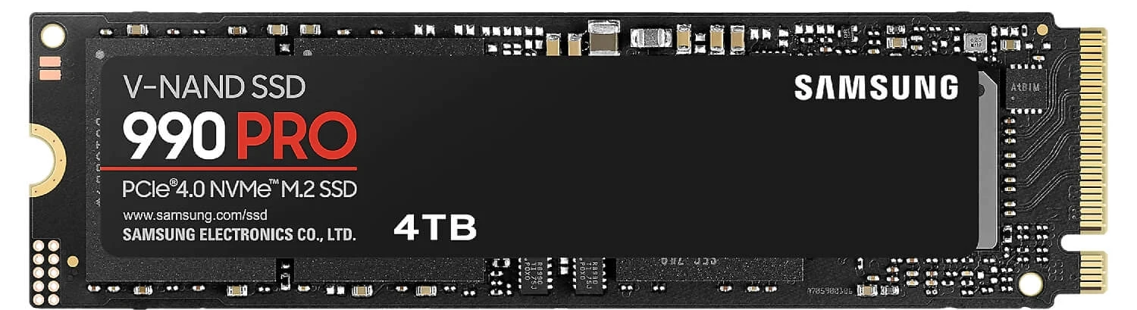
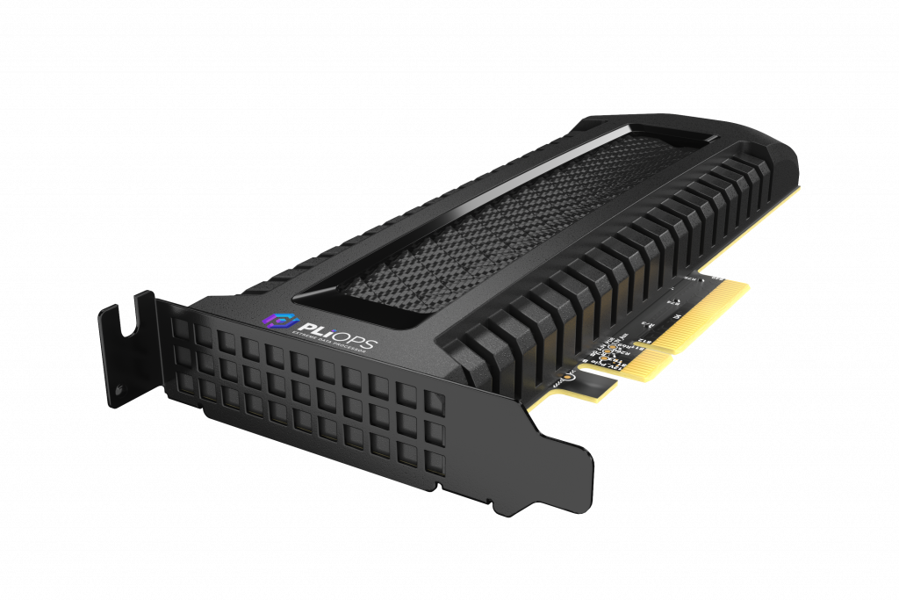
Is processing in/near storage going really feasible?
Data is aggressively compressed
DB tables: type-specific encoding + compression
Images: JPEG, PNG (LZ), …
Video: H265, …
Any processing must decompress data before processing, then compress again
At high bandwidth
In-storage: (de)compress inside memory array?
Near storage: must keep controller dirt-chip
In server: OS operation (e.g., dedup), custom DBs

Slide 33
Looking at the entire system
We need to see the bigger picture
Learn about evolving HW and SW trends
Learn about evolving HW and SW constraints
Understand how the entire system works

Slide 34
Tentative outline
 | Topic
1 | Principles of performance evaluation: Throughput, latency, arrival rate, service time, Little’s Law
2 | Hardware performance counters: (guest speaker: Anton Hanna, Intel) Usage, hierarchical performance analysis
3 | Identifying bottlenecks: Call graph, flame graph common suspects: memory, network, storage
4 | Accelerator patterns and design concepts: Systolic arrays (Google TPU), static/dynamic dataflow in CGRA (Speedata APU)
5 | Hardware design concepts: PCIe interconnect, architecture, interfaces, performance, PCIe-based accelerators

Slide 35
Tentative outline
 | Topic
6 | Cloud workload challenges: Virtual machines, containers, HW offload
7 | Cloud workload challenges: Virtual memory, 2D page walk, performance impact, HW offload proposals
8 | Cloud workload challenges: Advanced virtual memory, TLBs, TLB shootdown
9 | Cloud workload challenges: Microservices, Lambda/Function programming, HW/SW disparity
10 | DRAM: How it works, performance and power limitations, security issues (RowHammer)

Slide 36
Thank you Questions?

