Slide 1
Intro to Performance Evaluation
Yoav Etsion

Slide 2
Common performance evaluation metrics
Time
Latency
Service time
Processing time
Throughput
Arrival rate

Slide 3
Putting the metrics together
Agent A
Agent B
Request
Let’s examine how the metrics apply to two communicating agents
Agents can be anything
Software components (same/different hosts)
Networking
Processor <-> Memory
…
Response(s)
Time

Slide 4
Putting the metrics together
Agent A
Agent B
Request
Latency The time it takes between sending the request until the response begins to arrive
E.g., Read work from memory
Response(s)
Time

Slide 5
Putting the metrics together
Agent A
Agent B
Request
Processing time The time it takes for the receiving agent to process the request
Response(s)
Time

Slide 6
Putting the metrics together
Agent A
Agent B
Request
Service time The total time to complete your task
E.g., Refuel your car inc. waiting in line
E.g., Load a page in your browser
Response(s)
Time

Slide 7
Putting the metrics together
Agent A
Agent B
Request
Throughput (X/t) What is the rate in which you can complete multiple events
E.g., Home assignments/week
E.g., IPC, Network bandwidth
E.g., Incoming packets per second in NiC
Response(s)
Time
Request
Response(s)

Slide 8
Putting the metrics together
Agent A
Agent B
Request
Throughput (X/t) What is the rate in which you can complete multiple events
E.g., Home assignments/week
E.g., IPC, Network bandwidth
E.g., Incoming packets per second in NiC
Throughput may refer to interleaved streams
E.g., a web server
Response(s)
Request
Time
Response(s)

Slide 9
Putting the metrics together
Agent A
Agent B
Request
Arrival rate How many requests arrive per unit of time?
Somewhat similar to throughput, but does not refer to processing time
E.g., Missiles/day
E.g., Incoming packets per second in NiC
E.g., How many req/sec arrive to a web server
Response(s)
Time
Request
Response(s)

Slide 10
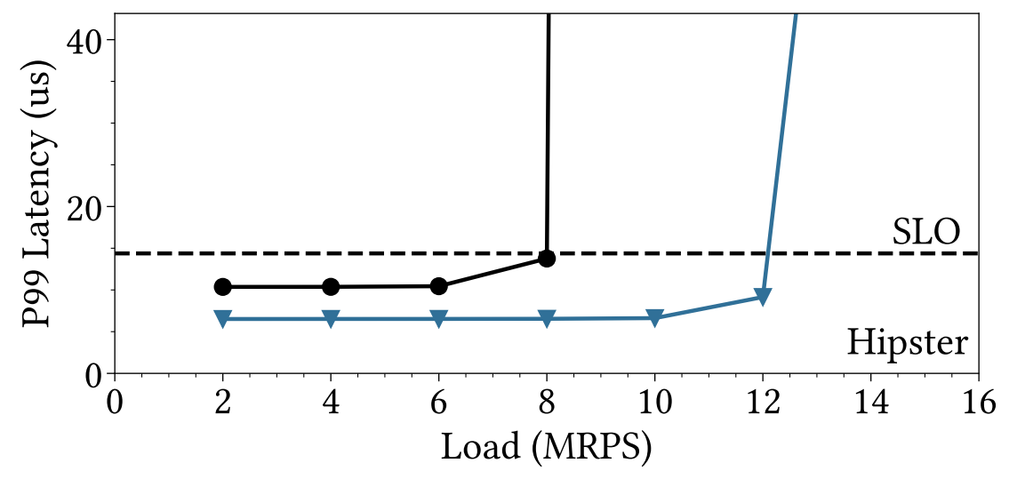
Putting the metrics together
Tail Latency Service providers need to guarantee that X% of requests are serviced within a predefined time (e.g., 99% within 18us)
AKA service level objective (SLO)
99% is known as P99
Challenge: scale the service
Increase RPS while keeping SLO
Service time typically explodes at some point
We want to push that point to the right
Requests/seconds

Slide 11
Classic: Latency vs. Bandwidth
Haifa
Tel Aviv
Request
We need to transfer 10,000TB from Tel Aviv to Haifa
What’s better:
Latency
Transfer time
Response(s)
Time

Slide 12
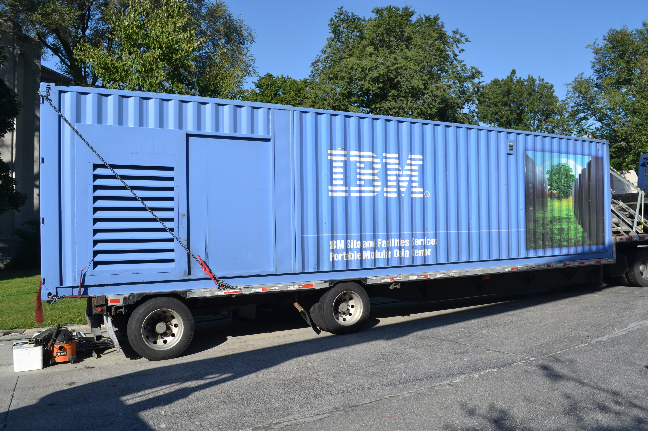
Classic: Latency vs. Bandwidth
Haifa
Tel Aviv
Request
We need to transfer 10,000TB from Tel Aviv to Haifa
What’s better:
800gbs fiber (100GB/s), or…
Data center truck with 1000 x 10TB disks?
Latency
Transfer time
Response(s)
Time

Slide 13
Classic: Latency vs. Bandwidth
Haifa
Tel Aviv
Request
Bandwidth:
Truck: 10,000TB / hr = 10,000/3600 = 2.8TB/s
Fiber: 100 GB/s = 0.1 TB/s
However, latency:
Truck: ~1 hour
Fiber: <1ms
Latency
Transfer time
Response(s)
Time

Slide 14
Agents are like fractals
Agent A1
Agent A2
Agent A3
Agent B1
Agent B2
In real systems agents have many components
Request
Response(s)
Time

Slide 15
Agents are like fractals
Agent A1
Agent A2
Agent A3
Agent B1
Agent B2
In real systems agents have many components
A: App -> OS -> NIC ->
B: NIC -> Service
Request
Response(s)
Time

Slide 16
Agents are like fractals
Agent A1
Agent A2
Agent A3
Agent B1
Agent B2
In real systems agents have many components
A: App -> OS -> NIC ->
B: NIC -> SW service
NIC: PCIe -> packet processor -> … optical transceiver ->
Request
Response(s)
Time

Slide 17
Fractals in the wild: Read from disk, simple host
App
Disk
Request
App calls read() syscall
Response(s)
Time

Slide 18
Fractals in the wild: Read from disk, simple host
App
OS (syscall)
OS (fs)
OS (block)
OS (driver)
SC
Disk
Request
When we call the read() syscall, we go through multiple SW/HW layers
App calls syscall, which traps to OS [SW]
OS filesystem maps file to disk blocks [SW]
OS block layer gets to device driver [SW]
Device driver call storage controller [SW/HW]
Storage controller comm. w. disk [HW]
Device sends data [HW]
And all the way back…
Response(s)
Time

Slide 19
Fractals in the wild: Read from disk, virtual machine
Host
VM
Things get even messier when running in a VM
The entire VM image is a single file on the host
The guest disk is fake; it is emulated by hypervisor
Sequence:
Guest map a file offset to a block in its “disk”
Hypervisor’s emulated disk needs to read block in guest’s “disk”
Hypervisor’s filesystem maps offset in guest image to a real block on disk
Storage controller access real block on disk
Modern clouds use networked storage, so the flow is even more complex (but optimized as hell)
App
Guest OS + FS
“disk”
Hypervisor + FS
emulation
SW
HW
Disk
“disk”

Slide 20
Fractals in the wild: Read from disk, virtual machine
App
Guest OS
(fs + block(
Virtual disk driver
VM (fs + block + driver)
Disk
Things get even messier when running in a virtual machine:
The guest disk is fake; it is emulated by hypervisor
The hypervisor, like OS, has filesystem, block, and device driver layers
Storage controller and disk remain the same
Switch from VM to hypervisor has very high latency
Limits supported arrival rate
Modern clouds use networked storage, so the flow is even more complex
Request
Time
Response(s)

Slide 21
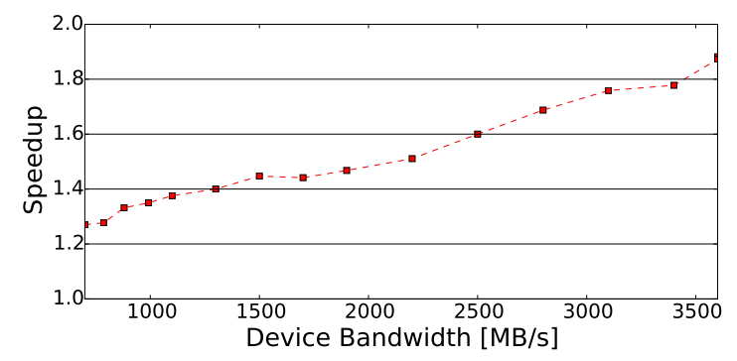
Fractals in the wild: Virtualization layers come at a price
Given the device bandwidth, what’s the performance cost of virtualization?
Speedup of simple host vs. VM
The faster the disk, the bigger the loss
Disk was simulated in memory, so we can control its bandwidth
“NeSC: Self-Virtualizing Nested Storage Controller”. Gottesman and Etsion, In MICRO 2016

Slide 22
NeSC’s HW/SW co-design: Offload block lookups to hardware
Host
VM
Add block-table lookups to storage controller
Works like page tables
Each VM’s disk is represented by a block table
Storage controller presents tables as HW disks
Block tables are created by hypervisor
VMs access new disk facility directly
No switch from VM to hypervisor
App
Guest OS + FS
“disk”
Hypervisor + FS
SW
HW
Block table mapper
Disk
“disk”

Slide 23
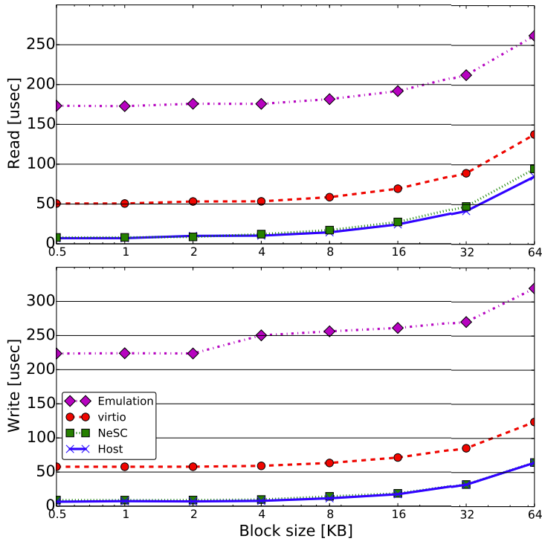
NeSC’s improved latency
NeSC’s latency is like running on a native host without a VM!

Slide 24
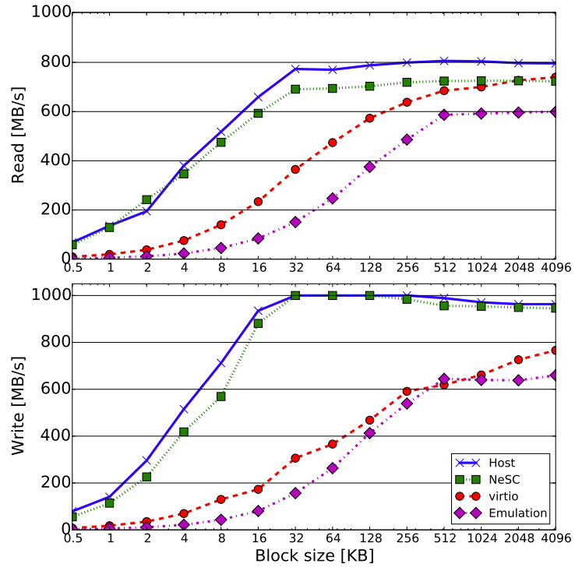
NeSC’s improved bandwidth
NeSC’s bandwidth is almost like running on a native host without a VM!
But what happens with large payloads?

Slide 25
Little’s Law
The relation between arrival rate, service time, and average number of requests in the system: L = λW
Lambda=arrival rate
W=service time
L=average number of request in the system
Refers to a stable system
Stable means that Lambda and W are orthogonal
Original paper: J. D. C. Little, "A Proof for the Queuing Formula: L = λW". In Operations Research 9(3) 383-337, 1961

Slide 26
Little’s Law in the wild
The equation provides a useful tool in many domains
How many chairs do we need to put in the bank branch?
No. of customers in the system given arrival rate and service time
How many tellers do we need in the bank branch?
More tellers reduce avg. service time
Of course, it’s quite useful in computing…

Slide 27
Little’s Law in the wild: Designing network switches
A high-end 800gbs Ethernet switch (100GB/s)
Standard Ethernet packet: 1500B
Lambda = 100GB / 1500B = 67M pps (per port)
Minimal packets/second the needs to be supported: 67M
W=200ns means we maintain a 200ns switching latency
L = buffer size = 67M pps * 0.0000002s = 13.4 packets (per port)

Slide 28
Little’s Law in the wild: Designing network switches
What about smaller packets?
Memory accesses fetch as little as 64B per transfer (cache line)
Lambda = 100GB / 64B = 1.56G pps (per port)
W=200ns means we maintain a 200ns switching latency
L = buffer size = 1.56G pps * 0.0000002s = 312 packets (per port)

Slide 29
Little’s Law in the wild: HW/SW co-design of a task scheduler
Modern parallel programming models are task-based
E.g., OpenMP
A task is a piece of finite code that needs to be executed
Tasks are inter-dependent and must be scheduled in a correct order
The runtime system must dynamically build the dependency graph and schedule tasks
But what are the requirements from the runtime system?
Etsion et al., “Task Superscalar: An Out-of-Order Task Pipeline”. In MICRO 2010

Slide 30
Little’s Law in the wild: HW/SW co-design of a task scheduler
OpenMP allows declaring input and output parameters using pragmas:
#pragma css task input(a, b) inout(c) void sgemm_t(float a[M][M], float b[M][M], float c[M][M]);
#pragma css task inout(a) void spotrf_t(float a[M][M]); #pragma css task input(a) inout(b) void strsm_t(float a[M][M], float b[M][M]); #pragma css task input(a) inout(b)
void ssyrk_t(float a[M][M], float b[M][M]);

Slide 31
Little’s Law in the wild: HW/SW co-design of a task scheduler
At run time, the main thread generates tasks: (example: Cholesky matrix decomposition)
float A[N][N][M][M]; // NxN blocked matrix with MxM blocks
for (int j = 0; j<N; j++) {
for (int k = 0; k<j; k++)
for (int i = j+1; i<N; i++)
sgemm_t(A[i][k], A[j][k], A[i][j]);
for (int i = 0; i<j; i++)
ssyrk_t(A[j][i], A[j][j]);
spotrf_t(A[j][j]);
for (int i = j+1; i<N; i++)
strsm_t(A[j][j], A[i][j]);
}

Slide 32
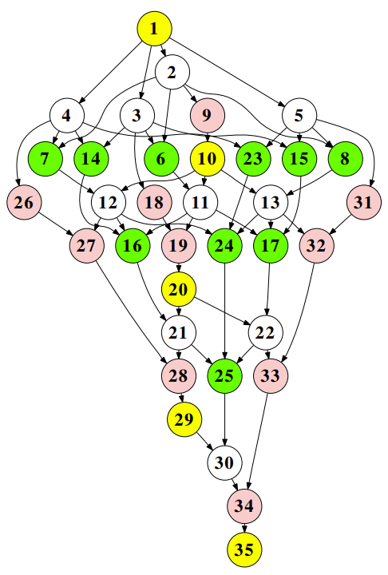
Little’s Law in the wild: HW/SW co-design of a task scheduler
This is what the full task dependency graph for a 5x5 Cholesky decomposition looks like

Slide 33
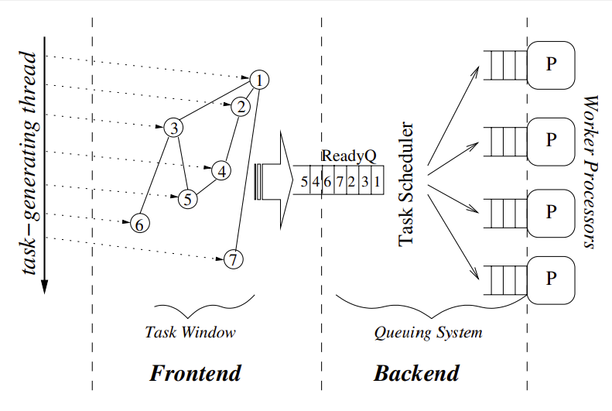
Little’s Law in the wild: HW/SW co-design of a task scheduler
The scheduler needs to constructs a partial graph and dispatch ready tasks

Slide 34
Little’s Law in the wild: HW/SW co-design of a task scheduler
Constraints:
We want to utilize a 256-core system
Tasks’ run time is determined by the way they are coded
It’s easier to write short functions, which stresses the scheduler
The scheduler must support an arrival rate of: Lambda = L / W = 256 / W
(where W is the task run time)

Slide 35
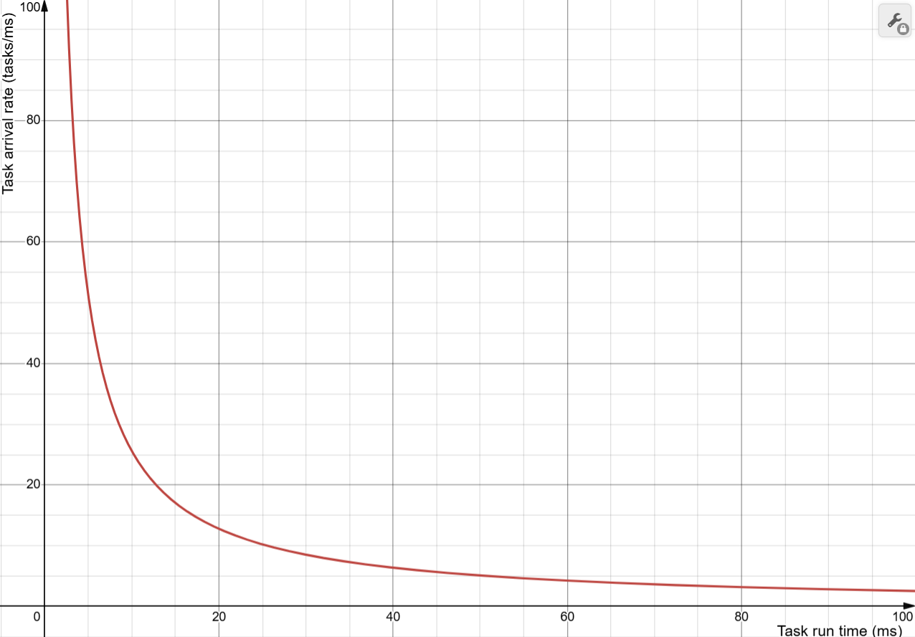
Little’s Law in the wild: HW/SW co-design of a task scheduler
Lambda = 256 / W
λ=Task arrival rate (tasks/ms)
W=Task run time (ms)

Slide 36
Little’s Law in the wild: HW/SW co-design of a task scheduler
Lambda = 256 / W
λ= Task arrival rate (tasks/ms)
We need to schedule at a rate of ~4,300 tasks/sec
~4.3
W=Task run time (ms)

Slide 37
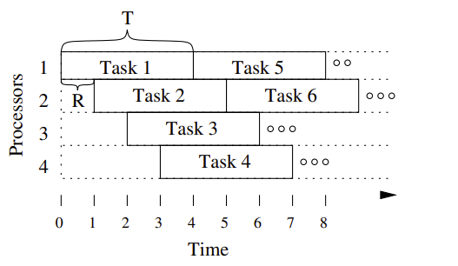
Little’s Law in the wild: HW/SW co-design of a task scheduler
An alternative view for this specific case study
The first core gets a task at time 0, and is then occupies it for 60ms (T)
Within time T we need to dispatch tasks to all 256 cores
Decode and dispatch a task every R=60/256=0.23ms (on average)
Maintain arrival rate of 1/0.00023=4347 tasks/second

Slide 38
Little’s Law in the wild: HW/SW co-design of a task scheduler
The generic Little’s Law applies here!
No need to invent new methods
Now that we know the requirements, we can design the scheduler

Slide 39
Summary
The basic metrics are almost universal
But they need to be clearly defined
Look at the whole system to identify the bottlenecks
And systems tend to be complex
Little’s Law is a key tool in an engineer’s toolbox
Use it! (we only saw a few examples…)

