Slide 1
PCIe (Peripheral Component Interconnect Express)
Yoav Etsion

Slide 2
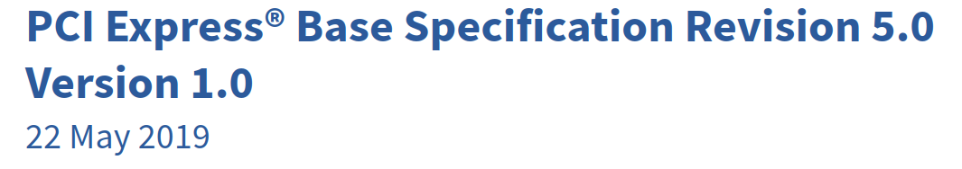

Welcome to the PCIe spec ☺
We’ll only cover the highlights…

Slide 3
PCIe overview
PCIe connects CPUs to all devices in the system
Except for DRAM
Descendant of ISA, PCI, PCI-X, AGP

Slide 4
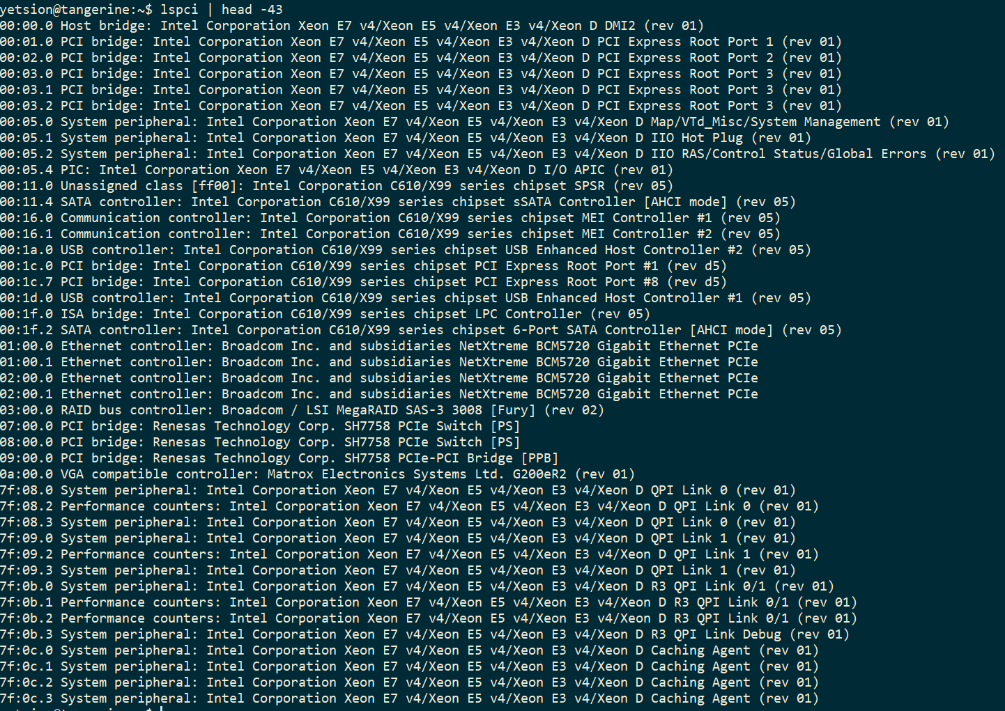

Slide 5
PCIe overview
PCIe connects CPUs to all devices in the system
Except for DRAM
Descendant of ISA, PCI, PCI-X, AGP
Modern servers are shipping with PCIe gen5/gen6 slots
Gen7 spec has been released
Tree topology*
Ignoring rarely used NTB and MR-IOV features
Guaranteed packet delivery (ack on each packet; no packet loss)
Devices can have multiple functions (e.g., NIC with two ports)

Slide 6
PCIe topology
CPU
Memory
PCIe Root Complex
Device
PCIe Endpoint

Slide 7
PCIe topology
CPU
Memory
PCIe Root Complex
PCIe Endpoint
PCIe Endpoint
PCIe Endpoint

Slide 8
PCIe topology
CPU
Memory
PCIe Root Complex
PCIe Endpoint
PCIe Endpoint
PCIe Endpoint
PCIe Switch
PCIe Endpoint
PCIe Endpoint
PCIe Endpoint

Slide 9
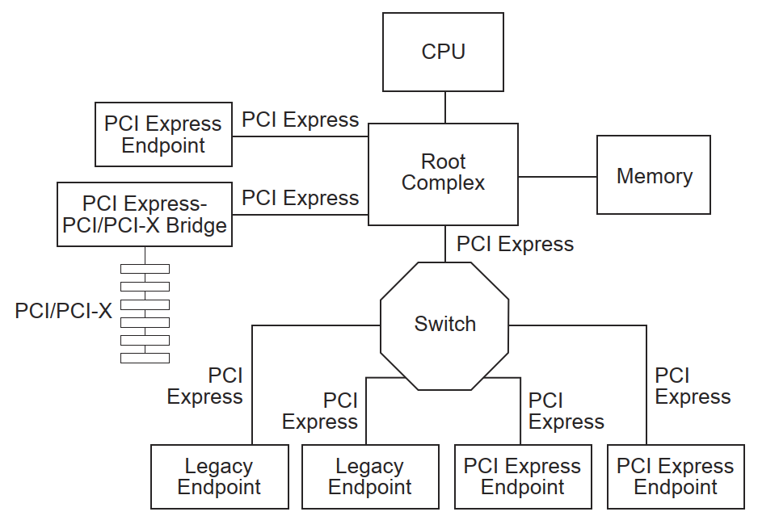
PCIe topology in the spec
Bridge devices connect other protocols - e.g., PCI-X, USB

Slide 10
PCIe topology
CPU
Memory
PCIe link
PCIe Root Complex
PCIe Endpoint
PCIe Endpoint
PCIe Endpoint
PCIe Switch
PCIe Endpoint
PCIe Endpoint
PCIe Endpoint

Slide 11
PCIe topology
CPU
Memory
Bus
PCIe Root Complex
PCIe Endpoint
PCIe Endpoint
PCIe Endpoint
PCIe Switch
Bus
PCIe Endpoint
PCIe Endpoint
PCIe Endpoint

Slide 12
PCIe enumeration
At boot time, the root complex enumerates the network
Checks endpoint configuration space
Read device vendor, type, class
Assigns configuration parameters to each endpoint
Negotiates speed with each device
Assigns bus numbers
Typically executed by the BIOS, and device map passed to the OS
OS can also redo the enumeration if BIOS allows

Slide 13
PCIe topology after enumeration
CPU
Memory
Bus 0x1
PCIe Root Complex
PCIe Endpoint
PCIe Endpoint
PCIe Endpoint
PCIe Switch
0x1
0x2
0x3
Bus 0x2
PCIe Endpoint
PCIe Endpoint
PCIe Endpoint
0x1
0x2
0x3

Slide 14
PCIe addressing: Bus:Device.Function (BDF)
CPU
Memory
Bus 0x1
PCIe Root Complex
PCIe Endpoint
PCIe Endpoint
PCIe Endpoint
PCIe Switch
0x1
0x2
0x3
The device address is the ~path from the root to the device
Known as BDF
Bus 0x2
PCIe Endpoint
0
1
PCIe Endpoint
PCIe Endpoint
0x1
0x2
0x3
BDF=1:2.0
BDF=2:2.1

Slide 15
Addressing examples

Slide 16
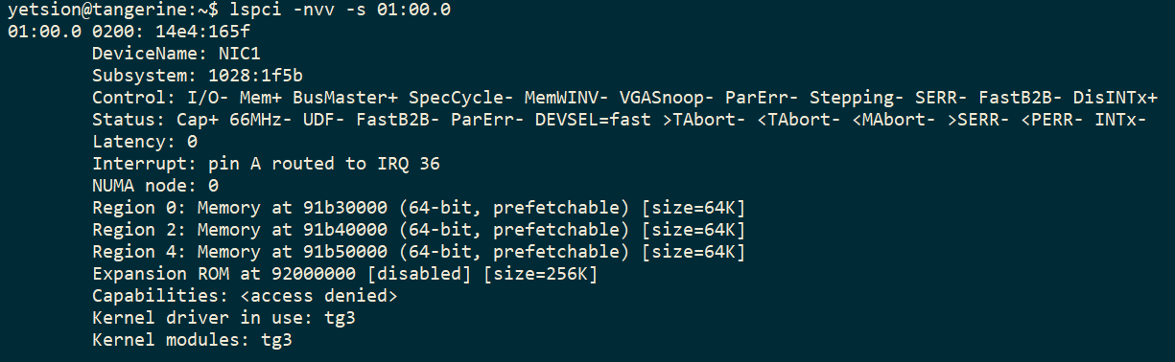
Device configuration space
Devices export their parameters through a configuration space

Slide 17
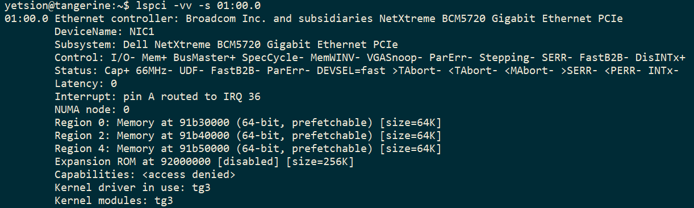
Device configuration space
Devices export their parameters through a configuration space

Slide 18
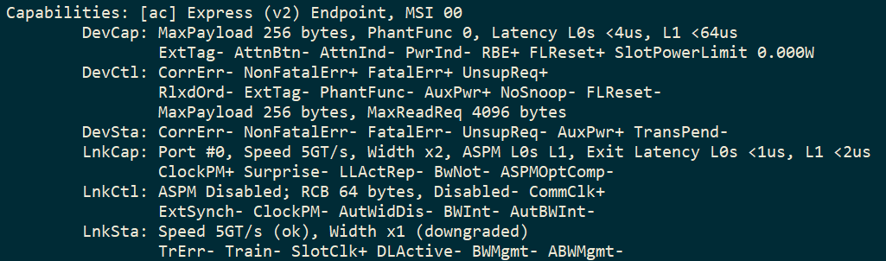
Device configuration space
Devices export their parameters through a configuration space
The root complex negotiates some parameters with devices

Slide 19
PCIe topology with multiple CPUs
Vendor-specific link (Intel QPI, AMD HyperTransport)
CPU
CPU
Memory
Memory
PCIe Root Complex
PCIe Root Complex
PCIe Endpoint
PCIe Endpoint
PCIe Endpoint
PCIe Switch
PCIe Endpoint
PCIe Endpoint
PCIe Endpoint
PCIe Switch
PCIe Endpoint
PCIe Endpoint
PCIe Endpoint
PCIe Endpoint
PCIe Endpoint
PCIe Endpoint

Slide 20
PCIe topology with multiple CPUs
Device-to-device can be limited by topology
Example:
We want direct GPU-NIC connectivity
What happens if we place them randomly?

Slide 21
PCIe topology with multiple CPUs Bad placement
Vendor-specific link (Intel QPI, AMD HyperTransport)
CPU
CPU
Memory
Memory
PCIe Root Complex
PCIe Root Complex
PCIe Endpoint
PCIe Endpoint
PCIe Endpoint
PCIe Switch
PCIe Endpoint
PCIe Endpoint
PCIe Endpoint
PCIe Switch
PCIe Endpoint
PCIe Endpoint
PCIe Endpoint
PCIe Endpoint
PCIe Endpoint
PCIe Endpoint
GPU
NIC

Slide 22
PCIe topology with multiple CPUs Good placement
Vendor-specific link (Intel QPI, AMD HyperTransport)
CPU
CPU
Memory
Memory
PCIe Root Complex
PCIe Root Complex
PCIe Endpoint
PCIe Endpoint
PCIe Endpoint
PCIe Switch
PCIe Endpoint
PCIe Endpoint
PCIe Endpoint
PCIe Switch
PCIe Endpoint
PCIe Endpoint
PCIe Endpoint
PCIe Endpoint
PCIe Endpoint
PCIe Endpoint
GPU
NIC

Slide 23
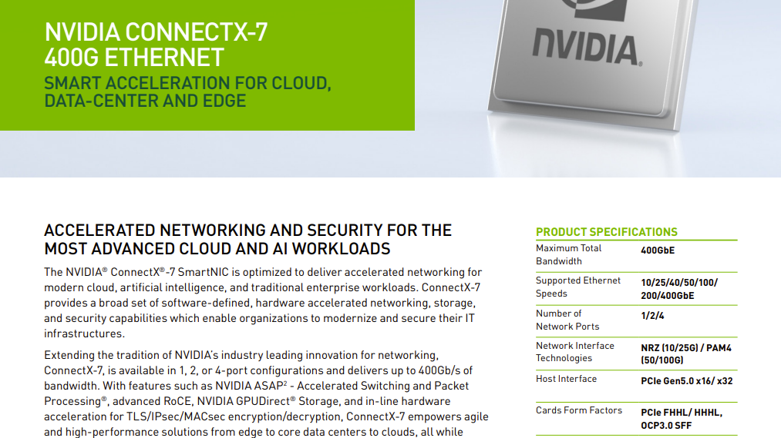

PCIe lanes

Slide 24
PCIe lanes
PCIe links are composed of serial lanes
E.g., a x16 device supports a link with 16 lanes
Each lane is full duplex
PCIe uses Low-voltage differential signaling (LVDS)
Passing a bit over two wires: D+ and D-
Receiving end checks V=D⁺-D⁻
Why?
Total 4 wires per lane (two wires in each direction)

Slide 25
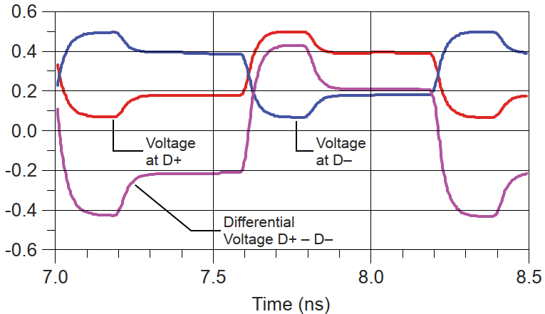
PCIe LVDS signaling

Slide 26
PCIe lane speeds
Generation | Lane speed (TPS) | Lane speed (bits/bytes)
PCIe 1.0 | 2.5GT/s | 2gbs = 250MB/s
PCIe 2.0 | 5.0GT/s | 4gbs = 500MB/s
PCIe 3.0 | 8.0GT/s | 8gbs = 1GB/s
PCIe 4.0 | 16.0GT/s | 16gbs = 2GB/s
PCIe 5.0 | 32.0GT/s | 32gbs = 4GB/s
PCIe 6.0 | 64.0GT/s | 64gbs = 8BG/s | PAM4 signaling

Slide 27
PCIe HW/SW interface: Host-to-Device
Device define memory spaces that can be mapped to OS/application
Device’s control registers and memory (as defined by their designer) are mapped to these regions
Regions controlled by Base Address Registers (BARs) in config space
Up to 6 BARs in 32b mode, 3 BARs in 64b mode

Slide 28
PCIe HW/SW interface: Host-to-Device
Broadcom NIC defined 3x 64KB spaces

Slide 29
PCIe HW/SW interface: Host-to-Device
Phys. Address space (64b)
Broadcom NIC defined 3x 64KB spaces
BIOS/OS maps BARs to physical address space at enumeration time
Phys. Memory
config
0x91b30000
BAR0
0x91b40000
BAR2
0x91b50000
BAR4

Slide 30
PCIe HW/SW interface: Host-to-Device
Host only accesses device logic through BARs
And whatever the designer put in the BARs
When host accesses a BAR, the PCIe root complex translates the memory address into a BDF address
Packet is sent to BDF address

Slide 31
PCIe HW/SW interface: Device-to-Host
Devices see the IO address space, defined by the host
All device accesses go to addresses in the IO space
Even interrupts use special addresses
Host uses IOMMU to map device memory accesses to phys. memory
IOMMU uses device’s BDF address to find the per-device page table

Slide 32
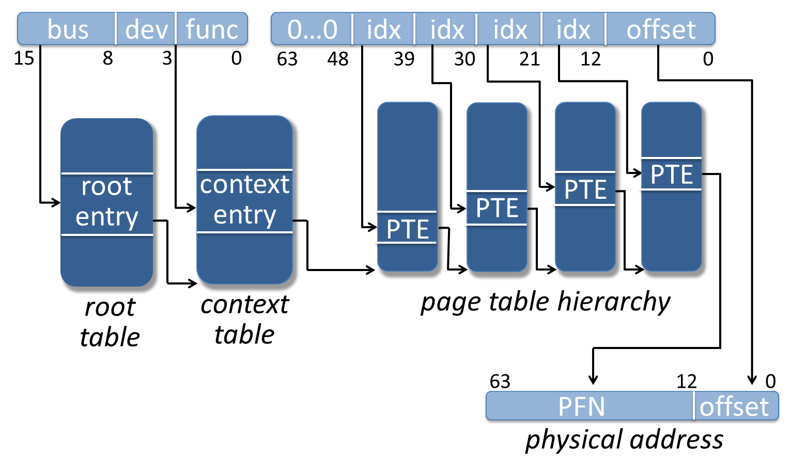
PCIe HW/SW interface: Device-to-Host

Slide 33
PCIe support for device virtualization HW/SW co-design example
A device can be mapped to a VM/container/app using the IOMMU
But the number of devices is limited
Can we dynamically allocate new virtual devices?
PCIe Single-root IO Virtualization (SR-IOV)
Every device has a physical function 0
SR-IOV lets host dynamically create/destroy virtual functions
Using Hypervisor-controlled physical function 0
Each virtual function has its own BARs that can be mapped to VM/container/app
Device designer defines how to multiplex requests from all its functions

Slide 34
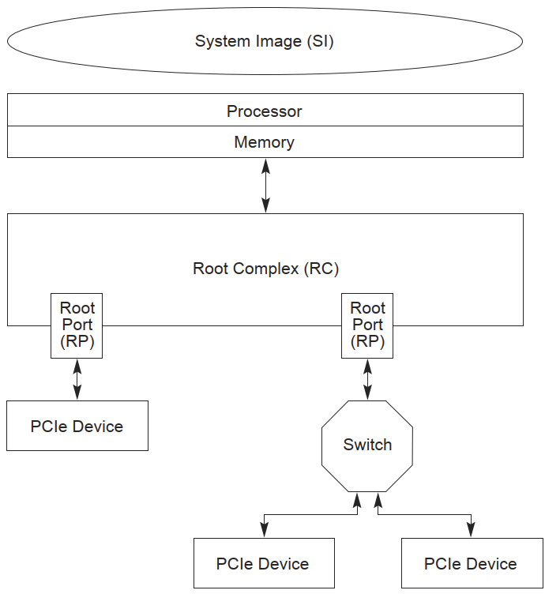
Native system

Slide 35
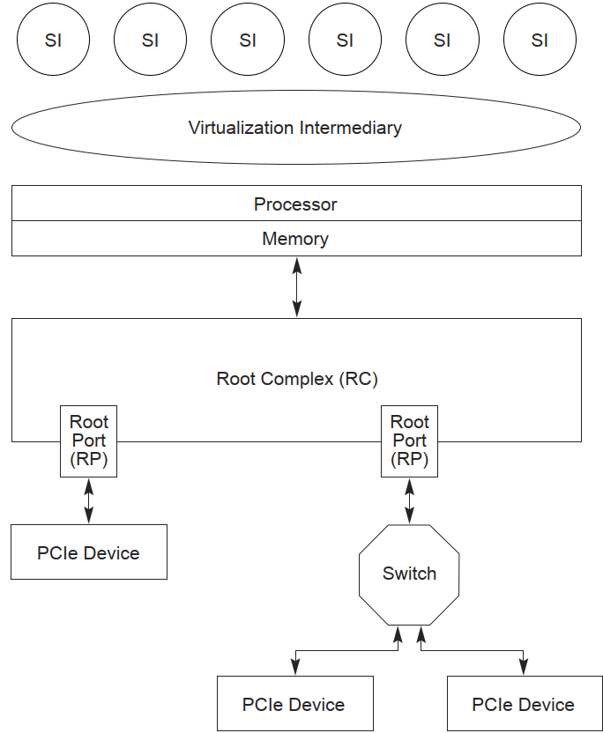
=VMs
SW virtualization (no SR-IOV)
=hypervisor

Slide 36
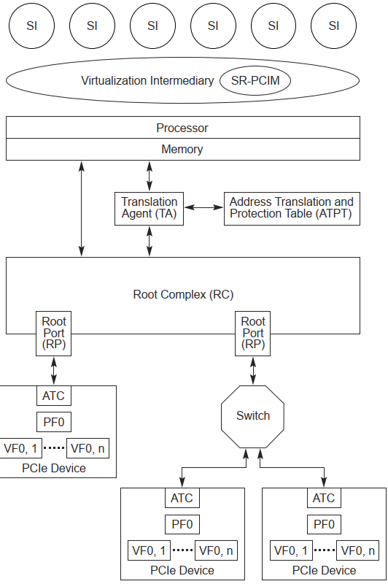
=VMs
HW virtualization (SR-IOV)
=hypervisor
SR-PCIM: SW that controls SR-IOV
(single-root PCI manager)
Translation agent: Address translation logic in IOMMU
ATPT: IOMMU page table
ATC: Address translation cache
(more on that soon)
Chip boundary

Slide 37
HW/SW co-design challenges in PCIe
PCIe is a central component in modern systems
As such, it poses many improvement opportunities
E.g., performance bottlenecks, security challenges, scaling challenges
Let’s examine some of the challenges in the virtualization domain

Slide 38
IOMMU throughput: The challenge
All traffic to the host goes through the IOMMU
IOMMU translation throughput can become a bottleneck
800gbs Ethernet NIC = 100GB/s
1500B frames: 66,666,667 translations/sec
64B frames: 1,562,500,000 translations/sec

Slide 39
IOMMU throughput
Hot research topic
Malka et al., “rIOMMU: Efficient IOMMU for I/O devices that employ ring buffers”. In ASPLOS 2015
Idea: Refactor IOMMU to use lists of buffers instead of page tables
Pros: Access pattern matches NIC traffic
Cons: GPUs exhibit different traffic patterns (not just ring buffers)
Real world (PCIe specification):
Multiple IOMMUs per chip/root complex
Increase IOTLB as much as possible
Distribute IOTLB by pushing caches to devices

Slide 40
=VMs
HW virtualization (SR-IOV)
=hypervisor
SR-PCIM: SW that controls SR-IOV
(single-root PCI manager)
Translation agent: Address translation logic in IOMMU
ATPT: IOMMU page table
ATC: Address translation cache
(now’s the time!)
- Aka DeviceTLB

Slide 41
IOMMU throughput: Distributed caching
Base idea: Devices know which buffers they are going to access
Let devices cache translations internally
IOMMU offers address translation service (ATS)
Devices can ask IOMMU for VA->PA translation when needed
Store translation in the devices address translation cache (ATC)
Send requests to host using phys. addresses
Pros:
Requests with phys. addresses do not require translation
Reduces load from IOMMU translation logic
Cons: Well…

Slide 42
Malicious devices: The challenge
Allowing devices to use PAs creates a security vulnerability
Can we trust a device to only access PA returned by PCIe’s ATS?
Vulnerability demonstrated using Thunderbolt devices
Markettos et al. “Thunderclap: Exploring vulnerabilities in operating system IOMMU protection via DMA from untrustworthy peripherals”. In NDSS 2019
Idea: Thunderbolt tunnels PCIe packets over USB-C
Attack: Implement a malicious NIC that uses ATS on a Thunderbolt FPGA card
Mitigation: Block ATS for USB controllers (at performance cost)

Slide 43
Malicious devices: Defenses?
Open research area
Alam et al., "CryptoMMU: Enabling Scalable and Secure Access Control of Third-Party Accelerators”. In MICRO 2023
Idea: Cryptographically sign ATS translation; allows only signed translations through IOMMU
Pros: simple hardware; nice solution
Cons: Not fully compatible with existing devices
More ideas are welcome

Slide 44
PCIe: Summary
PCIe is a crucial component in modern system
New CXL standard builds on PCIe
Built to serve devices inside a single server
Several companies that tried to scale it beyond the server failed
High-performance interconnect that binds all devices together
Very effective, but presents many challenges, e.g.,
Performance, esp. IOMMU
Secure system from malicious/buggy devices
And we haven’t even discussed device-to-device communications

