Slide 1
The Shift to Serverless / FaaS
Yoav Etsion

Slide 2
Disaggregating software services
We’re used to think of large software services are monoliths
E.g., web servers, E-commerce, Banking
But services are composed of a variety of individual logic elements
E.g., HTTP server, database, storage services
SW is easier to manage when it’s disaggregated into small components

Slide 3
Disaggregating software services
Cloud providers started with renting hardware, but now provide SaaS
E.g., database-as-a-service, HTTP server-as-a-service, storage-as-a-service
The large variety of available SaaS breaks down traditional SW server
Cloud customers can focus on business logic and integration
Business logic and integration require stateless functions, not servers
This new structure challenges existing HW/SW co-design paradigms

Slide 4
What is FaaS?

Slide 5
Before the cloud, there was the monolith server (on-prem)
Consider a web serving company:
Business logic is in web server
IT is responsible to maintain host
Services
OS
HW
Update SW against vulnerabilities
If business scales, need to buy more machines
More real estate, cooling, power
Host
NFS/File server
Web server (+PHP, JS, CSS)
Request
Database
OS
Hardware

Slide 6
In early cloud, we used virtual monolith servers (IaaS)
Cloud initially rented hardware
Monoliths moved as-is
Server consolidation
Customers could scale their business by renting more hardware
No need to buy hardware
Someone else manages real estate, cooling, power
Host
Guest Machine
NFS/File server
Web server
(+PHP, JS, CSS)
Request
Database
Guest OS
Virtual Hardware

Slide 7
The rise of SaaS
Cloud providers saw that many customers use similar services
E.g., storage, databases
Offering SaaS has added benefits:
Better utilization
Better scaling
Globally consistent databases
Reduced operating costs
Additional revenue sources
But customers still need to maintain entire VMs
Host
Guest Machine
Database SaaS
Web server
(+PHP, JS, CSS)
Request
NFS/File Server SaaS
Guest OS
Virtual Hardware

Slide 8
The rise of FaaS/microservices
The next logical step was to let customers just run their code
No need to maintain a VM
AKA: Function-as-a-Service
Customers can build large services by integrating SaaS with own logic
Request
HTTP server SaaS
Read html from DB
Database SaaS
User functions
Read images from storage
NFS/File Server SaaS

Slide 9
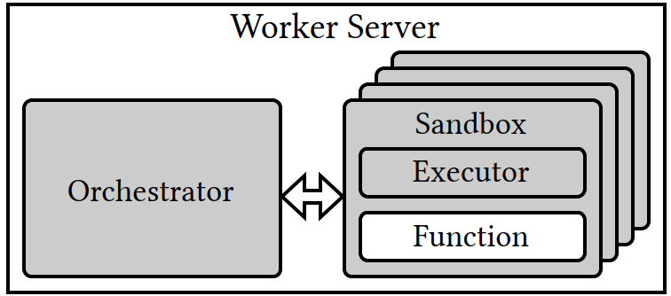
FaaS invocation
Orchestrator may run on a different machine; manages many cores
Each invocation must be isolated and run in a separate VM/sandbox
Major source of overhead
Prompts new avenues of HW/SW co-design

Slide 10
Programming FaaS
Trigger
Programmer provides function and a trigger event
Function is invoked when event happens
Functions typically stateless; state is stored in DB
Providers offer variety of potential triggers
E.g., HTTP request, stored object, data item streamed
Functions can be coded in a variety of languages
Programmers do not need to manage scale*
Request
HTTP server SaaS
Read html from DB
Invocation

Slide 11
How do functions trigger one another?
Functions trigger one another over network
E.g., RPC, REST API
Need to got through FaaS orchestrator
Arguments are packed (marshalled) and sent to orchestrator
Orchestrator unpacks (demarshals) data and schedules function
Remote calls are a major source of overhead
Prompted extensive research on offloading RPC management (mostly to SmartNIC)
Read html from DB
Database SaaS
User functions
Read images from storage
NFS/File Server SaaS

Slide 12
Key benefits of FaaS/microservices
Benefits for customers:
Focus on business logic (functions) and service integration
Customers do not deal with OS
Customers do not need to upgrade SW
Functions provide modularity
Customers can upgrade/improve specific functions
Billed only for own run time and memory usage, not for OS services
Request
HTTP server SaaS
Read html from DB
Database SaaS
User functions
Read images from storage
NFS/File Server SaaS

Slide 13
Key benefits of FaaS/microservices
Benefits for cloud providers:
Machines run homogeneous workloads
FaaS infrastructure optimized for hardware
Disaggregating facilitates scaling
Unified software infrastructure
Build their SaaS on top of FaaS infra.
Ultimately, FaaS lowers operational costs
Request
HTTP server SaaS
Read html from DB
Database SaaS
User functions
Read images from storage
NFS/File Server SaaS

Slide 14
Broad availability
Public cloud
AWS Lambda
Azure Functions
GCP Cloud Run functions
Billed for run time and memory used
E.g. sum of X*CPU milliseconds + Y*GB/s
Open-source systems available for self-managed data centers
E.g., OpenWhisk, OpenFaaS, Oracle FN

Slide 15
End-to-End FaaS-based services

Slide 16
Open benchmark suite: DeathStar
The DeathStar Benhmark suite is a collection of open-source end-to-end microservices that mimic real world services
E.g., Social network, E-commerce, Media serving, Banking
A great work that presents the benchmark and analyzes how the architecture impacts system design
Y. Gan et al., "An Open-Source Benchmark Suite for Microservices and Their Hardware-Software Implications for Cloud and Edge Systems“. In ASPLOS 2019.

Slide 17
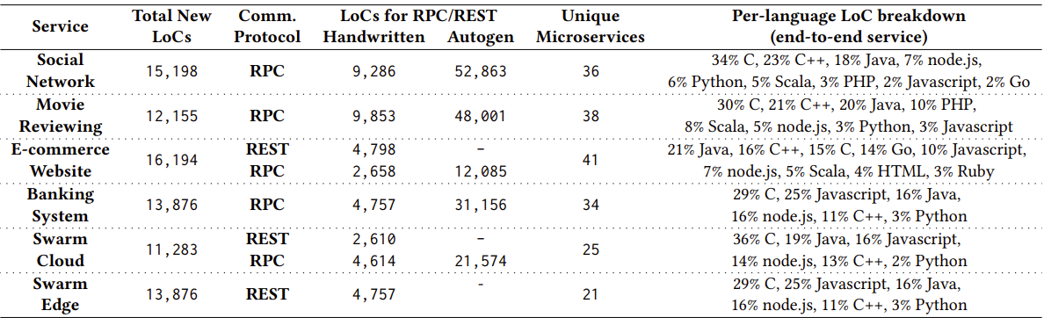
DeathStar benchmarks

Slide 18
DeathStar benchmarks: Decomposition

Slide 19
DeathStar benchmarks: Heterogeneity

Slide 20
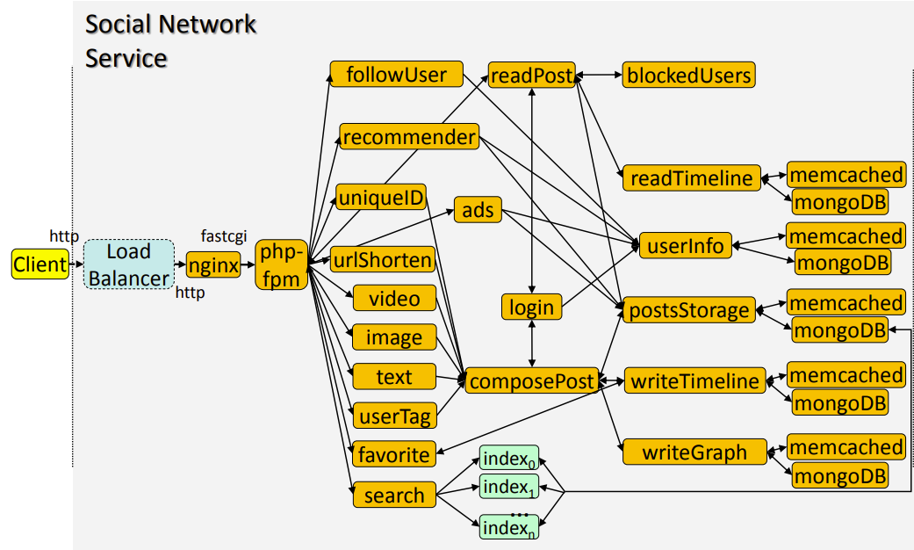
Example: Social network benchmark
E.g., X, FB, Instagram

Slide 21
Example: Social network benchmark
E.g., X, FB, Instagram
Frontend gets client requests

Slide 22
Example: Social network benchmark
E.g., X, FB, Instagram
Frontend gets client requests; calls service
Backend maintains state

Slide 23
Example: Social network benchmark
E.g., X, FB, Instagram
Frontend gets client requests; calls service
Backend maintains state
Processing done in stateless FaaS

Slide 24
Example: Social network benchmark
Read posts
Go to main service
Authenticate user
Checked if blocked
Get list of posts from storage
Get posts from storage
Each call is networked (e.g., RPC, REST API)

Slide 25
Example: Social network benchmark
Upload video
Go to main service
Compose post
Authenticate user
Store post
Write to timeline
Update graph

Slide 26
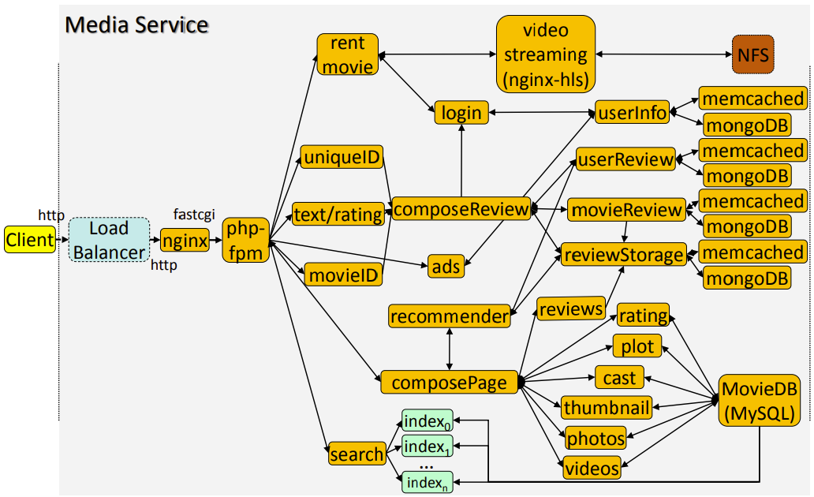
Example: Media Service
E.g, Netflix, AppleTV
Same frontend and backend
Different FaaS flows

Slide 27
Example: Media Service
Rent a movie
Go to main service
Authenticate user
Start streaming
Send file a chunks, few MBs at a time

Slide 28
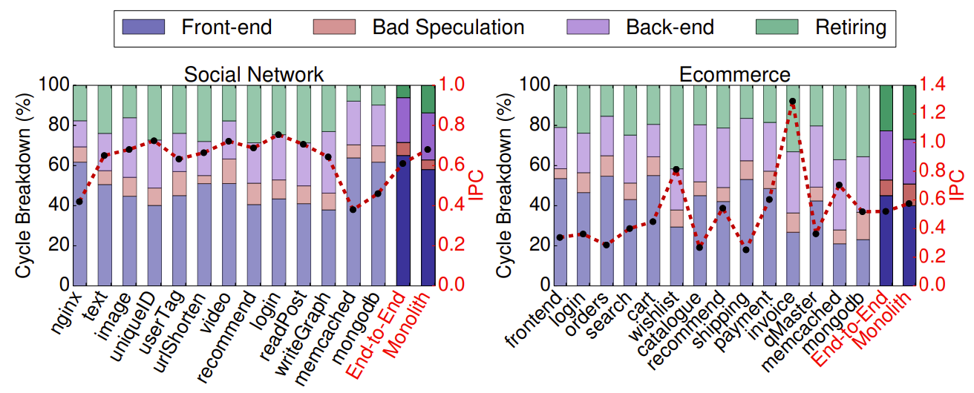
Implications on system design: Limited IPC

Slide 29
Implications on system design: Limited IPC
IPC is fairly low!

Slide 30
Implications on system design: Limited IPC
Pipeline stalled on instruction fetch

Slide 31
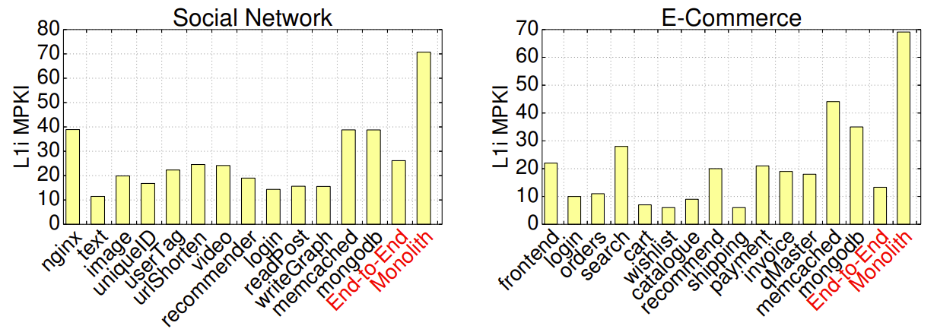
Implications on system design: Instruction cache

Slide 32
Implications on system design: Instruction cache
Inst. Cache misses

Slide 33
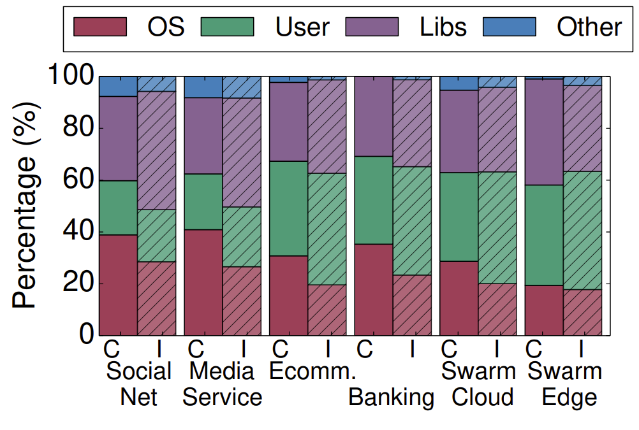
Implications on system design: The cost of RPC/REST API
Reminder:
Inter-service calls are not regular function calls
Calls must go through OS TCP stack
Syscalls + network incur major overheads
FaaS scalability comes at a cost!
C=Cycles I=Instructions

Slide 34
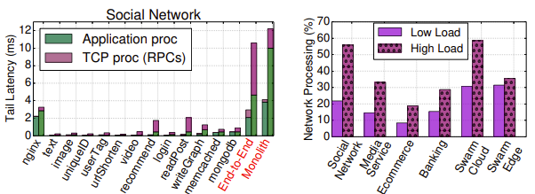
Implications on system design: The cost of RPC/REST API
Reminder:
Inter-service calls are not regular function calls
Calls must go through OS TCP stack
Syscalls + network incur major overheads
FaaS scalability comes at a cost!

Slide 35
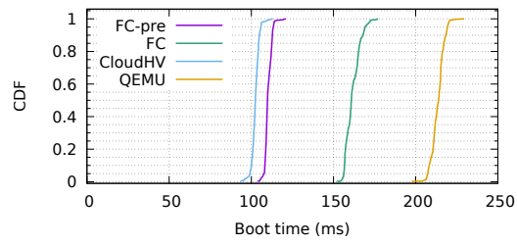
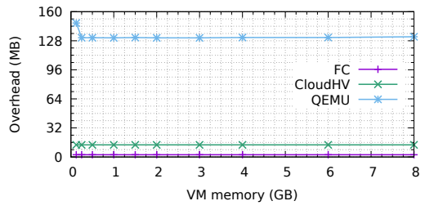
Additional overheads: FaaS invocation
Each FaaS invocation must be isolated from other tenants
But invoking a full VM for each function is costly (time + memory)
AWS Firecracker is a dedicated hypervisor for FaaS
Agache et al., “Firecracker: Lightweight Virtualization for Serverless Applications”. In NSDI 2020

Slide 36
Additional overheads: FaaS invocation
Each FaaS invocation must be isolated from other tenants
But invoking a full VM for each function is costly (time + memory)
AWS Firecracker is a dedicated hypervisor for FaaS
Agache et al., “Firecracker: Lightweight Virtualization for Serverless Applications”. In NSDI 2020
FC-pre=pre-configured FC (warm)
CloudHV=Intel Cloud Hypervisor (resembles FC)
QEMU=full blown KVM machine

Slide 37
Additional overheads: FaaS invocation
Each FaaS invocation must be isolated from other tenants
But invoking a full VM for each function is costly (time + memory)
AWS Firecracker is a dedicated hypervisor for FaaS
Agache et al., “Firecracker: Lightweight Virtualization for Serverless Applications”. In NSDI 2020
FC-pre=pre-configured FC (warm)
CloudHV=Intel Cloud Hypervisor (resembles FC)
QEMU=full blown KVM machine

Slide 38
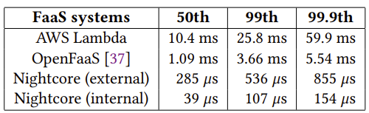
Additional overheads: FaaS invocation
Do we really need a full VM? Why not do it in user space?
The Nightcore project build a lightweight FaaS hypervisor
Function “boot time” is done at user-level
Functions invoke others using shared memory and UNIX domain sockets
Got the overheads down from milliseconds to microseconds
Jia & Witchell, “Nightcore: Efficient and Scalable Serverless Computing for Latency-Sensitive, Interactive Microservices”. In ASPLOS 2021

Slide 39
Software can only go so far: Hardware view
Software isolation is based on virtual memory address spaces
Each application is isolated in its own address space
Today’s mechanisms are based on 1980s apps
Monolithic
Individual users
Long-running
High overheads when crossing address spaces were acceptable
10s of milliseconds

Slide 40
Software can only go so far: FaaS view
FaaS functions are short-lived, targeting 10s of microseconds
Short-lived functions are easier to scale
Firecracker and Nightcore show that isolation is a major overhead
Initialize an address space
Cross an address space to call kernel networking code
Orchestrator has its own address space
What if we can map an entire FaaS into a single address space?

Slide 41
Jord: Rethinking address-space isolation
Principles:
Map orchestrator and functions into a single address space
Provide lightweight protection domains within an address space
Function invocations become simple function calls
More details in Li et al., “Single-Address-Space FaaS with Jord”. In ISCA 2025
Function A (code + data)
Orchestrator (code + data)
Function B (code + data)
HW checks permissions

Slide 42
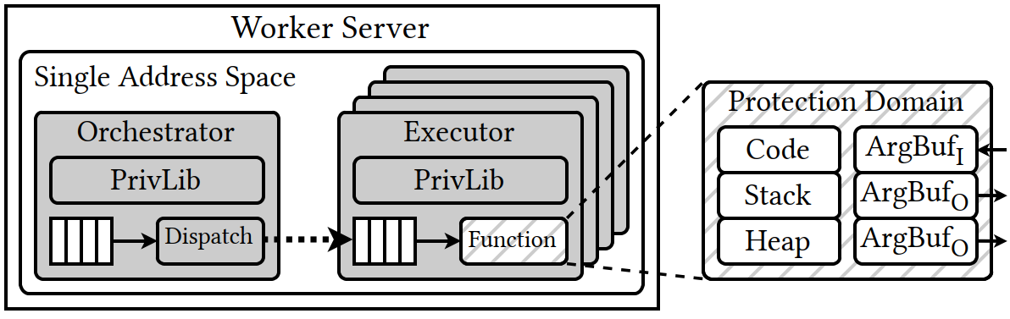
Jord: Rethinking address-space isolation
Each entity (functions, orchestrator) is a protection domain
OS maintains address ranges each protection domain can access
HW verifies protection on each call
Protected user-level library (PrivLib) creates domains in 10s of nsecs

Slide 43
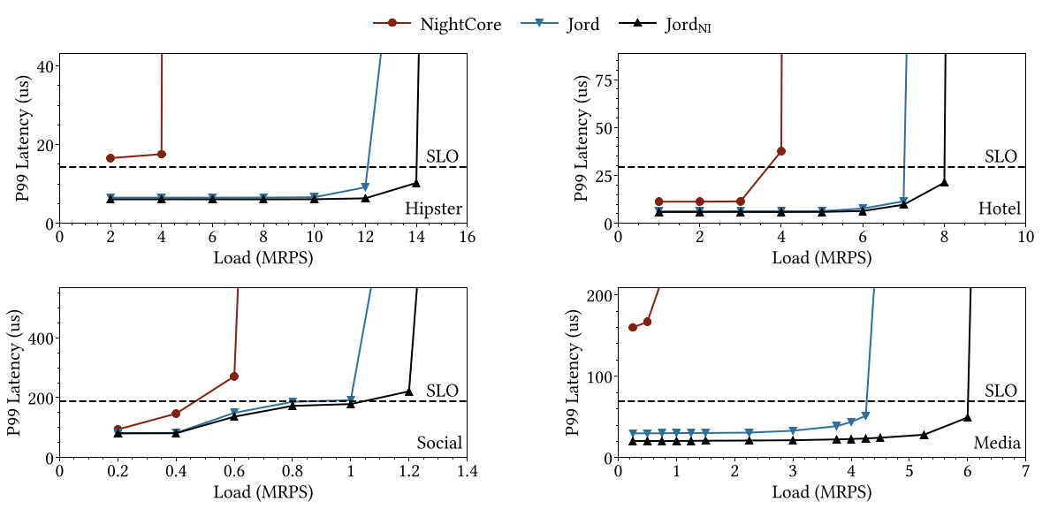
Jord Performance improvement
NI=No Isolation

Slide 44
Summary
FaaS / Serverless have emerged ~5 years ago
FaaS workloads challenge decades old HW/SW co-design
Requires system designers to think at much large scale
Many research avenues:
New communication primitives
New isolation primitives
Reducing invocation overheads
Exciting times; more and more services are moving to FaaS

Slide 45
Thank you ☺
Questions?

