Slide 1
Profiling & Accelerating Python Benchmarks
pyflate and nbody: from perf profiles to software fixes to hardware accelerator proposals
Chris Shakkour · Razan Jiryis
Course 00460882 · 06.10.2026
Notes:
Hi everyone. In this project we took two benchmarks from the pyperformance suite, pyflate and nbody, and asked the same questions about each one: where does the time actually go, why does it go there, how much can we win back in software, and what would dedicated hardware for the hot loop look like. Both parts of the talk follow the same six steps: what the benchmark does, profiling with perf, the bottlenecks we found, the optimization, the measured results, and finally a hardware accelerator proposal. We start with pyflate, where software alone gives a huge win, and then nbody, where the software story is much harder, which is exactly why the hardware proposal matters more there.

Slide 2
PART A
pyflate
A pure-Python bzip2 decompressor
Part A · pyflate
2
Notes:
Part A: pyflate. The name suggests gzip, but as we'll see, the file it actually decompresses is bzip2, so everything in this part is about the bzip2 decode path. The one thing to keep in mind for the next few slides is that the whole decompressor is written in plain Python, down to reading one bit at a time.

Slide 3
What pyflate does
pyperformance benchmark: a stand-alone, pure-Python bzip2 / gzip decoder (Paul Sladen, 2006)
Input: interpreter.tar.bz2, a snapshot of the CPython source tree
Output is verified with an MD5 checksum on every run
No compression library at all: every bit is decoded by Python code
Baseline
3.17 s
± 0.02 s per run (pyperf)
Decode pipeline, once per bzip2 block (bzip2_main)
Bit reader
byte by byte
Huffman decode
per symbol
Move-to-front
per symbol
Inverse BWT
per block
RLE decode
per output byte
MD5 check
once per run
Red = stages that run once per symbol or per byte, which the profile later points to
Part A · pyflate
3
Notes:
pyflate is a pure-Python decompressor. The benchmark decompresses a real bzip2 file, a tarball of the CPython source, and checks the result against a known MD5, so we know any optimization still produces byte-identical output. The important point is that there's no compression library involved at all. Every stage you see at the bottom is Python code: a bit reader that pulls one byte at a time from the file, Huffman decoding, move-to-front, the inverse Burrows-Wheeler transform and a final run-length decode. I've marked in red the stages that run once per symbol or per output byte. Those run millions of times, so they're our suspects before we even open the profiler. One run takes about 3.17 seconds. Let's see what perf says.

Slide 4
Profiling: hardware counters (perf stat)
Counter | Value | What it tells us
Instructions | 1,433,334,987,236 | ~1.4 trillion over the whole pyperf run
Cycles | 659,081,747,854 | the CPU is busy the whole time
IPC | 2.17 insn / cycle | high: the core is rarely stalled
Cache-miss rate | 7.0 % | highest of our two benchmarks
Branch-miss rate | 0.43 % | the interpreter loop predicts well
commands (run inside the VM)
Why cpu-clock?
perf stat -e cycles,instructions,cache-references,cache-misses,\
branch-instructions,branch-misses,bus-cycles,ref-cycles \
-- python3-dbg run_benchmark.py
perf record -F 999 -g -e cpu-clock -- python3-dbg run_benchmark.py
The VM's virtual PMU never raises sampling interrupts, so perf record on cycles gets 0 samples
Part A · pyflate
4
Notes:
First we measured the whole benchmark with perf stat, which just counts hardware events. The full pyperf run, with all its repetitions, executes about 1.4 trillion instructions. The IPC of 2.17 tells us the core is busy and not waiting on memory most of the time: the problem is that there's simply a huge amount of work. The cache-miss rate of 7 percent is the highest of our two benchmarks, and that's a hint we'll come back to, because it points to lots of small objects being allocated all over memory. At the bottom are the exact commands. One practical detail: for the sampling profile we used the cpu-clock software event instead of cycles. In our VM the virtual PMU never delivers the sampling interrupt, so a cycles-based perf record silently collects zero samples. perf stat reads the counters directly, so it works fine.

Slide 5
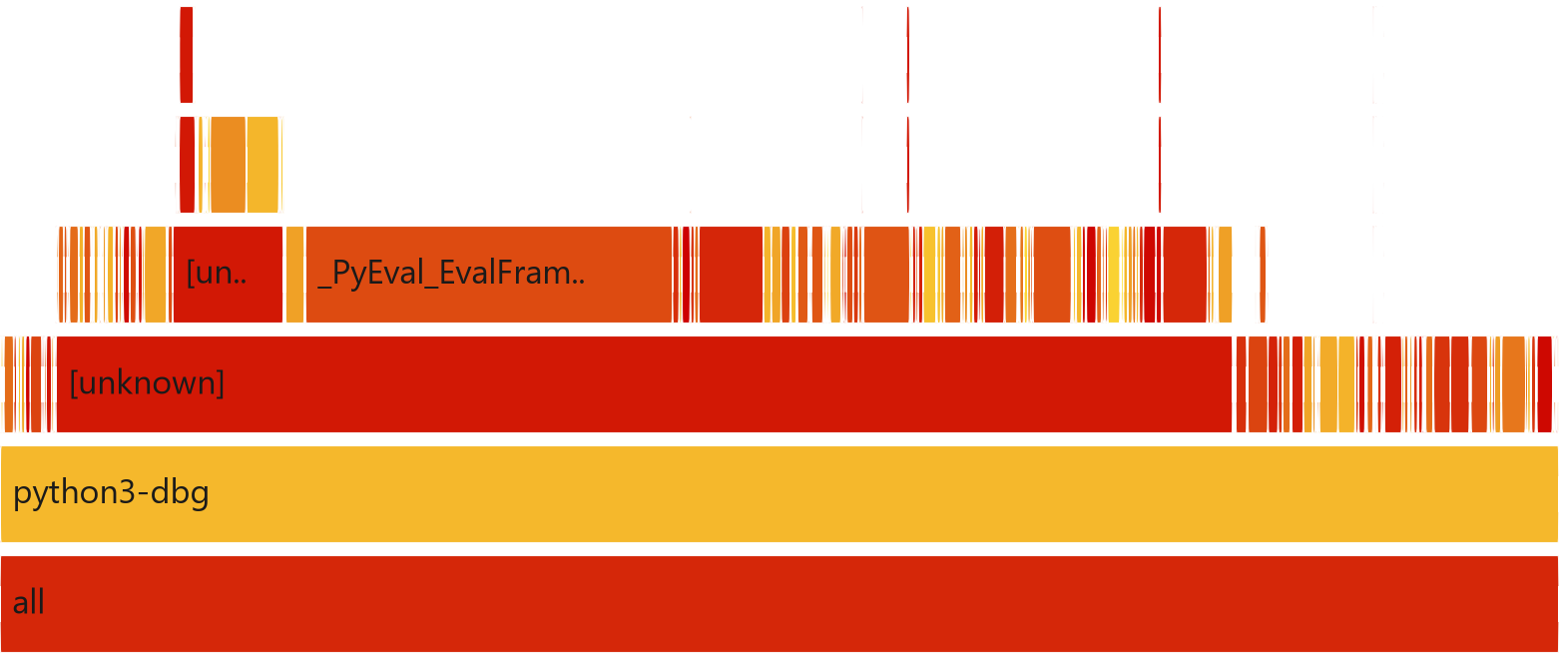
Profiling: flame graph of the original run
Widest self-time frames
23.5 % | _PyEval_EvalFrameDefault
4.1 % | _PyMem_DebugCheckAddress
3.0 % | __memset_avx2_unaligned
2.9 % | read_size_t
2.5 % | list_dealloc
2.3 % | call_function
2.1 % | list_ass_slice
1.5 % | lookdict_unicode_nodummy
Bottom 6 stack levels of original/flamegraph_original.svg. Width = share of CPU samples; the call stack grows upward from the root.
Part A · pyflate
5
Notes:
This is the flame graph, cropped to the bottom levels where the wide frames are. How to read it: the x-axis is the share of CPU samples, not time order, and the stack grows upward from the root at the bottom. The biggest single frame is the interpreter's main loop, _PyEval_EvalFrameDefault, at about 23 percent. That's the cost of running Python bytecode at all. What's more interesting is the rest: the right-hand panel lists the widest leaf frames, and most of them are memory functions: the debug allocator's address checks, memset, list_dealloc and list_ass_slice. There are also call_function and dictionary lookups, which are the cost of calling small Python functions and reading object attributes. The graph looks like a wide forest of thin towers, which means many small, separate costs rather than one obvious hot function.

Slide 6
Bottlenecks: where the self-time goes
Self % | Symbol | Category
22.40 | _PyEval_EvalFrameDefault | Interpreter
4.06 | _PyMem_DebugCheckAddress | Memory / allocator
2.81 | read_size_t | Memory / allocator
2.74 | __memset_avx2_unaligned_erms | Memory / allocator
2.46 | call_function | Algorithmic
2.32 | list_dealloc | Memory / allocator
1.92 | list_ass_slice | Memory / allocator
1.41 | lookdict_unicode_nodummy | Algorithmic
Memory: > 15 %
allocator, memset, list free and slice copy together
Algorithmic
one Python call and several attribute lookups per step of a search
perf report --stdio --no-children -g none (self time only)
Part A · pyflate
6
Notes:
To rank the hotspots properly, we used perf report with no-children, which gives self time: the time spent in a function's own code, not in what it calls. I've grouped the top entries into three categories. Navy is the interpreter itself. Red is memory management: allocating, clearing, copying and freeing objects. Added up, the memory entries are more than 15 percent of the whole run. Amber is algorithmic overhead: call_function and lookdict are the price of calling a tiny Python function and looking up attributes like x.bits and x.code, over and over. Note that the allocator numbers are inflated a bit because we profile the debug build of Python, python3-dbg, which adds checks to every allocation. But the question is still: which lines of code produce all these allocations and calls? That's the next slide.

Slide 7
Bottlenecks: the code behind the hotspots
run_benchmark.py · HuffmanTable.find_next_symbol · lines 224-235
linear scan, runs once per decoded symbol
def find_next_symbol(self, field, reversed=True):
cached_length = -1
cached = None
for x in self.table:
if cached_length != x.bits:
cached = field.snoopbits(x.bits)
cached_length = x.bits
if (reversed and x.reverse_symbol == cached) or (not reversed and x.symbol == cached):
field.readbits(x.bits)
return x.code
raise Exception("unfound symbol, even after end of table @%r"
% field.tell())
run_benchmark.py · RLE decode · lines 448-455
new bytes object per output byte
move_to_front · 288-289
new list per symbol
# Pointless/irritating run-length encoding step
while i < len(nearly_there):
if i < len(nearly_there) - 4 and nt[i] == nt[i + 1] == nt[i + 2] == nt[i + 3]:
out.append(nearly_there[i:i + 1] * (ord(nearly_there[i + 4:i + 5]) + 4))
i += 5
else:
out.append(nearly_there[i:i + 1])
i += 1
def move_to_front(l, c):
l[:] = l[c:c + 1] + l[0:c] + l[c + 1:]
Part A · pyflate
7
Notes:
Here are the three pieces of code behind those numbers, straight from the benchmark source. At the top is find_next_symbol, which decodes one Huffman symbol. It loops over the entire symbol table and, for each entry, compares the next bits of the stream to that entry's code. That's a linear search, and it runs for every single symbol in the file. Each iteration touches attributes like x.bits and x.reverse_symbol, which is the lookdict and call_function overhead we saw. Bottom left is the run-length decode: every output byte creates a new one-byte bytes object with a slice. Bottom right is move_to_front. That one line builds three new list slices and concatenates them into a fourth list, on every symbol, instead of moving one element in place.

Slide 8
Bottlenecks: root cause
1 · Algorithmic: O(n) Huffman search
2 · Memory: allocation churn
Every decoded symbol scans the symbol table from the start
Cost grows with table size × symbols decoded
Shows up as call_function 2.46 %, lookdict 1.41 %, PyTuple_GetItem 1.39 %, binary_op1 1.29 %
move_to_front rebuilds the list on every symbol
RLE creates one tiny bytes object per output byte
Allocator frames add up to more than 15 % of runtime
7.0 % cache misses, ~863K page-fault samples
Both costs exist only because bzip2 is re-implemented in pure Python, one object at a time.
Part A · pyflate
8
Notes:
So we have two root causes. The first is algorithmic. Real bzip2 decoders use lookup tables, so one symbol costs a constant amount of work. This one does a linear search, so the cost per symbol grows with the size of the table. The second is memory churn. Python lists and bytes are heap objects, so every slice and every concatenation allocates, copies and later frees memory. Doing that once per symbol and once per output byte is what fills the profile with allocator functions. It also explains the 7 percent cache-miss rate: we keep touching freshly allocated, scattered memory instead of a small, hot working set. The key insight is the bar at the bottom. Neither problem is part of bzip2 itself. They exist only because the decoder is written in Python, object by object.

Slide 9
Optimization: use the C bz2 module
Python's standard library already ships bz2, a thin wrapper around the compiled C library libbz2
Same algorithm, done with lookup tables and in-place buffers in C
Removes the Huffman scan, the move-to-front list churn and the per-byte RLE loop in one change
Correctness: the same MD5 check still passes, so the output is byte-identical
Before
~600 lines of Python decoder: bit reader, Huffman tables, MTF, BWT, RLE
After
one call: bz2.decompress(data), which runs inside libbz2 (C)
Part A · pyflate
9
Notes:
Since both bottlenecks come from implementing bzip2 in Python, the most effective fix is not to do that. Python's standard library already has a bz2 module, which is a thin wrapper around libbz2, the same C library everyone uses. It performs exactly the same decompression, but with table-driven Huffman decoding and in-place buffers, so it removes both bottlenecks at once. We considered fixing the two problems separately, with a dictionary-based Huffman lookup and an in-place move-to-front, and that would be a nice exercise. But the library swap is what you would actually do in real code. To prove it's still correct, the optimized version runs exactly the same MD5 check, and it passes, so the output is byte-for-byte identical.

Slide 10
Optimization: original vs. optimized code
original/run_benchmark.py · lines 632-650
pure-Python decoder
optimized/run_benchmark.py · lines 28-38
stdlib bz2 (C)
def bench_pyflake(loops, filename):
input_fp = open(filename, 'rb')
range_it = range(loops)
t0 = pyperf.perf_counter()
for _ in range_it:
input_fp.seek(0)
field = RBitfield(input_fp)
magic = field.readbits(16)
if magic == 0x1f8b: # GZip
out = gzip_main(field)
elif magic == 0x425a: # BZip2
out = bzip2_main(field)
...
dt = pyperf.perf_counter() - t0
def bench_pyflake(loops, filename):
with open(filename, 'rb') as f:
compressed = f.read()
range_it = range(loops)
t0 = pyperf.perf_counter()
for _ in range_it:
out = bz2.decompress(compressed)
dt = pyperf.perf_counter() - t0
Same timing harness and MD5 check on both sides. Only the decode call changes: bzip2_main(field) becomes bz2.decompress(compressed).
Part A · pyflate
10
Notes:
Here's the change side by side. On the left is the original benchmark loop: for each iteration it wraps the open file in a bit reader, reads the 16-bit magic number to decide between gzip and bzip2, and calls bzip2_main, which is the entry into the six hundred lines of Python decoder. On the right is the optimized version: read the compressed file into memory once, and each iteration makes a single call to bz2.decompress. The timing harness around it is identical, and after the loop both versions compute the same MD5 and raise an error if it doesn't match. One fair question is whether reading the file up front is cheating. It isn't really: the original also reads the whole file on every loop, just one byte at a time, so the I/O cost is tiny in both cases.

Slide 11
Results: ~244× faster
Mean ± std dev (pyperf)
Counter | Original | Optimized | Change
Instructions | 1.43 T | 41.7 G | 34.4× fewer
Cycles | 659 G | 33.0 G | 20.0× fewer
IPC | 2.17 | 1.26 | lower
Cache-miss rate | 7.0 % | 1.72 % | 4.1× better
Branch-miss rate | 0.43 % | 3.19 % | higher
3.17 s
original, ± 0.02 s
13.0 ms
optimized, ± 0.3 ms
Why did IPC go down and branch misses go up?
58.7 % of the new run is libbz2's bit-level decode, which is harder to predict than the repetitive bytecode loop. What matters is 34× fewer instructions for the same work.
Part A · pyflate
11
Notes:
The result: one run went from 3.17 seconds to 13 milliseconds, about 244 times faster. The assignment target was 7 percent, so this is far past it. The counters explain why: the same job now needs 34 times fewer instructions and 20 times fewer cycles, and the cache-miss rate dropped from 7 percent to under 2, because we stopped creating millions of tiny objects. The line you might ask about is IPC, which went down, and branch misses, which went up. That sounds like a regression, but it isn't. Most of the new run is spent in libbz2's tight bit-manipulation code, whose branches depend on the data and are genuinely hard to predict. The old interpreter loop looked great to the branch predictor because it repeated the same pattern, but it was doing 34 times more work. So total instructions is the metric that matters here.

Slide 12
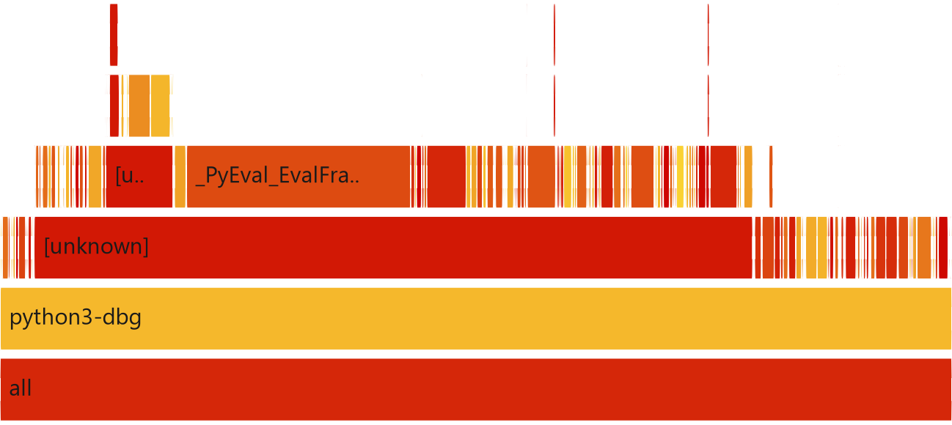
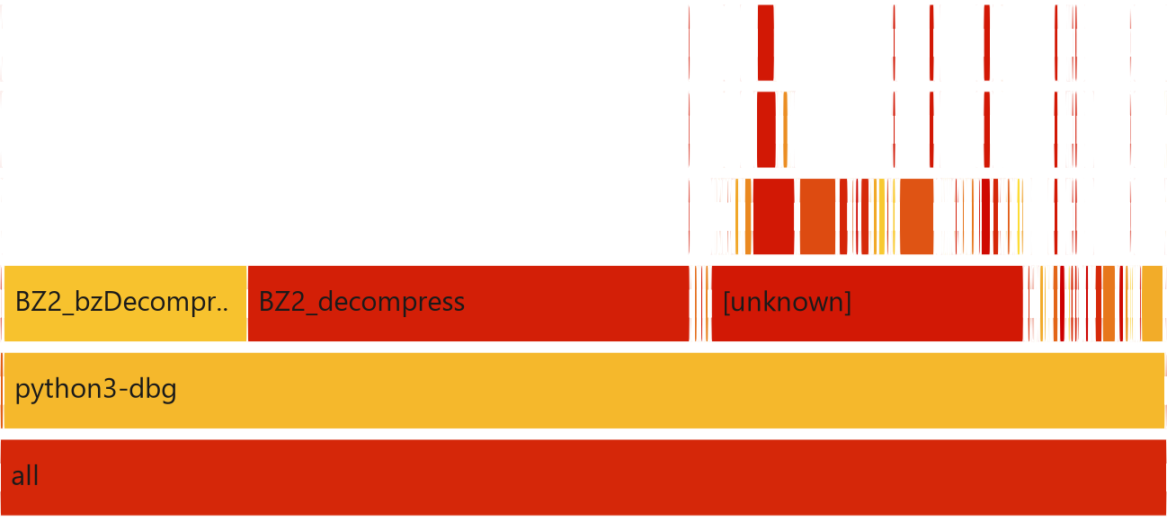
Results: flame graphs before and after
Before: a wide forest of thin Python towers
After: two C plateaus in libbz2
23.5 % _PyEval_EvalFrameDefault
4.1 % _PyMem_DebugCheckAddress
2.5 % list_dealloc · 2.1 % list_ass_slice
37.9 % BZ2_decompress
20.9 % BZ2_bzDecompress
3.1 % _PyEval_EvalFrameDefault (thin wrapper)
Compare shape and percentages, not raw sample counts: the optimized run is ~244× shorter.
Part A · pyflate
12
Notes:
The flame graphs confirm the change visually. On the left is the original: lots of narrow, differently coloured towers across the whole width, each one a small Python-level cost like list_dealloc or list_ass_slice. On the right is the optimized run: almost everything collapses into two wide, flat plateaus, BZ2_decompress and BZ2_bzDecompress, together about 59 percent. That's one compiled C function doing sustained work instead of thousands of short Python calls. The interpreter loop is still there, but it's down to 3 percent, which is just the thin wrapper around the call. One caution when comparing these: the sample counts are very different because the second run is so much shorter, so compare the shape and percentages, not the raw widths in samples.

Slide 13
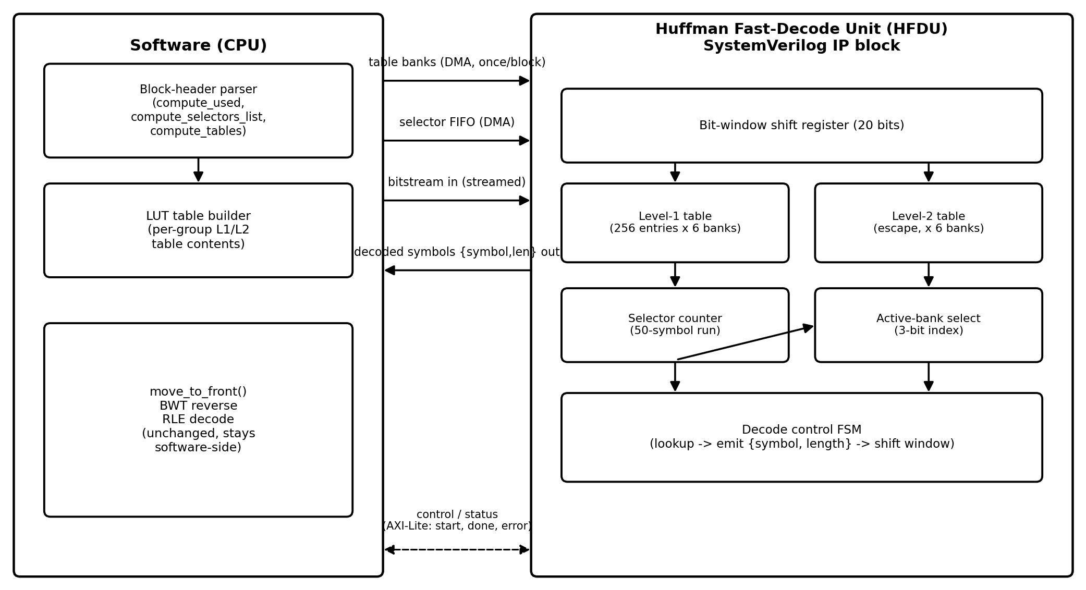
Hardware proposal: Huffman Fast-Decode Unit (HFDU)
1 cycle
per symbol on a level-1 table hit
6 banks
one per Huffman group
200-400 MHz
FPGA target · hardware/hfdu.sv
Part A · pyflate
13
Notes:
For the hardware proposal we targeted the algorithmic bottleneck, the Huffman symbol search, because that's the part that maps naturally onto hardware. We call it the Huffman Fast-Decode Unit, written in SystemVerilog. On the left, software still parses each block header, but instead of building Python objects it builds lookup tables and sends them to the accelerator by DMA, together with the bitstream. Inside the unit, a 20-bit shift register holds the next bits of the stream. The top 8 bits index a 256-entry level-1 table, which directly returns the symbol and its code length in a single cycle for most symbols. Longer codes fall through to a small level-2 table. There are six banks because bzip2 switches between up to six Huffman tables every 50 symbols, so the selector just changes the bank index with no reload stall.

Slide 14
Hardware proposal: benefit and trade-offs
Performance
Area
Decode goes from an O(n) scan to ~1 cycle per symbol
Removes ~6-7 % of self-time in call / lookup overhead, plus the scan itself
6 × (256-entry L1 + small L2) SRAM
A few KB in total: cheap in FPGA BRAM or ASIC SRAM
Power
Trade-off we made
One table read and compare per symbol
No fetch, decode or dispatch overhead as on a CPU
Keep all 6 banks loaded: more SRAM, zero switch stalls
New bottleneck: MTF, BWT and RLE stay in software
Part A · pyflate
14
Notes:
What does it buy us? In performance, symbol decoding goes from a linear scan to about one cycle per symbol, independent of the table size. In the profile, the call and lookup overhead of the scan alone was 6 to 7 percent, and the scan's own comparisons come on top of that. Area is modest: six small SRAM tables add up to a few kilobytes. Power is low because each symbol costs one table read and one compare, without any of a CPU's instruction fetch and decode overhead. The main design decision was keeping all six table banks loaded at once. It costs a bit more SRAM, but a design with one reloadable bank would stall on every table switch, which happens every 50 symbols. Honestly, once Huffman decoding is fast, the software stages become the new bottleneck. That is the natural next step, and the same approach is used in real hardware decompression engines like Intel QAT. That's pyflate. Now let's move to nbody.

Slide 15
PART B
nbody
A 5-body gravitational simulation in pure Python
Part B · nbody
15
Notes:
Part B: nbody. Here the situation is the opposite of pyflate. The algorithm is already the right one and there's no library we can swap in, so the question becomes how much we can win inside Python itself, and what that tells us about where hardware helps.

Slide 16
What nbody does
From the Computer Language Benchmarks Game: the Sun, Jupiter, Saturn, Uranus and Neptune under mutual gravity
Plain Python lists and floats; no numpy
Each loop: report_energy() → advance(0.01, 20000) → report_energy()
20,000 timesteps × 10 body pairs = 200,000 pair updates per loop
Baseline
483 ms
± 4 ms per loop (pyperf)
One timestep of advance(), repeated 20,000 times per loop
10 pairs
dx, dy, dz
Distance²
r² = dx²+dy²+dz²
Force factor
mag = dt · r^-1.5
Update velocities
6 list writes
5 bodies
pos += dt · vel
Red = the power operator and the list writes, which the profile later points to
Part B · nbody
16
Notes:
nbody simulates the Sun and the four gas giants attracting each other. It uses nothing but Python lists and floats. Each benchmark loop computes the system's energy, advances the simulation 20,000 timesteps, and computes the energy again. With five bodies there are ten pairs, so one loop does 200,000 pairwise force updates. At the bottom is one timestep. For every pair, compute the distance vector, its squared length, a force factor using a power of minus 1.5, and then update both bodies' velocities. Then move every body by its velocity. The math per pair is about two dozen floating-point operations, which a CPU can do in nanoseconds. Yet one loop takes 483 milliseconds. So the question for this part is: where does all that time go if not into the math?

Slide 17
Profiling: hardware counters (perf stat)
Counter | Value | What it tells us
Instructions | 260,503,357,966 | ~260 billion over the whole pyperf run
Cycles | 107,660,144,120 | compute-bound, like pyflate
IPC | 2.42 insn / cycle | even higher than pyflate's 2.17
Cache-miss rate | 2.83 % | tiny working set: 5 bodies fit in L1
Branch-miss rate | 0.49 % | the interpreter loop predicts well
same commands as pyflate
Reading the numbers
perf stat -e cycles,instructions,cache-references,cache-misses,\
branch-instructions,branch-misses,bus-cycles,ref-cycles \
-- python3-dbg run_benchmark.py
perf record -F 999 -g -e cpu-clock -- python3-dbg run_benchmark.py
High IPC with low misses: the CPU is fast; it just has too many instructions to run
Part B · nbody
17
Notes:
Same measurement method as for pyflate. The counters look almost perfect. IPC is 2.42, even higher than pyflate, and the cache-miss rate is under 3 percent, which makes sense: the whole simulation state is five bodies, a few hundred bytes, and it sits in the L1 cache. Branch prediction is also good. So this is not a memory problem and not a branch problem. The CPU is running at full speed. It just has far too many instructions to execute for such a small amount of math. That tells us the cost is in the instructions around the arithmetic, and to find them we need the sampling profile.

Slide 18
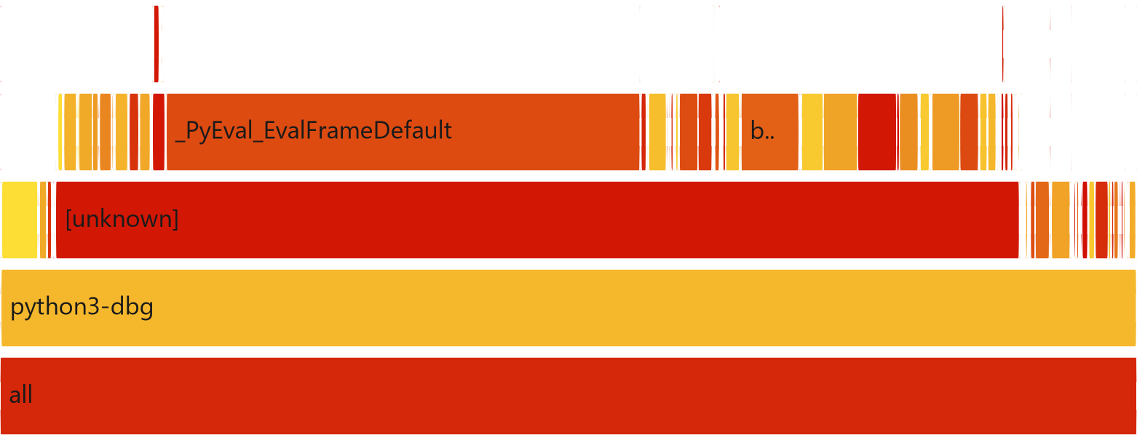
Profiling: flame graph of the original run
Widest self-time frames
41.7 % | _PyEval_EvalFrameDefault
5.3 % | binary_op1
3.6 % | PyFloat_FromDouble
3.4 % | float_mul
3.0 % | float_dealloc
2.5 % | list_ass_item
1.9 % | float_add
1.7 % | __ieee754_pow_fma
Bottom 5 stack levels of original/flamegraph_original.svg. Above them the stacks are ~129 levels of recursive interpreter frames.
Part B · nbody
18
Notes:
Here is nbody's flame graph, again cropped to the base. Unlike pyflate it's very simple at the bottom: almost everything sits under the interpreter loop, and above what you see here the stacks go up about 129 levels of nested interpreter frames. The right-hand panel shows the widest frames. The interpreter loop dominates. After it comes binary_op1, which is CPython's generic dispatcher for arithmetic operators. Then come the float functions: creating a float object, multiplying, freeing, adding. List item assignment and the pow function are there too. One detail in case you compare with the next slide: the flame graph gives the interpreter loop about 42 percent, while perf report's self-time ranking gives 29 percent. The two views count that frame differently, but the order of the hotspots is the same.

Slide 19
Bottlenecks: where the self-time goes
Self % | Symbol | Category
29.40 | _PyEval_EvalFrameDefault | Interpreter
3.37 | binary_op1 | Interpreter
2.51 | PyFloat_FromDouble | Float boxing
2.35 | float_mul | Float boxing
2.01 | float_dealloc | Float boxing
1.65 | list_ass_item | List writes
1.44 | validate_list | List writes
1.33 | float_add | Float boxing
Float boxing: ~9.3 %
create, compute and free a heap object for every float result
List writes: 4.17 %
v1[0] -= … goes through list_ass_item and debug checks
perf report --stdio --no-children -g none (self time only)
Part B · nbody
19
Notes:
With the self-time ranking we can group the costs. Navy is the interpreter: the main loop, plus binary_op1, the generic function every plus and times goes through to find out what types it's dealing with. Red is what we call float boxing. In CPython a float is not a register value, it's a heap object, so every arithmetic result allocates a new object and the old one gets freed. PyFloat_FromDouble, float_mul, float_add, float_sub and float_dealloc together are about 9.3 percent. Amber is list writes: every velocity update like v1[0] minus-equals goes through list item assignment, plus validate_list, which is a check that exists only in the debug build. That's 4.17 percent. Let's map these to the code.

Slide 20
Bottlenecks: the code behind the hotspots
original/run_benchmark.py · advance() · lines 78-97
runs 200,000× per loop
Line 85: ** (-1.5)
def advance(dt, n, bodies=SYSTEM, pairs=PAIRS):
for i in range(n):
for (([x1, y1, z1], v1, m1),
([x2, y2, z2], v2, m2)) in pairs:
dx = x1 - x2
dy = y1 - y2
dz = z1 - z2
mag = dt * ((dx * dx + dy * dy + dz * dz) ** (-1.5))
b1m = m1 * mag
b2m = m2 * mag
v1[0] -= dx * b2m
v1[1] -= dy * b2m
v1[2] -= dz * b2m
v2[0] += dx * b1m
v2[1] += dy * b1m
v2[2] += dz * b1m
for (r, [vx, vy, vz], m) in bodies:
r[0] += dt * vx
r[1] += dt * vy
r[2] += dt * vz
a pow() call per pair
Lines 82-93
~24 float operations per pair; each result is a new heap object
Lines 88-93
6 list item writes per pair
Part B · nbody
20
Notes:
This is the whole of advance(), exactly as in the benchmark. The outer loop runs 20,000 times, and the inner loop over ten pairs is where all the time goes. Line 85 is the force factor. It uses the power operator with minus 1.5, which becomes a call into the C math library's pow function. That's the __ieee754_pow_fma frame. Lines 82 to 93 are about two dozen floating-point operations per pair. In C each one would be a single instruction on a register. In CPython, each result is a new heap-allocated float object, the operator is dispatched through binary_op1, and the old value is freed. Lines 88 to 93 also write back into lists, which is the list_ass_item cost. None of this is a bad algorithm. It's the direct, correct way to write the physics.

Slide 21
Bottlenecks: root cause
1 · Float boxing and operator dispatch
2 · Interpreter work per operation
Every float result is a heap object: PyFloat_FromDouble 2.51 %, float_mul/add/sub 4.82 %, float_dealloc 2.01 %
Every operator is a generic, type-checked call: binary_op1 3.37 %
_PyEval_EvalFrameDefault 29.40 %: bytecode dispatch for each step
List writes 4.17 %, pow() 1.08 %
The algorithm is already optimal: O(pairs) per step
The arithmetic is trivial for a CPU. The cost is CPython's object model around every single operation.
Part B · nbody
21
Notes:
So the root cause here is different from pyflate. In pyflate we had a bad algorithm and object churn that came from reimplementing a library. In nbody the algorithm is already optimal, a fixed amount of work per pair per step. The problem is the execution model. Every float is boxed as a heap object, every operator goes through a generic dispatch that checks types first, and every line is several bytecodes interpreted one by one. Together that's about 46 percent of the self-time in the interpreter, boxing and list writes. The important consequence is that this cost is structural. We can't remove it by writing better Python. We can only try to pay it fewer times, and that's exactly what our optimization attempts tried to do.

Slide 22
Optimization: four attempts
Attempt | Change | Result | Verdict
1 · numpy | numpy arrays, vectorized over the 10 pairs | 848 ms | 75 % slower
2 · sqrt() | r2 ** -1.5 → dt / (r2 * sqrt(r2)) | 495 ms | 2.5 % slower
3 · flat indices | integer indices into flat tuples | 579 ms | 20 % slower
4 · unroll | unpack bodies once, write out all 10 pairs | 439 ms | 9.1 % faster
Baseline 483 ms ± 4 ms. All results are full calibrated pyperf runs.
Why the first three lost
numpy: per-call dispatch and scatter-add overhead is far larger than the math for only 5 bodies
sqrt(): the global lookup and function call cost as much as the pow() it replaced; flat indices add more subscripts than they save
Part B · nbody
22
Notes:
We tried four things, each aimed at a hotspot, and measured each one with a full pyperf run. First, numpy, the obvious answer for numeric Python. It was 75 percent slower, because with only five bodies the arrays are tiny, and numpy's per-call overhead is much larger than the arithmetic it saves. Second, replacing the power operator with sqrt, to remove the pow call. Slightly slower, because looking up and calling sqrt costs about as much as the pow it replaced. Third, iterating with integer indices instead of unpacking tuples. 20 percent slower, because it adds more subscript operations than it removes. The fourth one worked: manually unrolling the loop, 9.1 percent faster, above the 7 percent target. The lesson from the failures is that in CPython you win by executing fewer bytecodes, not by using a cleverer formula.

Slide 23
Optimization: original vs. unrolled code
original · lines 78-97
generic loops
optimized_unroll_experiment · lines 94-175
10 pairs written out
def advance(dt, n, bodies=SYSTEM, pairs=PAIRS):
for i in range(n):
for (([x1, y1, z1], v1, m1),
([x2, y2, z2], v2, m2)) in pairs:
dx = x1 - x2
dy = y1 - y2
dz = z1 - z2
mag = dt * ((dx * dx + dy * dy + dz * dz) ** (-1.5))
b1m = m1 * mag
b2m = m2 * mag
v1[0] -= dx * b2m
v1[1] -= dy * b2m
v1[2] -= dz * b2m
v2[0] += dx * b1m
v2[1] += dy * b1m
v2[2] += dz * b1m
for (r, [vx, vy, vz], m) in bodies:
r[0] += dt * vx
r[1] += dt * vy
r[2] += dt * vz
for i in range(n):
x0, y0, z0 = p0
x1, y1, z1 = p1
x2, y2, z2 = p2
x3, y3, z3 = p3
x4, y4, z4 = p4
# pair (0, 1)
dx = x0 - x1; dy = y0 - y1; dz = z0 - z1
mag = dt * ((dx * dx + dy * dy + dz * dz) ** (-1.5))
b1m = m0 * mag; b2m = m1 * mag
v0[0] -= dx * b2m; v0[1] -= dy * b2m; v0[2] -= dz * b2m
v1[0] += dx * b1m; v1[1] += dy * b1m; v1[2] += dz * b1m
...
p0[0] += dt * v0[0]; p0[1] += dt * v0[1]; p0[2] += dt * v0[2]
p1[0] += dt * v1[0]; p1[1] += dt * v1[1]; p1[2] += dt * v1[2]
p2[0] += dt * v2[0]; p2[1] += dt * v2[1]; p2[2] += dt * v2[2]
p3[0] += dt * v3[0]; p3[1] += dt * v3[1]; p3[2] += dt * v3[2]
p4[0] += dt * v4[0]; p4[1] += dt * v4[1]; p4[2] += dt * v4[2]
Before the loop, all bodies are unpacked once (line 92: (p0, v0, m0), …, (p4, v4, m4) = bodies). The ** power call is unchanged.
Part B · nbody
23
Notes:
Here's what unrolling means concretely. On the left, the original: every timestep it loops over the pairs list, and every iteration destructures two nested tuples to get the positions, velocities and masses. That's highlighted at lines 79 and 80. The body loop at line 94 does the same again. On the right, the unrolled version. The five bodies are unpacked once before the loop even starts. Each timestep unpacks the five positions once, then the ten pairs are written out by hand, so there's no loop and no tuple unpacking per pair. You see pair zero-one here, and the other nine follow the same pattern. The five position updates at the end are also written out. We deliberately left the power operator alone, so we're measuring only the effect of removing loop and unpacking bytecodes.

Slide 24
Results: 9.1 % faster
Mean ± std dev (pyperf)
Counter | Original | Unrolled | Change
Instructions | 260.5 G | 244.0 G | 6.8 % fewer
Cycles | 107.7 G | 100.0 G | 7.7 % fewer
IPC | 2.42 | 2.44 | about the same
Cache-miss rate | 2.83 % | 3.25 % | slightly worse
Branch-miss rate | 0.49 % | 0.49 % | unchanged
483 ms
original, ± 4 ms
439 ms
unrolled, ± 2 ms
Above the ≥ 7 % target, but only just
Cache misses rose slightly because the unrolled function body is much larger. The 7-8 % drop in instructions and cycles still wins overall.
Part B · nbody
24
Notes:
The result: 483 milliseconds down to 439, 9.1 percent faster, which passes the 7 percent target. The counters tell a consistent story. We execute 6.8 percent fewer instructions and 7.7 percent fewer cycles, and IPC is unchanged. So we didn't make anything run more efficiently. We just removed work, the loop and unpacking bytecodes. The cache-miss rate went up slightly, because the unrolled function is a lot more bytecode and code objects, but the reduction in instructions clearly outweighs it. Compare that with pyflate's 244 times. The difference is the whole point of this part. When the cost is the execution model itself, software can only shave the edges.

Slide 25


Results: flame graphs before and after
Before: original
After: unrolled
41.7 % _PyEval_EvalFrameDefault
5.3 % binary_op1
3.6 % PyFloat_FromDouble
36.2 % _PyEval_EvalFrameDefault
5.7 % binary_op1
3.8 % PyFloat_FromDouble
Same shape: unrolling cut the amount of work (~45K → ~42K samples), not the kind of work.
Part B · nbody
25
Notes:
The flame graphs make the same point visually. Before and after look almost the same: the interpreter loop at the base with binary_op1 and the float functions next to it. The interpreter loop's share went down from about 42 to 36 percent, because we removed loop and unpacking bytecodes. Float creation and binary_op1 actually take a slightly larger share now. That's not because they got slower. They're the part we couldn't remove, so they're a bigger fraction of a smaller total. Total samples dropped from about 45 thousand to 42 thousand, in line with the 9 percent. So unrolling changed how much work we do, not what kind of work. Every float operation is still boxed and dispatched, and that's what the hardware proposal attacks.

Slide 26
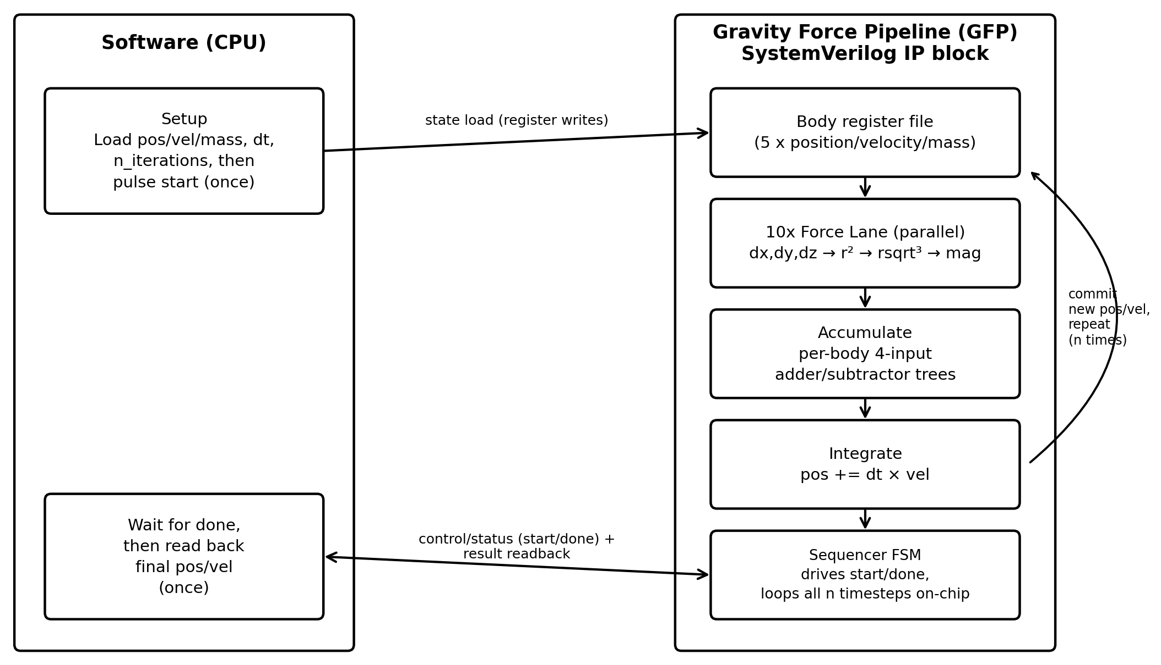
Hardware proposal: Gravity Force Pipeline (GFP)
10 lanes
one per body pair, all in parallel
35 doubles
all state on-chip, ~280 bytes
1 start
per advance() call; all n steps run on-chip
Part B · nbody
26
Notes:
The Gravity Force Pipeline is a SystemVerilog block that runs the entire advance call in hardware, all 20,000 timesteps. On the left, software loads the state once: positions, velocities and masses of five bodies, 35 doubles in total, plus dt and the iteration count. Then it pulses start. On the right, the state sits in a register file. Ten force lanes, one per pair, compute the distance, r squared, the reciprocal square root cubed and the velocity deltas, all in parallel. This is our unrolling idea taken to its end: instead of writing the ten pairs out in Python, they're ten pieces of wired hardware. A fixed adder tree accumulates the deltas per body, since each body is in exactly four pairs. The integrate stage updates positions, and the sequencer loops back without the CPU, which only reads the result when done asserts.

Slide 27
Hardware proposal: benefit and trade-offs
Performance
Area
No interpreter and no boxing: dx = x1 - x2 is a subtractor, not a heap object
~12-cycle critical path per timestep (an estimate, not measured)
10 lanes = 10× one lane's FP units (rsqrt³ is the largest)
Lanes grow as O(N²): large N needs shared, time-multiplexed lanes
Power
Scope and limits
Higher instantaneous power: 10 FP pipelines every cycle
Much shorter active time, with no fetch or dispatch overhead
report_energy() stays in software
Not tapeout-ready: no FP exception handling, reset sync or CDC
Part B · nbody
27
Notes:
Why is this worth it when software only got 9 percent? Because hardware removes the cost itself rather than paying it fewer times. A subtraction is a subtractor, not a heap allocation plus a type dispatch. Each timestep's critical path is the force-lane pipeline, about 12 cycles, dominated by the reciprocal square root unit. I want to be clear that this is an architectural estimate. We wrote and syntax-checked the RTL but didn't synthesize or time it. The main trade-off is area. Ten parallel lanes means ten sets of floating-point units, and the number of pairs grows with the square of the number of bodies. That's fine for five bodies, but a bigger simulation would share fewer lanes over time. Power per cycle is higher, but the active time is far shorter. And to wrap up: pyflate's lesson was to fix the algorithm, and nbody's is that when the execution model is the bottleneck, that's where hardware pays off.

Slide 28
Thank you
Chris Shakkour · Razan Jiryis
Resources
Project repository: github.com/ChrisShakkour/HW-SW-project-00460882
Reports: pyflate/report_pyflate.docx · nbody/report_nbody.docx
RTL: pyflate/hardware/hfdu.sv · nbody/hardware/gravity_force_pipeline.sv
Benchmarks: pyperformance (bm_pyflate, bm_nbody)
Flame graphs: Brendan Gregg's FlameGraph scripts
Thank you
28
Notes:
Thank you for listening. Everything we showed is in the GitHub repository on the slide: the profiling data, both flame graphs for every variant, the original and optimized benchmark code, the full reports, and the SystemVerilog for both accelerators. The benchmarks come from pyperformance, and the flame graphs were made with Brendan Gregg's FlameGraph scripts. We're happy to take questions.

