Slide 1
LOTR Based SoC Implantation of an LOTR RV Based SoC on an FPGA
Saar kadosh & adi levy

Slide 2
Background
Background
Definition and goals
Previous Project: GPC_4T Project
Implementation of 4 HW Threads RV32I Core
D_MEM_WRAP (D_MEM, CR_MEM) I_MEM_WRAP
Integrability to Ring Controller
Testing and Validation Environment
Fully Implementing LOTR
Multi Core Ring architecture
Testing and Validation
Architecture
Tools
Status
To Be Done

Slide 3
Definition And Goals
Background
Definition and goals
Project Goals:
Fully design Ring Architecture LOTR
Design, test and verification
Official RISCV “Compatibility Test”
Implementation of the LOTR on FPGA
Syntisizable and Compiled on Quartus environment
Efficiently execute complex Multi-Core and Multi-Threads programs on the LOTR
Architecture
Tools
Status
To Be Done

Slide 4
Lord-Of-The-Ring Architecture
Background
Definition and goals
Architecture
Tools
Status
To Be Done

Slide 5
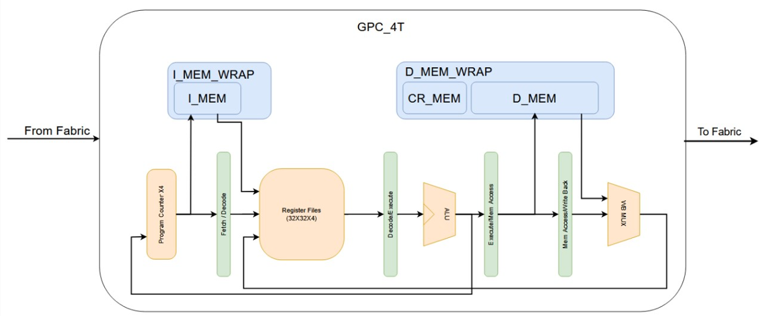
GPC_4T Architecture
Background
High Level Architecture Specifications
Definition and goals
Architecture
Tools
Status
To Be Done

Slide 6
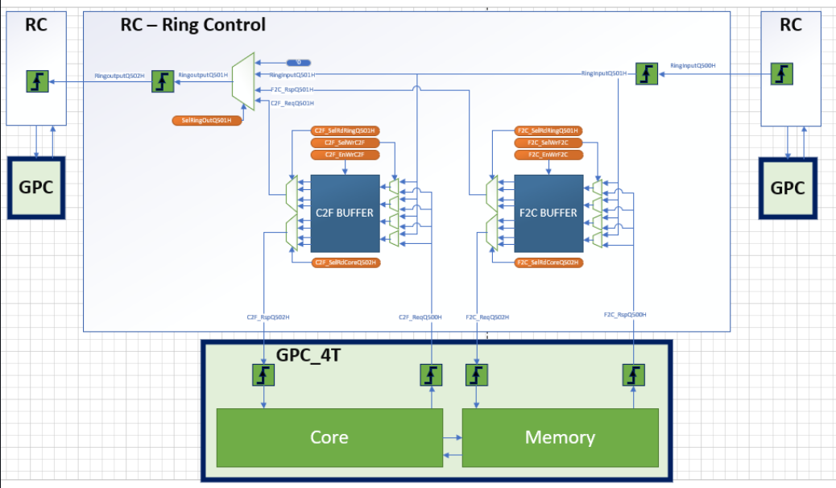
Ring Control Architecture
Background
High Level Architecture Specifications
Definition and goals
Architecture
Tools
Status
To Be Done

Slide 7
Tools
Background
Windows based RISCV Tool-Chain
C Compile Assembly Linker Assembler Machine code
SIMULATION – MODELSIM & POWERSHELL
Compilation Elaboration Simulation Wave tracker Memory
gIThUB
Windows based toolchain
Switching from WSL/PS scripts to simple bash scripts
Definition and goals
Architecture
Tools
Status
To Be Done

Slide 8
Status
Background
So far we updates the environment to support Fabric and Multi-Core compatibility
Test Bench
Multi Core Tests
Multi Core Scripts
RC Interface
Thread Stall when reading to Non-Local Memory
Writing to Non-Local Memory
Definition and goals
Architecture
Tools
Status
To Be Done

Slide 9
To Be Done
Background
Core Optimization
Optimization Arch Pipe
Support privileged CSR RISCV extension to allow OS
Support exception and error detections and interrupts
Official RISCV “Compatibility Test”
Enable more complex Multi-Thread tests
Test the Design on FPGA:
Design and test on Front Door access
Design IO Tile and integrate into standard Quartus IO
Syntisizable and Timing Conversion
Compile and Synthesize design on Quartus environment
Definition and goals
Architecture
Tools
Status
To Be Done

Slide 10
Question?

