Slide 1
Storytelling With Data
The following slides contain three questions and graphical answers on an ecommerce data set from an actual UK retailer. The data is a sample set derived from Kaggle:
"This is a transnational data set which contains all the transactions occurring between 01/12/2010 and 09/12/2011 for a UK-based and registered non-store online retail. The company mainly sells unique all-occasion gifts. Many customers of the company are wholesalers.”
Kaggle: https://www.kaggle.com/carrie1/ecommerce-data/home
Udacity Nanodegree, Marketing Analyst: https://www.udacity.com/course/marketing-analytics-nanodegree--nd023
Data cleaning
To arrive at a clean and consistent data set, I have:
changed data types to appropriate data types,
split the datetime into two separate columns, i.e. InvoiceDate and InvoiceTime,
added InvoiceMonth and Income columns and
replaced country names: EIRE -> Ireland, European Community -> EU, United Arab Emirates -> UAE

Slide 2
Which products generate the highest incomes?
The lunch – bag red retrospot is the most successful item sold. 18,779 lunch bags were sold in all, generating £34,897.31 income.
The top 7 products generate together 20 % of the overall income.
Marketing efforts should be focused here and variations of these products may bring further income.

Slide 3
What months generate the highest and lowest income?
Monthly income is the highest in November. This can be explained by the pre-Christmas sales.
The month with the lowest total income is April.
Marketing spend is necessary in Nov and Apr . In November to increase income even further due the large potential of sales before Christmas.
In April, marketing should look for a way to tap into the Easter holidays to increase the monthly income.

Slide 4
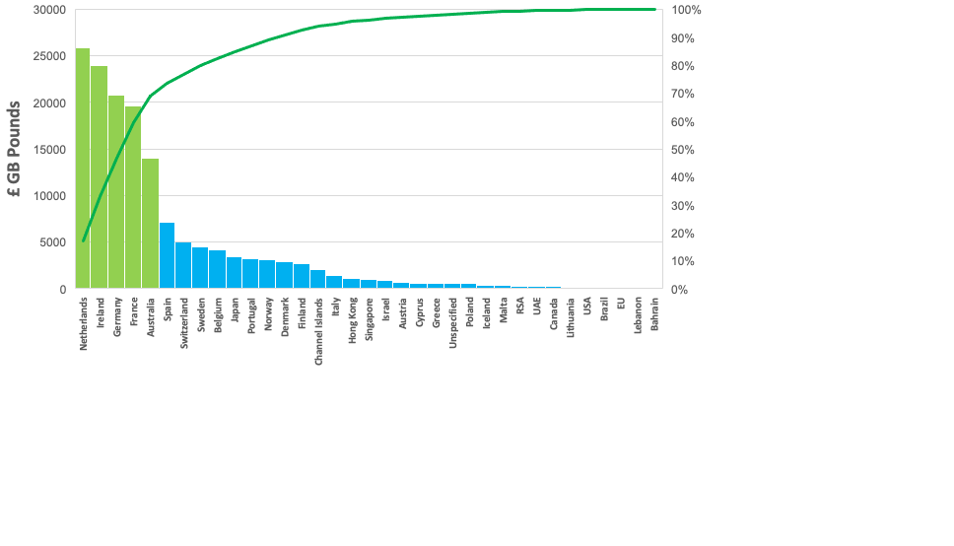
Where are the biggest markets outside the UK ?
The five largest markets outside the UK in 2011 were: Netherlands, Ireland, Germany, France and Australia. Together they make up 70 % of the overall income from outside the UK.
In GB Pounds £ the income from the Top 5 countries is: £100,503.19. This is approx. a ninth of the UK income.
Marketing efforts outside the UK will be most effective if focused on the five identified countries.
70 %

