Slide 1

EmporiUm
Texas Territories

Slide 2
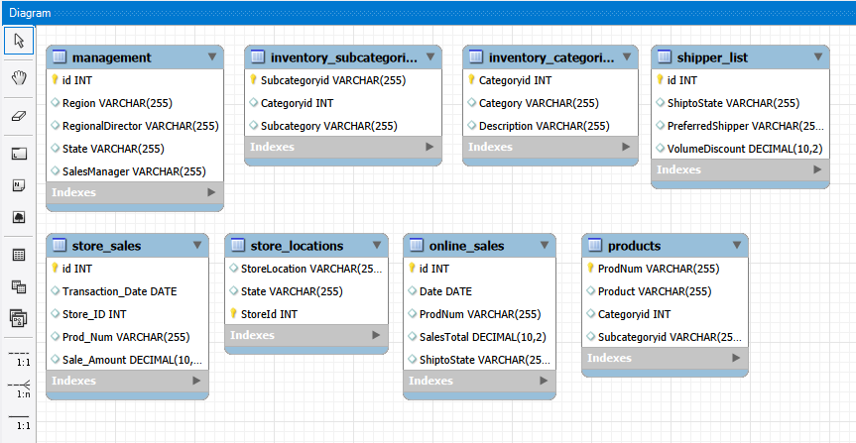
Beginning Steps
Generated ERD diagram
Identified tables and relationships
Examined primary and foreign keys
Ran SELECT statements to identify what gets returned

Slide 3
Total Overall Revenue in Texas
In-Store Sales – $3,417,850.01
Start Date – 01/01/2022
End Date – 12/31/2025
Range of 4 years

Slide 4
Revenue Breakdown By Month & Year
Over 4 years, there has been a constant increase in sales
October 2025 peaked with $168,955.72
Sales Increase Percentages
  2022 – $579,864.31
  2023 - $807,866.79 (+39%)
  2024 – $809,371.87 (+0.19%)
  2025 – $1,220,747.04 (+51%)

Slide 5
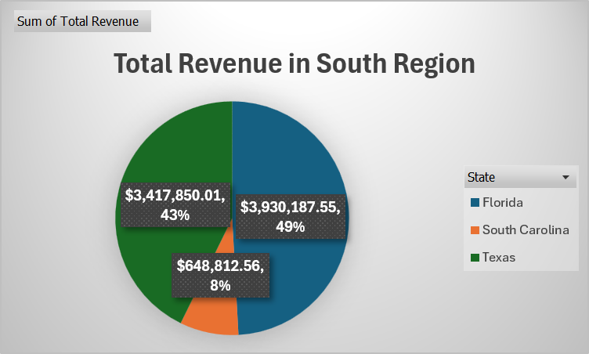
Total Revenue Comparison
The total revenue in the South amounts to $7,996,850.12.
Texas portion was about $3,417,850.01.
Texas ranks 2nd in this region, amassing 43% of those sales.

Slide 6
Transactions Per Month
Highest-selling month – October with 2,380 transactions
Lowest – February with 1,784 transactions
Highest-Selling Product Category – Stationery and Supplies
Lowest – Books (General)
No correlation observed between transaction count and average sales, as a month can have the highest number of transactions, but be outperformed in sales.

Slide 7
Average Transaction Amount by Product Category
Highest average product amount
  - Technology and Accessories - $22,365.
Lowest - Stationery and Supplies - $485.
Stationery and Supplies sell more items, but they also sell cheaper.

Slide 8
In-Store Texas
Sales Ranking
Rank | Store | Revenue
1 | Beaumont | $637,818.90
2 | Fort Worth | $351,772.59
3 | Desoto | $330,720.12
4 | Cedar Park | $312,628.27
5 | Baytown | $298,163.16
6 | Denton | $298,111.45
7 | Arlington | $292,987.49
8 | Austin | $291,145.00
9 | Bacliff | $280,714.34
10 | Georgetown | $269,344.64
11 | Dallas | $54,444.05
Beaumont is leading in sales.
Dallas has the minimum amount in revenue.
We can expect an average of $310,713.64 across our stores.

Slide 9
Key Takeaways
A focus should be placed on Dallas so that it can match its fellow territories in terms of revenue. We should try and see what Beaumont is doing differently since they are leading in revenue and apply it to Dallas.
We should find out what trends are happening during February to try and boost sales during that month since that is the upcoming quarter.
Opening an online market could also improve revenue for the region.

Slide 10

Thank You

