Slide 1
Venture Capital Investment Value Prediction Model “$$$$$$”
Chris Telles

Slide 2
Project Idea: $ Round Value Prediction
Venture Capital investment rounds
Seed, Series A, Series B, Series C
Purpose:
Invest in the best series C company and earn high returns.
Dissecting purpose:
Invest:
There are previous investors
I am current investor
There will be future investors
Amount invested is in the same range
Best:
Best growth between rounds and long term
Predicting how much valuation will grow between rounds
Predicting if the COs can keep up to their valuation
Does industry make a difference?
Series C:
Post A
Pre E
Compute best intra-round diff to lead to highest valuation

Slide 3
Assumptions
Companies have already been invested in previously
They are currently looking for Series B-D investment
They have not failed (bankruptcy, dissolution)
They are looking for capital in order to grow quickly

Slide 4
Variables
Company name (string)
Round type (angel, seed, series A, series B) (string, categorized into ints)
Round date (date)
Round amount invested (float)
Pre-money valuation (float)
Down round (bool)
CEO (string)
Changed CEO (bool)
Investor list (String / List / Series / Dict / DF)
Lead investor (String / List / Series)
Board members (String / List / Series)
Internal investor in round (bool)
External investor in round (bool)
Example:
[ Tesla,
Seed Round (0),
Aug 2006,
3.4 million,
10 million,
False,
Elon Musk,
False,
[DFJ, Musk, ...],
[DFJ, Musk],
True,
True,
etc etc ]

Slide 5
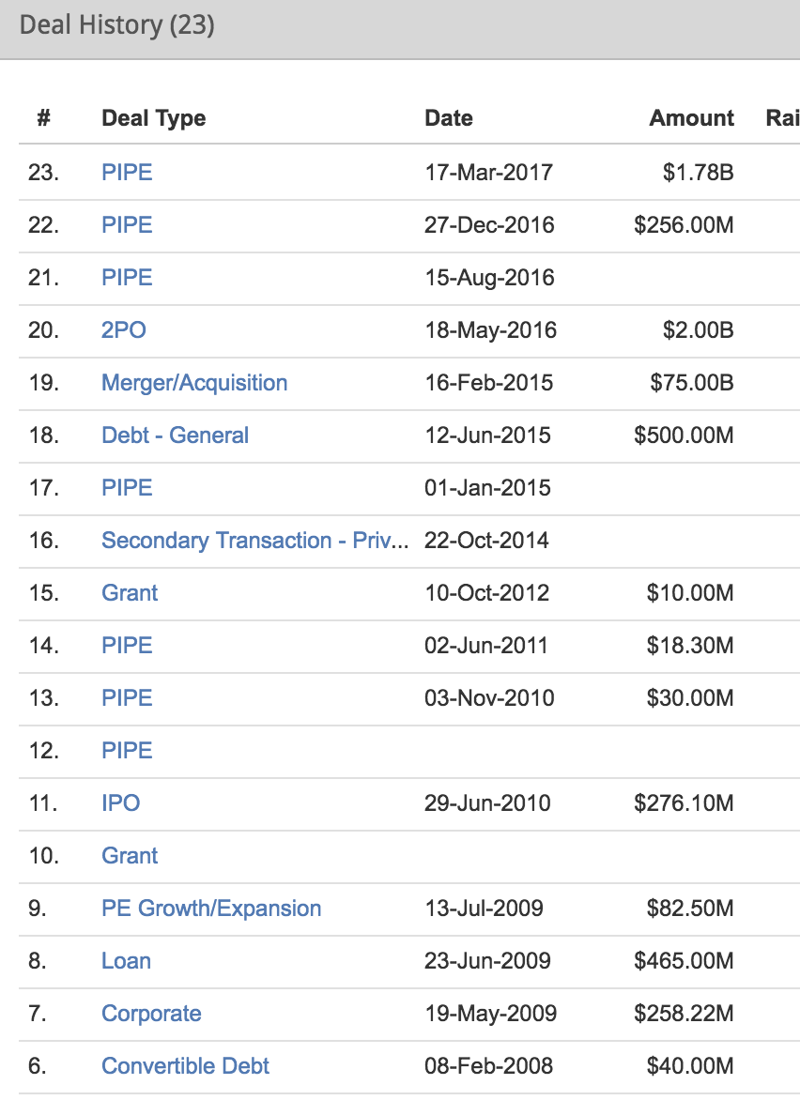
Data Source
PitchBook →

