Slide 1


Data science for service change
Presented by DataSF | datasf.org/science
City and County of San Francisco

Slide 2



What is data science?
Data Science
Applying advanced statistical tools to existing data to generate new insights
Service Change
Converting new data insights into (often small) changes to business processes
Smarter Work
More efficient and effective use of staff and resources

Slide 3
What complements data science?
(and is really good stuff to do)
Approach
Process
Outcome
Examples
Performance Management
Define, visualize, often using dashboards, and manage to KPIs
Meet goals and KPI targets
SF Scorecard, PublicWorks Stat & Stat starter kit
Evaluation
Assess a project, program or policy design or results
Better investment of resources; Better policy decisions
Evaluation of transitional-kindergarten in SF
Policy Analysis
Define and assess alternatives using a broad range of tools
Report or memo with policy or program recommendations
Shape Up SF Policy Analysis
Open Data
Publish civic data for use by the City and the public
Easier data sharing and reporting, new tools or services built on data
SFPUC Adopt a Drain
DataScienceSF
Identify insights using advanced statistics tied to a service change
Smarter work “on the ground” in real time
See rest of deck!

Slide 4
What complements data science?
(and is really good stuff to do)
Approach
All approaches can lead to service improvement. It’s about choosing the right tool for the job (and sometimes combining them)!
Performance Management
Evaluation
Policy Analysis
Open Data
DataScienceSF

Slide 5
What’s in the DataScienceSF Toolkit?
Statistical Methods
Tools
User Experience Research
Sentiment analysis
Time series analysis
Data mining
Multilevel modeling
Missing data imputations
Classification and clustering
Survival analysis
Pattern recognition
Principal component and factor analysis
AB testing
Machine learning
Forecasting
Propensity score matching
Logistic, multinomial and multiple linear regression techniques
Network analysis

Slide 6
What’s in the DataScienceSF Toolkit?
Statistical Methods
Tools
User Experience Research
Languages
Python
R
SQL
Javascript
NodeJS
Libraries
SciPy
Pandas
Scikit-learn
GPText
OpenNLP
Mahout
+many others
Data Engineering
Profiling
ETL
Job notices
APIs
Optimized data pipelines
Optimized data storage/access
Visualization
D3.js
Gephi
R
Leaflet
PowerBI
ggplot2
shiny

Slide 7
What’s in the DataScienceSF Toolkit?
Statistical Methods
Tools
User Experience Research
Iterative Prototyping
Photo journaling and documenting
Service blueprinting
Journey mapping
Ride-alongs
Process mapping
Ethnographic field research and user observation
Usability testing

Slide 8






What is NOT data science?
 This
 Not that
Service change
Academic research
Major overhauls / service disruptions
Small changes
Collecting new data (mostly ;)
Use existing data

Slide 9
Data Science
Project Types

Slide 10






Project Type: Find the needle in the haystack
What to target?
Data Science
Service Change
Target areas
Target categories
Target individuals
Service Issue:
Difficult to identify targets in a population
Data Science Process:
Use existing data and predictive modeling to identify targets
Service Change:
Engage with target subset of population
Result: Department resources are spent where most needed

Slide 11




Examples: Free fire alarms in New Orleans
Service Issue
Fire alarms to homes that have them
Data Science
ID homes with high prob. of no alarm
Service Change
Use list to shape outreach
Result
2x increase in hit rate
Notes:
Image source: https://www.flickr.com/photos/techy2610/
https://www.flickr.com/photos/usag-yongsan/

Slide 12
Examples: Find the needle in the haystack
Service Issue
Data Science
Service Change
Result
New Orleans Fire Department (Nola FD) distributes free fire alarms to homes. But many homes they visited already had them, wasting Nola FD’s resources.
Nola’s analytics team used public data to identify homes with a high probability of not having a fire alarm and provided Nola FD with a list.
Nola FD used the list to determine where to offer fire alarms.
With no increase in resources or patrols, Nola FD increased the hit rate of homes needing smoke alarms by 2x.
New Orleans Fire Alarms
New York City (NYC) conducts corporate tax audits. They are time consuming and 37% have no findings. They want to increase findings but maintain their number of audits.
NYC analyzed historical audit records and identified patterns of businesses. Outliers were flagged as possible audit targets.
The audit team targeted the flagged cases for audits.
With the same staff levels, the audit team decreased the percent of cases with no finding from 37 to 22%, leading to increased revenues.
New York City Tax Compliance
Notes:
Source: NOLA Office of Performance Analytics
Source: Data-Smart City Solutions

Slide 13

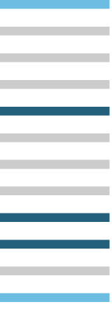

Project Type: Reduce your backlog
What to prioritize?
Data Science
Service Change
Service Issue:
Backlog is tackled via first in, first out (FIFO)
Data Science Process:
Create a model to categorize and group past and current cases
Service Change:
Prioritize cases based on categories in order of risk, need or opportunity
Result: Department addresses high priority cases first

Slide 14


Examples: Blight backlog in New Orleans
Service Issue
Backlog in blight enforcement
Data Science
Use data to grade cases per prior decisions
Service Change
Result created abatement tool
Result
1500+ case backlog gone in 100 days
Notes:
Image Source: https://www.flickr.com/photos/new_orleans_strata/

Slide 15
Examples: Reduce your backlog
Service Issue
Data Science
Service Change
Result
In Boston, they have a large list of residences with anti-social complaints filed against them.
The analytics team pooled data from housing, police, and tax agencies to gauge the nature of complaints and identify the biggest contributors to complaints.
The Air Pollution Control Commission expedited enforcement with the biggest contributors.
With no change in resources, Boston saw a 55% reduction in police calls associated with the targeted residences.
Boston Complaints
New Orleans (Nola) faced a significant backlog in blight enforcement due in part to bottlenecks in the decision making process and missing information.
Nola used data on the outcomes of previous blight cases to grade cases in the backlog and to recommend additional data to collect by field teams.
The enforcement team used the results as an abatement decision tool to speed the decision-making process of whether to demolish or foreclose a home.
Nola eliminated the 1,500+ case backlog in less than 100 days.
New Orleans Blight
Notes:
Source: Ash Center
Source: Data-Smart City Solutions

Slide 16



Project Type: Flag “stuff” early
How to detect?
Data Science
Service Change
Service Issue:
Hard to predict future condition which leads to reactive services
Data Science Process:
Use historical and current data to create estimate ranges for potential outcomes
Service Change:
Use estimates to change and tailor intervention points
Result: Department provides pro-active early interventions

Slide 17

Examples: Use of force alerts in Charlotte
Service Issue
Excessive force have neg. impact on community
Data Science
Identify patterns to refine early warning
Service Change
Flagged recurring complaints
Result
Accuracy up 20%; False positives down 55%
Notes:
Image Source: https://www.flickr.com/photos/kenfagerdotcom/

Slide 18
Examples: Flag “stuff” early
Service Issue
Data Science
Service Change
Result
Excessive force violations by police officers have huge negative repercussions in the community and for police careers.
The analytics team refined an early warning system, identifying patterns that often led to officers having negative interactions with the public.
The department flagged recurring complaints against officers and notified supervisors when certain thresholds were reached.
The CMPD system increased accuracy by 15-20% while reducing false positives by 55%.
Charlotte Police Violence
In Chicago, a large number of children are thought to be exposed to lead paint in older houses.
The analytics team built a model of exposure using data on homes, history of children’s exposure at that address and conditions of neighborhood.
They conducted targeted inspections and provided remediation funding to homes identified in the model.
Chicago reached the most vulnerable families before severe health effects from lead contamination manifest.
Lead Poisoning in Chicago
Notes:
Source: Data Science for Social Good
Source: Data Science for Social Good

Slide 19
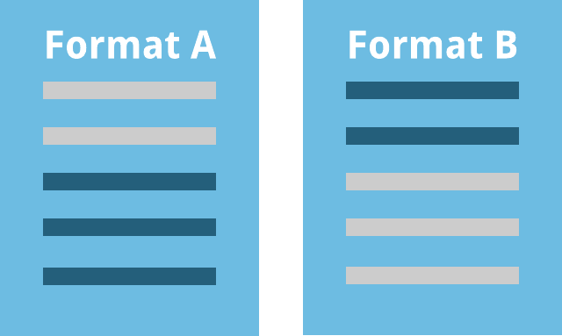

Project Type: Improve your outreach
Which form?
Data Science
Service Change
62%
respond
78%
respond
Service Issue:
Costly outreach methods are not tested before implementation
Data Science Process:
Statistical testing on outreach methods to identify which, when, and to whom to send
Service Change:
Use statistically validated outreach method
Result: Department increases response rates

Slide 20
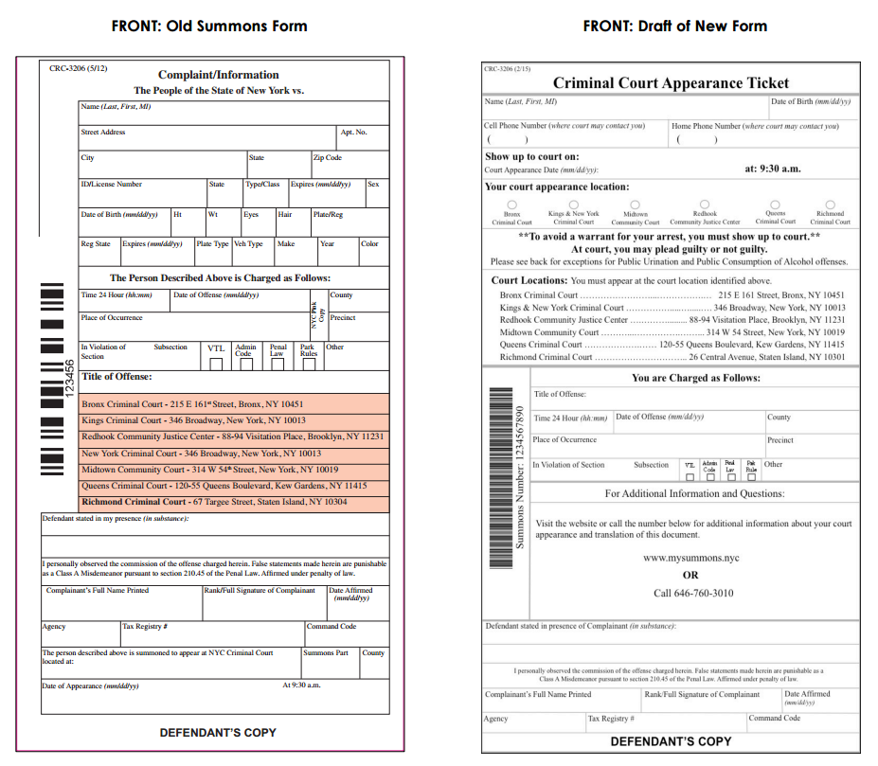
Examples: NYC Summons Redesign
Service Issue
40% cited no-show leading to costly arrest
Data Science
Redesigned and tested summons form
Service Change
Deployed new form and rescheduled timelines
Result
Currently evaluating impact
Notes:
Image Source: http://www.ideas42.org/blog/project/nypd-summons-redesign/

Slide 21
Examples: Improve your outreach
Service Issue
Data Science
Service Change
Result
In New Orleans, they have a low take up rate of free primary care appointments.
The analytics team tested different SMS reminders to those eligible for appointments.
The department implemented the most successful SMS text.
60% increase in clients using free primary care appointments
NOLA Community Health Program
40% of those cited for low-level violations did not take required next steps, leading to issuance of arrest warrants.
Experiment and test redesign of summons process
Reschedule court timelines to facilitate greater access
Evaluating impact on use of costly arrest warrants (Project currently in progress)
NYC Summons Redesign
Notes:
Source: NOLA Office of Performance Analytics
Source: Ideas42

Slide 22
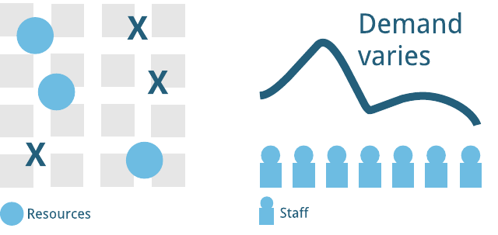


Project Type: Optimize your resources
How to distribute?
Data Science
Service Change
Service Issue:
Difficult to identify where to place or distribute resources to be most effective
Data Science Process:
Use geospatial and/or other data to identify optimal distribution of resources
Service Change:
Re-allocates resources to optimal distribution
Result: Department decreases response times; increases volume

Slide 23
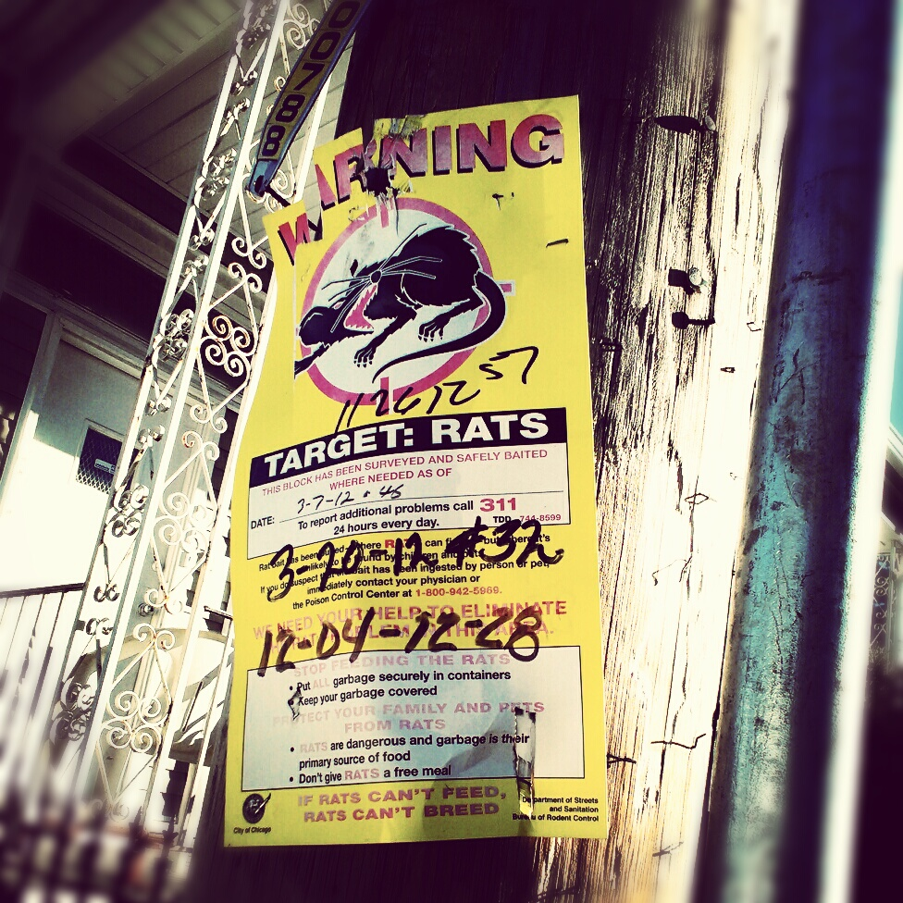
Examples: Chicago Pest Control
Service Issue
Challenging to predict outbreaks
Data Science
Analyze data associated with outbreaks
Service Change
Proactive targeting of leading indicators
Result
15% drop in requests for service
Notes:
Image Source: https://www.flickr.com/photos/65172294@N00/

Slide 24
Examples: Optimize your resources
Service Issue
Data Science
Service Change
Result
Chicago’s rodent baiting program finds it challenging to predict rodent outbreaks and locations leading to spikes in 311 complaints.
Predicted potential danger of outbreaks by using leading indicators and other data correlated with previous outbreaks.
Directed rodent baiting to areas identified by leading indicators, including events, like water main breaks.
Resident requests for rodent control services dropped by 15%
Chicago Pest Control
In New Orleans, ambulance standby locations are chosen based on dispatcher habits or instincts.
Analytics team used city wide analysis of data on accident patterns, traffic patterns, and crew readiness to identify optimal standby locations
Ambulances deployed at new optimized locations
Targeting short response times to EMS calls (Project currently in progress)
NOLA Ambulance Stand-by Location
Notes:
Source: Data-Smart City Solutions
Source: NOLA Office of Performance Analytics

Slide 25




Summary: The five project types
Find the needle in the haystack
Reduce you backlog
Some combination
Flag “stuff” early
Improve your outreach
Optimize your resources
Something else…

Slide 26
Overview of Phases
Solicitation
Selection
Project refining
Present
April - May
May 19
May 22 – Jun 5
Jun 7
June
July - November
Dec
Application due
Announce winners
Analysis & service change

Slide 27
Phase: Solicitation
Opportunities to learn more
Brown bags
Office hours
Invited presentations
Dates at datasf.org/science
April - May
May 19
May 22 – Jun 5
Jun 7
June
July - November
Dec

Slide 28
Phase: Solicitation
How to prepare
Brainstorm projects using the project types
Identify possible service changes
Review data that could help
Identify key staff members
Learn more at datasf.org/science
April - May
May 19
May 22 – Jun 5
Jun 7
June
July - November
Dec

Slide 29
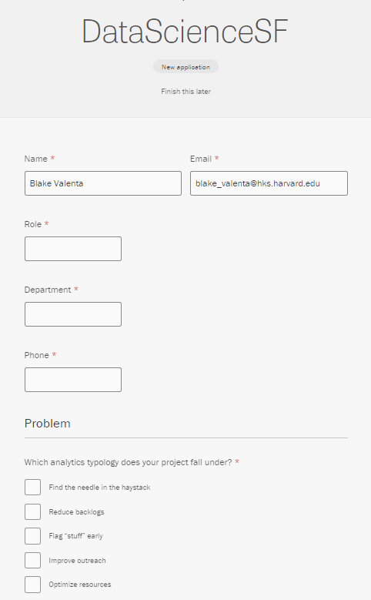
Phase: Application
Available at datasf.org/science
Brief online form
Problem statement (200 word max)
Impact statement (100 words max)
Service change statement
Data overview
Project champion
April - May
May 19
May 22 – Jun 5
Jun 7
June
July - November
Dec

Slide 30
Phase: Application
Criteria to keep in mind
Above all else: A viable path to service change
Question / problem answerable by data science
Solvable within cohort time frame
Impact
Department commitment
Data readiness
April - May
May 19
May 22 – Jun 5
Jun 7
June
July - November
Dec

Slide 31
Phase: Selection
Process
Initial review
Criteria assessment
Application scoring
Department follow-ups, as needed
Be available for questions (email or in person)
Estimating 5-10 projects for 1st Cohort
April - May
May 19
May 22 – Jun 5
Jun 7
June
July - November
Dec

Slide 32
Phase: Winners Announced
And gentle off-ramps for the rest…
Some projects may not be appropriate for data science or for our timeline. We will help identify other opportunities that may be a better fit:
Civic Bridge – pro bono opportunities via the Mayor’s Office of Civic Innovation
STIR – startup technology engagements via the Mayor’s Office of Civic Innovation
DataSF Dashboarding Services
Controller's Performance Unit
Data Academy classes
External Data Science groups or volunteers
April - May
May 19
May 22 – Jun 5
Jun 7
June
July - November
Dec

Slide 33
Phase: Project refining
During this phase, we will:
Meet to refine the scope
Optionally, do initial site visits/interviews
Prepare data for analysis
Outputs
Project charter
Data exchanges and agreements, as needed
April - May
May 19
May 22 – Jun 5
Jun 7
June
July - November
Dec

Slide 34
Phase: Analysis and service change
During this phase, we will:
Conduct site visits, ride-alongs and interviews, as appropriate
Conduct iterative analysis
Implementation testing
Handoff and training
Analysis
Review
Service Plan
April - May
May 19
May 22 – Jun 5
Jun 7
June
July - November
Dec

Slide 35
Phase: Analysis and service change
What DataSF Brings
Statistical Methods
Final Product is Algorithm + Tool:
Algorithms that are scripted and automated (real time if needed) tied to some service change tool (e.g. list, service, alert) implemented together and maintained by department
Tools
User Experience Research
What You Bring
Issue expertise
A good question & data
Project champion

Slide 36
Phase: Present (& Disseminate)
During this phase, we will:
Present and celebrate the results with cohort
As appropriate, write an article for DataSF Speaks (datasf.org/blog) and/or other venues
Disseminate method and approach (not data) for other departments and cities to learn
Data Scientist will continue to be available during office hours for continued support
April - May
May 19
May 22 – Jun 5
Jun 7
June
July - November
Dec

Slide 37






Meet the team ☺ & Acknowledgements
Blake
Harvard DataSmart Fellow
…and PowerBI Ninja
Jason
Open Data Program Manager
…and the ♥ of DataSF
Erica
ShareSF Program Manager
…and expert truffle hunter
Joy
Chief Data Officer
…and recent succulent propagator
Janine
Open Data Services Engineer
…and budding bird watcher
Kim
Data Scientist
…and R extraordinaire
Many thanks to New Orleans’ NOLAlytics team, New York City’s MODA, and Harvard’s DataSmart for their resources, tools and templates!

Slide 38
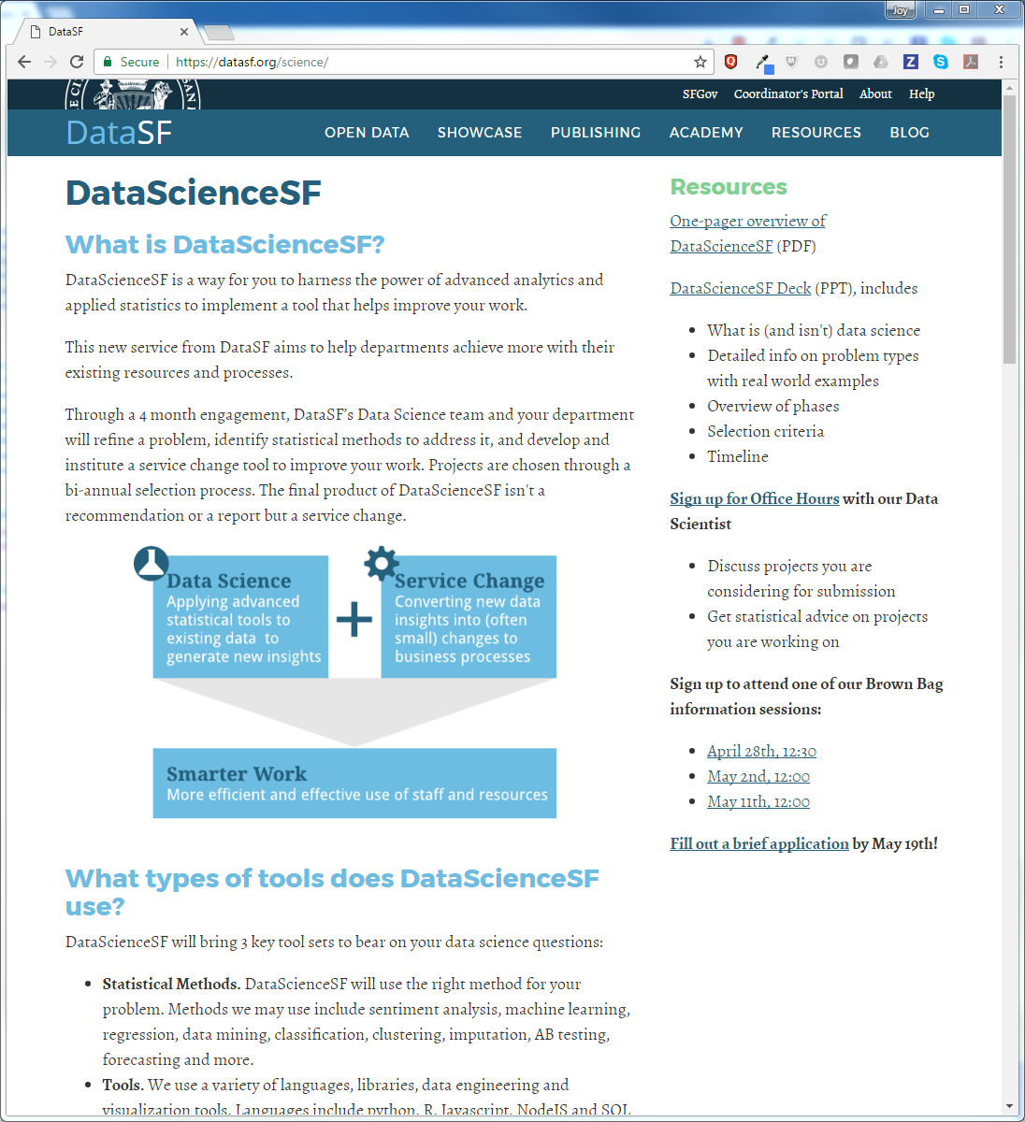
Visit datasf.org/science
At datasf.org/science:
This powerpoint
1 pager
Sign up for office hours
Sign up for brown bag
Apply!

Slide 39

Thank yoU @datasf | datasf.org |datasf.org/blog

