Slide 1
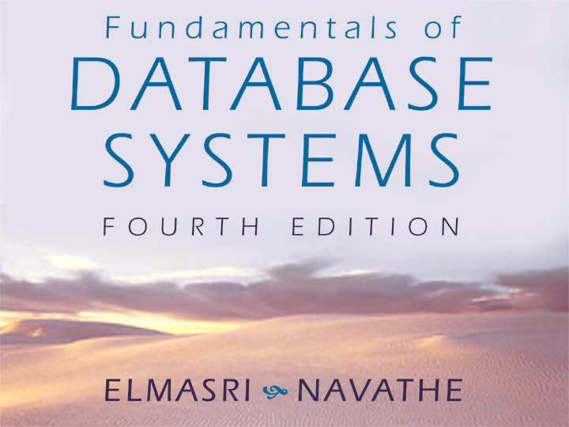

Slide 2
Models, Schemas, basic concepts

Slide 3
Contents
Quick revisting the last lecture
Introduction to basic concepts (cont.)
Data models
Entity-Relationship diagrams

Slide 4
Let us recall some points of the last lecture

Slide 5
Basic concepts
Data models
60-ties of the previous century
hierarchical data model
CODASYL (network)
70-ties and later
Relational
80-ties
Object oriented data model

Slide 6
Basic concepts
Other data models
Graph model
XML model

Slide 7
Example: Data in Graph model
root
Notice a
new kind
of data.
beer
beer
bar
manf
manf
prize
name
A.B.
name
servedAt
year
award
Bud
M’lob
1995
Gold
name
addr
Joe’s
Maple
The beer object
for Bud
The bar object
for Joe’s Bar

Slide 8
Example: an XML Document
A NAME
subobject
<?xml version = “1.0” encoding = “utf-8” ?>
<BARS>
<BAR><NAME>Joe’s Bar</NAME>
<BEER><NAME>Bud</NAME>
<PRICE>2.50</PRICE></BEER>
<BEER><NAME>Miller</NAME>
<PRICE>3.00</PRICE></BEER>
</BAR>
<BAR> …
</BARS>
A BEER
subobject

Slide 9
Basic concepts
Data model = structure + language
A data model determines:
A language for defining structures: DDL
A language for manipulating structures: DML

Slide 10
Basic concepts
A language for defining structures: DDL
P₃
P₂
P₄
P₁
Database
P₅
P_{n}
P₆
…

Slide 11
Basic concepts
A language for defining structures: DDL
P₃
P₂
P₄
Schema
Written in DDL
P₁
P₅
P_{n}
P₆
…

Slide 12
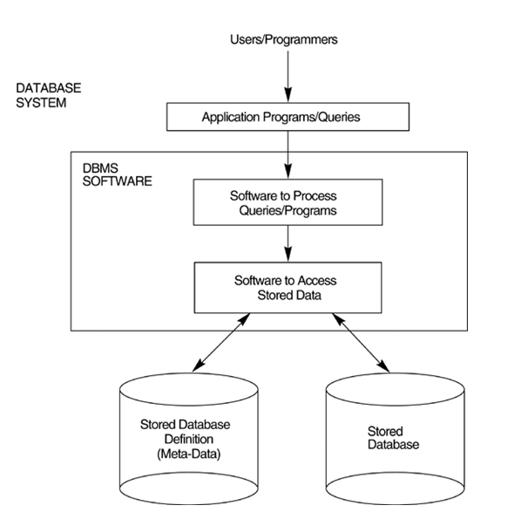
Basic concepts
A language for manipulating structures i.e. DML is used in programs
P₃
P₂
P₄
DML
P₁
DML
Database
P₅
DML
DML
DML
P_{n}
P₆
…

Slide 13
In more detail

Slide 14
Basic concepts
So, we have new concepts
a database schema, which is written in the Data Description Language
application programs, which are writen with the use of Data Manipulation Language

Slide 15
Basic concepts
Schema as a metadata
Database as an instance

Slide 16
Basic concepts
Schema describes general properties of data
These properties reflect the properties of real-world objects being described by the information system
The properties are sometimes called integrity contraints

Slide 17
Basic concepts
Examples
In the schema we have to express that:
The age of (every) student must be between 18 and 30
The students on Semester_1 can be registered to the subjects giving no more than 30 ECTS, and the numer of lectures should be > 4
Every student has an Index Number which uniquely identifies him/her

Slide 18
We have ended here
Subschema, view

Slide 19
Basic concepts
Subschema, view
For each group of users we have an extraction of the schema, which defines a part of the database structure, relevant to these users needs

Slide 20
Example: an XML Document
A NAME
subobject
<?xml version = “1.0” encoding = “utf-8” ?>
<BARS>
<BAR><NAME>Joe’s Bar</NAME>
<BEER><NAME>Bud</NAME>
<PRICE>2.50</PRICE></BEER>
<BEER><NAME>Miller</NAME>
<PRICE>3.00</PRICE></BEER>
</BAR>
<BAR> …
</BARS>
A BEER
subobject

Slide 21
Basic concepts
Data model = structure + language
A data model determines:
A language for defining structures: DDL
A language for manipulating structures: DML

Slide 22
Basic concepts
A language for defining structures: DDL
P₃
P₂
P₄
P₁
Database
P₅
P_{n}
P₆
…

Slide 23
Basic concepts
A language for defining structures: DDL
P₃
P₂
P₄
Schema
Written in DDL
P₁
P₅
P_{n}
P₆
…

Slide 24
Basic concepts
A language for manipulating structures i.e. DML is used in programs
P₃
P₂
P₄
DML
P₁
DML
Database
P₅
DML
DML
DML
P_{n}
P₆
…

Slide 25
In more detail

Slide 26
Basic concepts
So, we have new concepts
a database schema, which is written in the Data Description Language
application programs, which are writen with the use of Data Manipulation Language

Slide 27
Basic concepts
Schema as a metadata
Database as an instance

Slide 28
Basic concepts
Schema describes general properties of data
These properties reflect the properties of real-world objects being described by the information system
The properties are sometimes called integrity contraints

Slide 29
Basic concepts
Examples
In the schema we have to express that:
The age of (every) student must be between 18 and 30
The students on Semester_1 can be registered to the subjects giving no more than 30 ECTS, and the numer of lectures should be > 4
Every student has an Index Number which uniquely identifies him/her

Slide 30
We have ended here
Subschema, view

Slide 31
Basic concepts
Subschema, view
For each group of users we have an extraction of the schema, which defines a part of the database structure, relevant to these users needs

Slide 32
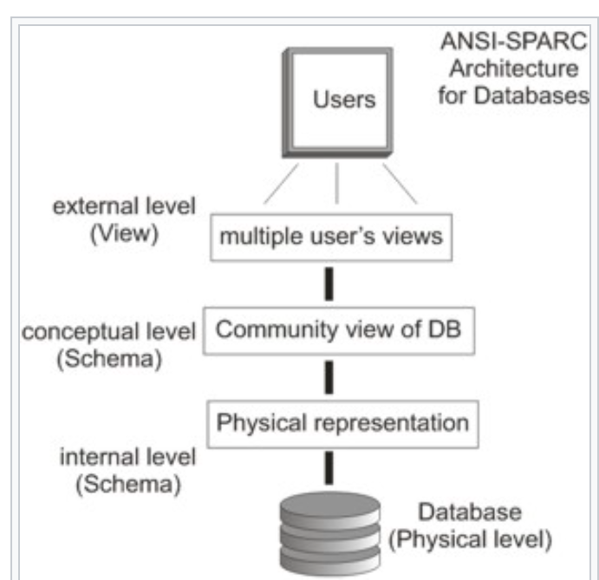
Basic concepts
ANSI-SPARC 3 levels model
End user view
DBA/Programmer
view

Slide 33
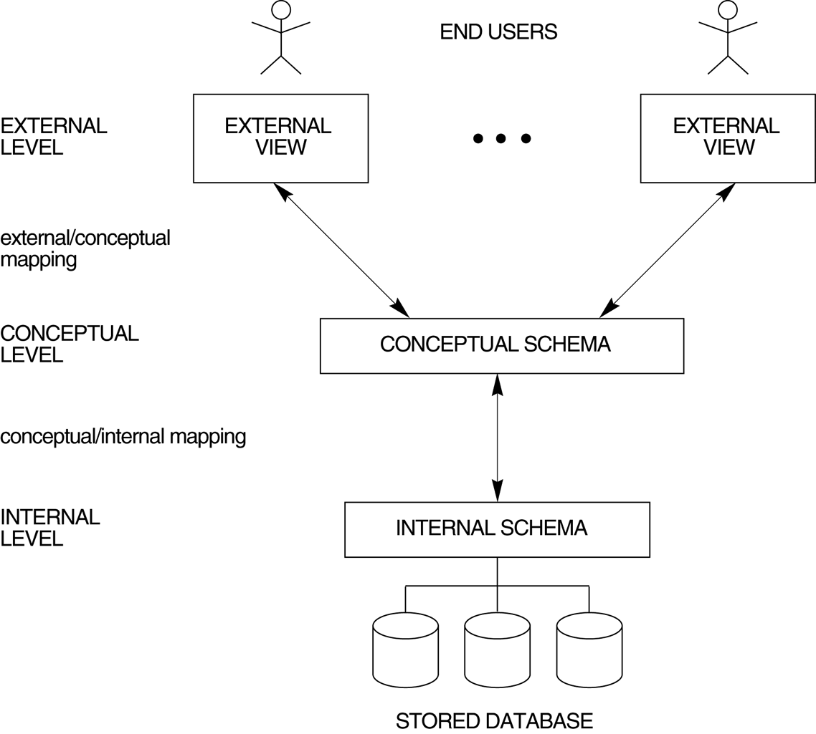
The three-schema architecture.

Slide 34
The same nowadays
3 levels of abstraction
Conceptual (external in ANSI)
Logical (conceptual in ANSI) _____________________
Physical

Slide 35
Basic concepts
Conceptual level (also called external level):
It defines how each group of end-users sees the organization of data in the database. A single database can have any number of views at the conceptual level.

Slide 36
Basic concepts
Conceptual level (also called external level):
Example: In a University system conceptual level refers to
Students
Lectures
Programs (curricula)
Lecturers,
etc

Slide 37
Basic concepts
Conceptual level (also called external level):
The real-world object are seen by end users by means of the”attribute” that describe the objects, such as
Student is characterized by its name, study subject, age, address, etc
Lectures is characterized by lecture title, ECTS, semester to start, preceeding lectures, etc

Slide 38
Basic concepts
Logical level (in ANSI schema):
unifies the various external views into a compatible global view, expressed by a database language. It provides the synthesis of all the external views. It is out of the scope of the various database end-users, and is rather of interest to database application programmers and database administrators (DBA).

Slide 39
Basic concepts
Logical level (in ANSI schema):
unifies the various external views into a compatible global view, expressed by a database language. It provides the synthesis of all the external views. It is out of the scope of the various database end-users, and is rather of interest to database application programmers and database administrators (DBA).

Slide 40
Basic concepts
Physical level (in ANSI internal level, physical representation):
It is concerned with the way DBMS represents data on the storage, i.e. it deals with storage layout of the data, using storage structures, such as, i.a., indexes (to enhance performance).
Hence, if refers to cost, performance, scalability and other operational matters.

Slide 41
Data models
Let us recall - we distinguish:
Conceptual level
Logical level (depends on the data model)
Physical level
(briefly
discussed
already
To be
discussed
next

Slide 42
Data models
Let us recall - we distinguish:
Conceptual level
Logical level (depends on the data model)
Physical level
(briefly
discussed
already)
To be
discussed
now (briefly)

Slide 43
Basic concepts
Data models (let us recall)
60-ties of the previous century
hierarchical data model
CODASYL (network)
70-ties and later
Relational
80-ties
Object-oriented data model
2000
Graph data model
XML data model

Slide 44
Data models
Hierarchical model
CODASYL model
Relational model

Slide 45
Hierarchical model
The hierarchical structure was developed by IBM in the 1960s.
Relationships between records form a tree.

Slide 46
Hierarchical model
Relationships between records form a tree.
University
faculty
faculty
faculty
Institute
Institute
Institute
Institute

Slide 47
CODASYL data model
We have the following primitives:
Records
Sets of records
1 owner
many members

Slide 48
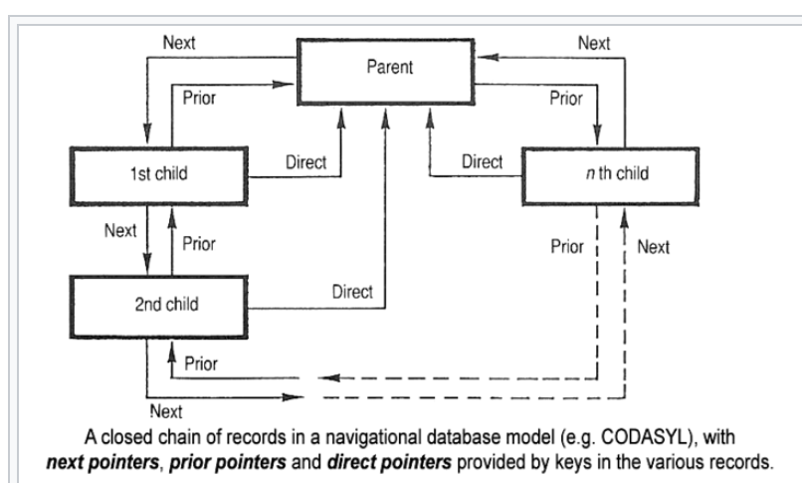
CODASYL data model
We have the following primitives:
Records
Sets of records
1 owner
many members

Slide 49
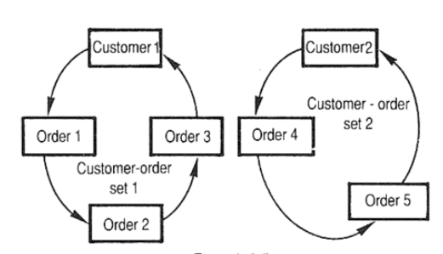
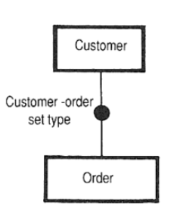
CODASYL data model
Example

Slide 50
Basic concepts
How can we define DBMS
Wikipedia:
„The database management system (DBMS) is the software that interacts with end users, applications, and the database itself to capture and analyze the data. The DBMS software additionally encompasses the core facilities provided to administer the database".

Slide 51
Basic concepts
How can we define DBMS
… but (also in Wikipedia):
„Often the term "database" is also used to loosely refer to any of the DBMS, the database system or an application associated with the database.”

Slide 52
Basic concepts
We will distinguish between
Data Base Management System (DBMS)
and
database

Slide 53
Basic concepts
… and define (describe) DBMS by „must have” functions

Slide 54
Basic concepts
„Must have” functions
Support of a data model
The model should support multiple views, so that end user(s) can see the data in various ways
Languages:
Data definition language (DDL),
Data manipulation language (DML)
Design tools

Slide 55
Basic concepts
„Must have” functions (cont)
programming tools (high level DML, nested in (a) host language(s))
Storage of data
Efficient access to data reflecting operations expressed in DML (usually embedded in the programs);
Processing in multi-user environment (transaction management)

Slide 56
Basic concepts
„Must have” functions (cont)
Security (of data, and data structures) - access control
Recovery tools
maintenance tools (i.a. import, export, monitoring, defragmentation and analysis utilities.)
data independence;

Slide 57
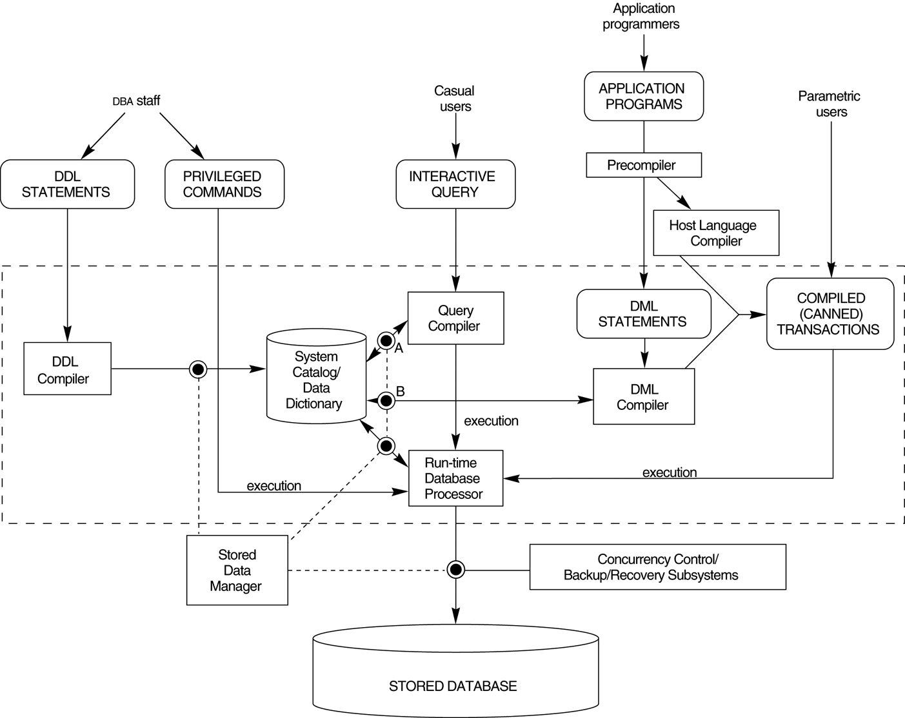
Component modules of a DBMS and their interactions.

Slide 58
Basic architecture of IS using DBMS
Centralized (the main approach up to mid of 90-ties, with the use of mainframes)
Client server approach, started in 90-ties with the dissemination of minicomputers, replacing mainframes

Slide 59
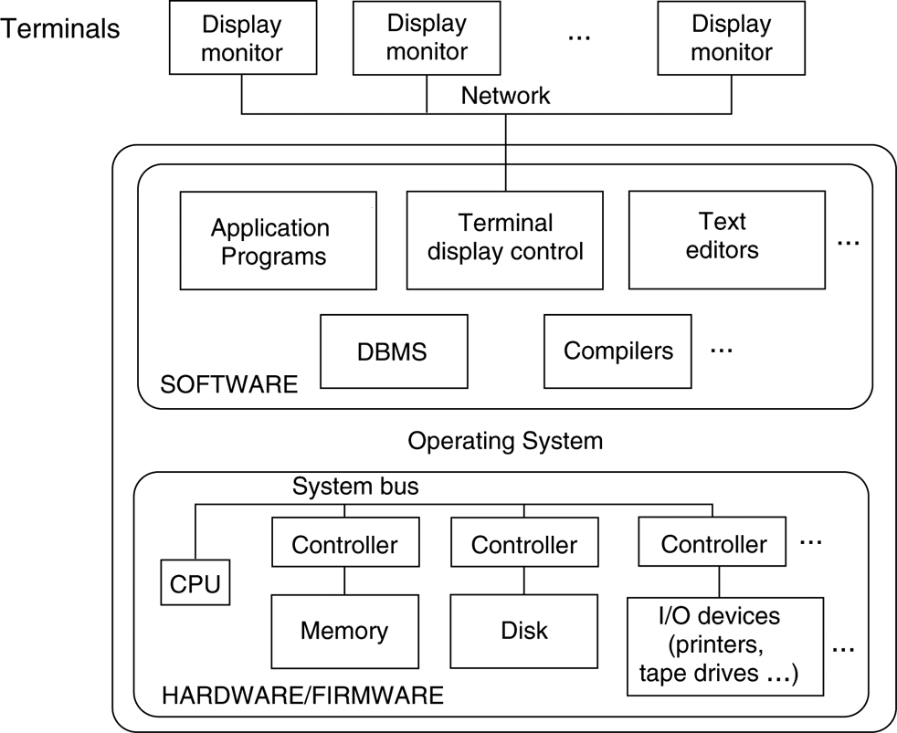
A physical centralized architecture.

Slide 60
A physical centralized architecture.
Terminals are not programmable
All the programs are on the mainframe

Slide 61
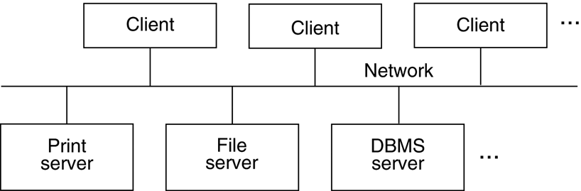
Logical two-tier client/server architecture.
Clients are programmable
A part of the processing is performer by client
Another part is performer on the server

Slide 62
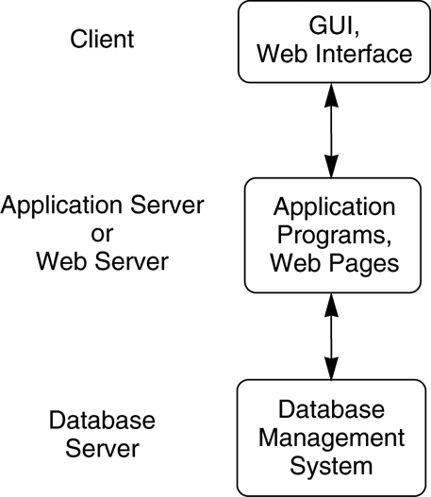
Logical three-tier client/server architecture.
Transfer of processing to the client from the Aplication Server
Transfer of processing to the Application Server from the DBMS

Slide 63
Basic concepts
Data independence:
The decisions made for performance optimization purposes should be invisible to end-users and applications.

Slide 64
Basic concepts
Data independence:
There are two types of data independence: Physical data independence and logical data independence.
Physical data independence means that independently of the physical organization of DB, the end-user does not see any difference in the logic of the database.

Slide 65
Basic concepts
Data independence:
There are two types of data independence: Physical data independence and logical data independence.
In other words, organization of data in the physical media (e.g. disk storage) does not influence understanding of data by end-users.

Slide 66
Basic concepts
Data independence:
Physical data design is driven mainly by performance requirements, and requires a good knowledge of the expected workload and access patterns, and a deep understanding of the features offered by the chosen DBMS.

Slide 67
Basic concepts
Data independence:
Logical database independence:
Changes on the logical (programmers) level should not affect application programs written using conceptual level interfaces.
… but this is a much more difficult condition, because application programs usually refer to logical level, i.e. to schema

Slide 68
Basic concepts
Data independence:
Logical database independence:
Changes on the logical (programmers) level should not affect application programs written using conceptual level interfaces.
… but this is a much more difficult condition, because application programs usually refer to logical level, i.e. to schema

Slide 69
Basic concepts
Data independence:
Logical database independence:
Changes on the logical (programmers) level should not affect application programs written using conceptual level interfaces.
… but this is a much more difficult condition, because application programs usually refer to logical level, i.e. to schema
Nota bene – this was one of the most important motivations for developing object- oriented databases

Slide 70
Basic concepts
During the EDABA course we will go though all the tree levels
Conceptual
Logical, and
Physical

Slide 71
Conceptual level

Slide 72
Conceptual level
Artificial Intelligence
Semantic network by Wikipedia
A semantic network, or frame network is a knowledge base that represents semantic relations between concepts in a network. This is often used as a form of knowledge representation.

Slide 73
Conceptual level
Artificial Intelligence
It is a directed or undirected graph consisting of vertices, which represent concepts, and edges, which represent semantic relations between concepts, mapping or connecting semantic fields.

Slide 74
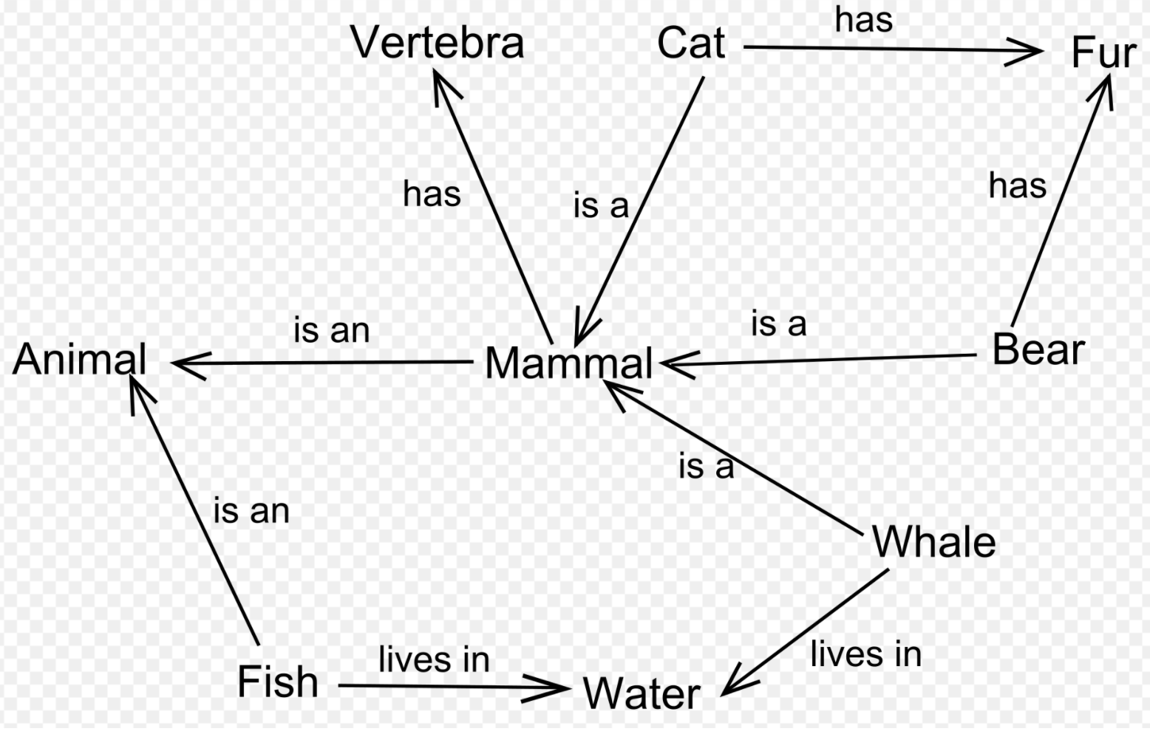
Conceptual level
Artificial Intelligence

Slide 75
Conceptual level
Artificial Intelligence
A semantic network may be instantiated as, for example, a graph database, concept map, or an ontology (wikidata).

Slide 76
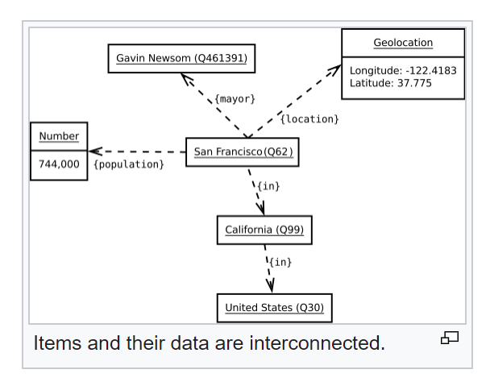
Conceptual level
Artificial Intelligence
Wikidata (linked Open data)

Slide 77
Conceptual level
Software engineering, and databases
Entity relationship diagrams by Peter Chen, 1976
An E-R diagram is usually the result of an analysis aiming at defining and describing what is important to processes in the area of an Information System.

Slide 78
Conceptual level
IMPORTANT
The conceptual level serves as means for database analysts to express the properties of data at a stage of designing the information system

Slide 79
Conceptual level
Basic primitives
Entities
Relationships between the entities

Slide 80
Conceptual level
Entity is represented by a rectangular with a label, eg
Student
Lecture

Slide 81
Conceptual level
Relationship links entities. It is represented by a diamond and edges
registered
in
Student
Lecture

Slide 82

Conceptual level
Entities are described by the attributes
Student

Slide 83
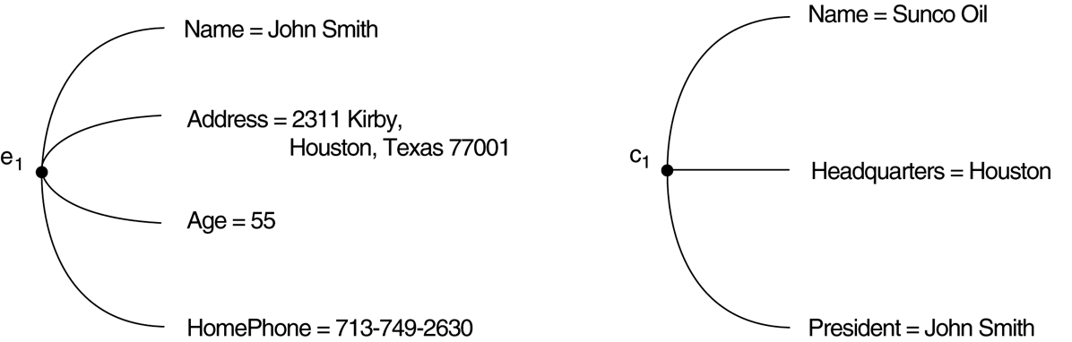
Two entities (instances), employee e₁ and company c₁, and their attributes.

Slide 84
Conceptual level
Entities are described by the attributes
Address
Name
Year of birth
Student

Slide 85
Conceptual level
Attributes may be multivalued
Author name
Title
Year of publication
Book

Slide 86
Conceptual level
Attributes may be identifying the entity (key attributes, identifiers)
Author name
Title
Year of publication
Book
ISBN
Key attributes are
underlined

Slide 87
Conceptual level
Relationships also may have attributes:
Passed
exam
Student
Lecture

Slide 88
Conceptual level
Relationships also may have attributes:
date
Passed
exam
Student
Lecture
Note

Slide 89
Conceptual level
Attributes may be simple
City
Street
Number
Address
Year of birth
Name
Student

Slide 90
Conceptual level
…or composed
City
Street
Number
Address
Year of birth
Address
Name
Student

Slide 91
Conceptual level
…or derived
City
Street
Number
Address
Year of birth
Address
Name
AGE
Student

Slide 92
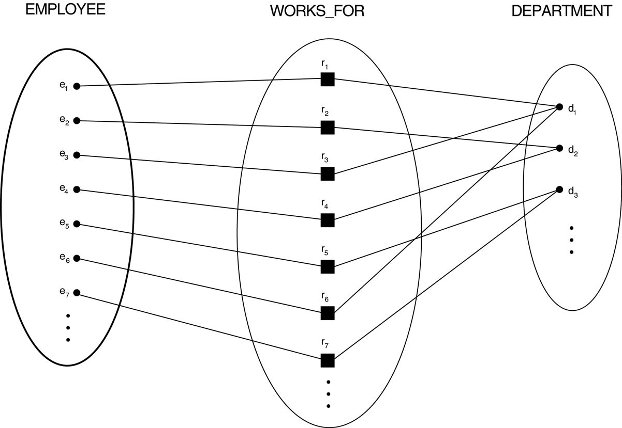
Conceptual level
Types of relationships

Slide 93
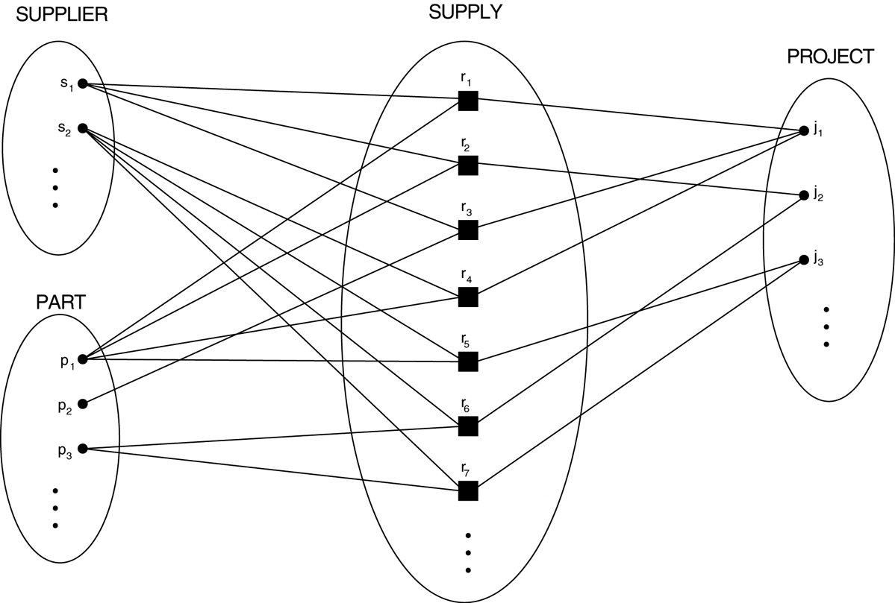
Conceptual level
Types of relationships

Slide 94
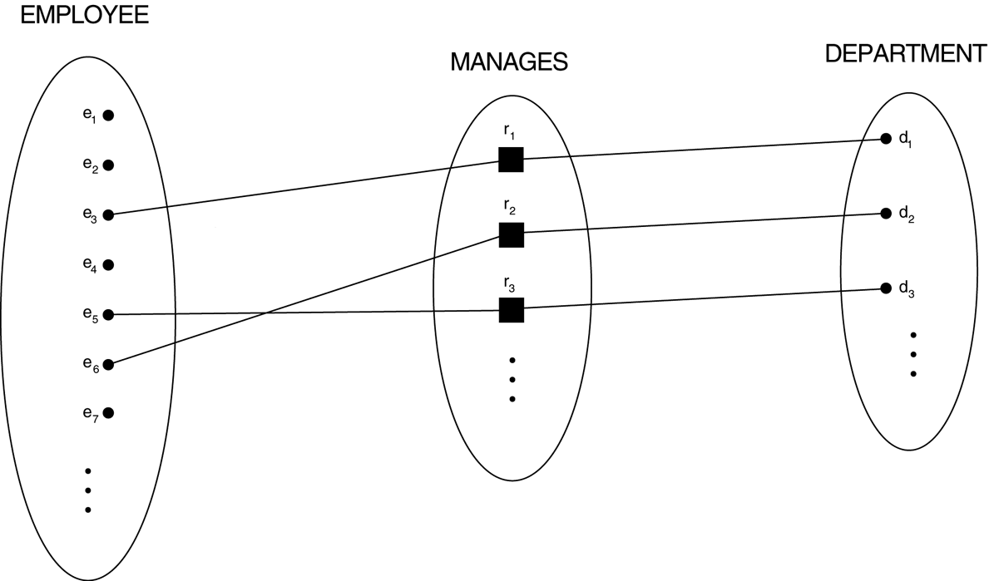
Conceptual level
Types of relationships (one-to-one)

Slide 95
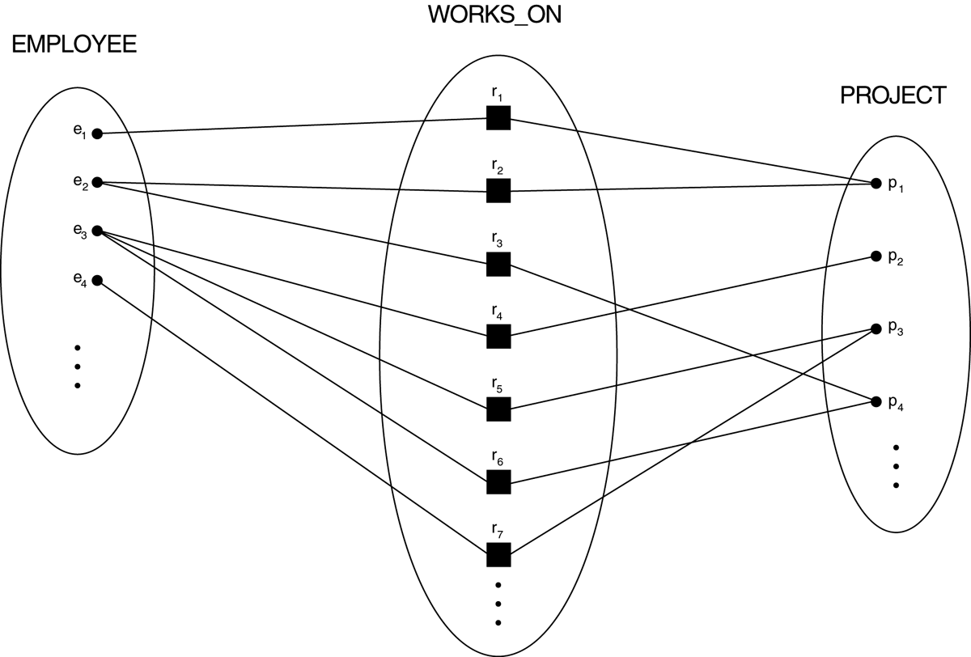
Conceptual level
Types of relationships (many-to-many

Slide 96
Conceptual level
Types of relationships
1:1
1:N
M:N

Slide 97
Conceptual level
Types of relationships
1:1 relationship
Director of
1
1
Professor
Institute
Each Institute has 1 director (only one), who is profesor. There is only 1 profesor at the position of director for a given institute

Slide 98
Conceptual level
Types of relationships
1:N relationship
Works for
N
1
Lecturer
Institute
Each lecturer works for 1 institute (only one), who is profesor. The institute employs many lecturers

Slide 99
Conceptual level
Types of relationships
M:N relationship
attends
N
M
Student
Lecture
Each student may attend many lectures, each lecture may be attended by many students

Slide 100
Conceptual level
Important:
types of relationships are integrity constraints
They define rules that are obligatory in the world being descibed

Slide 101
Conceptual level
More specific relationship types:
Structural constraints
attends
(10:40)
(4,6)
Student
Lecture

Slide 102
Conceptual level
More specific relationship types:
Total participation
Works for
N
1
Lecturer
Institute
Each lecturer must be in relations works for with an institute (must have an affiliation)

Slide 103
Conceptual level
A
Works for
N
1
Lecturer
Institute
B
Works for
N
1
Lecturer
Institute
In (B) we may have lecturers that are not assigned to any institute.

Slide 104
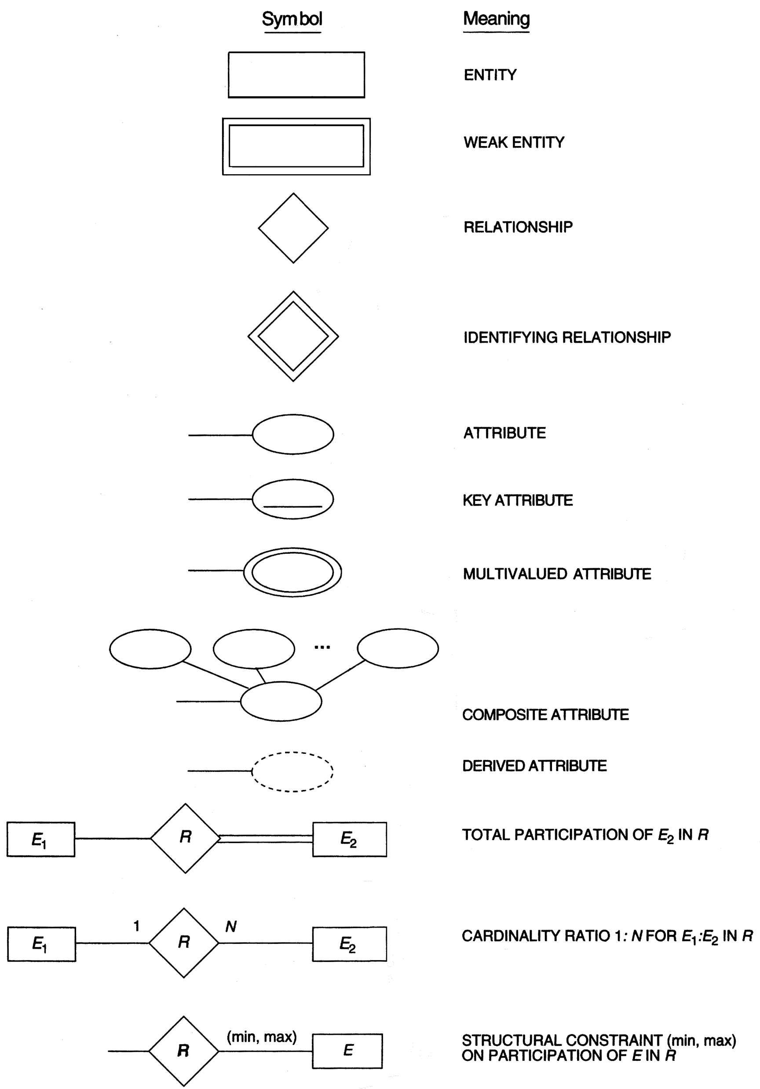
Summary of the notation for ER diagrams.

Slide 105
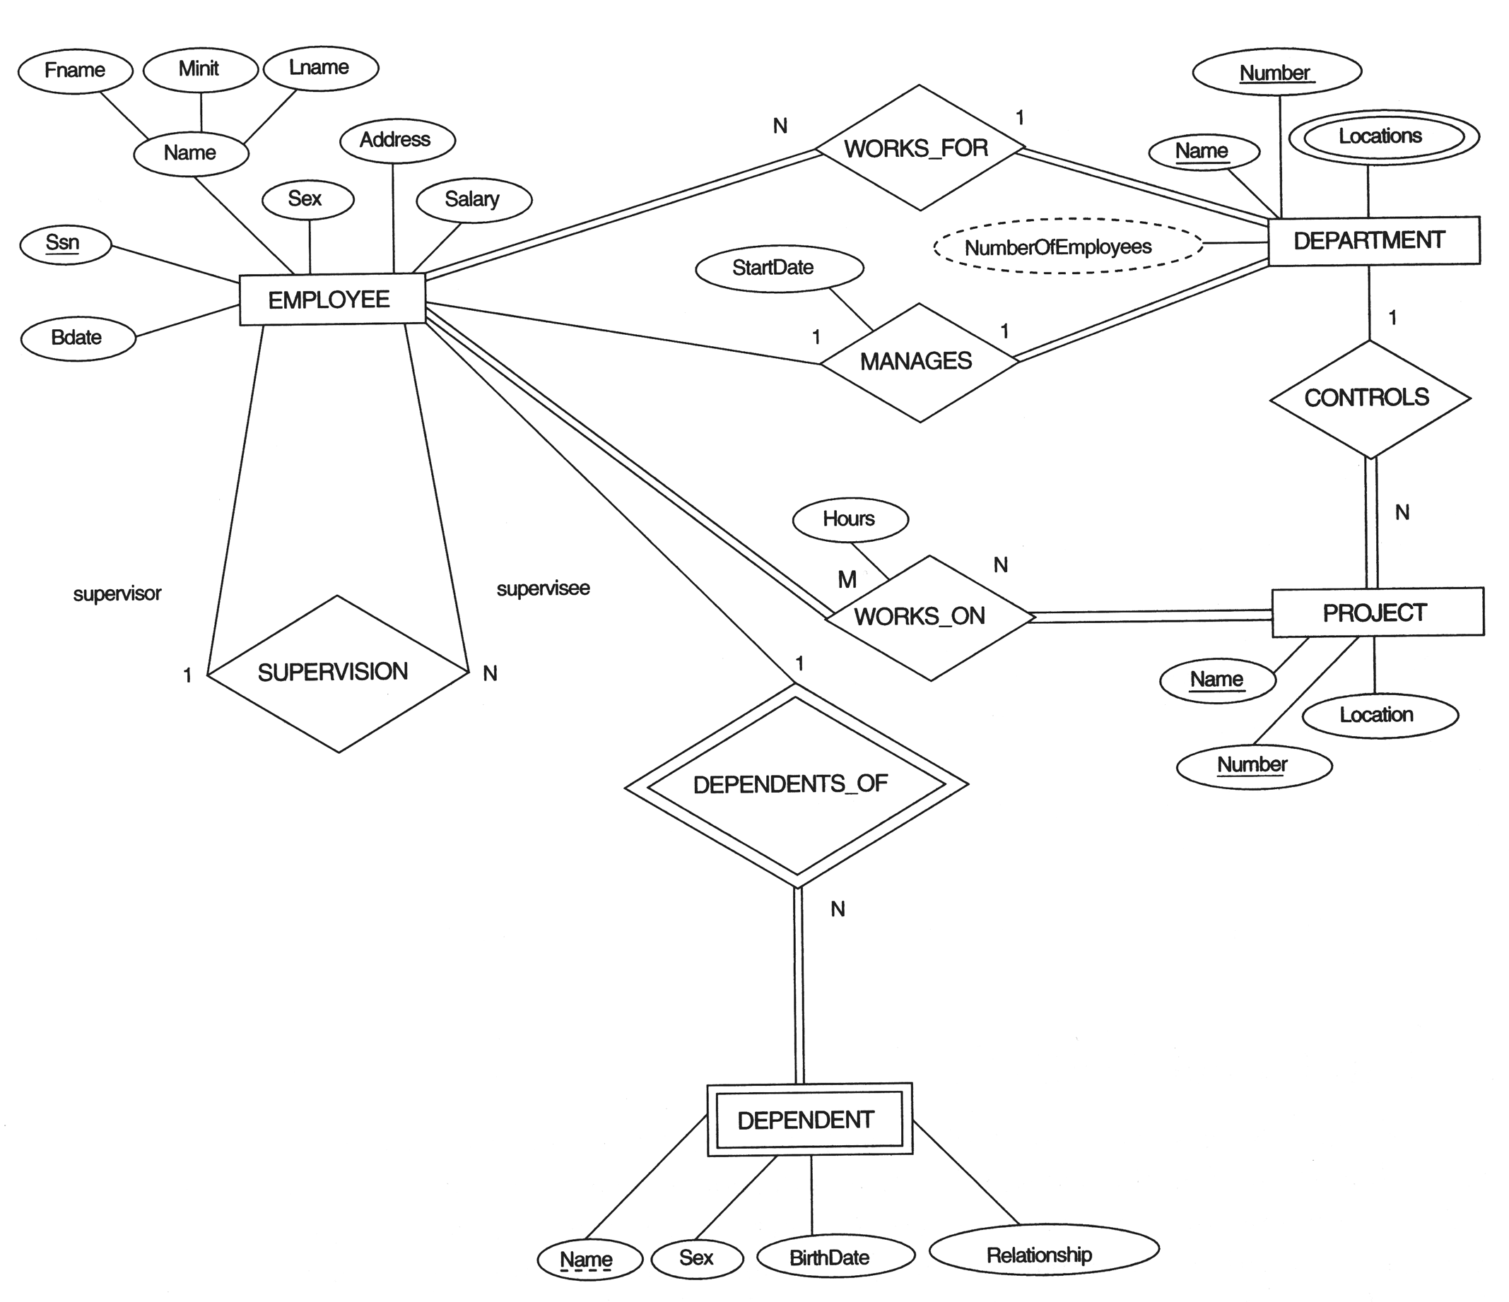
FIGURE 3.2 An ER schema diagram for the COMPANY database.
Number of employees
is derived attribute
Every deptartment
has a manager
Recoursiveness:
Employee
refers to emplyee

Slide 106
FIGURE 3.2 An ER schema diagram for the COMPANY database.
and every employee is affiliated at a department
Every department has employees
Every deptartment
has a manager
Recoursiveness:
Employee
refers to emplyee
It is a weak entity

Slide 107
FIGURE 3.2 An ER schema diagram for the COMPANY database.
Every department has employees
Relatioship with an attribute
Every deptartment
has a manager

Slide 108
FIGURE 3.2 An ER schema diagram for the COMPANY database.
Every department has employees
Relatioship with an attribute
Every deptartment
has a manager

Slide 109
Conceptual level
Let us consider recursive relationships
supervises
1
N
Employee
Employee
Has father
1
N
person
Person

Slide 110
Conceptual level
Let us consider recursive relationships
The instances of such diagrams are often trees, sometimes are latices, in this case they cannot have cycles:
Descendant cannot be ancestor for itself

Slide 111
Conceptual level
Tree:
P is father of P
P is a boss of P
P
P
P
P
P
P

Slide 112
Conceptual level
Latice:
Paper cites Paper
P
P
P
P
P
P
cites
M
N
Paper
Paper

Slide 113
Conceptual level
Let us consider recursive relationships
Descendant cannot be ancestor for itself
This is a very strong integrity constraint, and not so easy to express with E-R diagrams, (actually not possible!)

Slide 114
Conceptual level
But recursive relationships may also build a graph
Graph:
City is connected with another city
C
C
C
C
C
C

Slide 115
Conceptual level
In this case no constraints are imposed on the graph
Graph:
City is connected with city
C
C
C
C
C
C

Slide 116
Conceptual level
Let us recall
The conceptual level serves as a means for database analysts to express the properties of data at a stage of designing the information system

Slide 117
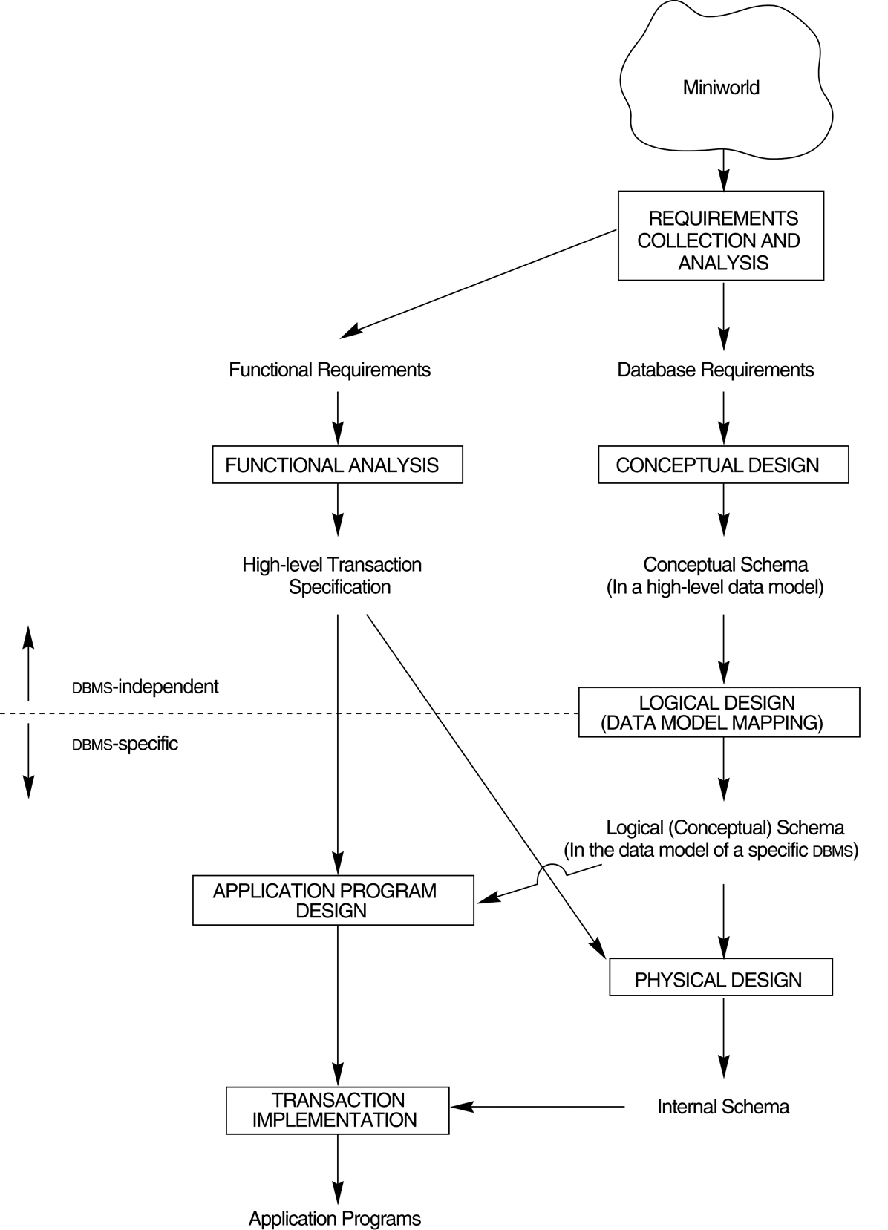
A simplified diagram to illustrate the main phases of database design.

