Slide 1

nnn-n-WebCam-Swift-API-YY-2022-07-22.odp
CTI One Corporation
This document is created by: Harry Li, Ph.D.
Yusuke Yakuwa
Zhenyu Wang
June 18, 2022

Slide 2
macOS Webcam 1
https://github.com/mihailsalari/macOS-Camera
import AVFoundation
import Cocoa
enum CameraError: LocalizedError {
case cannotDetectCameraDevice
case cannotAddInput
case previewLayerConnectionError
case cannotAddOutput
case videoSessionNil
var localizedDescription: String {
switch self {
case .cannotDetectCameraDevice: return "Cannot detect camera device"
case .cannotAddInput: return "Cannot add camera input"
case .previewLayerConnectionError: return "Preview layer connection error"
case .cannotAddOutput: return "Cannot add video output"
case .videoSessionNil: return "Camera video session is nil"
}
}
}
typealias CameraCaptureOutput = AVCaptureOutput
typealias CameraSampleBuffer = CMSampleBuffer
typealias CameraCaptureConnection = AVCaptureConnection
protocol CameraManagerDelegate: AnyObject {
func cameraManager(_ output: CameraCaptureOutput, didOutput sampleBuffer: CameraSampleBuffer, from connection: CameraCaptureConnection)
}
protocol CameraManagerProtocol: AnyObject {
var delegate: CameraManagerDelegate? { get set }
func startSession() throws
func stopSession() throws
}
final class CameraManager: NSObject, CameraManagerProtocol {
private var previewLayer: AVCaptureVideoPreviewLayer!
private var videoSession: AVCaptureSession!
private var cameraDevice: AVCaptureDevice!
private let cameraQueue: DispatchQueue
private let containerView: NSView
weak var delegate: CameraManagerDelegate?
init(containerView: NSView) throws {
self.containerView = containerView
cameraQueue = DispatchQueue(label: "sample buffer delegate", attributes: [])
super.init()
try prepareCamera()
}
deinit {
previewLayer = nil
videoSession = nil
cameraDevice = nil
}

Slide 3
macOS Webcam 2
https://github.com/mihailsalari/macOS-Camera
private func prepareCamera() throws {
videoSession = AVCaptureSession()
videoSession.sessionPreset = AVCaptureSession.Preset.photo
previewLayer = AVCaptureVideoPreviewLayer(session: videoSession)
previewLayer.videoGravity = .resizeAspectFill
let devices = AVCaptureDevice.devices()
cameraDevice = devices.filter { $0.hasMediaType(.video) }.compactMap { $0 }.first
if cameraDevice != nil {
do {
let input = try AVCaptureDeviceInput(device: cameraDevice)
if videoSession.canAddInput(input) {
videoSession.addInput(input)
} else {
throw CameraError.cannotAddInput
}
if let connection = previewLayer.connection, connection.isVideoMirroringSupported {
connection.automaticallyAdjustsVideoMirroring = false
connection.isVideoMirrored = true
} else {
throw CameraError.previewLayerConnectionError
}
previewLayer.frame = containerView.bounds
containerView.layer = previewLayer
containerView.wantsLayer = true
} catch {
throw CameraError.cannotDetectCameraDevice
}
}
let videoOutput = AVCaptureVideoDataOutput()
videoOutput.setSampleBufferDelegate(self, queue: cameraQueue)
if videoSession.canAddOutput(videoOutput) {
videoSession.addOutput(videoOutput)
} else {
throw CameraError.cannotAddOutput
}
}
func startSession() throws {
if let videoSession = videoSession {
if !videoSession.isRunning {
cameraQueue.async {
videoSession.startRunning()
}
}
} else {
throw CameraError.videoSessionNil
}
}

Slide 4
macOS Webcam 3
https://github.com/mihailsalari/macOS-Camera
func stopSession() throws {
if let videoSession = videoSession {
if videoSession.isRunning {
cameraQueue.async {
videoSession.stopRunning()
}
}
} else {
throw CameraError.videoSessionNil
}
}
}
// MARK: - AVCaptureVideoDataOutputSampleBufferDelegate
extension CameraManager: AVCaptureVideoDataOutputSampleBufferDelegate {
func captureOutput(_ output: AVCaptureOutput, didOutput sampleBuffer: CMSampleBuffer, from connection: AVCaptureConnection) {
delegate?.cameraManager(output, didOutput: sampleBuffer, from: connection)
}
}

Slide 5
WebCam Program Structure
https://github.com/mihailsalari/macOS-Camera
AVCapture
Session
NSView
WebCam
AVCapture
Device
AVCaptureVideo
PreviewLayer
AVCapture
DeviceInput
AVCaptureVideo
DataOutput

Slide 6
AVCaptureOutput
https://developer.apple.com/documentation/avfoundation/avcaptureoutput
An abstract superclass for objects that provide media output destinations for a capture session.
Overview
This class provides an abstract interface to connect capture output destinations, such as files and streams, to a capture session.
A capture output can have multiple connections, one for each stream of media that it receives from a capture input. A capture output doesn’t have any connections when you create it. When you add it to a capture session, the session automatically forms connections between compatible inputs and outputs.

Slide 7
CMSampleBuffer
https://developer.apple.com/documentation/coremedia/cmsamplebuffer-u71
An object that contains zero or more media samples of a uniform media type.
Overview
Sample buffers are Core Foundation objects that the system uses to move media sample data through the media pipeline. An instance of CMSampleBuffer contains zero or more compressed (or uncompressed) samples of a particular media type and contains one of the following:
A CMBlockBuffer of one or more media samples
A CVImageBuffer, a reference to the format description for the stream of CMSampleBuffers, size and timing information for each of the contained media samples, and both buffer-level and sample-level attachments

Slide 8
AVCaptureConnection
https://developer.apple.com/documentation/avfoundation/avcaptureconnection
An object that represents a connection from a capture input to a capture output.
Overview
Capture inputs have one or more input ports (instances of AVCaptureInput.Port). Capture outputs can accept data from one or more sources (for example, an AVCaptureMovieFileOutput object accepts both video and audio data).
You can add an AVCaptureConnection instance to a session using the addConnection(_:) method only if the canAddConnection(_:) method returns true. When using the addInput(_:) or addOutput(_:) method, the session forms connections automatically between all compatible inputs and outputs. You only need to add connections manually when adding an input or output with no connections. You can also use connections to enable or disable the flow of data from a given input or to a given output.

Slide 9
AVCaptureVideoPreviewLayer
https://developer.apple.com/documentation/avfoundation/avcapturevideopreviewlayer
A Core Animation layer that displays video from a camera device.
Overview
Use this layer to provide a preview of the content the camera captures. A convenient way to use this class in iOS is to set it as the backing layer for a view as shown below.
class PreviewView: UIView {
// Use AVCaptureVideoPreviewLayer as the view's backing layer.
override class var layerClass: AnyClass {
AVCaptureVideoPreviewLayer.self
}
var previewLayer: AVCaptureVideoPreviewLayer {
layer as! AVCaptureVideoPreviewLayer
}
// Connect the layer to a capture session.
var session: AVCaptureSession? {
get { previewLayer.session }
set { previewLayer.session = newValue }
}
}

Slide 10
AVCaptureSession
https://developer.apple.com/documentation/avfoundation/avcapturesession/
An object that configures capture behavior and coordinates the flow of data from input devices to capture outputs.
Overview
To perform real-time capture, you instantiate a capture session and add appropriate inputs and outputs. The following code fragment illustrates how to configure a capture device to record audio.
// Create the capture session.
let captureSession = AVCaptureSession()
// Find the default audio device.
guard let audioDevice = AVCaptureDevice.default(for: .audio) else { return }
do {
// Wrap the audio device in a capture device input.
let audioInput = try AVCaptureDeviceInput(device: audioDevice)
// If the input can be added, add it to the session.
if captureSession.canAddInput(audioInput) {
captureSession.addInput(audioInput)
}
} catch {
// Configuration failed. Handle error.
}

Slide 11
AVCaptureSession 2
https://developer.apple.com/documentation/avfoundation/avcapturesession/
Call the startRunning() method to start the flow of data from the inputs to the outputs, and call the stopRunning() method to stop the flow.
Important
The startRunning() method is a blocking call which can take some time, therefore start the session on a serial dispatch queue so that you don’t block the main queue (which keeps the UI responsive). See AVCam: Building a Camera App for an implementation example.
You use the sessionPreset property to customize the quality level, bitrate, or other settings for the output. Most common capture configurations are available through session presets; however, some specialized options (such as high frame rate) require directly setting a capture format on an AVCaptureDevice instance.

Slide 12
AVCaptureSession.Preset
https://developer.apple.com/documentation/avfoundation/avcapturesession/preset
Presets that define standard configurations for a capture session.
Overview
Setting a sessionPreset value provides a convenient way to configure a capture session for common use cases.
Photo
static let photo: AVCaptureSession.Preset
A preset suitable for capturing high-resolution photo quality output.

Slide 13
DispatchQueue
https://developer.apple.com/documentation/dispatch/dispatchqueue/
An object that manages the execution of tasks serially or concurrently on your app's main thread or on a background thread.
Overview
Dispatch queues are FIFO queues to which your application can submit tasks in the form of block objects. Dispatch queues execute tasks either serially or concurrently. Work submitted to dispatch queues executes on a pool of threads managed by the system. Except for the dispatch queue representing your app's main thread, the system makes no guarantees about which thread it uses to execute a task.
You schedule work items synchronously or asynchronously. When you schedule a work item synchronously, your code waits until that item finishes execution. When you schedule a work item asynchronously, your code continues executing while the work item runs elsewhere.
Important
Attempting to synchronously execute a work item on the main queue results in deadlock.

Slide 14
NSView
https://developer.apple.com/documentation/appkit/nsview/
The infrastructure for drawing, printing, and handling events in an app.
Overview
You typically don’t use NSView objects directly. Instead, you use objects that descend from NSView or you subclass NSView yourself and override its methods to implement the behavior you need. An instance of the NSView class (or one of its subclasses) is commonly known as a view object, or simply as a view.
Views handle the presentation and interaction with your app’s visible content. You arrange one or more views inside an NSWindow object, which acts as a wrapper for your content. A view object defines a rectangular region for drawing and receiving mouse events. Views handle other chores as well, including the dragging of icons and working with the NSScrollView class to support efficient scrolling.
AppKit handles most of your app’s NSView management. Unless you’re implementing a concrete subclass of NSView or working intimately with the content of the view hierarchy at runtime, you don’t need to know much about this class’s interface. For any view, there are many methods that you can use as-is. The following methods are commonly used.
frame returns the location and size of the NSView object.
bounds returns the internal origin and size of the NSView object.
needsDisplay determines whether the NSView object needs to be redrawn.
window returns the NSWindow object that contains the NSView object.
draw(_:) draws the NSView object. (All subclasses must implement this method, but it’s rarely invoked explicitly.) An alternative to drawing is to update the layer directly using the updateLayer() method.

Slide 15
AVCaptureDevice
https://developer.apple.com/documentation/avfoundation/avcapturedevice
An object that represents a hardware or virtual capture device like a camera or microphone.
Overview
Capture devices provide media data to capture session inputs that you connect to an AVCaptureSession. An individual device can provide one or more streams of media of a particular type.
You don’t create capture device instances directly. Instead, retrieve them using an instance of AVCaptureDevice.DiscoverySession, or by calling the default(_:for:position:) method.
A capture device provides several configuration options. Before attempting to configure device properties, such as its focus mode, exposure mode, and so on, you must first acquire a lock on the device by calling the lockForConfiguration() method. You should also query the device’s capabilities to ensure that the new modes you intend to set are valid for the device. You can then set the properties and release the lock using the unlockForConfiguration() method. You may hold the lock if you want all settable device properties to remain unchanged. However, holding the device lock unnecessarily may degrade capture quality in other apps sharing the device and isn’t recommended.

Slide 16
AVCaptureDeviceInput
https://developer.apple.com/documentation/avfoundation/avcapturedeviceinput
An object that provides media input from a capture device to a capture session.
Overview
This class is a concrete subclass of AVCaptureInput that you use to connect a capture device to a capture session.

Slide 17
NSView.wantsLayer
https://developer.apple.com/documentation/appkit/nsview/1483695-wantslayer
A Boolean value indicating whether the view uses a layer as its backing store.
Overview
Setting the value of this property to true turns the view into a layer-backed view—that is, the view uses a CALayer object to manage its rendered content. Creating a layer-backed view implicitly causes the entire view hierarchy under that view to become layer-backed. Thus, the view and all of its subviews (including subviews of subviews) become layer-backed. The default value of this property is false.
In a layer-backed view, any drawing done by the view is cached to the underlying layer object. This cached content can then be manipulated in ways that are more performant than redrawing the view contents explicitly. AppKit automatically creates the underlying layer object (using the makeBackingLayer() method) and handles the caching of the view’s content. If the wantsUpdateLayer method returns false, you should not interact with the underlying layer object directly. Instead, use the methods of this class to make any changes to the view and its layer. If wantsUpdateLayer returns true, it is acceptable (and appropriate) to modify the layer in the view’s updateLayer() method.
For layer-backed views, you can flatten the layer hierarchy by setting the canDrawSubviewsIntoLayer property to true. To prevent a subview from having its contents flattened into this view’s layer, explicitly set the value of the subview’s wantsLayer property to true.
In addition to creating a layer-backed view, you can create a layer-hosting view by assigning a layer directly to the view’s layer property. In a layer-hosting view, you are responsible for managing the view’s layer. To create a layer-hosting view, you must set the layer property first and then set this property to true. The order in which you set the values of these properties is crucial.
In a layer-hosting view, do not rely on the view for drawing. Similarly, do not add subviews to a layer-hosting view. The root layer—that is, the layer you set using the layer property—becomes the root layer of the layer tree. Any manipulations of that layer tree must be done using the Core Animation interfaces. You still use the view for handling mouse and keyboard events, but drawing must be handled by Core Animation.

Slide 18
AVCaptureVideoDataOutput
https://developer.apple.com/documentation/appkit/nsview/1483695-wantslayer
A capture output that records video and provides access to video frames for processing.
Overview
You use this output to process compressed or uncompressed frames from the captured video. You can access the frames with the captureOutput(_:didOutput:from:) delegate method.

Slide 19
Typealias
https://www.programiz.com/swift-programming/typealias
A type alias allows you to provide a new name for an existing data type into your program. After a type alias is declared, the aliased name can be used instead of the existing type throughout the program.
Type alias do not create new types. They simply provide a new name to an existing type.
The main purpose of typealias is to make our code more readable, and clearer in context for human understanding.

Slide 20
protocol
https://docs.swift.org/swift-book/LanguageGuide/Protocols.html
A protocol defines a blueprint of methods, properties, and other requirements that suit a particular task or piece of functionality. The protocol can then be adopted by a class, structure, or enumeration to provide an actual implementation of those requirements. Any type that satisfies the requirements of a protocol is said to conform to that protocol.
In addition to specifying requirements that conforming types must implement, you can extend a protocol to implement some of these requirements or to implement additional functionality that conforming types can take advantage of.

Slide 21
Typealias
https://www.programiz.com/swift-programming/typealias
A type alias allows you to provide a new name for an existing data type into your program. After a type alias is declared, the aliased name can be used instead of the existing type throughout the program.
Type alias do not create new types. They simply provide a new name to an existing type.
The main purpose of typealias is to make our code more readable, and clearer in context for human understanding.

Slide 22
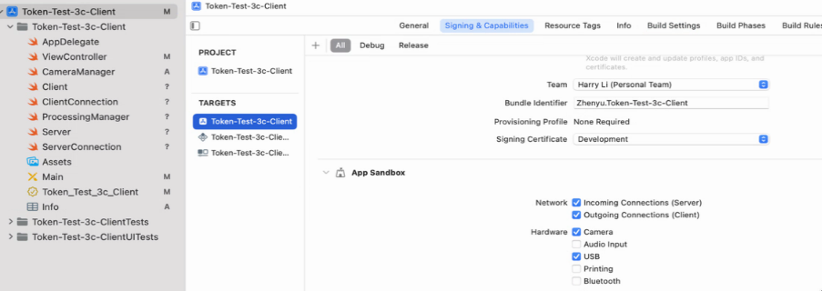
Token Test 3c Xcode Project Settings
https://developer.apple.com/documentation/xcode/adding-capabilities-to-your-app?language=objc
Available “Network” and “USB”
1. Choose Project
2. Choose Target
3. Choose Singing & Capabilities
4. Turn on Network “Incoming-Connections”, “Outgoing Connections”, and “USB”

Slide 23
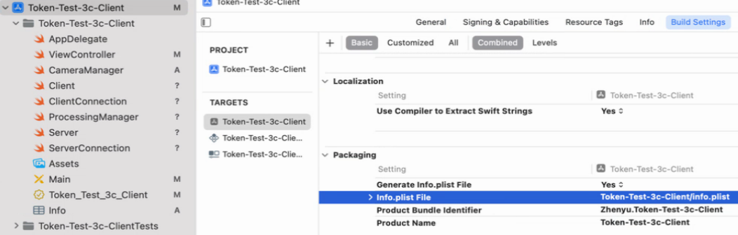
Xcode info.plist Settings
Available “Network” and “USB”
1. Choose Project
2. Choose Target
3. Choose Build Settings
4. In “Packaging”, set Info.plist File

Slide 24
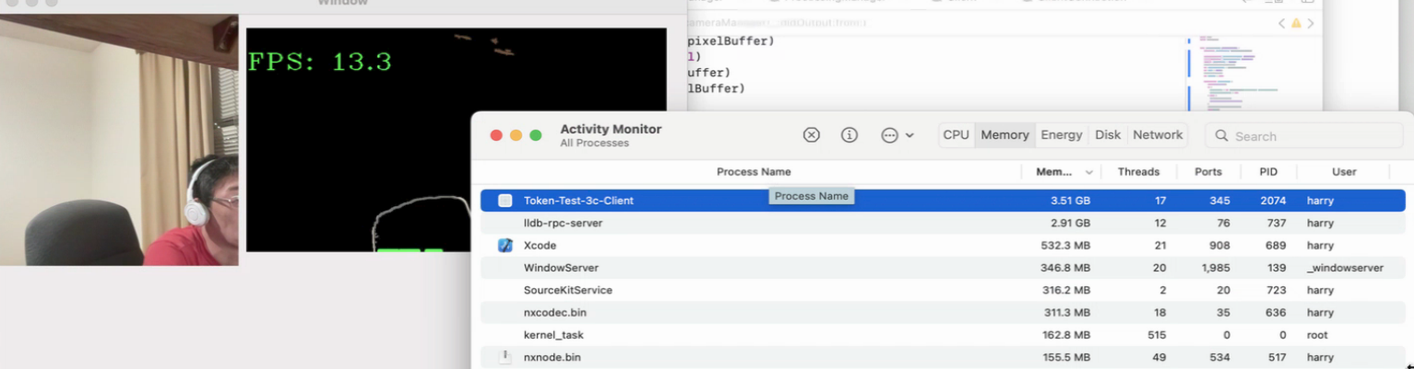
Token Test 3c Memory Leak
1. Memory leak

Slide 25
ARC in Swift
https://docs.swift.org/swift-book/LanguageGuide/AutomaticReferenceCounting.html
Swift uses Automatic Reference Counting (ARC) to track and manage your app’s memory usage. In most cases, this means that memory management “just works” in Swift, and you don’t need to think about memory management yourself. ARC automatically frees up the memory used by class instances when those instances are no longer needed.
However, in a few cases ARC requires more information about the relationships between parts of your code in order to manage memory for you. This chapter describes those situations and shows how you enable ARC to manage all of your app’s memory. Using ARC in Swift is very similar to the approach described in Transitioning to ARC Release Notes for using ARC with Objective-C.
Reference counting applies only to instances of classes. Structures and enumerations are value types, not reference types, and aren’t stored and passed by reference.

Slide 26
Token Test 3c Memory Leak: Getting Image
ViewController.swift
extension ViewController: CameraManagerDelegate {
func cameraManager(_ output: CameraCaptureOutput, didOutput sampleBuffer: CameraSampleBuffer, from connection: CameraCaptureConnection) {
guard let pixelBuffer = CMSampleBufferGetImageBuffer(sampleBuffer) else
{
return
}
let originalCIImage = CIImage(cvImageBuffer: pixelBuffer)
let originalCIContext = CIContext(options: nil)
let imageWidth = CVPixelBufferGetWidth(pixelBuffer)
let imageHeight = CVPixelBufferGetHeight(pixelBuffer)
guard let originalCGImage = originalCIContext.createCGImage(originalCIImage, from: CGRect(x: 0, y: 0, width: imageWidth, height: imageHeight)) else{
return
}
originalNSImage = NSImage(cgImage: originalCGImage, size: CGSize(width: imageWidth, height: imageHeight))
}
}

Slide 27
Token Test 3c Memory Leak: Sending Image
ProcessingManager.swift
while (true){
if imageData != nil{
// Convert a original image from NSImage to PNG Data
guard let unwrappedNSImage = originalNSImage else {
//print("Unwrapped and Nil: ", Date())
continue
}
guard let originalCGImage = unwrappedNSImage.cgImage(forProposedRect: nil, context: nil, hints: nil) else{
print("originalCGImage is nil")
originalNSImage = nil
continue
}
let bitmapImgRep = NSBitmapImageRep(cgImage: originalCGImage)
guard let pngData = bitmapImgRep.representation(using: .png, properties: [:]) else { return }
processingClient.connection.send(data: (pngData) as Data)
originalNSImage = nil
}
}

Slide 28
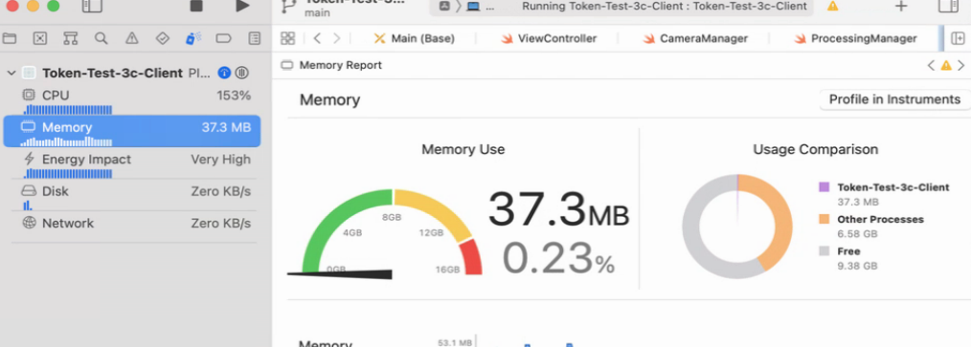
Xcode Debug Navigator
1. Choose “Show the Debug Navigator”
2. Choose “Profile in Instruments”
1
2

Slide 29
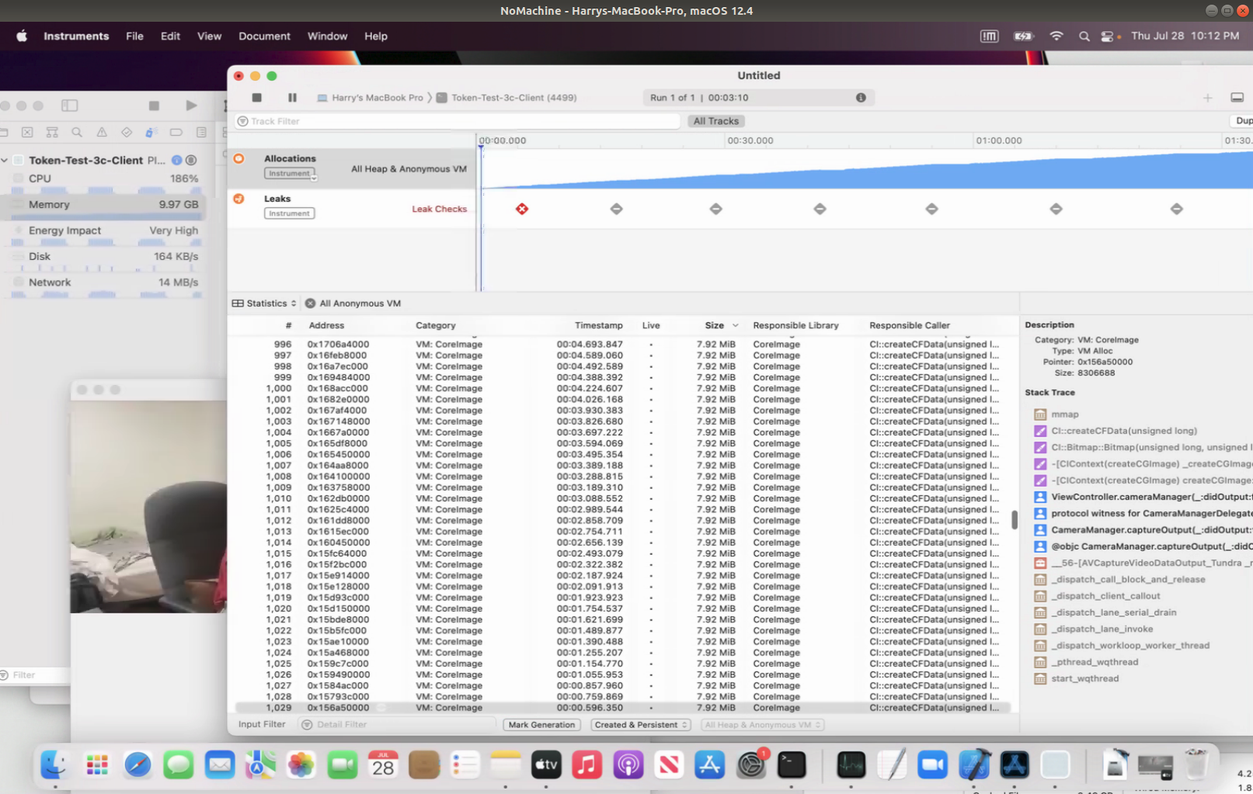
Xcode Debug Navigator
1
2

Slide 30
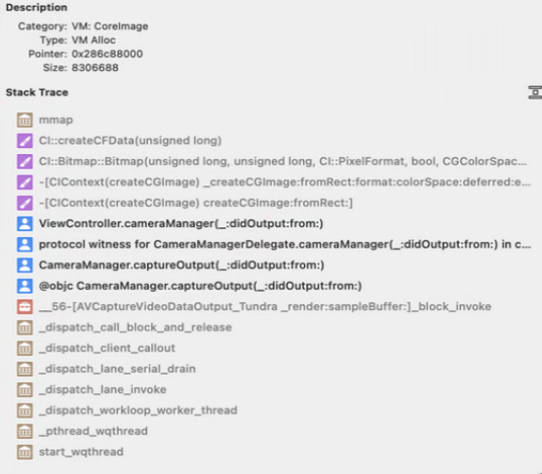
Heap Memory and Source Code
while (true){
if imageData != nil{
// Convert a original image from NSImage to PNG Data
guard let unwrappedNSImage = originalNSImage else {
continue
}
guard let originalCGImage = unwrappedNSImage.cgImage(forProposedRect: nil, context: nil, hints: nil) else{
print("originalCGImage is nil")
originalNSImage = nil
continue
}
1

Slide 31
Memory Leak Test
Question 1: Can we replace thread A by a simple/easier thread to allow thread b to view videos?
Webcam
Question 2: Can we replace thread A by a simple/easier thread to allow thread b to receive data?
MP4 or QT
From JPEG
Question 3: Can we replace thread A by a simple/easier thread to allow thread b to receive hello?
“Hello”
Note:
a. Memory Leaking Detection Small Data may not cause leaking even there’s leaking problem.
b.

Slide 32
Data Memory Leak Test 3
In ViewContoller.swift,
extension ViewController: CameraManagerDelegate {
func cameraManager(_ output: CameraCaptureOutput, didOutput sampleBuffer: CameraSampleBuffer, from connection: CameraCaptureConnection) {
print("ViewController.CameraManagerDelegate()")
// 2022-08-02 YY Set Hello
let HELLO_STR = "HelloHelloHelloHelloHelloHelloHelloHelloHelloHelloHelloHelloHelloHelloHelloHelloHelloHelloHelloHello"
var helloStr = ""
for i in 1...100000 {
helloStr = helloStr + HELLO_STR
}
print("ViewController.CameraManagerDelegate() After loop")
processingManager.setHelloString(setWords: helloStr)
}
In ProcessingManager.swift,
var helloStr = ""
public func start(server: String, port: UInt16) {
Thread.detachNewThread{
self.startThread(server: server, port: port)
}
}
public func startThread(server: String, port: UInt16) {
//processingClient = Client(host: server, port: port)
//processingClient.start()
while(true){
helloStr.append("a")
print("Hello str count:", helloStr.count)
sleep(UInt32(0.1))
}
}
public func setHelloString(setWords: String){
helloStr = setWords
print("ProcessingManager.setHelloString()")
}
100×100000÷1024÷1024= 9.5 MB

Slide 33
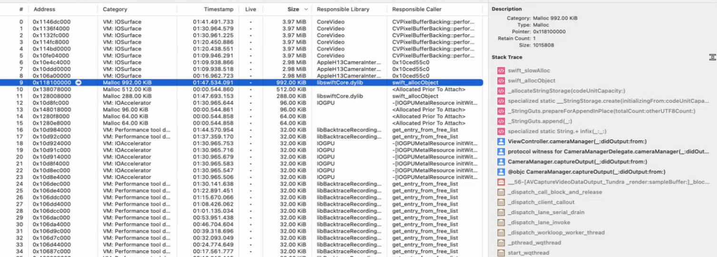
Data Memory Leak Test 3 Result

Slide 34
Image Memory Leak Test 2 Code
In ViewContoller.swift,
extension ViewController: CameraManagerDelegate {
func cameraManager(_ output: CameraCaptureOutput, didOutput sampleBuffer: CameraSampleBuffer, from connection: CameraCaptureConnection) {
let url = URL(fileURLWithPath: "/Users/harry/Downloads/testimage.png")
guard let testNSImage = NSImage(contentsOf: url) else{
//print("ViewController.CameraManagerDelegate(). image file is nil")
return
}
// let imgView = NSImageView(image: img)
print("ViewController.CameraManagerDelegate()")
processingManager.setImage(image: testNSImage)
}
In ProcessingManager.swift,
var originalNSImage : NSImage?
public func start(server: String, port: UInt16) {
Thread.detachNewThread{
self.startThread(server: server, port: port)
}
}
public func startThread(server: String, port: UInt16) {
while(true){
guard let unwrappedNSImage = originalNSImage else {
//print("Unwrapped and Nil: ", Date())
continue
}
print("unwrappedNSImage size:", unwrappedNSImage.size)
sleep(UInt32(0.1))
}
}
public func setImage(image: NSImage){
originalNSImage = image
}

Slide 35
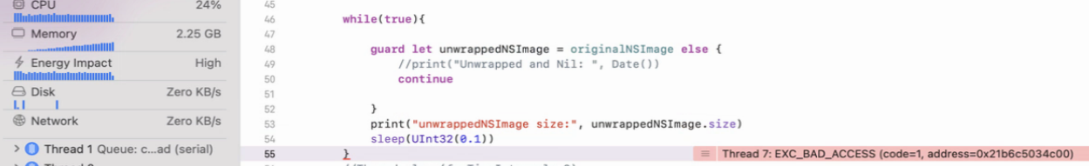
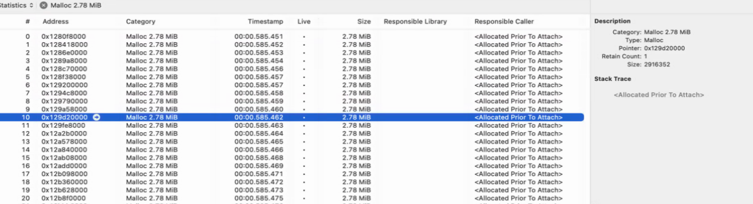
Image Memory Leak 2 Test Result

Slide 36
Image Memory Leak Test 2 Code without MultiThreading
In ViewContoller.swift,
extension ViewController: CameraManagerDelegate {
func cameraManager(_ output: CameraCaptureOutput, didOutput sampleBuffer: CameraSampleBuffer, from connection: CameraCaptureConnection) {
let url = URL(fileURLWithPath: "/Users/harry/Downloads/testimage.png")
guard let testNSImage = NSImage(contentsOf: url) else{
return
}
print("ViewController.CameraManagerDelegate()")
processingManager.printImageSize(image: testNSImage)
}
}
In ProcessingManager.swift,
public func printImageSize(image:NSImage){
originalNSImage = image
guard let unwrappedNSImage = originalNSImage else {
print("Unwrapped and Nil: ", Date())
return
}
print("unwrappedNSImage size:", unwrappedNSImage.size)
}
No Memory Leaking

Slide 37
Image Memory Leak Test 2 Code without MultiThreading
In ViewContoller.swift,
extension ViewController: CameraManagerDelegate {
func cameraManager(_ output: CameraCaptureOutput, didOutput sampleBuffer: CameraSampleBuffer, from connection: CameraCaptureConnection) {
let url = URL(fileURLWithPath: "/Users/harry/Downloads/testimage.png")
guard let testNSImage = NSImage(contentsOf: url) else{
return
}
print("ViewController.CameraManagerDelegate()")
processingManager.printImageSize(image: testNSImage)
}
}
In ProcessingManager.swift,
public func printImageSize(image:NSImage){
let unwrappedNSImage = image
print("unwrappedNSImage size:", unwrappedNSImage.size)
guard let originalCGImage = unwrappedNSImage.cgImage(forProposedRect: nil, context: nil, hints: nil) else{
print("originalCGImage is nil")
return
}
let bitmapImgRep = NSBitmapImageRep(cgImage: originalCGImage)
autoreleasepool{
guard let pngData = bitmapImgRep.representation(using: .png, properties: [:]) else { return }
}
}
Memory Leaking

Slide 38
Image Memory Leak Test 2 Code without MultiThreading
extension ViewController: CameraManagerDelegate {
func cameraManager(_ output: CameraCaptureOutput, didOutput sampleBuffer: CameraSampleBuffer, from connection: CameraCaptureConnection) {
let url = URL(fileURLWithPath: "/Users/harry/Downloads/testimage.png")
autoreleasepool{
guard let testNSImage = NSImage(contentsOf: url) else{
return
}
print("ViewController.CameraManagerDelegate()")
processingManager.printImageSize(image: testNSImage)
}
}
}
In ProcessingManager.swift,
public func printImageSize(image:NSImage){
autoreleasepool{
print("unwrappedNSImage size:", image.size)
guard let originalCGImage = image.cgImage(forProposedRect: nil, context: nil, hints: nil) else{
print("originalCGImage is nil")
return
}
let bitmapImgRep = NSBitmapImageRep(cgImage: originalCGImage)
guard let pngData = bitmapImgRep.representation(using: .png, properties: [:]) else { return }
}
}
No Memory Leaking

Slide 39
autoreleasepool
https://swiftrocks.com/autoreleasepool-in-swift
https://github.com/koher/swift-image/issues/38

Slide 40
Select eGlass from USB Video Devices
let deviceDiscoverySession = AVCaptureDevice.DiscoverySession.init(deviceTypes: [AVCaptureDevice.DeviceType.builtInWideAngleCamera, AVCaptureDevice.DeviceType.externalUnknown], mediaType: .video, position: AVCaptureDevice.Position.unspecified)
// Set "eGlass" device
for device in deviceDiscoverySession.devices{
if device.localizedName.lowercased().contains("eglass"){
cameraDevice = device
break
}
}
// Set the first device
if cameraDevice == nil{
cameraDevice = deviceDiscoverySession.devices.first
}
device.localizedName returns “HoverCam eGlass”

Slide 41
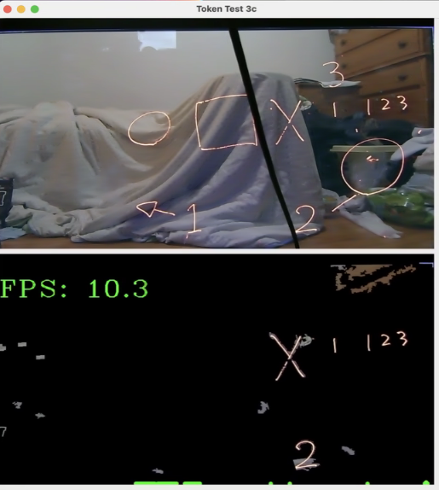
TT3c with eGlass
Fig . The result of Token Test 3c with eGlass

