Slide 1
Terminal App
Subway Trip Planner

Slide 2
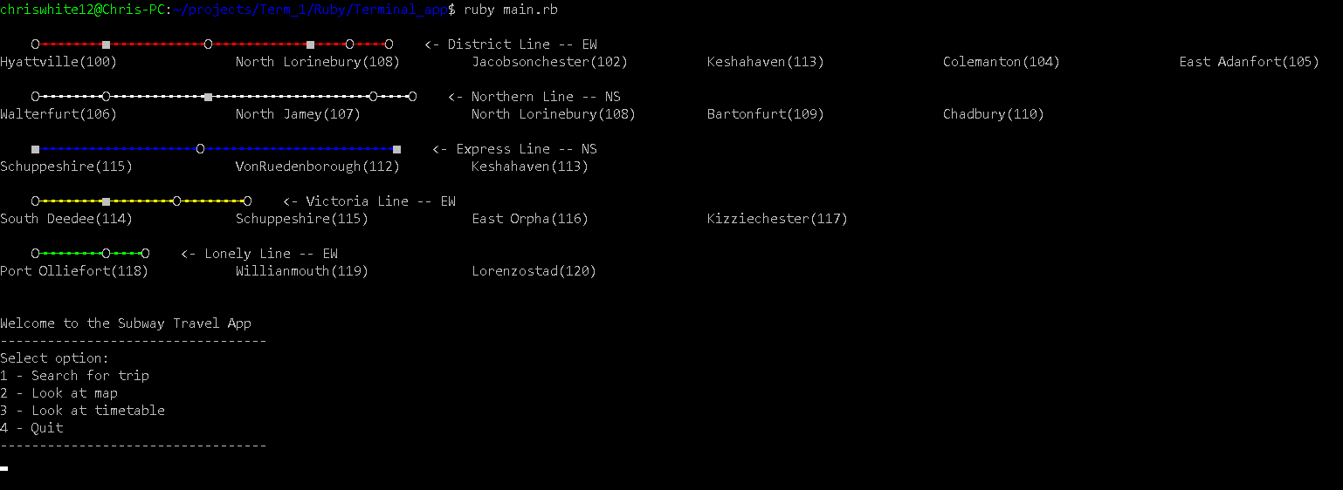
Demo

Slide 3
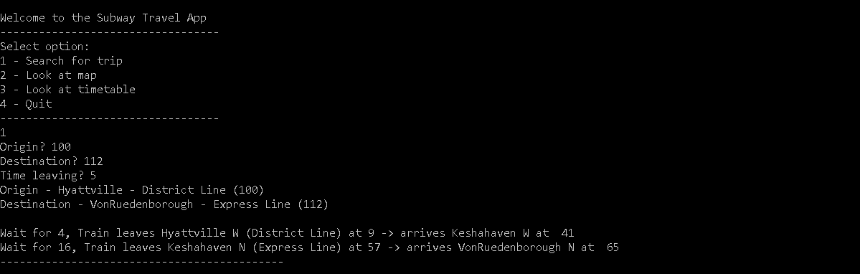
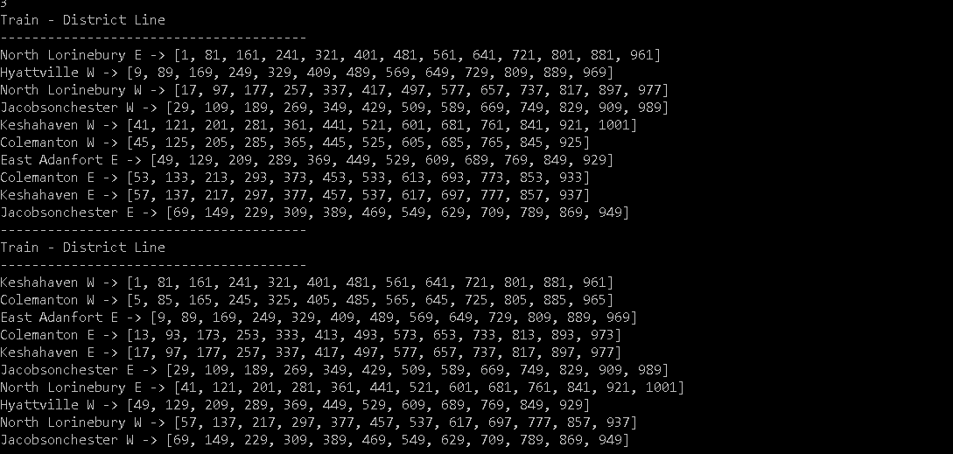

Slide 4
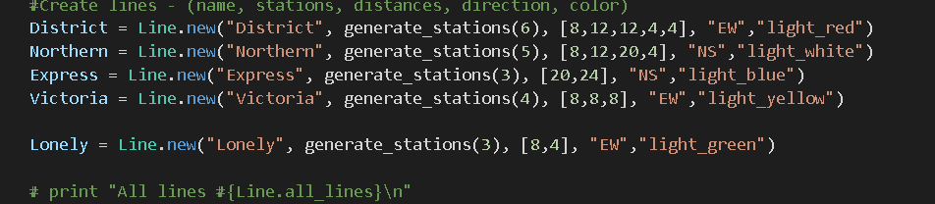
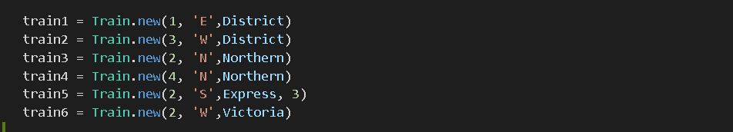
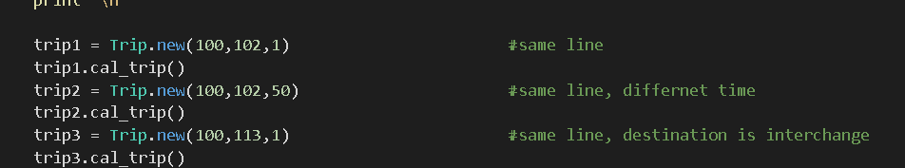
Objects
Line objects are created with:
Name
Randomly named stations
Distance between each station
Direction and
Colour
Trains objects are created with:
Starting point
Direction
And which line it is placed on
Trip objects are created with:
Origin and destination name
Time

Slide 5
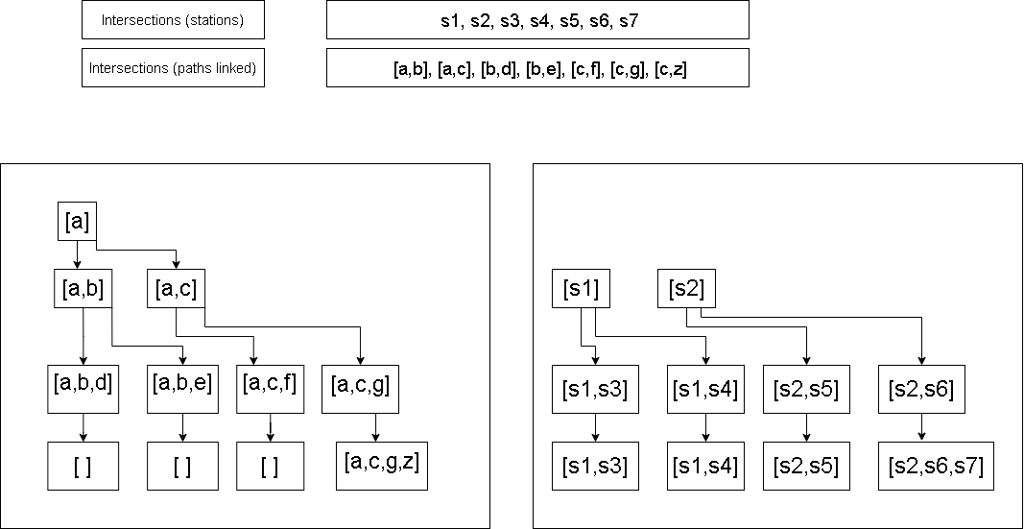
Calculating the trip

Slide 6
Further work
There are some features that haven’t been implemented.
There can only be one possible path calculated with the current program. Function be implemented if the distance and time taken is returned
Displaying the map as an animation
Displaying time correctly

