Slide 1
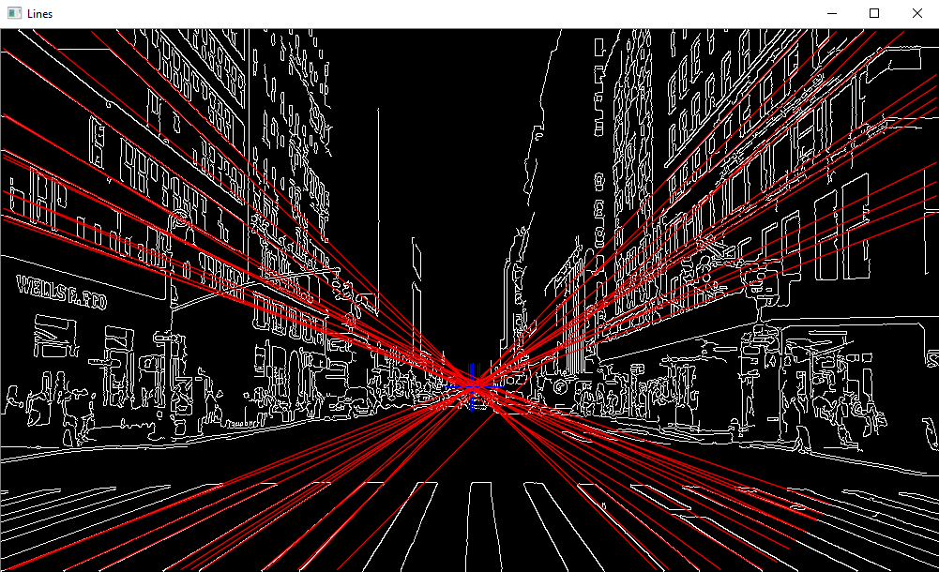
Detection of Vanishing Points in Unstructured Images

Slide 2

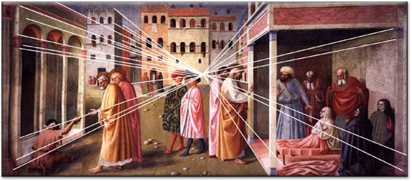
History
- Prior to 15th Century, paintings looked skewed
- Filippo Di Ser Brunellesco was one of the first renaissance artists to make effective use of perspective, by extending vanishing points from the horizon
- First theorem on perspective published by Guidobaldo de Monte in 1600

Slide 3
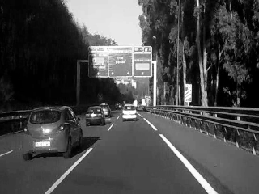
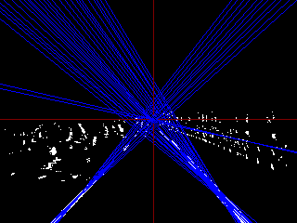
Current Approaches
- Nieto (2011) finds vanishing points by detecting lane markings, Hough transform and MSAC
- (Zhou et. al) and (Cipolla et. al.) also use vanishing points for automatic camera calibration and lens detection

Slide 4
Method & Objectives
- Previous methods require envrionment information (lane marking size)
- Manual tuning of all thresholds
- And a structured environment (easily distinguishable geometry)
- Project aim is for algorithm to be less dependent on scene structure
- Should not rely on predefined geometry or manual threshhold values

Slide 5
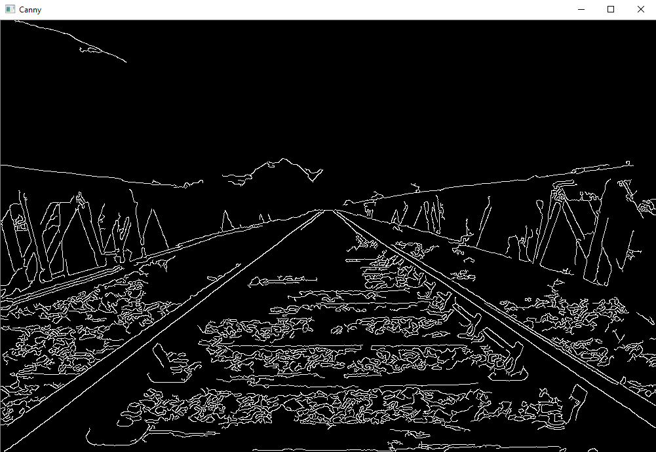
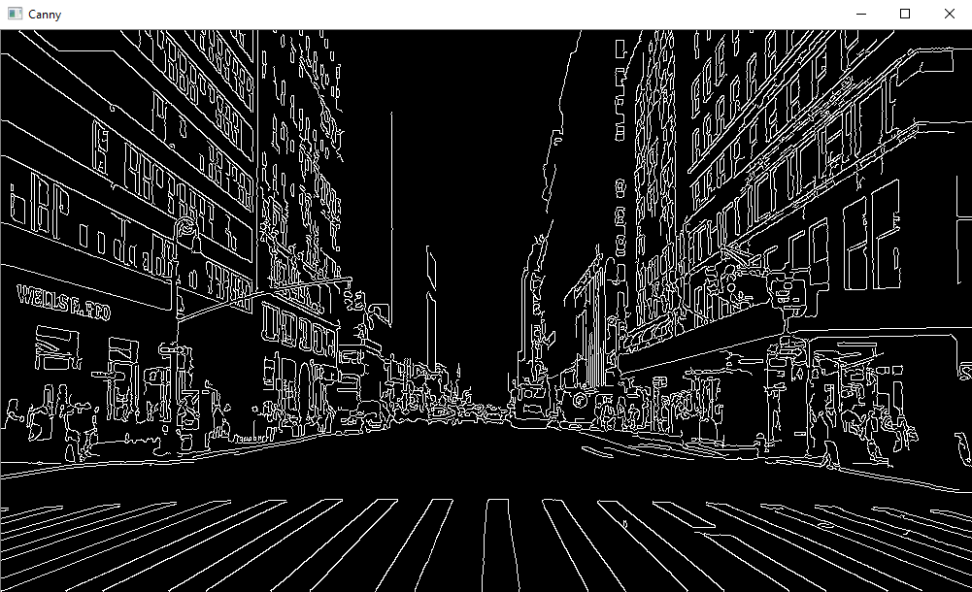
Greyscale and Canny filter
- Canny filter on greyscale image
- Based on work of Wong (2009) median of grey channel taken, threshhold limits set to 1 std. dev. Away
- Found to be reasonably robust across multiple images

Slide 6
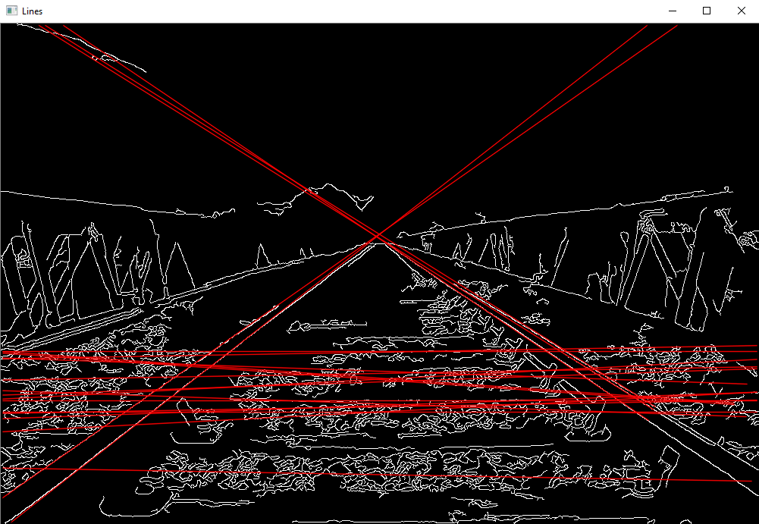
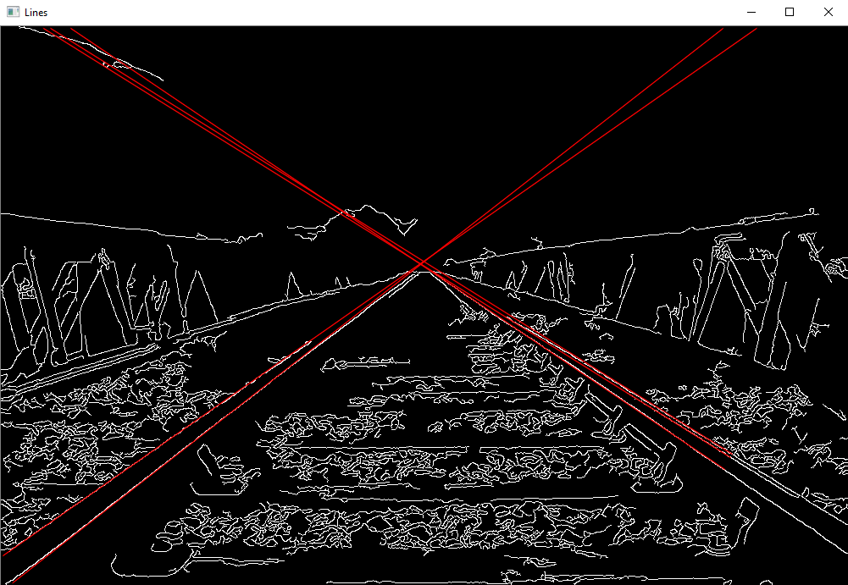
Hough Lines and filtering
- Convergence lines successfully detected, however false positives also detected
- Hough lines threshhold based on size of image, therefore all images rescaled to 1000 pixels across
- Convergence lines should always be diagonal, so vertical and horizontal lines rejected (lines with gradient of 0, 90, 180, or 270 degrees, +/- threshhold)
if ((theta1 >(0 + theta_thresh)) && (theta1 < (CV_PI / 2 - theta_thresh)) || (theta1 >((CV_PI / 2) + theta_thresh)) && (theta1 < (CV_PI - theta_thresh))) {

Slide 7

Convergence Line Crossing Detection
- Vanishing point defined as point where two vanishing lines cross
- Calculated as intersection of two line equations
- Calculated for every pair combination of detected convergence lines (double for() loop)
float determinative = (costheta1 * sintheta2) - (sintheta1 * costheta2);
intersection.x = ((sintheta2 * rho1) - (sintheta1 * rho2)) / determinative;
intersection.y = ((-costheta2 * rho1) + (costheta1*rho2)) / determinative;
cv::drawMarker(image_colour, intersection, cv::Scalar(255, 0, 0), cv::MARKER_CROSS, 50, 1, 8);

Slide 8
Testing
- What's the error? (in pixels)
- Manually define vanishing point (not always easy)
- Subject to human error
- Usually multiple vanishing points found (in one case 414 VPs)
- Affected by unstructured geometry in image
- Hough lines threshhold modified by divisor, divisor varied for testing
- Find average
- Find average distance from manually defined VP

Slide 9
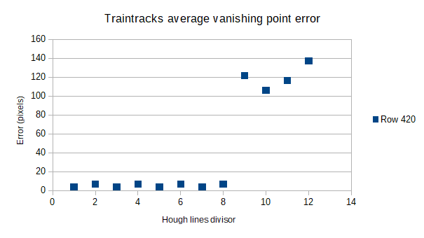
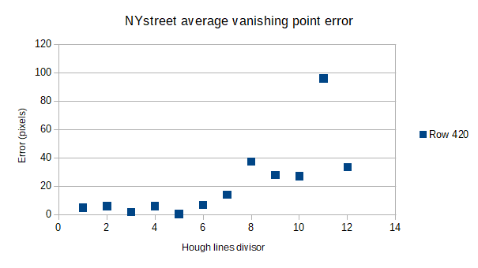
Results
- Hough transform still manual
- Larger Hough divisor allows more convergence lines, more VPs
- In general, more VPs means more error
- False positives often emerged from dense, clustered lines (ie. foliage)
- Automatic Canny threshhold still has difficulties with heavily "bloomed" images
- Generally, automatic Canny threshold successful
- Standardising size of image is good approach for Hough lines
- Better method of rejection for non-converging lines needed

Slide 10
References
Carter, P. (1998). Geometry in Art and Architecture Unit 11. [online] Available at:
https://www.dartmouth.edu/~matc/math5.geometry/unit11/unit11.html [Accessed 17th March 2018]
Andersen, K. (2007). The Geometry of An Art. 1st ed. [ebook] Copenhagen: University of Copenhagen. Pp245-248. Available at: https://books.google.co.uk/books?id=8B_JeMxNUIkC&pg=PA245&lpg=PA245&dq=vanishing+point+theorem&source=bl&ots=IqUy5GfP8z&sig=J8ElEdZGflC14_lwo3FTLjWts-o&hl=en&sa=X&ved=0ahUKEwiIhur7xLnaAhWkL8AKHab0AfoQ6AEIygEwGw#v=onepage&q=vanishing%20point%20theorem&f=false [Accessed 17th march 2018]
Nieto, M. (2011). Lane markings detection and vanishing point detection with OpenCV. [Blog] marcosnietoblog. Available at: https://marcosnietoblog.wordpress.com/2011/12/27/lane-markings-detection-and-vanishing-point-detection-with-opencv/ [Accessed 22nd March 2018]
Wong, K. (2009). Canny Edge Detection Auto Thresholding. [online] Available at:
http://www.kerrywong.com/2009/05/07/canny-edge-detection-auto-thresholding/ [Accessed March 30th 2018]
He, B.W, Zhou, X, L, Li, Y, F. (2011). A new camera calibration method from vanishing points in a vision system. In: Transaction of the Institute of Measurement and Control. [online] Hong Kong: City University of Hong Kong, pp.806-822. Available at: http://citeseerx.ist.psu.edu/viewdoc/download?doi=10.1.1.920.2887&rep=rep1&type=pdf [Accessed 3rd April 2018]
Cipolla, R, Drummond, T, Robertson, D. (1999) camera calibration from vanishing points in images of architectural scenes. In: The tenth British Machine Vision Conference. [online] Cambridge, University of Cambridge. Available at: https://pdfs.semanticscholar.org/7782/2ed97da9f8d7deb59aafb869c8234803f05a.pdf [Accessed 8th April 2018]

