Slide 1

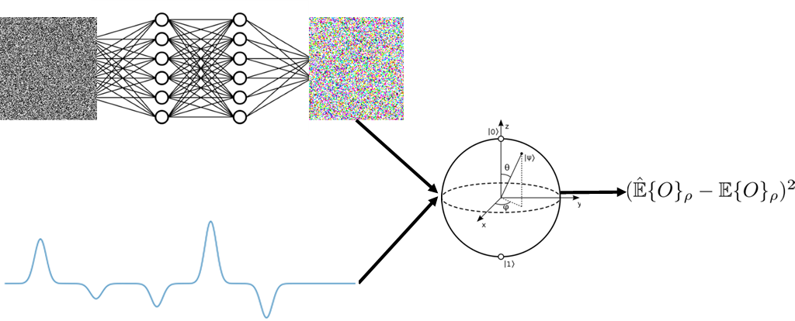

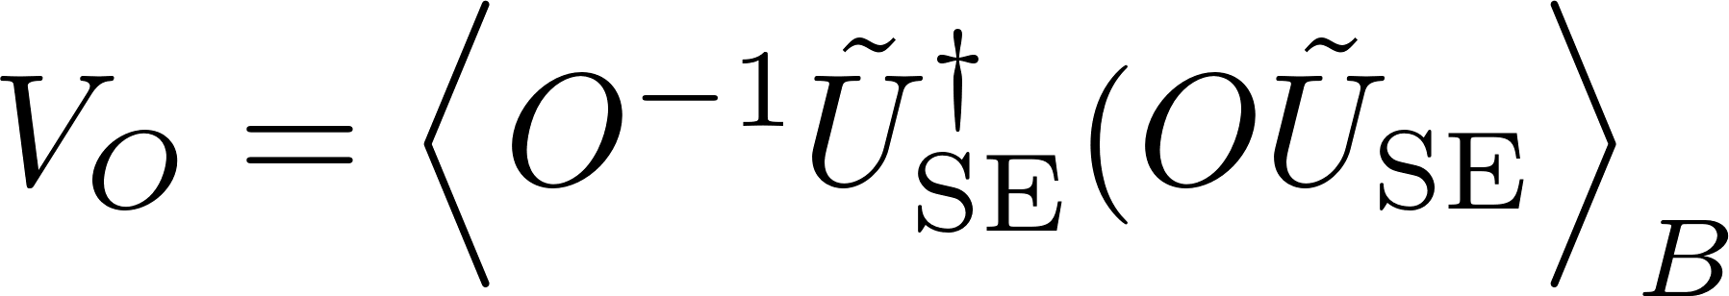
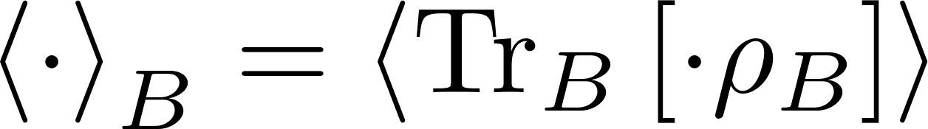
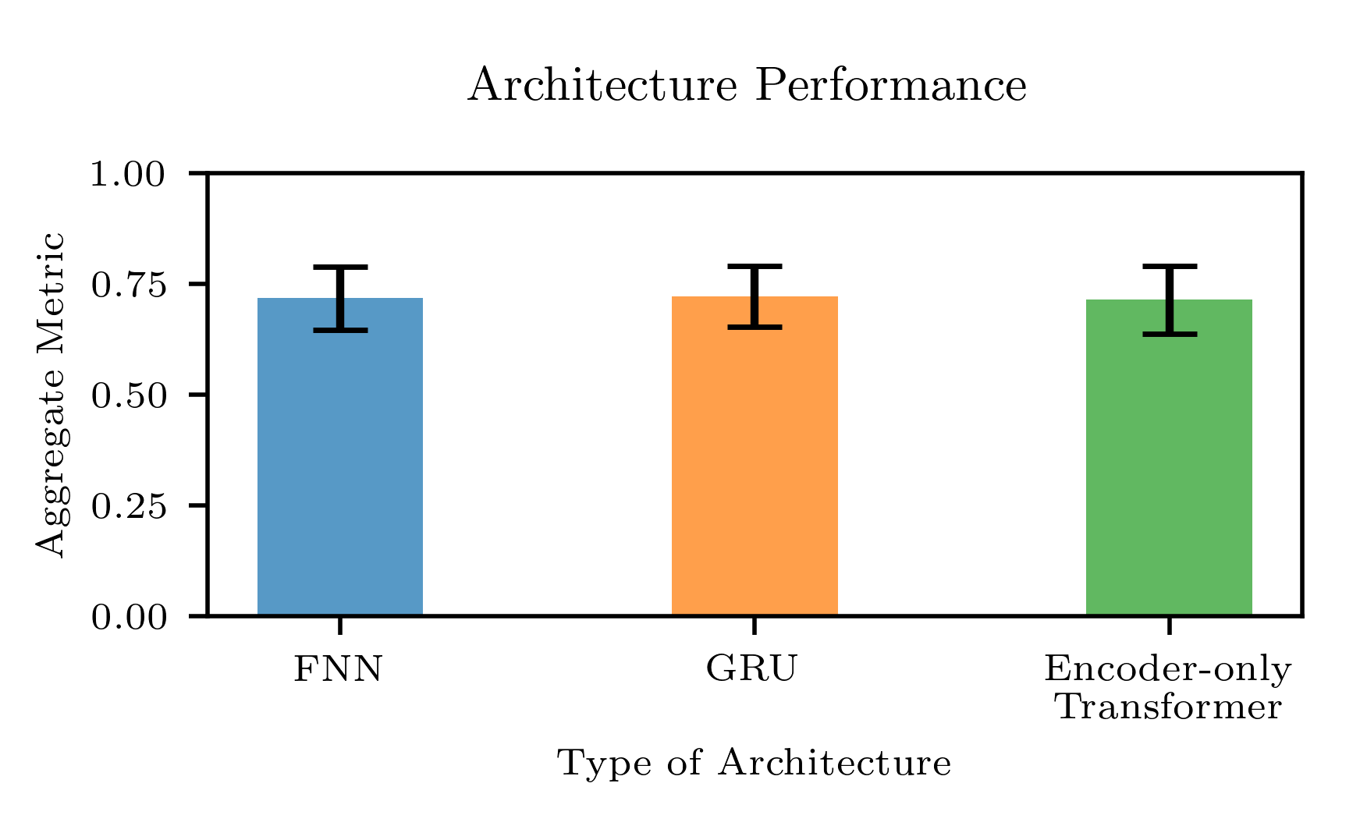


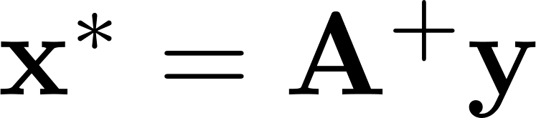




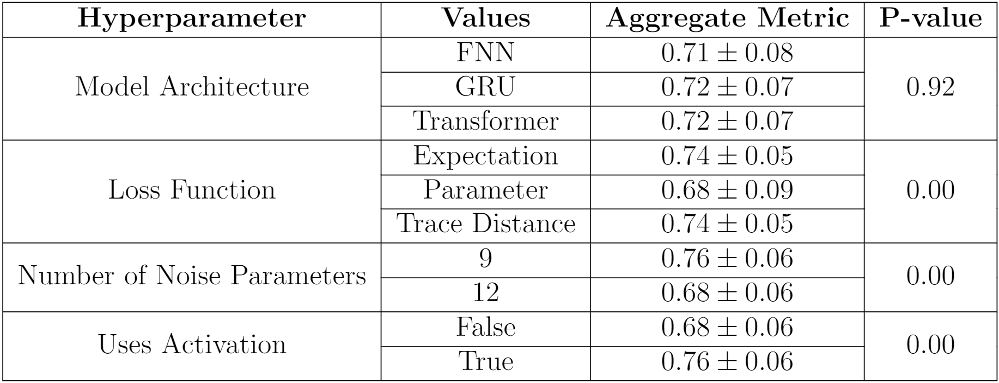


Title goes here
By line goes here
Transformer-Based Learning for Predicting Qubit Environment Interactions
Chris Wise*, Ruvi Lecamwasam, Jason Twamley, Jo Plested, and Matt Woolley
We present a method to deduce qubit-environment interactions using only observable expectations. We then investigate transformer-based architectures that map control pulses to qubit-environment interactions. Finally, we introduce a novel transformer-based qubit simulator to learn the classical noise distribution of a quantum computer.
Motivation
Predicting qubit-environment interactions given an arbitrary control pulse sequence is non-trivial [1]. This non-triviality motivated our exploration of machine learning (ML) models to perform these predictions, where a sufficiently accurate model enables efficient optimisation of control pulses.
Previous Work
Assumptions about the environment have limited previous work using ML to predict qubit-environment interactions or optimise control pulses. To address this, Youssry et al. [1] proposed a formalism that separated closed-system dynamics from system-environment interactions. In this formalism, observable expectations become,
Transformers for Predicting Qubit-Environment Operators
We developed two loss functions:
the trace distance between predicted and ground truth operators,
the MSE between predicted and ground truth parameters.
These loss functions were tested against the expectation-based MSE per previous work [1].
We also benchmarked three models:
encoder-only transformer,
gated recurrent unit (GRU) [1],
feedforward neural network (FNN).
Experiments also investigated the use of final layer activation functions and the number of operator parameters predicted.
It was found that the number of parameters predicted, final layer activation functions, and the loss function all impacted model performance. However, the FNN, GRU and encoder-only transformer all performed similarly. Since the FNN was performant, this indicates that predicting qubit-environment interactions may be easier than first thought.
Transformer-based Qubit Simulator
We then integrated an encoder-only transformer into an open-quantum system qubit simulator. This model learned to map white noise to noise present on a quantum computer, where model output was combined with control pulses to compute observable expectations. This transformer-based qubit simulator could model ground truth expectations with 96% accuracy.
were,
with,
where encodes the influence of qubit-environment interactions.
Extensions To Previous Formalism
We started by writing
Contributions
Extending qubit-environment interaction operator formalism.
Developing a transformer-based architecture for quantum-based problems and benchmarking it against other deep learning models.
Introducing a novel transformer-based qubit simulator.
References
[1] Youssry A., Paz-Silva G. A., and Ferrie C. ``Characterization and control of open quantum systems beyond quantum noise spectroscopy''. In: npj Quantum Information 6.1 (2020), p. 95.
[2] Perrier E., Youssry A., and Ferrie C. ``QDataSet, quantum datasets for machine learning''. In: Scientific Data 9.1 (2022), p. 582.
Deriving the structure of we found that only three parameters were required to specify in the single qubit case. With this parameterisation, we solved
where contains parameters, is the Moore-Penrose pseudoinverse of which is built from observable and control unitary parameters, and yycontains observable expectations.
1000 estimated operators were calculated from expectations, with corresponding ground truth operators, from QDataSet [2]. We found a maximum error of 0.00002 and an average of 0.000003 between the ground truth and estimated operators. With GPU acceleration, on average, 0.005 +/- 0.0001 seconds were required for these calculations.
*c.wise@student.unsw.edu.au

