Slide 1
Param 1-3, SEIZ
Order: caveman, windmill, small world, anisotropy

Slide 2
Readme
Each row is a parameter set, from 1 to 3
Each colomn is a topology: caveman, windmill, small world, anisotropy

Slide 3
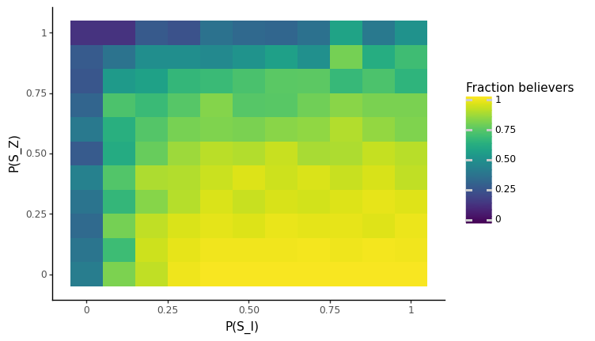
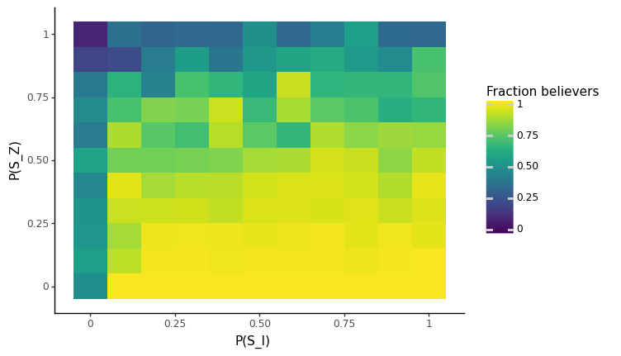
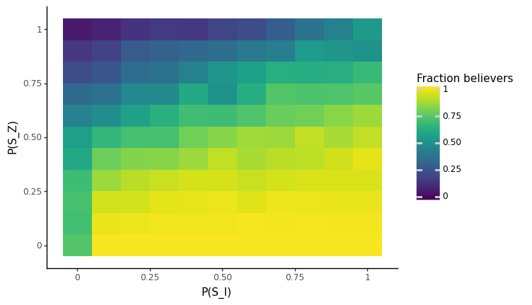
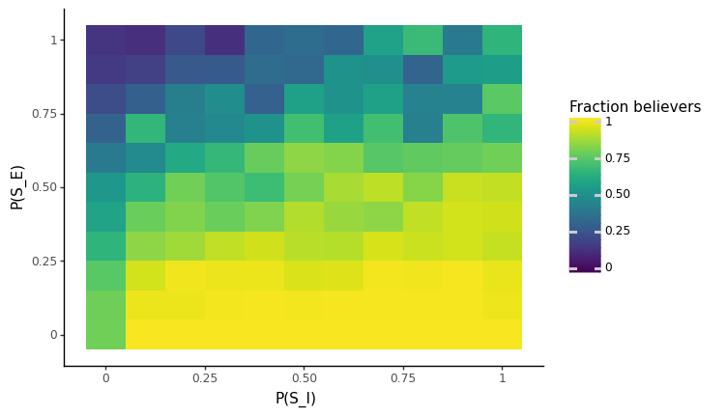
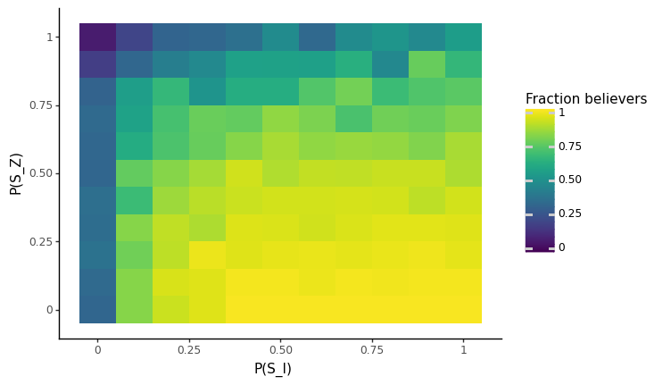
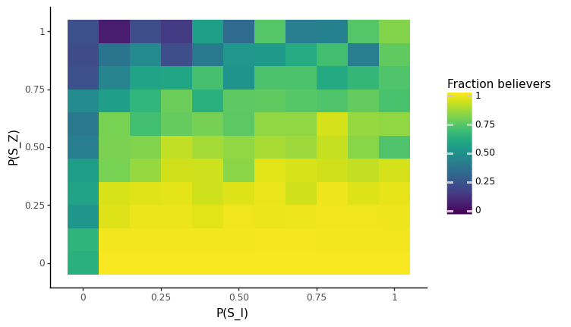
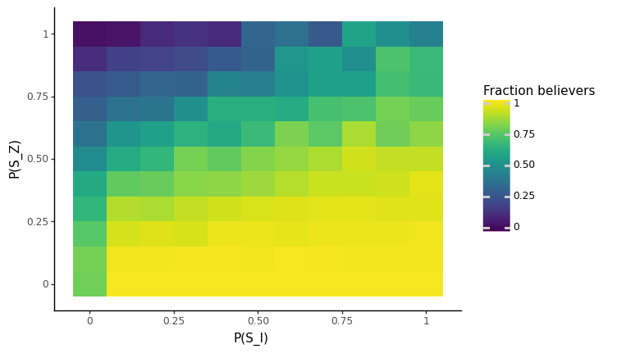
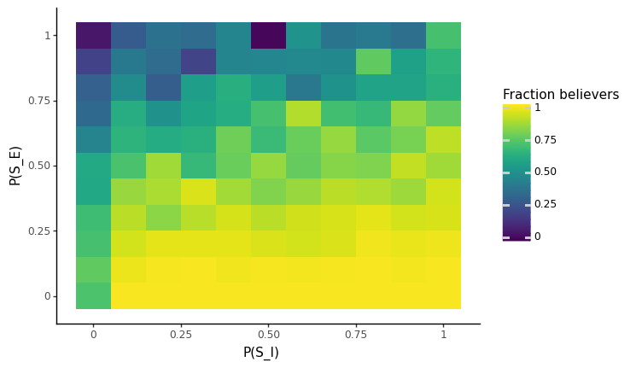
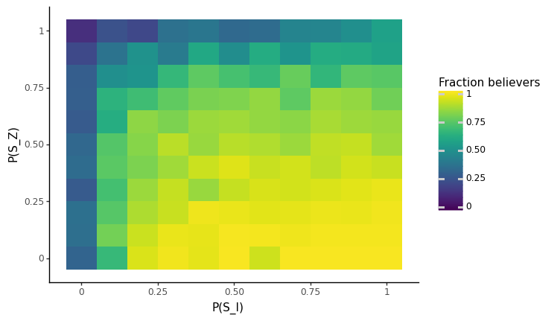
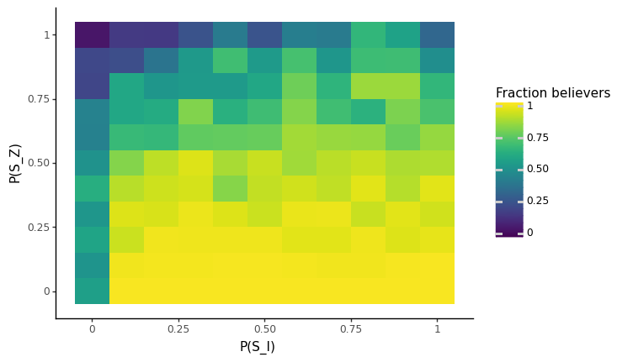
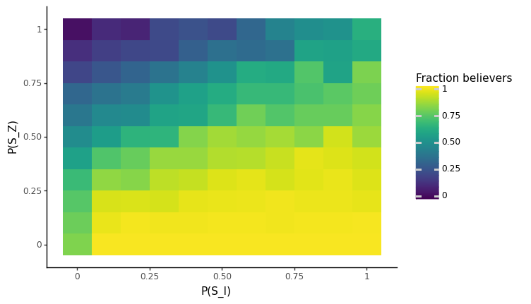
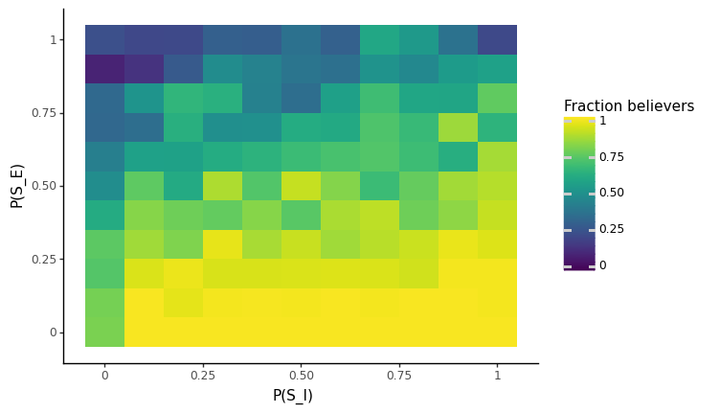
P(SZ) VS P(SI), P(EI)=0.01

Slide 4
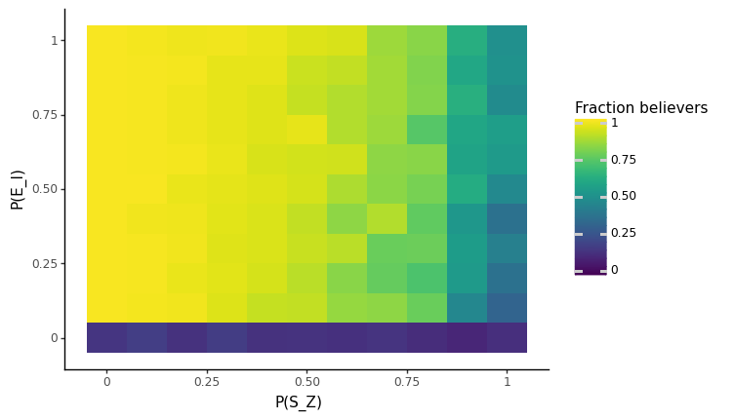
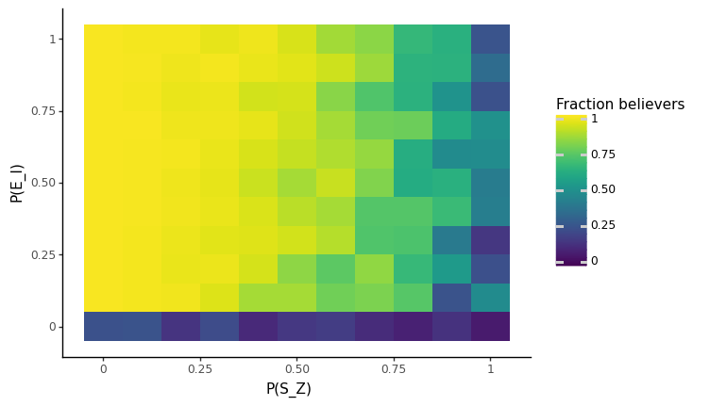
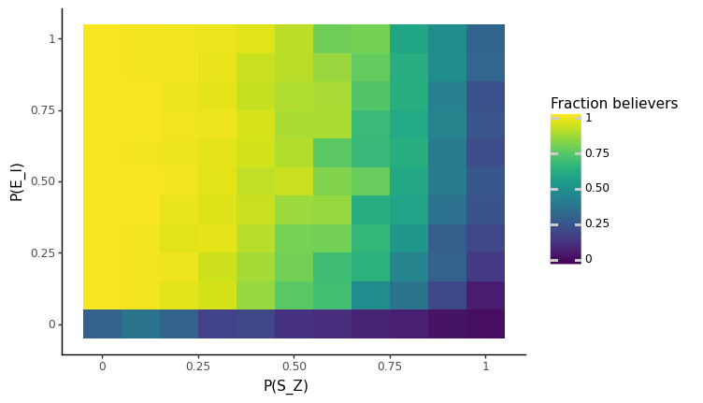
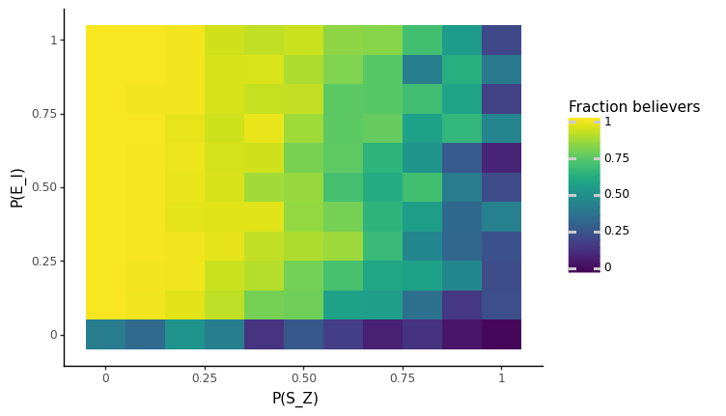
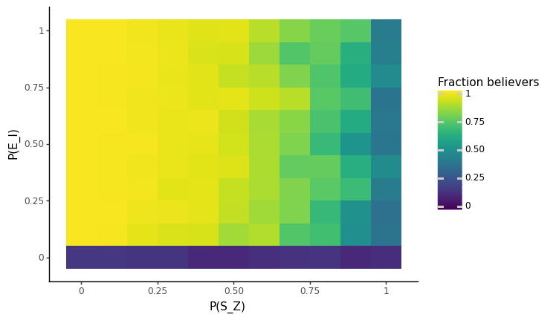
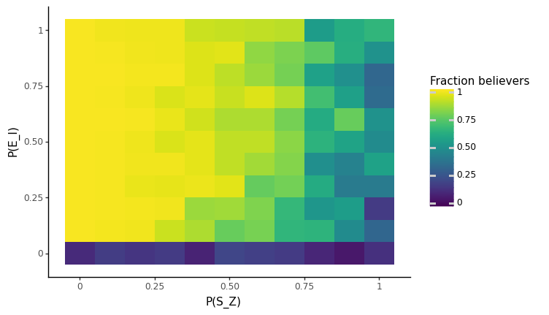
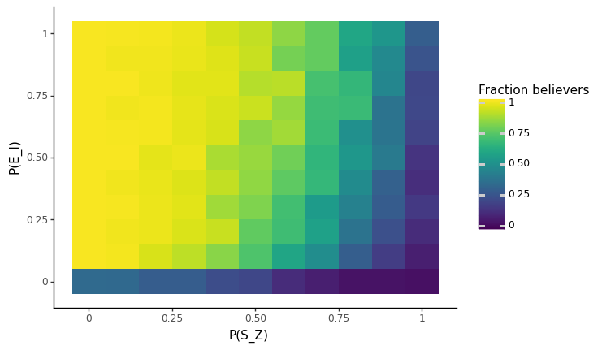
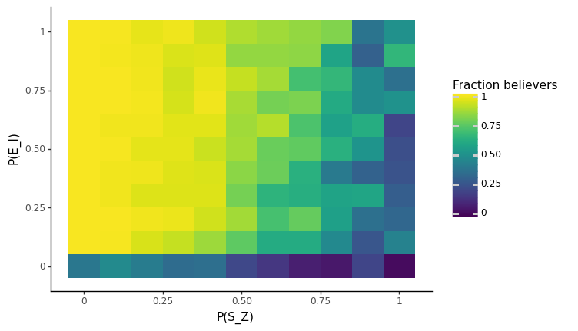
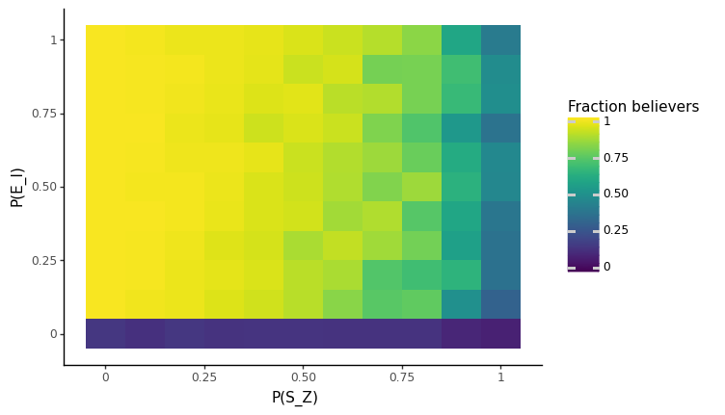
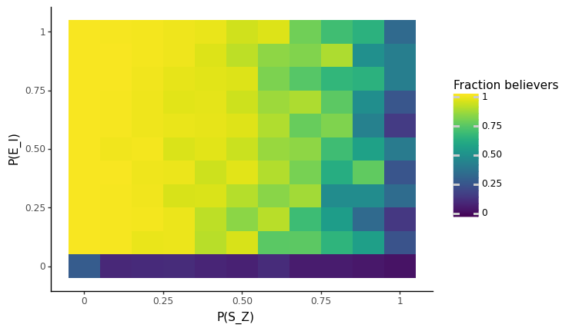
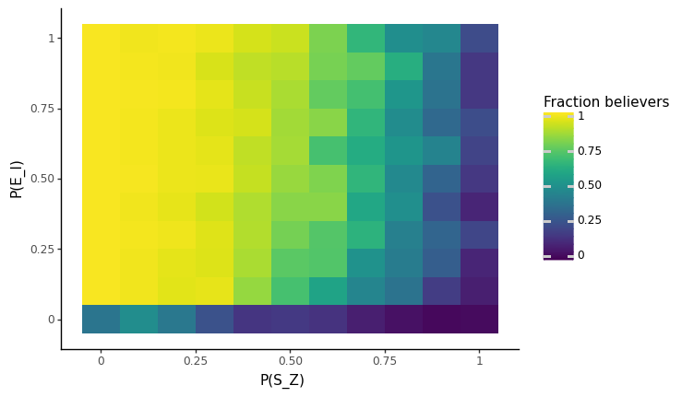
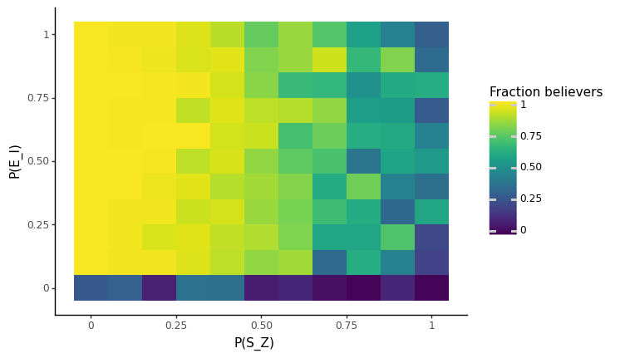
P(SZ) VS P(EI), P(SI)=0.03

Slide 5
Param 1-3, SEIZ+
Order: caveman, windmill, small world, anisotropy

Slide 6
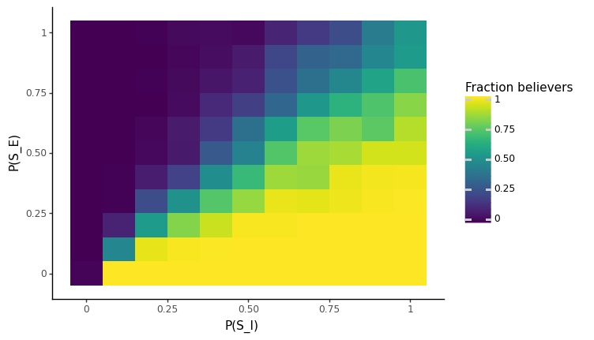

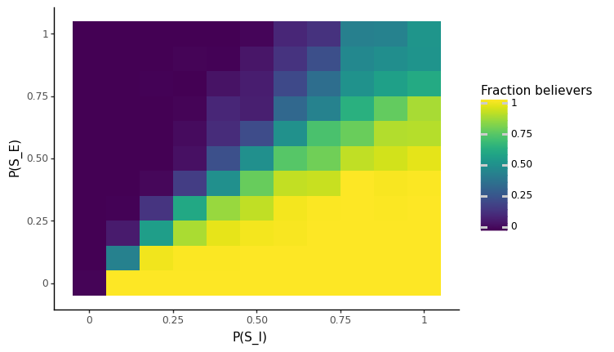
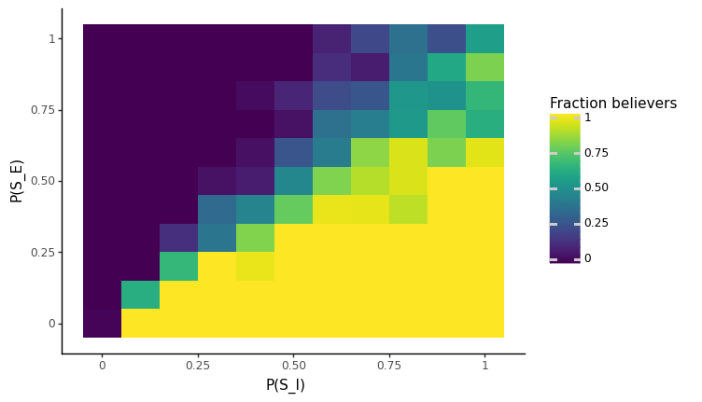





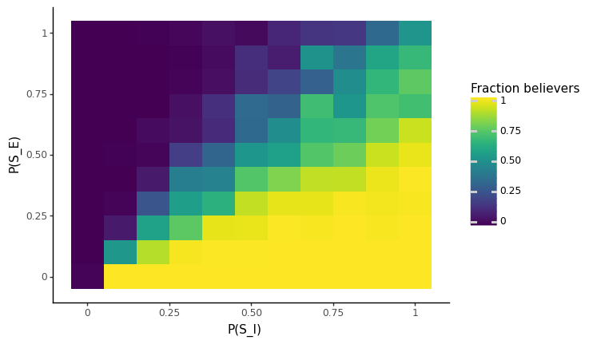

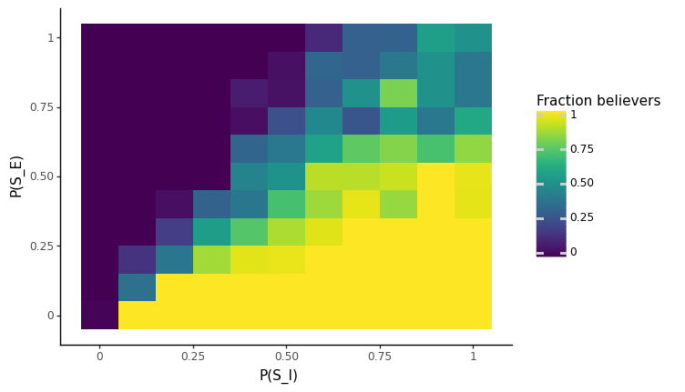
P(SZ) VS P(SI), Neighbor_threshol=0.7

Slide 7
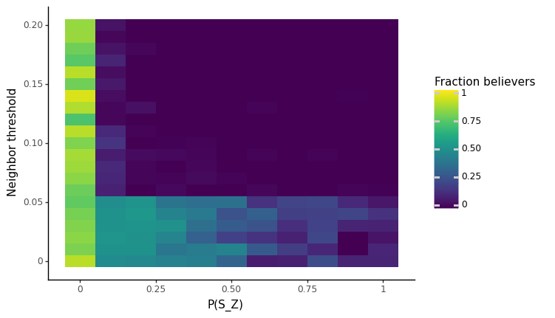
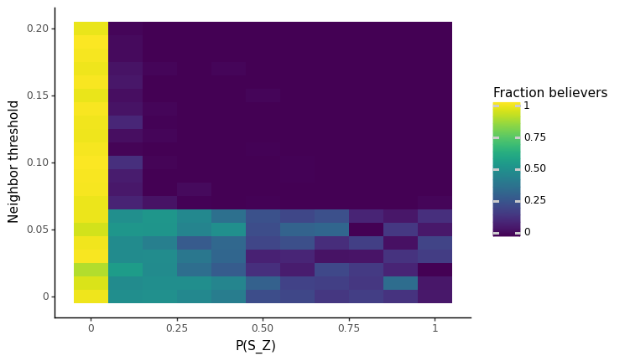
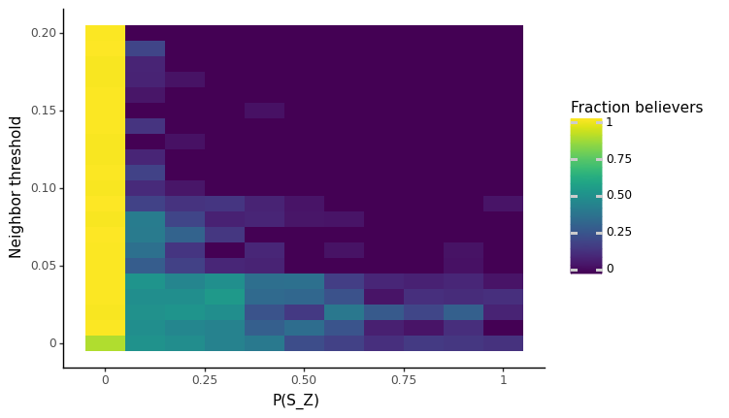
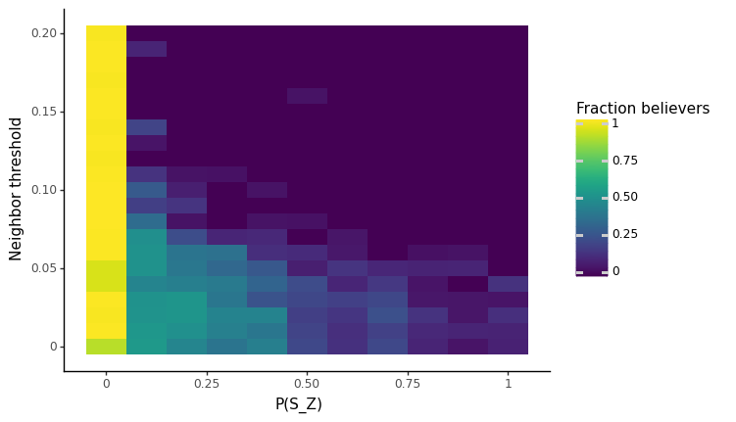
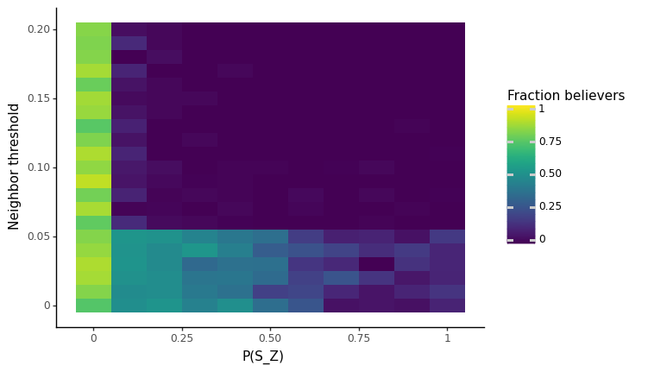


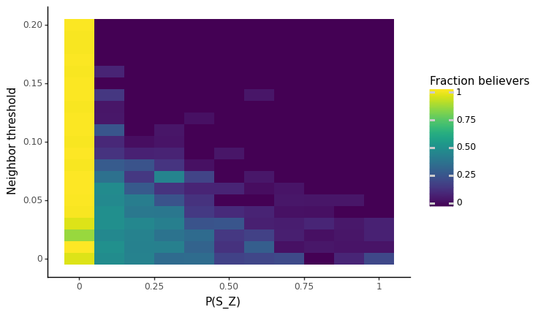


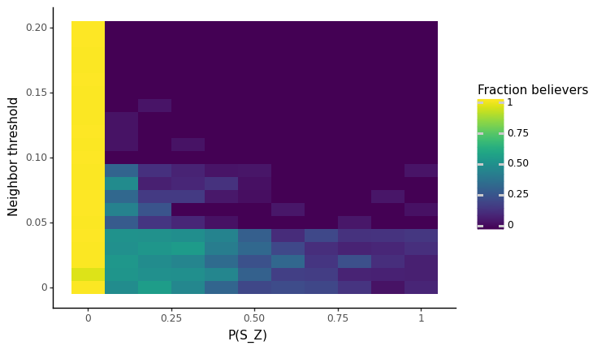
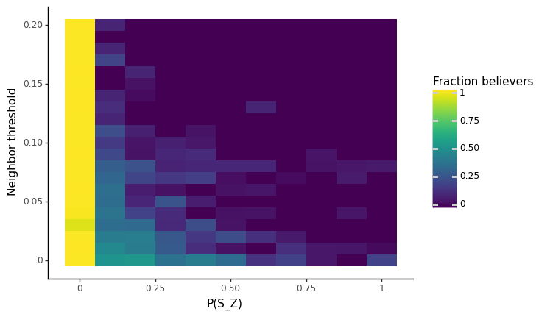
P(SZ) VS NEIGHBOUR, PSI=0.03

Slide 8
Summary difference in parameters Density Clustering Coefficient, parameters. 120 n
 | Caveman |  |  |  | Windmill |  |  |  | Smallworld |  |  |  | Anisotropic
 | D | CC |  |  | D | CC |  |  | D | CC |  |  | D | CC
1 | 0.1597 | 0.9845 | 6 | 20 | 0.1322 | 0.9927 | 8 | 16 | 0.168 | 0.7105 | 20 | 0 | 0.1513 | 0.494 | 15 | 60 | 0.96
2 |  |  |  |  |  |  |  |  |  | 0.629 |  | 0.05 | 0.15 | 0.7057 | 21 | 84 | 0.96
3 |  |  |  |  |  |  |  |  |  | 0.5174 |  | 0.1 | 0.1448 | 0.922 | 27 | 108 | 0.32

Slide 9
Summary results (to test with 4,5,6…)
With P(EI)=0.01, as soon as P(SI) goes a bit high every one converts

