Slide 1
ECE254 Lab2 Tutorial ARM RL-RTX Task Management
Irene Huang
(last updated: 2015/09/14)

Slide 2
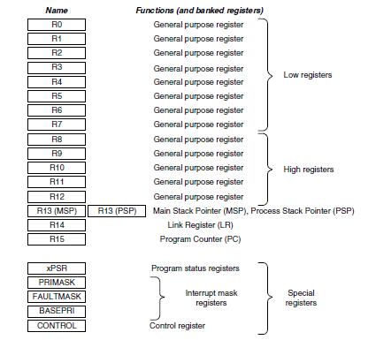
Cortex-M3 Registers
32-bit microprocessor
32-bit data path
32-bit register bank
32-bit memory interface
Harvard Architecture
Separate data and memory bus
Low registers: R0-R7
16-bit Thumb instructions
32-bit Thumb-2 instructions
High registers: R9-R12
All Thumb-2 instructions
MSP: default after reset os kernel, exception handler
Privileged
PSP: base-level application
unprivileged, user-level
(Image Courtesy of [1])

Slide 3
AAPCS (ARM Architecture Procedure Call Standard)
R0-R3 , R12
Input parameters Px of a function. R0=P1, R1=P2, R2=P3 and R3=P4
R0 is used for return value of a function
R12, SP, LR and PC
R12 is the Intra-Procedure-call scratch register.
R4-R11
Must be preserved by the called function. C compiler generates push and pop assembly instructions to save and restore them automatically.

Slide 4
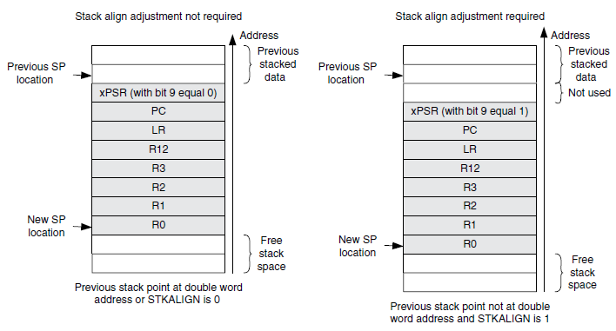
Exception Stack Frame
(Image Courtesy of [1])

Slide 5
Lab3 Part A Requirements (1)
A function to obtain the task information
Task information data structure
Return value
OS_R_OK
OS_R_NOK
OS_RESULT os_tsk_get(OS_TID task_id, RL_TASK_INFO *buffer)
typedef struct rl_task_info {
U8 state; /* Task state */
U8 prio; /* Execution priority */
U8 task_id; /* Task ID value for optimized TCB access */
U8 stack_usage; /* Stack usage percent value. eg.=58 if 58%*/
void (*ptask)(); /* Task entry address */
} RL_TASK_INFO;
Where to define this data structure?

Slide 6
Lab3 Part A Requirements (2)
Task state symbols
Assumption
No private stack in any tasks in the system.
#define INACTIVE 0
#define READY 1
#define RUNNING 2
#define WAIT_DLY 3
#define WAIT_ITV 4
#define WAIT_OR 5
#define WAIT_AND 6
#define WAIT_SEM 7
#define WAIT_MBX 8
#define WAIT_MUT 9
#define WAIT_MEM 10
Where to add these states?

Slide 7
Task Stack
Size of a task stack
os_stackinfo in RTX_Lib.c
Starting address of each task stack
Stack initial setup is done by rt_init_stack() in HAL_CM3.c
Stack pointer of a RUNNING task
rt_get_PSP() in HAL_CM3.c
Stack pointer of a non-RUNNING task
Struct OS_TCB {
…
U32 tsk_stack;
U32 *stack;
…
}

Slide 8
Lab3 Requirements Part B (1)
Assumption: only one memory pool defined by the user application
A blocking fixed-size memory allocator
Input
Starting address of the memory pool
Return
A pointer to an available memory block
Q: What if there is no memory block available?
void *os_mem_alloc(void *box_mem)

Slide 9
Lab3 Requirements Part B (2)
Assumption: only one memory pool defined by the user application
A function to release the memory block
Input:
Starting address of the memory pool
Pointer to the memory block to free
Return
OS_R_OK
OS_R_NOK
Q: What if there are processes blocked waiting for memory?
OS_RESULT os_mem_free(void *box_mem, void *ptr)

Slide 10
Use Existing Kernel Functions (1)
In rt_MemBox.c
void *rt_alloc_box (void *p_mpool)
A blocking memory allocator pseudo code
ptr = rt_alloc_box ();
If ptr is null, then
adding the task to waiting list
block the calling task
else
return ptr
endif

Slide 11
Use Existing Kernel Functions (2)
In rt_MemBox.c
int rt_free_box (void *p_mpool, void *box)
Psedo code of a memory de-allocator that may unblock a task. Assume box points to the memory block to be freed.
If there are tasks waiting for memory, then
remove a task from the waiting list
set its TCB ret_val to box
let os unblock the task
return OS_R_OK or OS_R_NOK
else
return the result of rt_free_box()
endif

Slide 12
How to Create a Waiting List?
The rt_List.c file
rt_put_prio()
rt_get_first()
You may want to explore other functions in the file

Slide 13
Context Switching Kernel Functions
In rt_Task.c
rt_block(): change TCB state
rt_dispatch(): dispatch the next to run task
In HAL_CM3.c
SVC_Handler:
Save the current running task context
Restore the newly picked task context

Slide 14
__asm void SVC_Handler (void) {
;...
BLX R12 ; Call SVC Function
MRS R12,PSP ; Read PSP
LDR R3,=__cpp(&os_tsk)
LDM R3,{R1,R2} ; os_tsk.run, os_tsk.new
CMP R1,R2
BEQ SVC_Exit ; no task switch
CBZ R1,SVC_Restore ; Runtask deleted?
PUSH {R2,R3}
MOV R3,#1
STRB R3,[R1,#TCB_RETUPD] ; os_tsk.run->ret_upd = 1
STMDB R12!,{R4-R11} ; Save Old context
STR R12,[R1,#TCB_TSTACK] ; Update os_tsk.run->tsk_stack
BL rt_stk_check ; Check for Stack overflow
POP {R2,R3}
; omit the rest of the code below
}

Slide 15
__asm void SVC_Handler (void) {
...
SVC_Restore
STR R2,[R3] ; os_tsk.run = os_tsk.new
LDR R12,[R2,#TCB_TSTACK]; os_tsk.new->tsk_stack
LDMIA R12!,{R4-R11} ; Restore New Context
LDRB R3,[R2,#TCB_RETUPD] ; Update ret_val?
MSR PSP,R12 ; Write PSP
CBZ R3,SVC_Return
LDR R0,[R2,#TCB_RETVAL] ; Write os_tsk.new->ret_val, U32
SVC_Exit
STR R0,[R12] ; Function return value
SVC_Return
MVN LR,#:NOT:0xFFFFFFFD ; set EXC_RETURN value
BX LR
; omit the rest of the code below
}

Slide 16
Hints
RL-RTX Kernel
Kernel data structure in rt_TypeDef.h
Struct OS_TCB
Struct OS_XCB
Struct OS_TSK
Task management in rt_Task.c
rt_block(U16, U8)
rt_dispatch(P_TCB)
os_active_TCB
os_idle_TCB
os_tsk
os_rdy
Read the rt_Mailbox.c file rt_mbx_send() function to see how the return value of rt_mbx_receive() function is set when a task is found waiting for a message and unblocked.

