Slide 1
A reusable pattern for linear trendlines and forecasting in Splunk
Chris Younger

Slide 2
Who is this guy?
Splunk consultant (JDS Australia)
Member of the SplunkTrust
Developer of 17 Splunkbase apps
Find me in #apac on splunk-usergroups.slack.com
Tag me on Splunk answers
chris@chrisyounger.com.au
https://www.linkedin.com/in/chrisyounger/

Slide 3
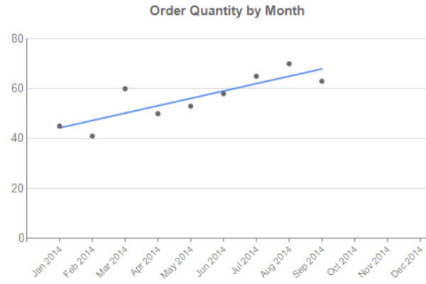
Problem: How to calculate a linear trendline?
What is a linear trendline?
A linear trendline is a best-fit, straight line through a time-series data
Useful to extend into the future for forecasting
A type of linear regression

Slide 4
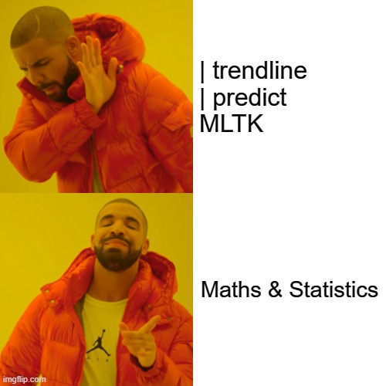
Possible solutions:
| trendline
Can only do moving averages etc. not a straight line
| predict algorithm=LL
Only for future prediction, needs complex trickery to draw a line of best fit over current data
Machine Learning Toolkit (MLTK)
Complex, computationally expensive
A visualization (e.g. scatter line chart)
Only for display
Maths/statistics
Perfect!
This is Splunk, so there are probably other solutions that I am not aware of…

Slide 5
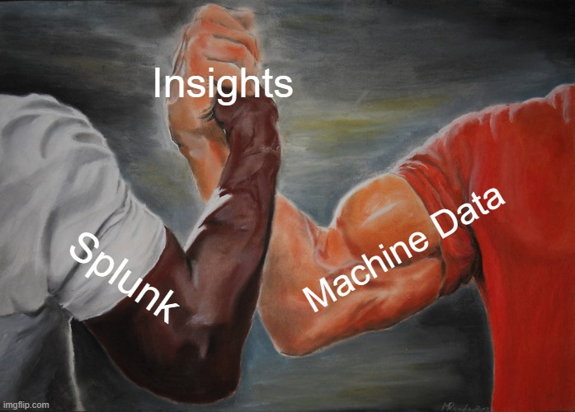
<<two fields/columns of data, _time and value>>
| eval x = if(isnull(value), null(), _time)
| eventstats count(x) as numevents sum(x) as sumX sum(value) as sumY sum(eval(x * value)) as sumXY sum(eval(x * x)) as sumX2 sum(eval(value * value)) as sumY2
| eval slope = ((numevents * sumXY) - (sumX * sumY)) / ((numevents * sumX2) - (sumX * sumX))
| eval yintercept = (sumY - (slope * sumX)) / numevents
| eval trendline = (yintercept + (slope * _time))
<< plot the trendline field >>

Slide 6
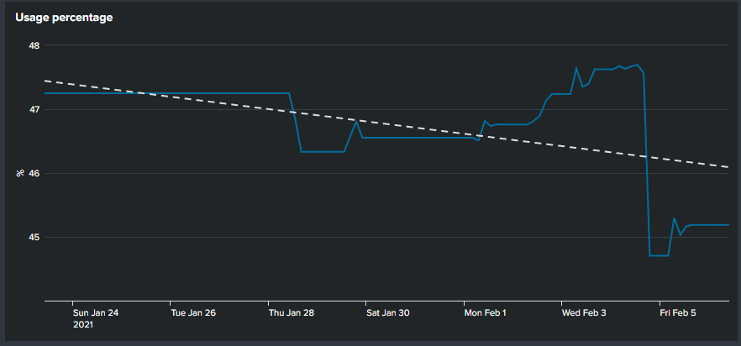
Example:
index=os host="server1" mount="C:"
| timechart avg(value) as value
| eval x = if(isnull(value), null(), _time)
| eventstats count(x) as numevents sum(x) as sumX sum(value) as sumY sum(eval(x * value)) as sumXY sum(eval(x * x)) as sumX2 sum(eval(value * value)) as sumY2
| eval slope = ((numevents * sumXY) - (sumX * sumY)) / ((numevents * sumX2) - (sumX * sumX))
| eval yintercept = (sumY - (slope * sumX)) / numevents
| eval trendline = (yintercept + (slope * _time))
| fields + _time value trendline
| rename value as "Usage %" trendline as "Trend"

Slide 7
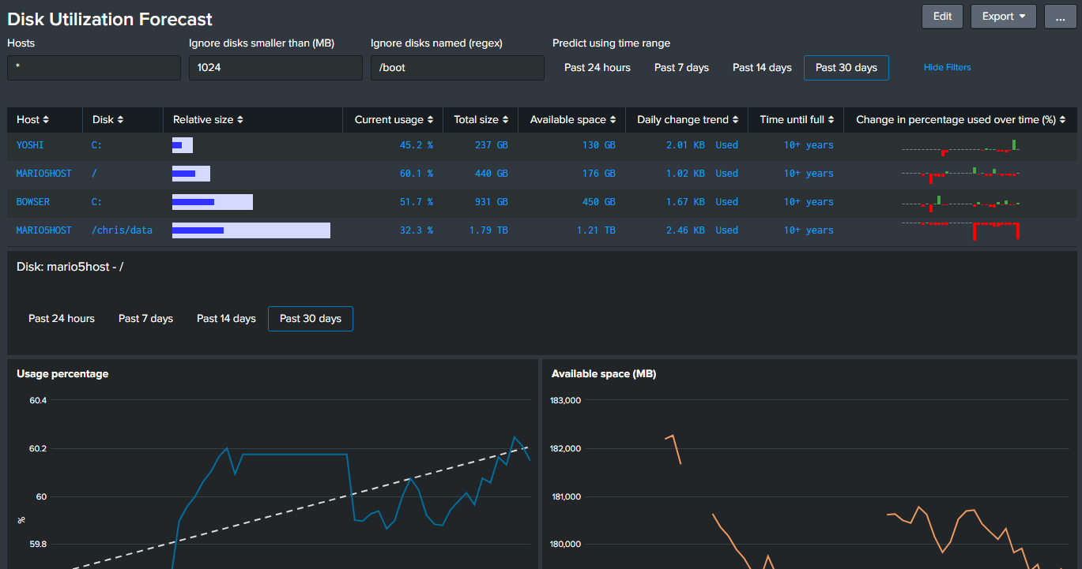
Extending further:

Slide 8
Things to be aware of / tricks
| eventstats can run out of memory with massive datasets
Increase memory limits or refactor the calculations into two phases(searches), and replace eventstats with stats.
Use this algorithm with any numeric metric, not just disk drives.
Create a macro for reusability
Extend with a “BY” modifier to calculate for multiple sources at once
Easily forecast into the future using the time picker or time modifiers (e.g. +3mon)
Set the trendline to a dotted line using custom XML:
<option name="charting.fieldColors">{"Trend":"#dddddd"}</option>
<option name="charting.fieldDashStyles">{"Trend":"dash"}</option>

Slide 9

Any questions?
Download this deck and supporting code from here:
https://github.com/ChrisYounger/SplunkBits

