Slide 1

Quantitative Impact Assessment of EV Integration into LV Distribution Networks & EV Charging Scheduling based on a Dynamic Pricing Scheme
Christo Balla
Supervisor: Eleftherios Kontis

Slide 2
Introduction to the Topic
Global acceleration of electric-vehicle penetration in distribution networks
Uncertain demand and a variety of demand patterns (EVCS, Home Chargers etc, Challenging to manage or predict!)
Home charging: single-phase, temporal clustering of EV home-dominant demand during evening hours -> operational challenges (grid is struggling to host)
Οperational challenges (higher peaks, feeder overloading, technical losses, congestion, large voltage drops, worsened voltage asymmetries, accelerate equipment aging , etc)
Need for increasing hosting capacity
Grid infrastructure reinforcements (expensive)
Demand-Side Management (advanced)
Dynamic pricing ∈ Price-based DR ⊂ DR ⊂ DSM

Slide 3
Thesis Objectives
quantify how increasing EV penetration affects LV network operation and specifically in voltage-quality (voltage unbalances and undervoltages used as voltage-quality indicators aligned with EN 50160 limits).
Estimate the operational risk of the grid (risk exposure of metrics to violations of EN 50160 standard limits).
Design of a grid-aware dynamic pricing signal that reflects quantified network stress (represents the market price with suppliers’ margin + dynamic network tariffs.
Price-oriented EV charging coordination mechanism (Price-based DR, goal: operational and economic risk exposure mitigation).
Evaluate the mitigation of grid stress (reduction of unbalance and undervoltage events and violation tendencies)

Slide 4
Logical Chain Workflow
Simulate the uncoordinated charging and identify the problem (intensive hours, weak buses, operational risk exposure)
Build a decentralized EV charging coordinator based on DP Policy
Goal : Reduce economic and operational risk exposure
Simulate and evaluate the effectiveness of DP in mitigating the problem
STAGE 1
STAGE 2
STAGE 3

Slide 5
Uncertainties in Demand
Residential Demand (e.g., HVAC systems, lighting, etc)
EV home charging demand (initial SoC, location, battery capacity, arrival times, etc)
Probabilistic Modeling: Captures real-world uncertainties/parameters with their corresponding assumptions
Residential Demand
Normal distribution (based on household profile)
EV demand
Initial State of Charge -> Weibull [10,40]% of nominal Battery Capacity
Battery Capacity -> Uniform [60,80] kWh
Arrival/Start times -> EV-demand-profile driven
Location connected -> Random Permutation
Availability window -> Uniform [7,10] hours (controlled case)
Sampling Methods
(Monte Carlo, Latin Hypercube)

Slide 6
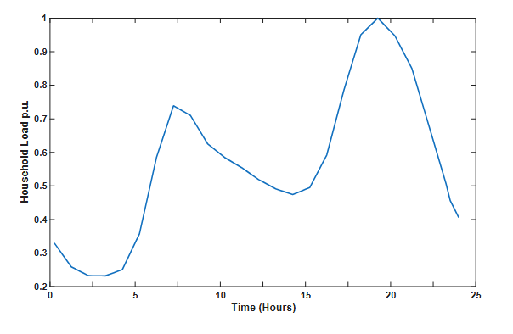
Observed Data: Ηousehold profile
Normal(mean(t),std=3.33%)

Slide 7
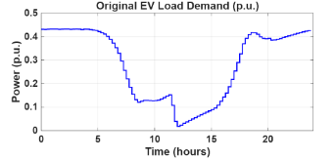
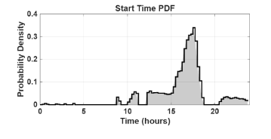
Observed Data : EV profile
Positive Derivative + normalization

Slide 8

Voltage Unbalance Factor
IEC Definition
CIGRE Definition
(mathematical form of EN 50160)
Identical but with key differences!
EN 50160 → $VUF ≤ 2\%$

Slide 9
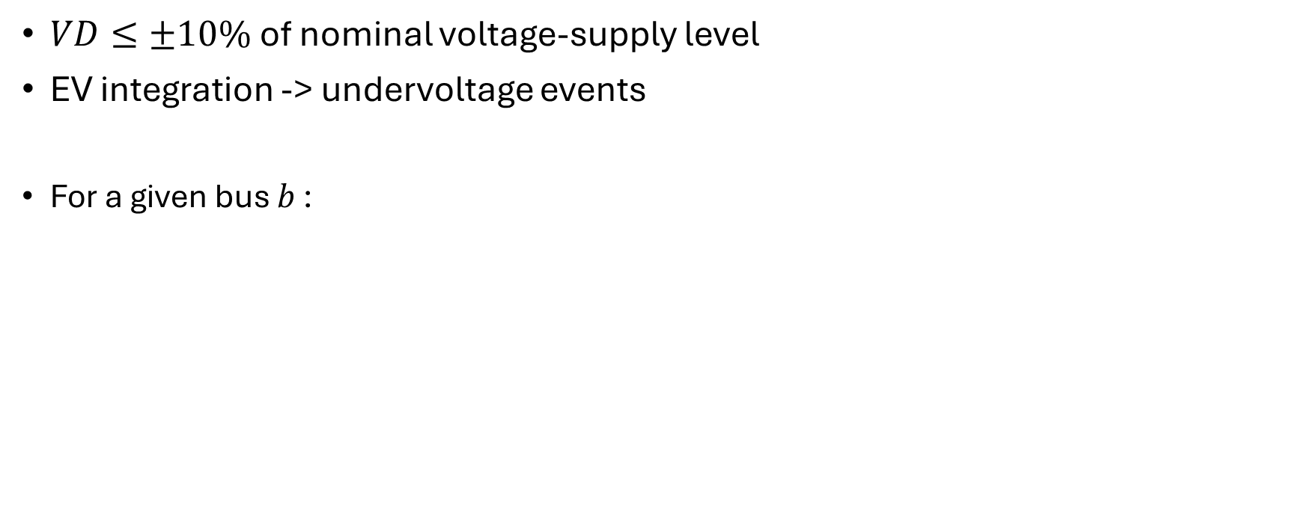
Voltage Deviation
$VD≤±10\%$ of nominal voltage-supply level
EV integration -> undervoltage events
For a given bus $b$ :

Slide 10
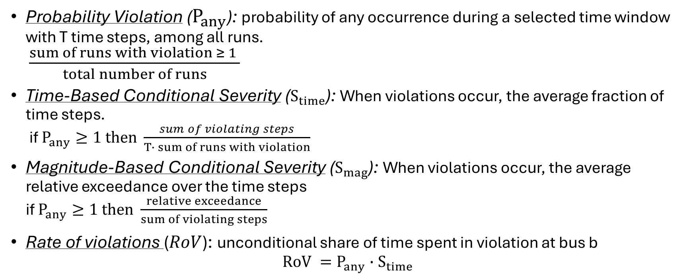
Risk Metrics
Probability Violation ($P_{any}$): probability of any occurrence during a selected time window with T time steps, among all runs.
$\frac{sum of runs with violation ≥ 1 }{total number of runs}$
Time-Based Conditional Severity ($S_{time}$): When violations occur, the average fraction of time steps.
if $P_{any}≥1 then$ $\frac{sum of violating steps}{T∙ sum of runs with violation}$
Magnitude-Based Conditional Severity ($S_{mag}$): When violations occur, the average relative exceedance over the time steps
if $P_{any}≥1 then$ $\frac{relative exceedance}{sum of violating steps}$
Rate of violations ($RoV$): unconditional share of time spent in violation at bus b
$RoV =P_{any}{∙S}_{time}$

Slide 11
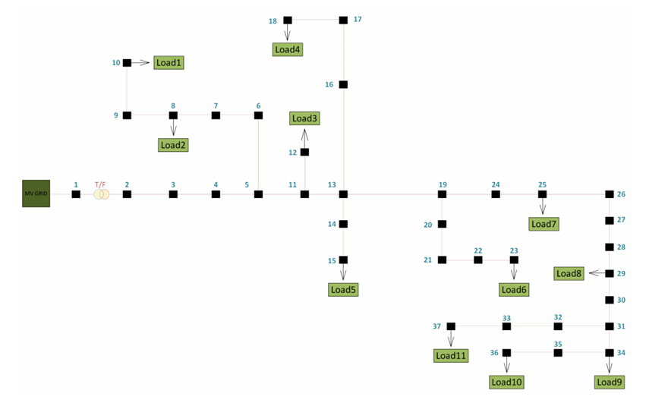
Grid Under Study
20/0.69 kV
37 buses
D-Y
OLTC

Slide 12
Pipeline
Uncertainty Modeling
Sampling
Load Flow
Calculate the metrics (VUF, VD)
Meta Processing (risk metrics)
Optimization
Controlled case
Target SoC =0.8
Pmax = 7.4kW
Network Topology

Slide 13
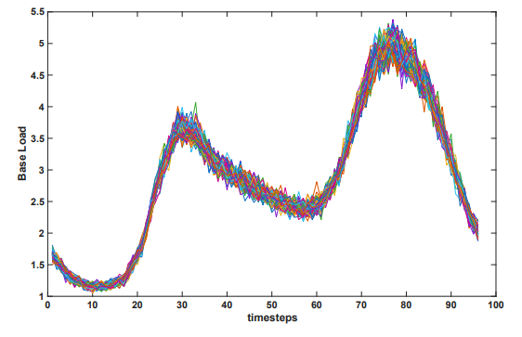
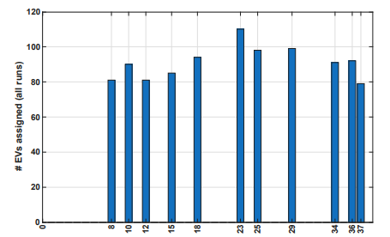
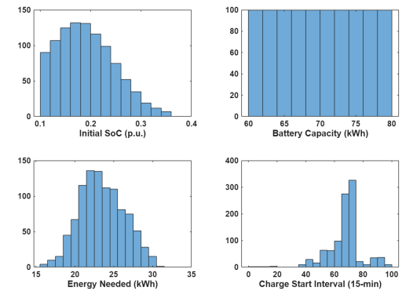
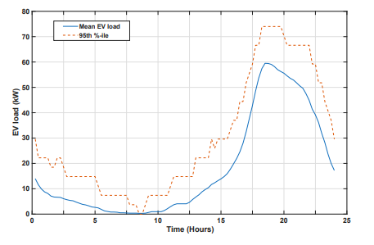
Validation of Uncertain Inputs

Slide 14
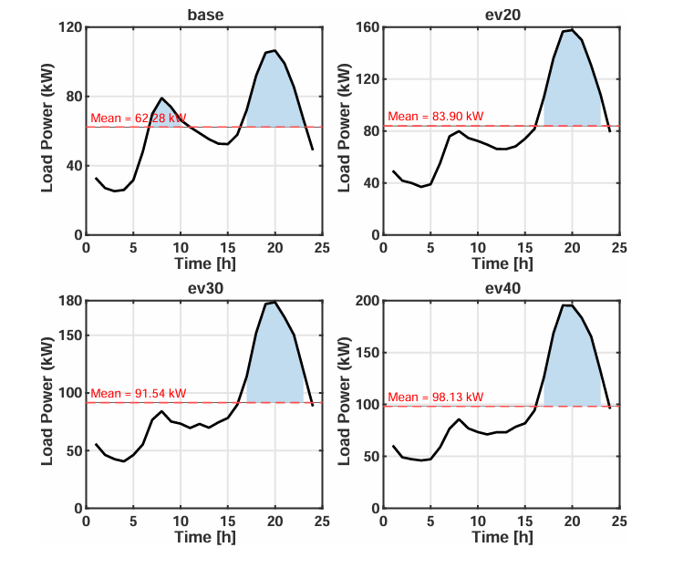
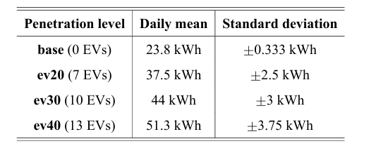
STAGE 1: Power Analysis
Total Power Demand (24h-Profile)
Total System Losses
Notes:
Μια σημαντικη λεπτομερεια είναι θα χρεισιμοποιουμε το π95 ως βασικο μας μετρικο καθως τα ΠΛΦ σταντιες εκτιμανε την αξιοπιστια του δικτυου ή άλλες συμπεριφορες βασει του 95% των ρανς

Slide 15
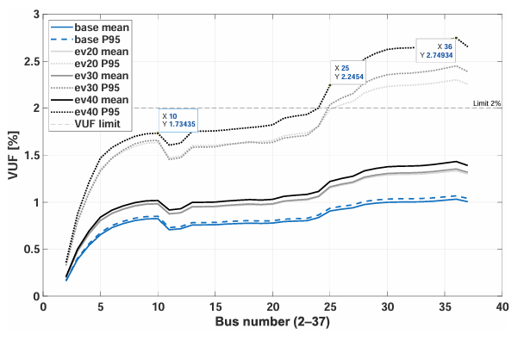
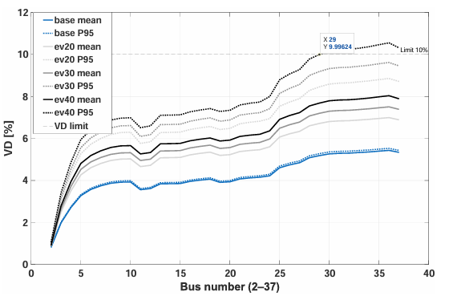
STAGE 1: Average VUF and VD during the peak hours
Intensive hours = 17:00-23:00
Farthest buses : high mean VUF and VD during the time window

Slide 16
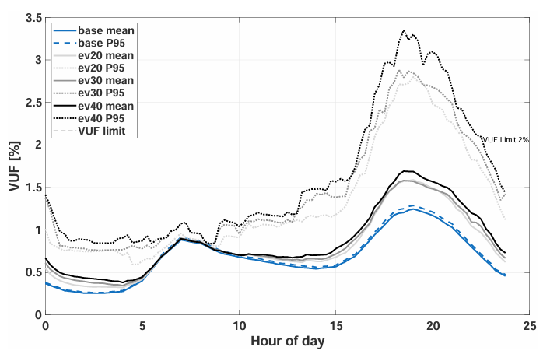
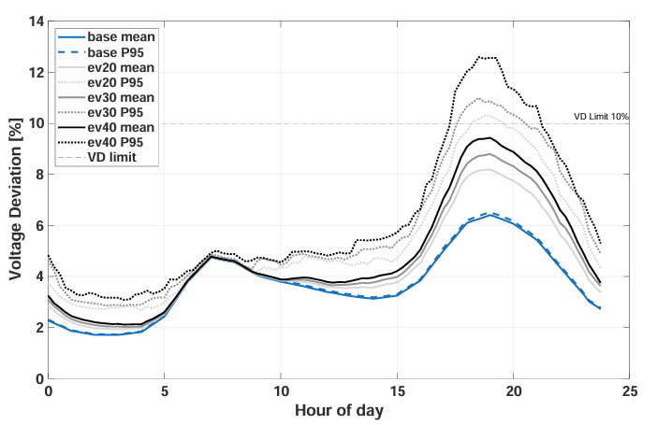
STAGE 1: Worst bus 24-h performance

Slide 17
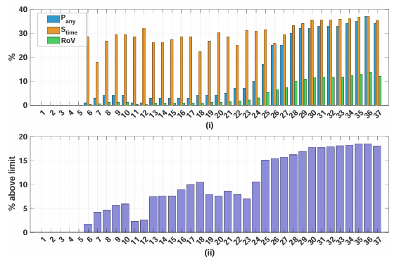
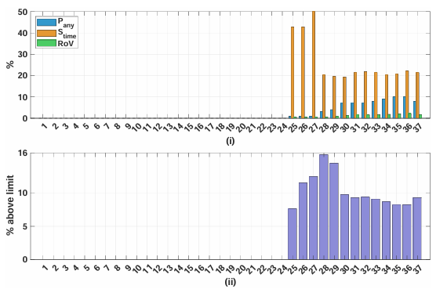
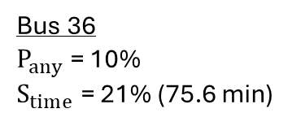
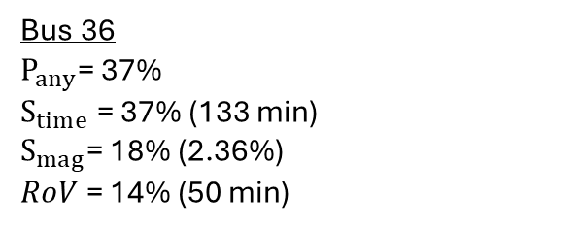
STAGE 1: Probabilistic Risk Analysis – ev20
Bus 36
$P_{any}$= 37%
$S_{time}$ = 37% (133 min)
$S_{mag}$= 18% (2.36%)
$RoV$ = 14% (50 min)
Bus 36
$P_{any}$ = 10%
$S_{time}$ = 21% (75.6 min)
VUF
VD

Slide 18
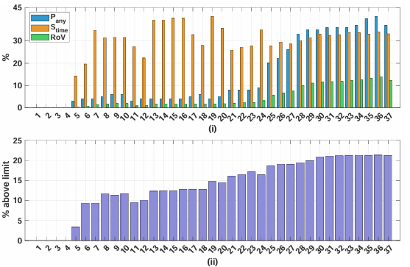
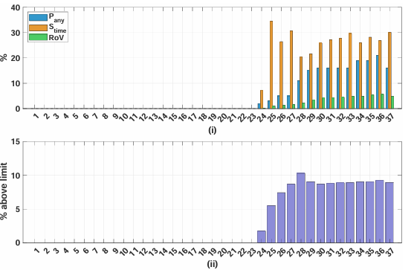
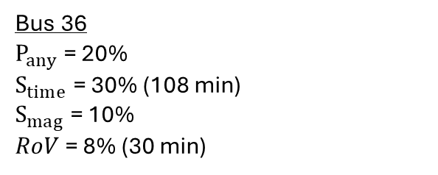
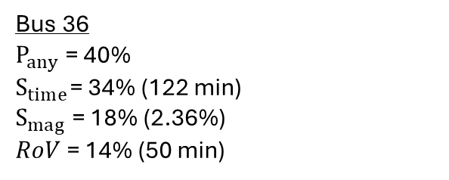
STAGE 1: Probabilistic Risk Analysis – ev30
Bus 36
$P_{any}$ = 40%
$S_{time}$= 34% (122 min)
$S_{mag}$ = 18% (2.36%)
$RoV$ = 14% (50 min)
Bus 36
$P_{any}$ = 20%
$S_{time}$ = 30% (108 min)
$S_{mag}$ = 10%
$RoV$ = 8% (30 min)
VUF
VD

Slide 19
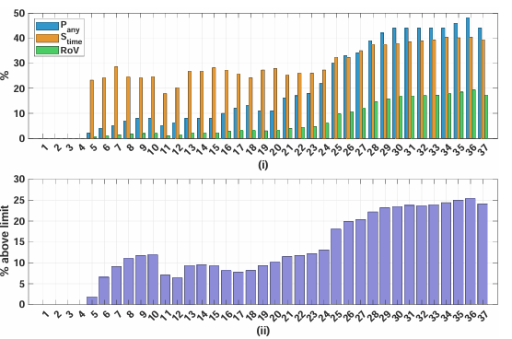
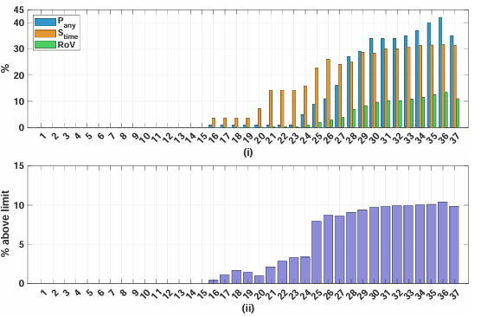
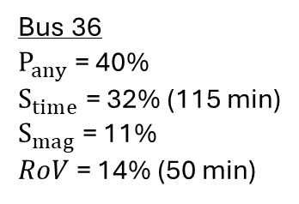
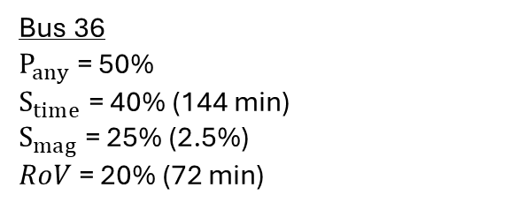
STAGE 1: Probabilistic Risk Analysis – ev40
Bus 36
$P_{any}$ = 50%
$S_{time}$= 40% (144 min)
$S_{mag}$ = 25% (2.5%)
$RoV$ = 20% (72 min)
Bus 36
$P_{any}$ = 40%
$S_{time}$ = 32% (115 min)
$S_{mag}$ = 11%
$RoV$ = 14% (50 min)
VUF
VD

Slide 20
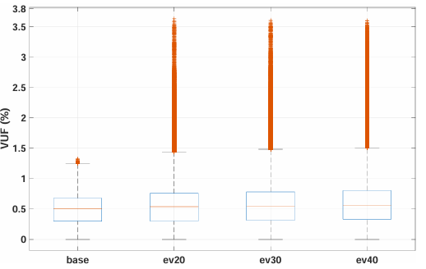
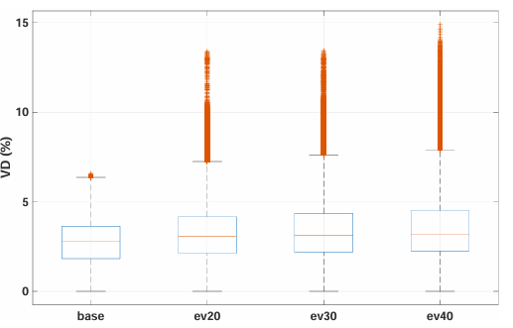
STAGE 1: Boxplots
VUF outliers: 19.287, 18.898, 21.360 (4.446, 4.867, 7.156 of them ≥ 2%)
VD outliers: 12.247, 14.130, 16.195 (467, 1.343, 3.213 of them ≥ 10%)
Notes:
An kai sto vd den exoyme polles paraviaseis, vlepoyme oti kimenontai se megales times

Slide 21
STAGE 2: Grid-Aware Dynamic Pricing
Energy Pricing Contracts:
Wholesale + supplier margins
Policy support + government taxes
DSO & TSO services
Notes:
Παραδειγμα : συμβολαιο ζενιθ, τα νετγουρκ ταριφς βαρανε κεφαλι

Slide 22
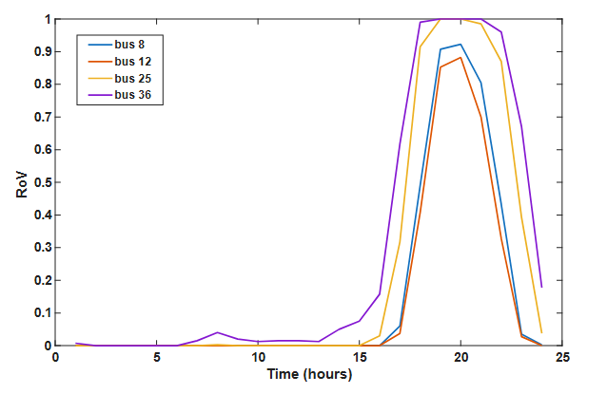
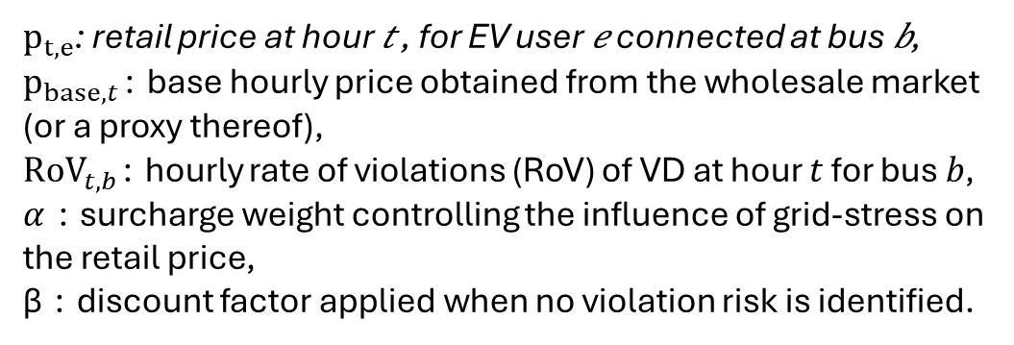
STAGE 2: Grid-Aware Dynamic Pricing
$p_{t,e}$: retail price at hour 𝑡 , for EV user 𝑒 connected at bus 𝑏,
$p_{base,t}$∶ base hourly price obtained from the wholesale market (or a proxy thereof),
${RoV}_{t,b}$∶ hourly rate of violations (RoV) of VD at hour 𝑡 for bus 𝑏, $α$ ∶ surcharge weight controlling the influence of grid-stress on the retail price,
β ∶ discount factor applied when no violation risk is identified.
compromise of specific interest between
DSO & Supplier under NRA regulations
Notes:
Η τιμη η χρηματιστιριακη day-ahead+καποιο πιθανο μαρτζιν του προμηθευτη, επι έναν συντελε

Slide 23

STAGE 2: Optimization Framework for EV charging scheduling
Decision Variable:
Objective (minimize total charging cost):
Constraints:
1. Availability window $We$:
2. Energy requirement:
3. State-of-charge limits:
4. Per-slot aggregate power cap :

Slide 24
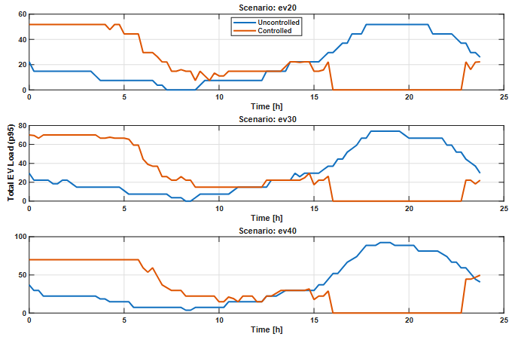
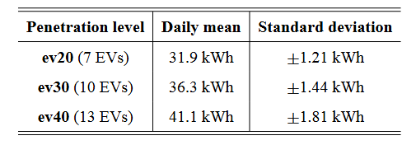
STAGE 3: Power Analysis
Total Power Demand (24h-Profile shifted)
Total System Losses

Slide 25
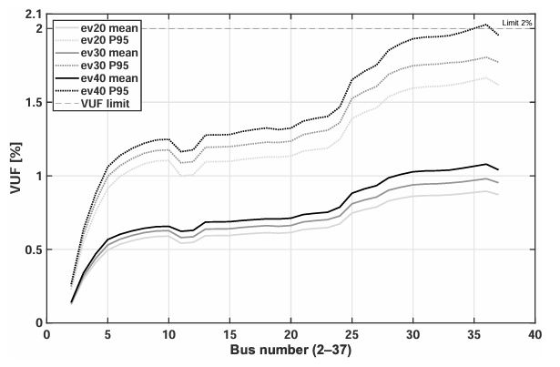
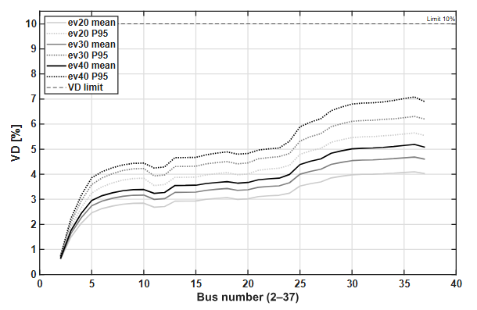
STAGE 3: Average VUF and VD during the peak hours
Intensive hours = 01:00-07:00
Farthest buses : lower mean VUF and VD during the time window
Notes:
Σημαντική μετατοπιση των καμπυλών προς τα κατω

Slide 26
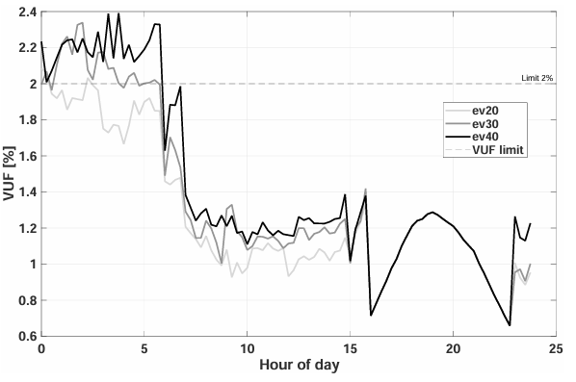
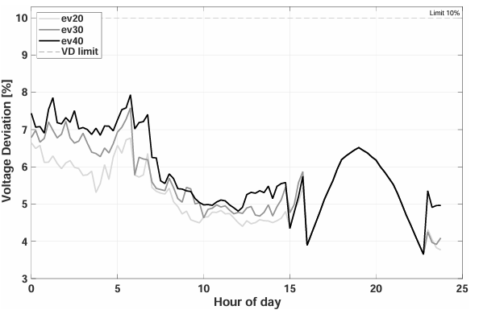
STAGE 3: Worst bus 24-h performance

Slide 27
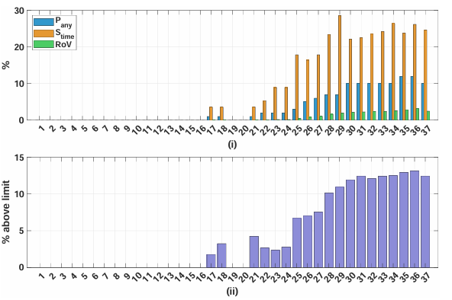
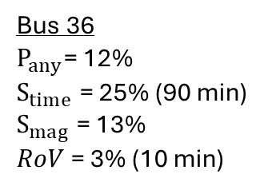
STAGE 3: Probabilistic Risk Analysis – ev20
VD violations are eliminated
VUF
Bus 36
$P_{any}$= 12%
$S_{time}$ = 25% (90 min)
$S_{mag}$ = 13%
$RoV$ = 3% (10 min)

Slide 28
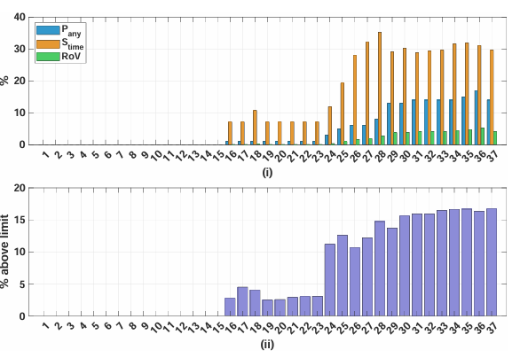
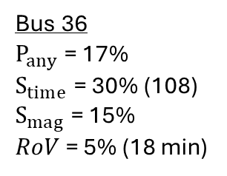
STAGE 3: Probabilistic Risk Analysis – ev30
VD violations are eliminated
VUF
Bus 36
$P_{any}$ = 17%
$S_{time}$ = 30% (108)
$S_{mag}$ = 15%
$RoV$ = 5% (18 min)

Slide 29
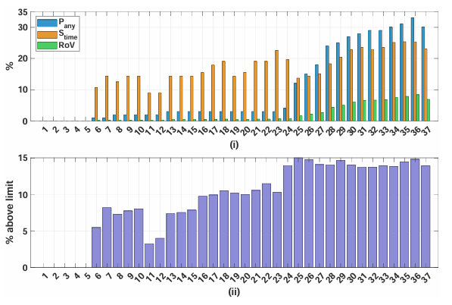
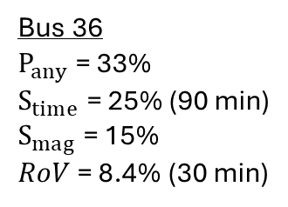
STAGE 3: Probabilistic Risk Analysis – ev40
VD violations are eliminated
VUF
Bus 36
$P_{any}$ = 33%
$S_{time}$ = 25% (90 min)
$S_{mag}$ = 15%
$RoV$ = 8.4% (30 min)

Slide 30
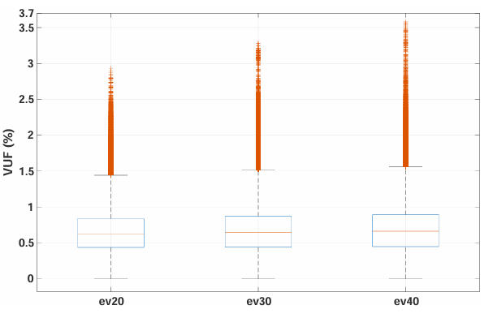
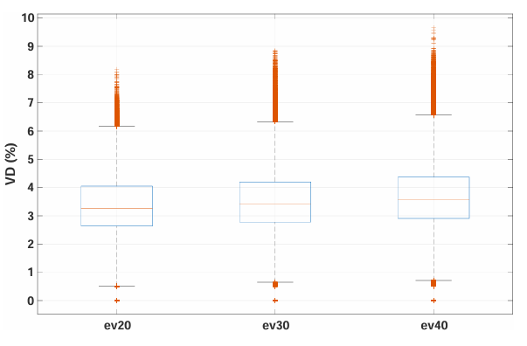
STAGE 1: Boxplots
VUF outliers: 5.689, 6.144, 7.871 (756, 1.316, 2.275 of them ≥ 2%)
VD outliers: 13.435, 15.219, 18.509 (none of them ≥ 10%)

Slide 31
Comprehensive Review of Risk Exposure for VUF

Slide 32
Comprehensive Review of Mitigation Achieved – EV20
Percentage Reduction
Notes:
68% meiwsh εκθεσης κινδυνου σε παραβιασεις οριων ασσυμετριας
Και 100% σε VD

Slide 33
Comprehensive Review of Mitigation Achieved – EV30
Percentage Reduction

Slide 34
Comprehensive Review of Mitigation Achieved – EV40
Percentage Reduction
Notes:
Σχετικη αυξηση των ποσοστων μειωσης πικ ντιμαντ και λοσσες. Ωστοσο παρατηρουμε μικρότερο μετριασμό προβλήματος VUF>2 σε σχεση με ev20
Arketa mikrotero, alla e3akoloythei na einai simantiki meish toy kindinoy (operational risk exposure)

Slide 35

Thank you for your attention!

