Slide 1


Photography Website

Slide 2

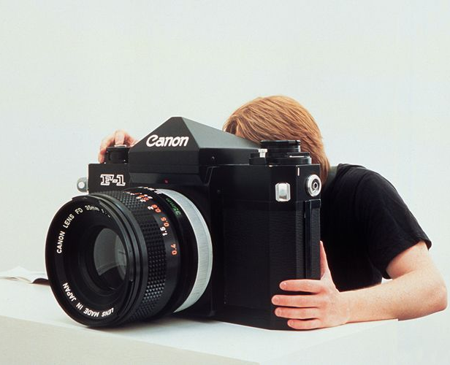



Personal Website

Slide 3

Website Design

Slide 4
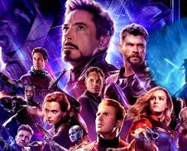
End Game

