Slide 1
MATLAB Integration for the fertilized forests library

Slide 2
Table of contents
Miscellaneous and requirements
Getting MATLAB to work with C++ and abstraction of the interface to MATLAB
Automatic code generation
C++ header parsing and code generation
Demo

Slide 3
Miscellaneous and requirements

Slide 4
Miscellaneous and requirements
MATLAB should be able to use the complete functionality of the fertilized forests library
The library should be useable with a easy (MATLAB-like) syntax with no prior knowledge of C/C++
The computational time should be low (the native C++ library should be used within MATLAB)

Slide 5
Getting MATLAB to work with C++ and
abstraction of the interface to MATLAB

Slide 6
Getting MATLAB to work with C++
MATLAB is able to call native code in two different ways:
with use of a special entry point in a C-library with *.mexw64 ending
#include "mex.h"
void mexFunction(int nlhs, mxArray *plhs[], int nrhs, const mxArray *prhs[])
# of input mxArrays
# of expected output mxArrays
Array of pointers to the expected output mxArrays
input mxArrays

Slide 7
Getting MATLAB to work with C++
MATLAB is able to call native code in two different ways:
By calling entry points of a normal *.dll file
[notfound,warnings] = loadlibrary(‘LibName.dll’, ‘MainHeader.h’, ‘addheader’, ‘Header2.h’, ...);
retVal = calllib(‘LibName.dll’, ‘entryPointName’, args{:});
However there is no support of C++ within MATLAB when calling functions in native code.

Slide 8
Getting MATLAB to work with C++
Constructors of C++ classes have to be called to initialize the objects trees and forests consist of:
The problem can be solved by casting all object types to void *
typedef IBaggingStrategy<input_dtype, feature_dtype, annotation_dtype, leaf_return_dtype, forest_return_dtype> split_strat_t;
ClassicTraining(const std::shared_ptr<split_strat_t> &splitting_strategy)
: splitting_strategy(splitting_strategy) {}
void * getClassicTraining_i_i_uint_fv_fv (void * splitting_strategy) {
return BaseMethods::getClassicTrainingBase<int, int, uint, std::vector<float>, std::vector<float>>
(splitting_strategy);
}

Slide 9
Getting MATLAB to work with C++
Constructors can be called from MATLAB without MATLAB knowing of those objects.
These pointers have to be put in a KeepAliveManager since all references to a shared_ptr are lost when handing the pointer over to MATLAB because the object would not exist anymore. ➔ MATLAB can destruct those objects later on by using a native function call
ptr = calllib(‘LibName.dll’, ‘getClassicTraining_i_i_uint_fv_fv’, splittingStrategyPtr);

Slide 10
Getting MATLAB to work with C++ Other difficulties
Building vector of objects (e.g. trees) from MATLAB
Passing over default values
Correct usage of template classes with C-API
…
% ThresholdDecider
tDecider = soil.ThresholdDecider(stdFeatureSelect, linSurface, rcto, -1, -1, -1, -1, -1);
deciderVec = soil.BuildIDeciderVector(deciderVec, tDecider);
__declspec(dllexport) void * getClassicTraining_i_i_uint_fv_fv (void * splitting_strategy);
__declspec(dllexport) void * getClassicTraining_f_f_uint_fv_fv (void * splitting_strategy);
__declspec(dllexport) void * getClassicTraining_uint8_uint8_uint_fv_fv (void * splitting_strategy);
__declspec(dllexport) void * getClassicTraining_uint8_int16_uint_fv_fv (void * splitting_strategy);
__declspec(dllexport) void * getClassicTraining_uint8_int16_int16_fv_fv (void * splitting_strategy);
__declspec(dllexport) void * getClassicTraining_uint8_int16_int16_hp_vhp (void * splitting_strategy);
__declspec(dllexport) void * getClassicTraining_f_f_f_rpf_vprpff (void * splitting_strategy);
__declspec(dllexport) void * getClassicTraining_d_d_d_rpd_vprpfd (void * splitting_strategy);

Slide 11
Abstraction of the interface to MATLAB
Heavily inspired by the python interface of the library
Should be an easy to use object oriented like interface

Slide 12
Abstraction of the interface to MATLAB
plotX = [-6, 6, 100];
plotY = [-6, 6, 100];
soil = Soil();
% create tree...
tree = soil.StandardClassificationTree(2, 2, 6, 2, 2, -1, -1, -1, -1, -1, -1, -1);
% fit tree
tree.Fit(X, Y);
% paint probability plot
figure;
point_prob_plot(tree, X, Y, plotX, plotY);
n_classes
max_depth
n_features
…

Slide 13
Abstraction of the interface to MATLAB
classdef Classifier < FertilizedObject
properties
FitFunctionName = 'fit%s';
PredictFunctionName = 'predict%s';
FunctionFormat = '';
end
methods
function this = Classifier(type, dataTypes, libName, ptr, functionFormat)
this = this@FertilizedObject(type, dataTypes, libName, ptr);
this.FunctionFormat = functionFormat;
end
function Fit(this, X, Y)
% get c library function name
suffix = this.GetTypeSuffix(1, 5);
fitName = sprintf(this.FitFunctionName, sprintf(this.FunctionFormat, this.Type, suffix));
varargs = {};
if strcmp(this.Type, 'Forest')
varargs = {8}; % append num_threads argument for forests....
elseif strcmp(this.Type, 'Tree')
varargs = {1}; % set complete_dfs to true
end
calllib(this.LibName, fitName, this.ClassifierPtr, X, Y, varargs{:});
end
function [Y] = Predict(this, X)
% get c library function name
suffix = this.GetTypeSuffix(1, 5);
fitName = sprintf(this.PredictFunctionName, sprintf(this.FunctionFormat, this.Type, suffix));
Y = calllib(this.LibName, fitName, this.ClassifierPtr, X);
end
end
end

Slide 14
Automatic code generation

Slide 15
Automatic code generation
Since most stuff is implemented as a class within the library similar code is needed for the constructors etc.
The C/C++ code and the functionality that calls the native code from MATLAB can be generated automatically
This is done with a templating engine for Python: jinja

Slide 16
Automatic code generation
Classes and their corresponding functions/constructors etc. are represented in a python object structure
These variables are being passed to the jinja engine, which populates templates
Based on some conditions most of the C++ wrapping code can be generated and updated automatically

Slide 17
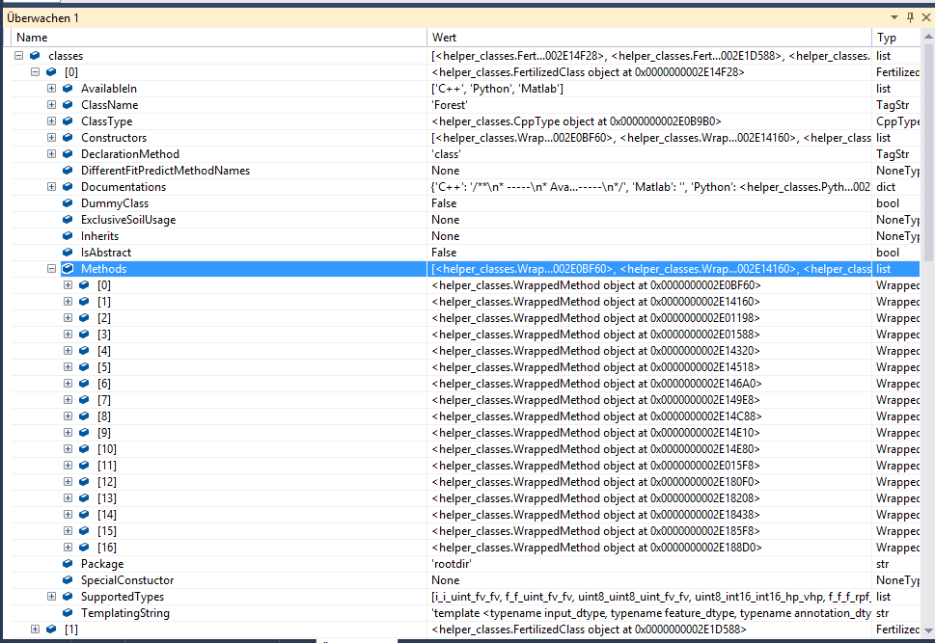
Automatic code generation

Slide 18
C++ header parsing and code generation

Slide 19
C++ header parsing and code generation
Python object structure has to be created manually
Solution: Usage of python library cppheaderparser scans all fertilized headers and collects all classes with their constructors and functions (also standalone functions)
If a method or constructor should be available in MATLAB it has to be stated in the doxygen comment
Header parsing and code generation supports also Python interface and code generation of serialization code

Slide 20
C++ header parsing and code generation
Example documentation:
/**
* -----
* Available in:
* - C++
* - Python
* - Matlab
* .
* Instantiations:
* - int; int; uint; std::vector<float>; std::vector<float>
* - float; float; uint; std::vector<float>; std::vector<float>
* - uint8_t; uint8_t; uint; std::vector<float>; std::vector<float>
[...]
* .
*
* -----
*/
template <typename input_dtype, typename feature_dtype, typename annotation_dtype, typename leaf_return_dtype, typename forest_return_dtype>
class Forest {
[...]
/**
*
* -----
* Available in:
* - C++
* - Python
* - Matlab
* .
*
* -----
*/
Forest(const uint &max_tree_depth, ...

Slide 21
C++ header parsing and code generation
C++ header parsing and the code generation are able to generate fully working wrapper and MATLAB code to use the matfertilized.dll library easily without the vast knowledge of the C++ code
The fast computations of the fertilized library can also be seen from within MATLAB
The MATLAB library is always up-to-date with the newest additions to the library
Bugs can be avoided due to the repetitive code generation

Slide 22
Demo

Slide 23
Thank you for listening!

