Slide 1

English HL 2026
Mr Peter Ruddock
ruddockp@ieb.co.za

Slide 2


Slide 3

Marking and Examining

Slide 4
Communication Channels
IEB Assessment Specialist convenes a National Subject Forum (NSF) Meeting
IEB Assessment Specialist tables matter at Committee for Curriculum and Assessment (CCA)
NSF Meeting held and final draft of amended SAG document shared with all schools in subject community for comment where applicable
Teacher/Cluster/NSF Rep brings matter to IEB Asessment Specialist
SAGS matter identified by subject community at individual teacher or cluster level.
Any changes to SAGs communicated to schools via circular

Slide 5
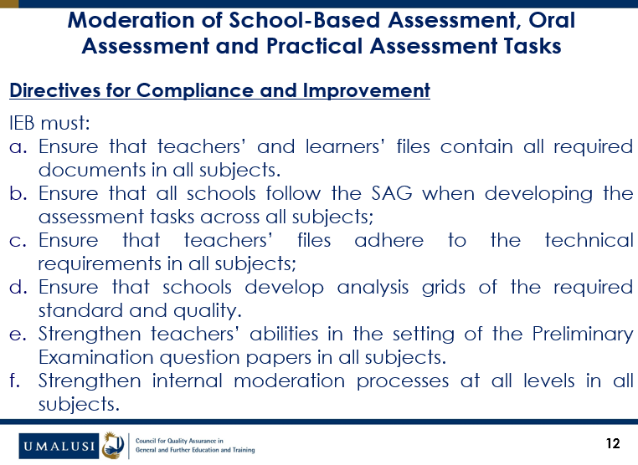

Slide 6
SAGs changes
Section A and Section B replaced by writing process task
Revised SBA coversheets and moderation tools
Summary rubric: removed half marks
Prepared Speech rubric
Writing rubric
Gumph extraction

Slide 7

https://forms.office.com/r/GtZ30XRHzK

Slide 8
Workshops
Curiosity
Creative Thinking
Writing Process Task
QSBs - Poetry

Slide 9
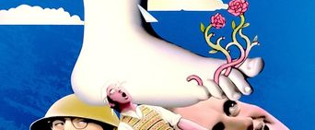
AND NOW FOR SOMETHING COMPLETELY DIFFERENT…

Slide 10

The Hidden Curriculum
Every school has two curricula: the one in the policy documents, and the one embodied by the adults.
While curriculum tells us what we intend to teach, research consistently shows that students are most deeply formed by what they experience repeatedly — especially what adults model and what school structures reward.

Slide 11
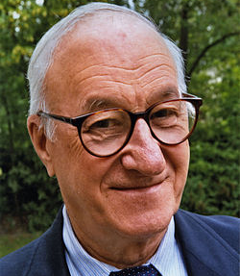
Social Learning Theory
Professor Albert Bandura:
Humans learn behaviours, attitudes, emotional responses, and norms primarily through observing others.
Learning often occurs without direct instruction or reinforcement.
Models with status, authority, or relational proximity are most influential.

Slide 12

Anxiety: An Identity Issue
When learning environments consistently link being wrong with being diminished, children learn — implicitly — that their ideas are themselves.
The deeper problem with fear of failure is not that children avoid mistakes but that they begin to experience mistakes as threats to who they are.

Slide 13

Rethinking Ideas
You are not your ideas.
Ideas are things we try on, revise, abandon, and sometimes outgrow — without any loss of dignity or selfhood.
If children are never taught this, disagreement feels like rejection,
revision feels like humiliation, and learning becomes a defensive act.

Slide 14

Epistemic Courage
  The courage to explore, revise, and even abandon ideas while remaining secure in one’s sense of self and belonging.
  The ability to adapt one’s thinking in response to new perspectives and evidence.

Slide 15

Epistemic Courage isn't a workshop topic; it's a cultural outcome.
Teachers build the culture (through what they reward, protect, structure) and act as models that students then imitate.

Slide 16
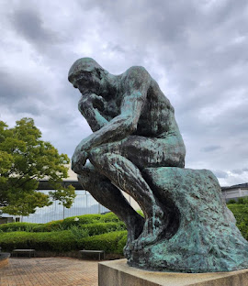
The Teacher’s Role:
Modelling Being, Not Just Knowing
What teachers model when epistemic courage is alive:
Vulnerability
Active Listening
Adaptive Thinking
We are not merely teaching English;
We are writing humanity.

Slide 17

English Teachers Model Epistemic Courage Through:
Empathic Intelligence
In literature and poetry, students don’t just learn about others, they learn from within others.

Slide 18
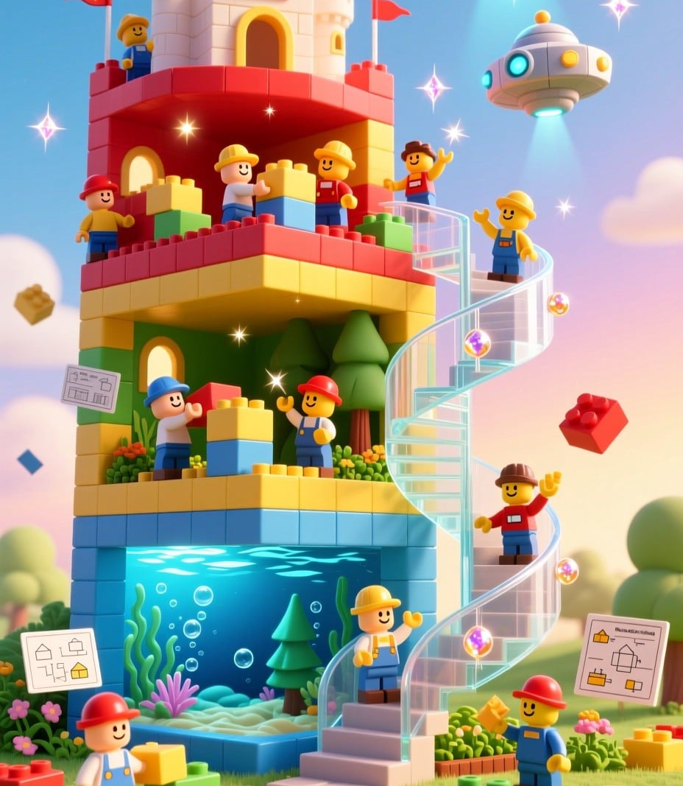
English Teachers Model Epistemic Courage Through:
Collaborative Genesis
We teach the non-negotiable art of co-creation of meaning

Slide 19
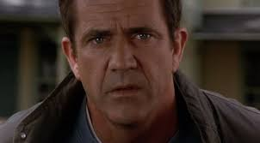
English Teachers Model Epistemic Courage Through:
The Grammar of Humanity
We teach the decoding of subtext, posture, tone, and silence. We teach students:
that how something is said, rather than what is said is often the message itself
That we must never assume that the loudest voice is the most valid voice. Silence is also a voice.

Slide 20
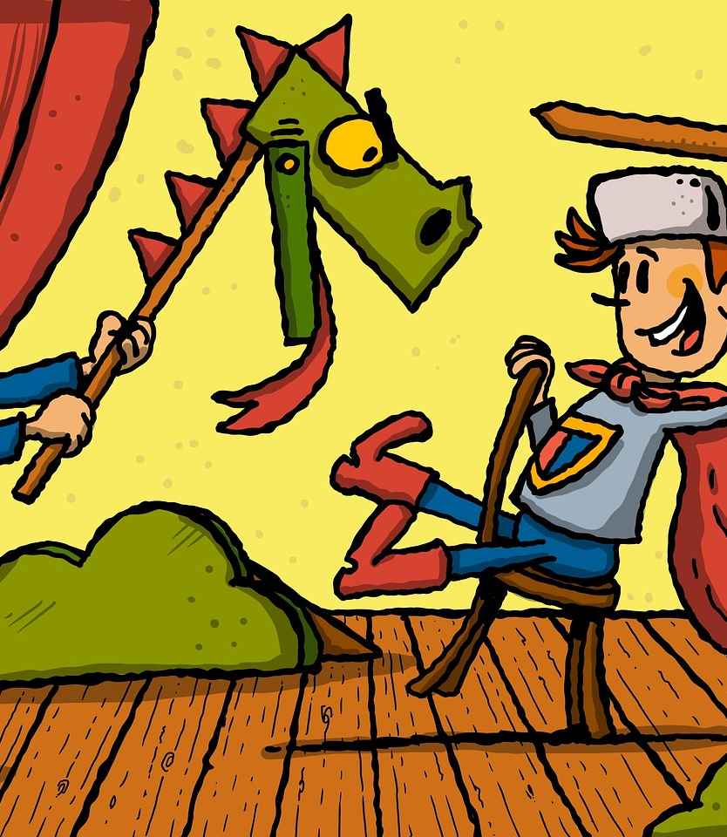
English Teachers Model Epistemic Courage Through:
Resilient Identity Play
By providing safe spaces for learners to try on different identities – resisting such simple labels as the hero, the villain, the fool – we cultivate selves that are fluid and adaptable.

Slide 21
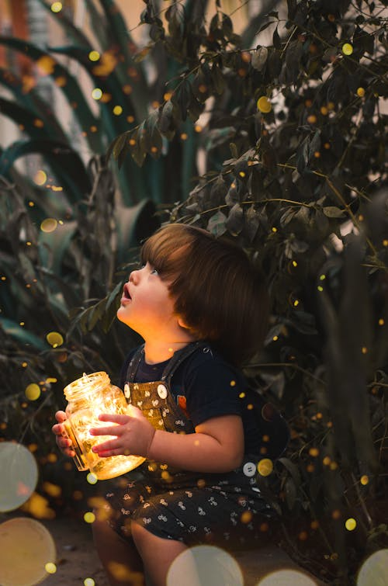
"Children have never been very good at listening to their elders, but they have never failed to imitate them."
– James Baldwin

