Slide 1


Slide 2
Common Assessment Task
The focus of the CAT for 2026 is on Poetry Skills.
The following overarching questions should be explored:
  How does poetry speak to the human condition?
  What was the poet’s intention in writing a certain poem?
  What poetic techniques have been used?
  How do these techniques feed into the intention?

Slide 3
Learners will need to select one poem from the seen poetry syllabus as their anchor text that refers to an aspect of the human condition.
They will then identify three additional poems that “talk to” the themes, the intention and the techniques of this chosen poem.
These may be published poems, AI-created poems, poems written by the learners themselves, or repurposed versions of the seen poem.
Songs are not allowed for this task - meaning must be analysed through poetic choices, without reliance on musical or performance elements

Slide 4
Learners will write a formal analytical essay in which they evaluate how one of their chosen poems and one of two unseen poems supplied by the school use poetic techniques more effectively to raise awareness of the human condition.
Speech - Explain how poetry evokes emotion in readers, using a line chosen from the seen poetry syllabus as the starting point.
A powerpoint presentation is not compulsory.
There will be no compulsory 10-mark discussion, but the Integrated Listening & Speaking task will remain.

Slide 5
PAPER 1

Slide 6
Opening remarks
The 2025 marking session ran smoothly, and we are very proud of the processes we have put in place to ensure that each candidate's script receives fair and consistent attention.
The examiner, the internal moderator, 28 senior markers, and Umalusi spent much time on the pre-standardisation and standardisation process, and this led to the Marking Guidelines being implemented consistently throughout the marking and moderation process.
The guidelines were opened during the standardisation process, which allowed for a range of responses to be considered.
The guidelines were opened during the standardisation process, which allowed for a range of responses to be considered. This was particularly evident in the language section, where we allowed for ½ marks.
As a Paper 1 marking committee, we are very proud of the whole process, and we are confident that the utmost care has been taken to ensure the fair and consistent treatment of each candidate.

Slide 7
Question 1—Comprehension:
Candidates dealt with this section extremely well. It was particularly clear that many candidates spent more time on the comprehension than any other question.
The marks for the comprehension seemed higher than other sections of the paper as candidates over-wrote in places and did not spend as much time on other questions.
Candidates are reminded to use specific attitude and positioning words when answering these questions. The same applies to tone and mood in later questions across the examination paper.
When dealing with the effectiveness of specific elements (figures of speech etc.) candidates must unpack the figure of speech being discussed and place it in context of the passage. Ultimately, candidates must reflect on its effectiveness.
When dealing with rhetorical questions, candidates are encouraged to move beyond stating the function of rhetorical questions. Candidates must link the function to the content in the passage.
Candidates responded well to the seen poem ‘nobody loses all the time’ and its link to the comprehension passage. Candidates should expect to see poetry throughout the paper and respond to the questions in the context of the question.
Refer to SAGS for appropriate word length.

Slide 8
Question 2 – Summary:
The summary skill being assessed is the selection of appropriate information (occasionally from multiple texts/infographics) and synthesising it in a manner that is fit-for-purpose or a new context. Candidates are encouraged to note the difference between transactional writing (creation of content using the sources as inspiration) vs the summary (summary and synthesis of the sources)
The purpose of the summary is not to simply shorten a large section of text; candidates must learn how to select appropriate information and present it in a manner that is fit- for-purpose. The summary task in the 2025 question paper asked the candidates to synthesise three texts about the importance of a phone-free academic day.
An awareness of audience, context, intention, and voice are key when engaging with this question. The candidates dealt well with the ‘speech to junior grades’ nature of the task. Given the nature of the task, candidates were able to decide for themselves the register of the speech – all options were accepted.
Candidates are encouraged to practise/develop a fluid and succinct style after extracting only the relevant information and conveying it in their own words.
Teachers are encouraged to use the various summary tasks on the IEB portal as part of their students’ preparation. The format is not the focus but rather register of the proposed format.
· Please remind candidates to ensure that they put an ‘exact word count’ and they should not lie.
· Similarly, candidates should not include additional or new information that is not included in the original texts.

Slide 9
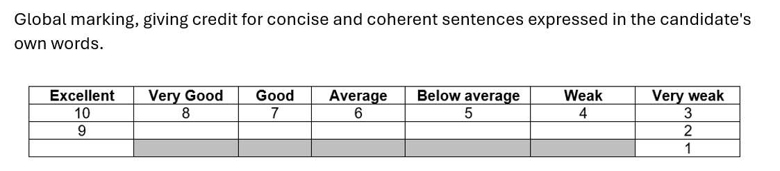
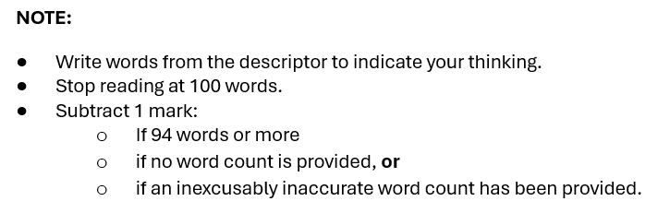
Question 2 – Summary PROPOSED NEW RUBRIC
Proposed removal of the ½ marks in the rubric.
Benefits:
  Enhance the reliability of the mark for the summary. (7, 7.5, 8, etc.)
  Encourages clearer rubric design: (Descriptors are sharper and more decisive.)
  Aligns with the nature of the summary skills: fundamentally about selection, precision, and clarity.
  Half marks in the summary means markers may award ½ marks at an additional 10 places in the rubric (beyond the whole numbers).
  It will strengthen moderation discussions and simplify marker training.
  Clarify expectations for candidates.

Slide 10
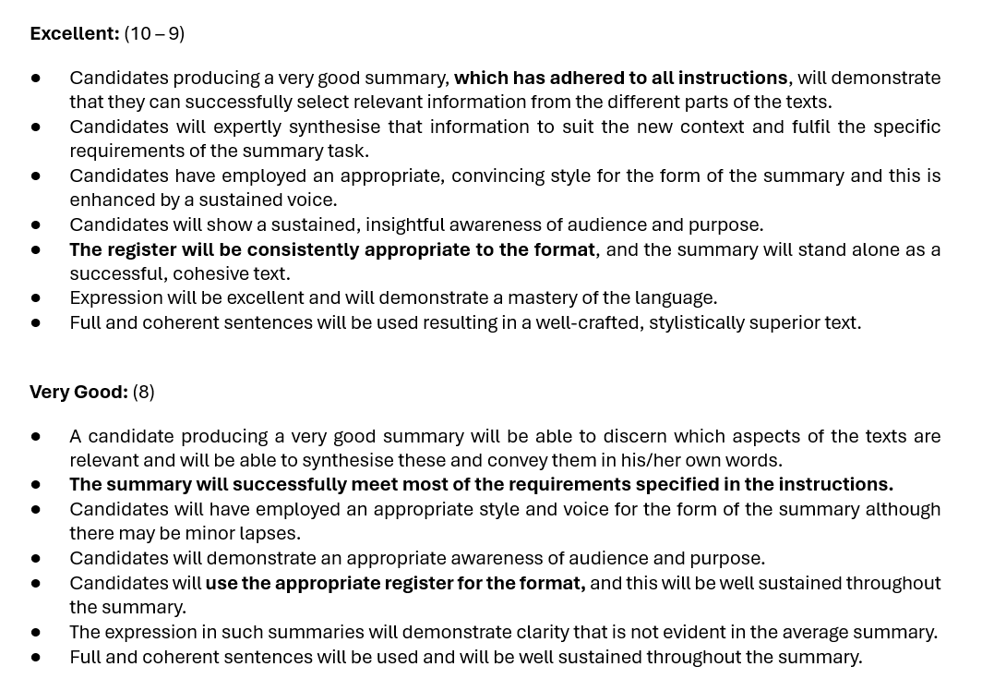
Question 2 – Summary PROPOSED NEW RUBRIC

Slide 11
Questions 3 and 4—Poetry:
Candidates enjoyed this section of the paper, and the feedback from teachers regarding the selection of poems was very positive, with specific reference to the unseen poem.
Candidates are reminded that any viable poetry combination can be asked and that they should not try to guess the combination based on previous examination papers.
Many students did not attempt Question 4 (Unseen Poetry). Candidates are encouraged to attempt every question in the examination paper. Question 4.5 asked the candidates to unpack personification and link it to mood. This question was certainly doable given the candidates understanding.
When dealing with structure of poems, candidates should look for similarities and differences and how they impact meaning. Candidates responded well to Question 3.5 which asked how the poets’ use of the sonnet form explored ‘inner conflict and self-awareness’ and ultimately ‘resolves emotional struggles. Even those candidates who could not unpack the sonnet forms were able to achieve well by linking the quotations to the thematic meanings of the poems.
CAT! CAT! CAT! CAT!

Slide 12
Question 5—Visual and Critical Literacy:
Candidates are encouraged to spend more time preparing for these types of questions, and perhaps engaging with a word list or glossary of sorts may be helpful in growing their examination vocabulary.
Students must be reminded to check the text to which the question refers (some used the incorrect text in their responses) and to number their responses exactly as the question paper numbers them.
As with the comprehension, the language questions added to the Critical and Visual Literacy section were dealt with well.
Candidates must understand the difference between visual and verbal details and their impact on advertisements. Visual details refers to the pictures, while verbal details refer to the specific words.
When answering questions about ‘layout’ candidates must refer to the placement or positioning of the specific visual and verbal details. Their answers might include (centred, background, foreground, left etc.). In ‘layout’ questions, candidates are not required to the unpack the specific diction or visuals, but rather their placement.

Slide 13
Question 6 – Language
It seems that more candidates than in previous years completed the entire question paper, as Question 6 seemed to have been completed successfully. Question 6 combined the basics of grammar with a more nuanced understanding of tautology and singular/plural words (phenomenon/phenomena).
It is possible to achieve high marks for this question – if the candidates prepare thoroughly. This section is linked to the learning aspect of the paper.
Candidates are also reminded that language-styled questions are not limited to this section of the question paper but can, in fact, be incorporated into other questions (as seen in 2025).
Students must be more systematic in their interrogation of the language questions. Some elements of the questions were ignored (or students did not know their theory).

Slide 14
Final Remarks:
Please continue to incorporate the use of the Generic Descriptors in classroom teaching.
It was encouraging to see candidates deal with 3,4- and 5-mark questions successfully, but it is suggested that candidates identify a strategy for answering 2-mark questions. Many candidates overwrote answers for 2 marks.
Please guide weaker candidates with regards to the layout of the paper. In some cases, candidates muddled their questions up a lot, making the sequence of their responses very difficult to follow. Schools are encouraged to mirror the final Paper 1 examination structure asap in the FET phase.
As far as possible, candidates must answer questions in their own words and not lift from the question or the text. There were instances of candidates simply rewording the question in their responses, which implied a lack of understanding of the question. Please also encourage candidates to see that intertextual references can come from anywhere and can be included in any aspect of the question paper.

Slide 15
Final Remarks:
Encourage students to look beyond the silos and engage positively with the questions asked.
Thank you very much to all teachers for the wonderful work that is being done in the classroom. It is evident that there is a deep commitment to the learners in our care and that they are in very good hands.
Thank you to the markers who marked the 2025 examination. It is truly rewarding to hear the positive comments from the new markers and to welcome back those who mark year in and year out.
What to expect in 2026?
Consistency and fairness in terms of questioning style.
Asking students to think beyond silos.

Slide 16
PAPER 2

Slide 17
Overview of the Paper
Structure remained consistent with previous years
Emphasis on broad, interpretive questions to encourage critical thinking
Othello replaced The Tempest in the Shakespearean section
The Handmaid’s Tale was the more popular novel choice (65% of centres)
Transactional Writing included:
  Open Letter (Compulsory)
  Email vs. Blog (Blog less popular but scored higher)

Slide 18
Shakespeare: Othello
Question Focus: Whether audiences identify more with Iago than Othello
Strengths:
  Nuanced, insightful responses
  Well-structured contrasting perspectives
  Engaged critically, avoiding formulaic answers
Areas for Improvement:
  Incomplete responses, neglecting broader implications
  Overuse of informal phrases
  Issues with quotations (too long, too short, or absent)
  Weak introductions lacking key topic anchoring
Guidance for Teachers:
Teach quote embedding and present-tense analysis
Discourage rhetorical questions, colloquial language, and first-person pronouns
Promote critical engagement over memorisation

Slide 19
Novels: The Handmaid’s Tale & The Theory of Flight
Strengths:
  Focused analysis on fewer characters led to richer essays
  Improved nuanced question interpretation
Areas for Improvement:
  Over-reliance on memorised essays
  Disjointed responses due to weak logical progression
  Partial engagement with texts (e.g., using only series adaptations)
  Repetitive analysis & quote-pack dependency
  Character name spelling errors
Guidance for Teachers:
Encourage a holistic study of texts
Avoid pre-written essays and pre-selected quote packs
Teach individual character analysis rather than plot recounting

Slide 20
Transactional Writing
Open Letter (Compulsory)
Strengths:
  Strong personal anecdotes and persuasive techniques
  Effective introductions and conclusions
Areas for Improvement:
  Overly casual language detracted from impact
  Exceeding word limit led to unfocused arguments
  Sincerity and maturity need to be evident
Email vs. Blog (Choice Question)
Strengths:
  Creativity, personal insights, and current affairs integration
  Blogs: Imagery, humour, and mature voice enhanced responses
Areas for Improvement:
  Intertextuality sometimes distracted from task focus
  Blogs: Informal tone should maintain sophistication of ideas/diction

Slide 21
Recommendations for Teachers
  Reinforce critical engagement over memorisation
  Teach structured, evidence-based arguments
  Guide students on transactional writing nuance and voice
  Encourage attempts at every question

Slide 22
In Conclusion :)
2024 Paper challenged candidates to think critically and creatively
Responses ranged from 100% to 0%, highlighting disparities
Some areas require improvement, but overall quality reflects dedication
Continued collaboration & refined teaching practices will lead to future success
Focus on character development and major themes will remain central to Paper 2

