Slide 1
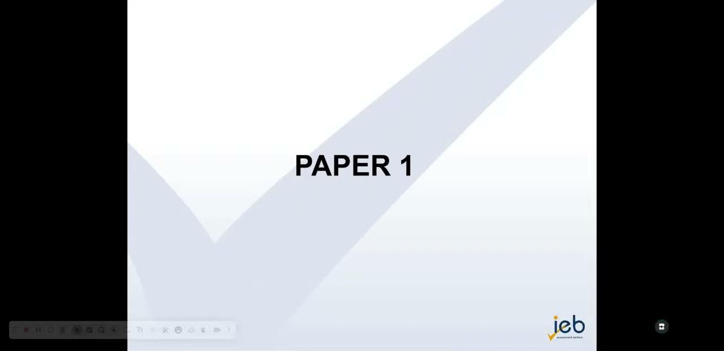

Slide 2
P2 Feedback
Chelsea van Lieshout

Slide 3
Overview of the Paper
Structure remained consistent with previous years
Emphasis on broad, interpretive questions to encourage critical thinking
Othello is in its second year (2026 will be the final round)
The White Tiger (Global South) was the more popular novel choice (80% of IEB centres) & Brave New World (Classic)
Transactional Writing included:
  Open Letter (Compulsory)
  Email vs. Eulogy (Choice)

Slide 4
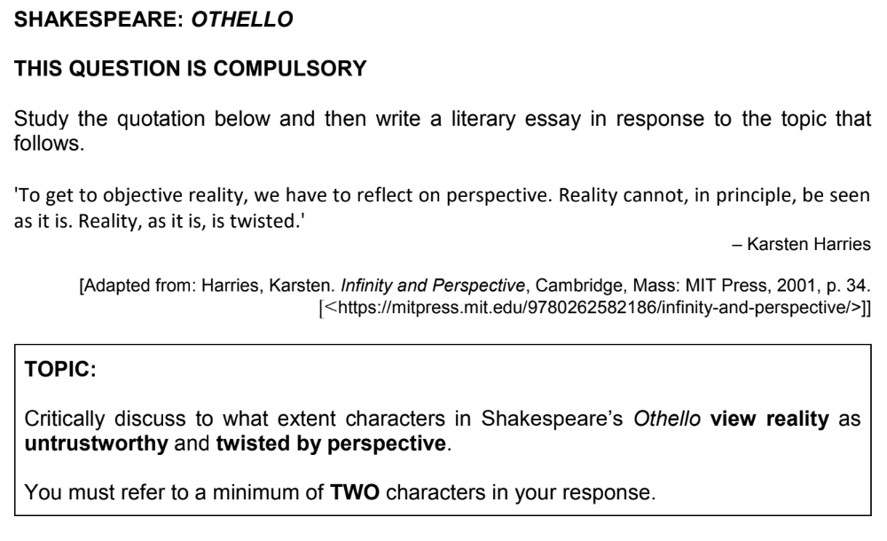
Shakespeare: Othello

Slide 5
“Liberating education consists in acts of cognition, not transferrals of information.” (Paulo Freire, Pedagogy of the Oppressed, 1970)

Slide 6
“To what extent”
The Othello question, in particular, required students to plot their argument along a spectrum of possibilities. They needed to determine which characters recognised that reality is a fallible and tenuous construct and could manipulate perspective (Iago), which characters believed that “men should be what they seem” and thus fell victim to deception (Othello), and which characters were aware of duplicity but were deceived nonetheless. (Roderigo, Emilia).
Celebrated students who could show that they know with confidence, accuracy and clarity.

Slide 7
3. This is an encoding paper: we are assessing how students can add meaning/analysis/insight/understanding to a primary text (novel or play).
4. Implicit in the skill of writing, is the candidate’s ability to select evidence from the text. This is on a small level, choosing the correct quotes, from the correct point in the play, but on a more significant level, the candidate’s ability to refer to big events, scenes, and characters. And perhaps, most importantly, a candidate’s ability to choose the correct topic that will illustrate their knowledge, skill and voice the best.

Slide 8
5. On the whole, we saw a decline of rehearsed essays.
6. Success across both essays relied on a student’s ability to
  Determine a clear and clean thesis statement.
  Develop a logical progression of argument, with cohesive language.
  Structure rich paragraphs that tackled an aspect of their argument at a time.
  Reference to scenes/events must be chronologically arranged.
  Root their argument in a scene or moment in the play, & weave together literary evidence that build a compelling argument: quotes, paraphrasing, symbolism, diction, imagery, etc.

Slide 9

PEEL
7. PEEL/Burger method/PEAL, are useful mechanisms to show structured thinking/reasoning - particularly when introducing literary essays in high school.
8. Please encourage students to develop a confident approach to writing paragraphs, and develop depth, fluidity and rigor. Any method of organising an argument is useful, provided it does not harden into formula or superficiality. Students are encouraged to stretch their language, and imagine ways to refer back to the topic in order to avoid repetitive phrasing.

Slide 10
Iago states quite boldly to Roderigo that he “[is] not what [he is]”. His duplicitous nature is clear through his actions as well, as he emerges from the darkness and shouts alarmist statements up to Desdemona’s father, Brabantio. Iago deftly reframes the love affair between Desdemona and Othello as something bestial, warping Brabantio’s once-fond feelings for Othello into something hateful. Iago relies on Brabantio’s nascent prejudice, as he claims that Othello is a “black ram” who is “tupping” his innocent daughter. Iago’s use of imagery relies on racial stereotypes of an oversexed Moor who exploits the innocence and fragility of white, Venetian girlhood. Moreover, Iago happily twists the good reputation of Othello by implying that Othello has used witchcraft to beguile Desdemona. Brabantio is enraged, and, thus, his perspective has been successfully distorted.

Slide 11
Style
Use present tense (‘Iago believes…”)
Integrate quotes grammatically – they should not simply ‘float’ in an essay, or remain uninterrogated/unexplained.
Formal register throughout, absolute avoidance of colloquial terms, slang terms (unalived, ‘gets with’ Desdemona’, ‘Did Othello dirty’, ‘Desdemona is for the streets”)
Students must use accurate quotes and close reference to texts. No sweeping statements.
Underline titles, especially with eponymous characters.
Avoid ‘you’ point of view
Please avoid philosophical introductions
No rhetorical questions
Avoid moralising/didactic writing.

Slide 12
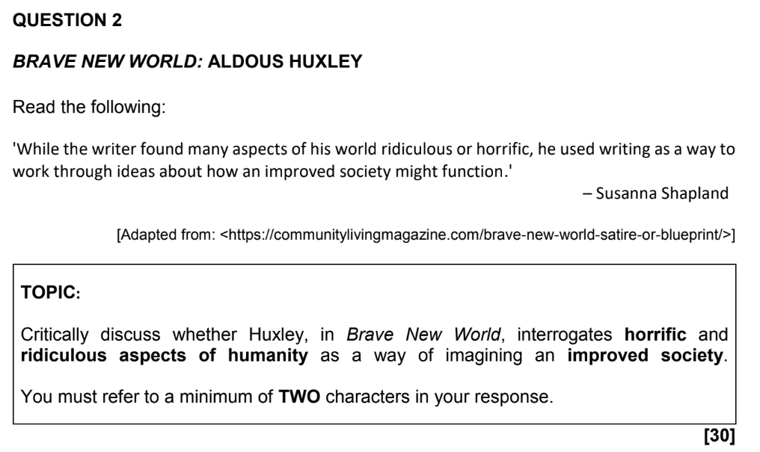
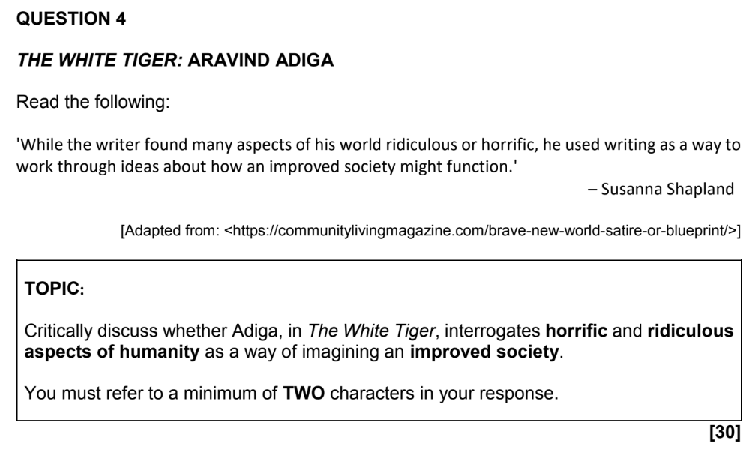
Novels: Brave New World & The The White Tiger

Slide 13
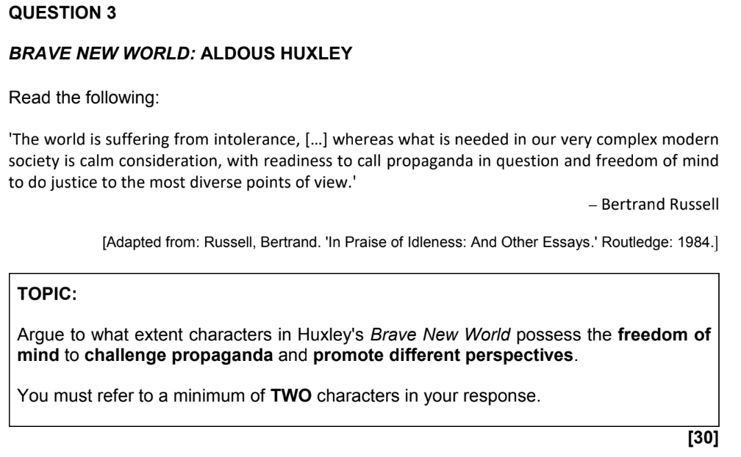
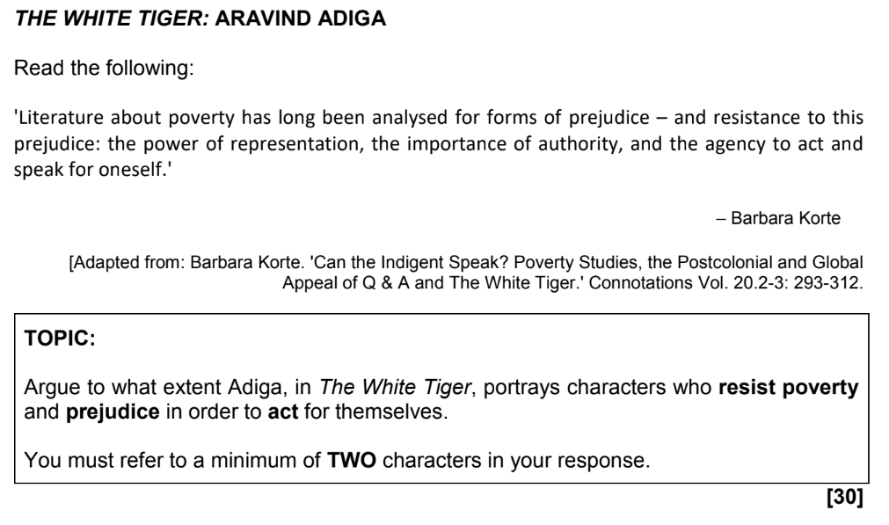

Slide 14
Platform Paragraphs
Platform paragraphs are a useful development in literary essay writing. These are paragraphs that fall after the introduction. They are OPTIONAL tools that allow for a student to offer a broader, world-building paragraph that provides context to the narrower, close-reading argument paragraphs that follow. Platform paragraphs provide useful context that frame the argument. This could be the postcolonial context or caste system in India, or the broad mechanisms of control employed by the World State. However, platform paragraphs should point to a specific part of the question, and not simply float, untethered from the argument. The platform paragraph provides a foundation for analysis that comes later on.
- Broad contextual sweeps
- No evidence or character engagement.

Slide 16
In The White Tiger, Aravind Adiga does not merely tell a story of ambition, he exposes the grinding reality of poverty as an oppressive and inescapable force. Balram’s early life in the Darkness, where families live crammed into dilapidated homes and access to food and education is limited, demonstrates how systemic poverty shapes every choice a person makes. The seemingly fixed caste system, corrupt landlords, and lack of opportunity in the Darkness are not incidental details, they function as mechanisms of control, keeping characters like Balram trapped in servitude while the wealthy thrive. Adiga makes it clear that social and economic inequality is not merely unfair; it is a violent structure that determines destinies before individuals can even imagine a way out.

Slide 17
Intertextuality in Essays
Unpacking existing intertextual references that are found in the world of the novel. For example, when Huxley borrows from Miranda in Shakespeare’s The Tempest, “Oh, Brave New World, that there are…”. Students can make a parallel between John the Savage’s initial awe when meeting Lenina to Miranda’s immediate attraction to Ferdinand. They can then refer to the second & third occasions when John makes this reference, outlining his progressive irony and disgust at humanity – straying from Shakespeare’s initial intended use.
Students do NOT need to try to integrate external theorists, critics or parallel literature alongside their reading of the novel (for example, offering a Freudian reading, making mention of Samuel Taylor Colerdige, or finding likeness in Life of Pi or 1984.

Slide 18
Transactional Writing

Slide 19
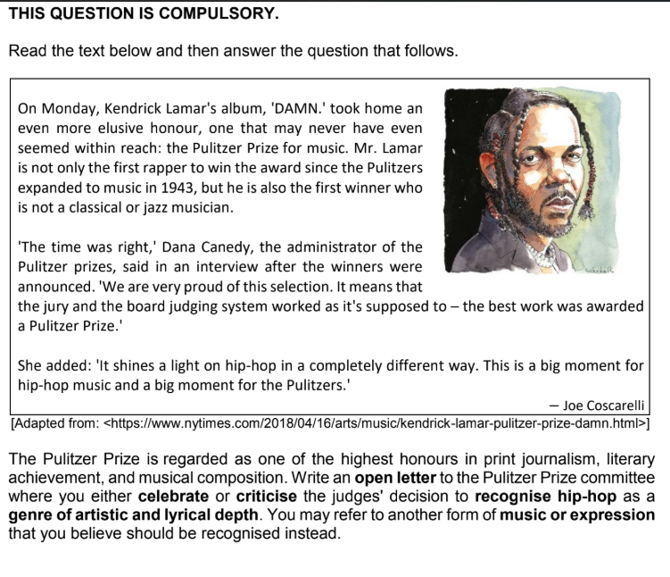

Slide 20
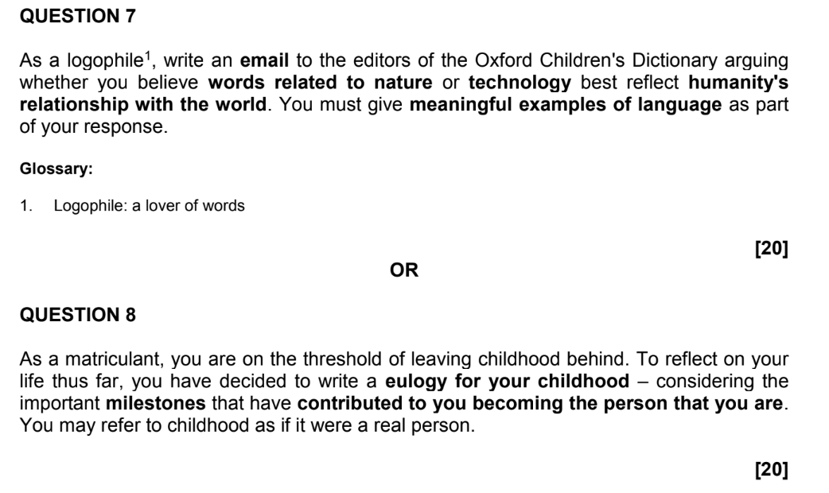

Slide 21
Transactional Writing
Students should practice ‘bringing the outside world in’ where appropriate – this could mean drawing on their own life, building an argument based on Greek myth or a poem that they love, referring to political events in the real-world, provided that the references are relevant and enhance their writing – according to purpose and audience.
Transactional Writing is inherently a creative and intelligent act. Students need to be aware of WHO they are writing to (audience), WHO they are writing as (their persona), WHY they are writing (purpose) and, therefore HOW they should curate their language (STYLE).

Slide 22
Transactional Writing
The transactional responses were strong on the whole.
Fewer students seemed to struggle with time-management, and this is perhaps credit to the shorter stimuli (less reading).
Greater original responses on the whole - again, perhaps a result of students relying less a shorter stimulus passage.
Passionate responses (both in support of hip hop and criticising hip hop’s inclusion in the Pulitzer Prize’s music category).
Students will always be given an ‘escape hatch’
Of the choice options, the eulogy (Q8) was the strongest response. This speaks to students ability to draw on their own lives and a much more accessible style (melancholy, lament, nostalgia). These were a delight to read and mark!
Please encourage students to write with control and subtlety. No need to magnify trauma for effect.

Slide 23
Students should choose transactional writing based on the topic, and their own ability to provide depth and voice, rather than their anxieties around format.
Voice is determined by being attentive to, and utilising:
· Punctuation for meaning
· Paragraphing
· Format
Humour, authentic anecdote, clever analogies
· Diction
· Imagery
Tone
· Rhetorical device

Slide 24
Recommendations for Teachers
  Please attend marking
  Attend cluster meetings
  Ask for moderation from experienced teacher friends
  Sign up to be Oral or SBA moderators
  Keep reading
  Keep sharing
  Find time to rest

Slide 25
Thank you
&
Farewell

