Slide 1

ORALS
A true differentiator

Slide 2
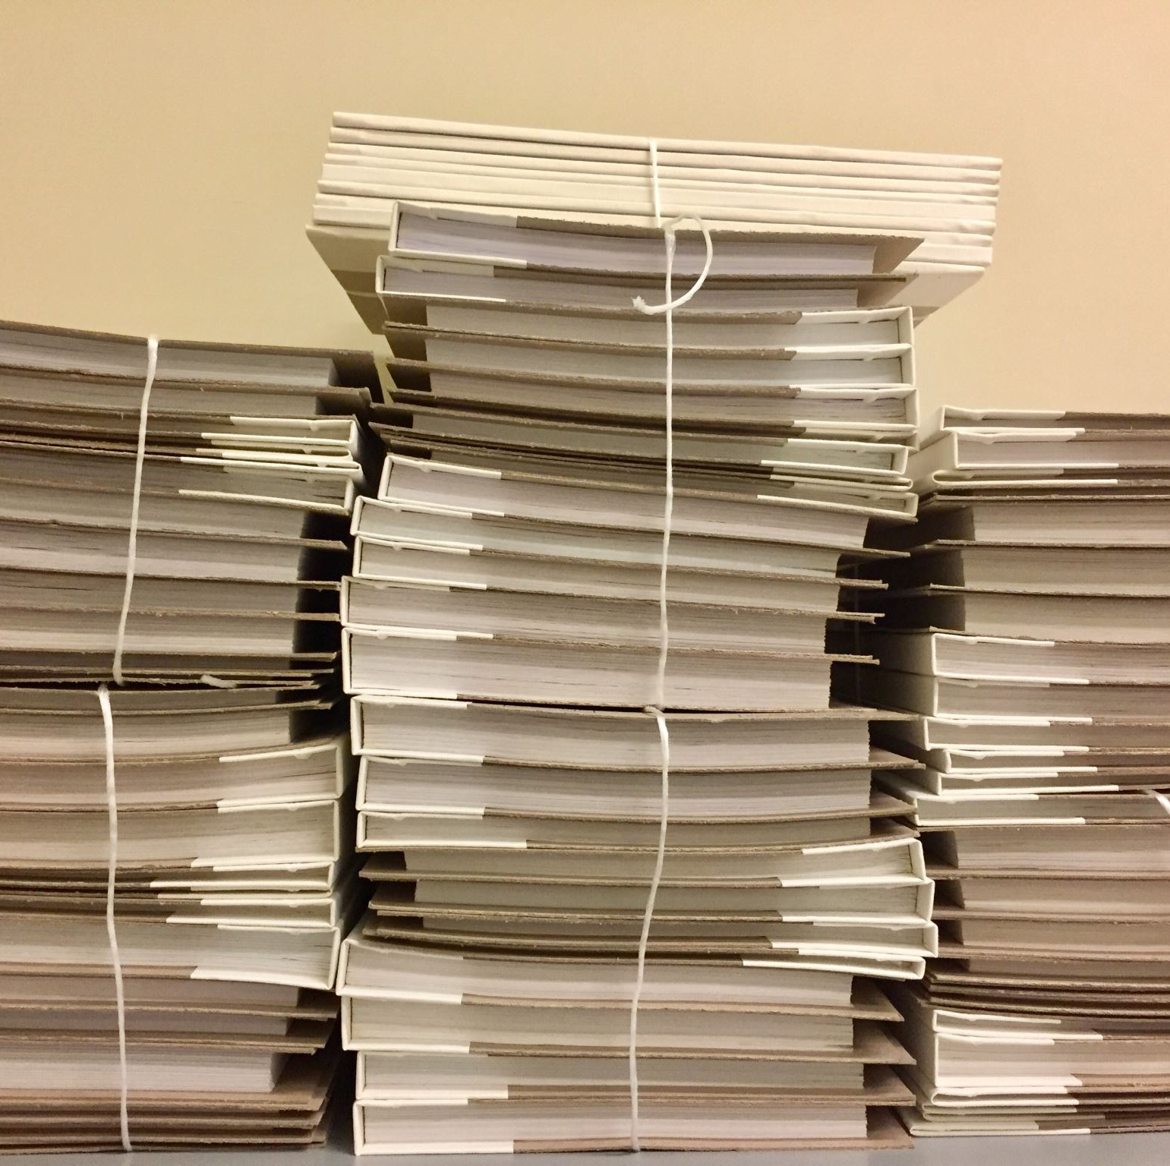
Adminstration of orals
Recordings
Correct weighting on mark sheets
‘Storage’

Slide 3
Prepared orals
Rigour
Variation
Required length
PPT/Visual element
A+
Audience awareness

Slide 4
Listening and reading
Listening comprehensions: style and question types
Prepared reading : choice and delivery
Unprepared reading

Slide 5

Support and moderation
Clusters
Using recordings as tool

Slide 6

Questions?

