Slide 1

















No Soma Required: Helping Students Navigate ‘Brave New World’
FIONA KAMPMANN
ST JOHN’S COLLEGE

Slide 2

How do we navigate the novel?
  One of the most frequently censored books in history.
  Examine it through the lens of a dystopian genre.
  Begin with an overview of the issues in the novel.
  This provides students with an idea of what to expect. and pre-empts the sensationalism.
  Make students read the novel authentically.
  Initial discussion before teaching the novel.
  Ask students to draw parallels between the society in which we live and that of New London AF 632.

Slide 3

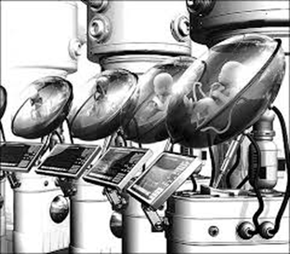
Utopia vs Dystopia
  A utopia is a society where everything is perfect (eu + topos - means ‘a good place’.
  A dystopia is a futuristic, imagined universe in which oppressive societal control and the illusion of a perfect society are maintained through totalitarian control. Dystopias, through an exaggerated worst-case scenario, make a criticism about a current trend, societal norm, or political system.

Slide 4
Why can the novel be considered contentious?
  Set in A.F. 632 in a futuristic society very different to our own.
  Employs Eugenics - planned breeding and production of cloned humans.
  Society is stratified and based on a hierarchical caste system.
  Traditional religion has been replaced by the worship of Consumerism.
  Social conditioning is used to dictate the citizens’ behaviour.
  Promiscuous behaviour is encouraged.
  Philosophy of ‘Everyone Belongs to everyone else’.
  Use of Soma to ensure that the citizens remain happy at all times.

Slide 5
Context in which the novel was written
  It was written in 1932 between the first and second world war.
  The social effects of the Great War were evident.
  People were beginning to question the established social and moral beliefs.
  There was a desire for more equality in class and gender.
  Mass production and technological innovations such as car, radios and telephones transformed daily life.
  People were concerned about the change in their daily lives and were worried about losing their indivduality.

Slide 6

How do world events impact on the content of the novel?
  The changing nature of the world between both wars and the growth of consumerism because of mass production are reflected in extreme consequences.
  Consumerism becomes a religion where the society worships Henry T Ford.
  The rise of Socialism in the 1920s is highlighted by the emergence of a totalitarian world state.
  Family life breaks down completely.

Slide 7
How do Psychology and Innovation impact upon the novel
  1879: The first psychological laboratory opens in Germany.
  1886: Sigmund Freud argued that awareness of the unconscious mind is essential to understanding conscious thought and behavior.
  1900: Gregor Mendel’s scientific studies of genetic inheritance are rediscovered. Interest in eugenics grows.
  1900-1920s: Introduction ofchewing gum,radio, movies, and advertising
  1908: The first Model T car is produced.
  Henry Ford’s development of an assembly line.

Slide 8
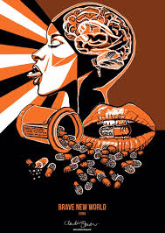



Themes
  Predestination
  Social conditioning
  Stability of Society
  Consumerism
  Commodification
  Marginalisation
  Promiscuity
  Individual vs the Community
  Freedom
  Happiness
  High Art

Slide 9
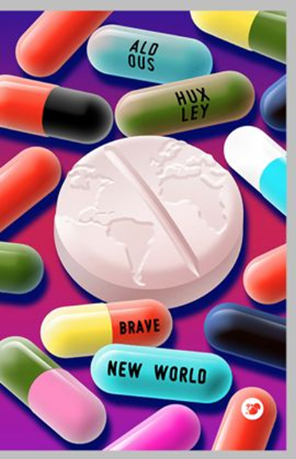
The Title - ‘Brave New World’
  Irony of the title which has connotations of hopefulness and beauty.
  It is taken from ‘The Tempest’ where Miranda anticipates a world of promise.
  Instead, we are presented with a sterile, controlled society where progress has not brought fulfillment.
  The World State is not the utopia that the title suggests.

Slide 10
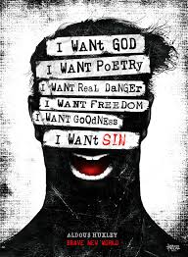
Parallels to ‘The Tempest’
  Compares the ‘utopia’ of The Island to that of New London.
  Sycorax is alone on the island ; Linda is left behind on The Savage Reservation in the midst of a storm.
  Marginalisation of Caliban and John the Savage.
  Caliban is marginalised by Prospero and Miranda; John is marginalised as a consequence of his mother’s lack of morality and his rejection by the Zuni Native Americans.
  Both attempt to rebel - Caliban against Propoero; John against the ritual of dispensing soma.
  Prospero gives up his magic; Mustapha Mond gives up his individual happiness and serve the happiness of society.
The Subversion of Drama in Huxley's Brave New World by Edward Lobb

Slide 11

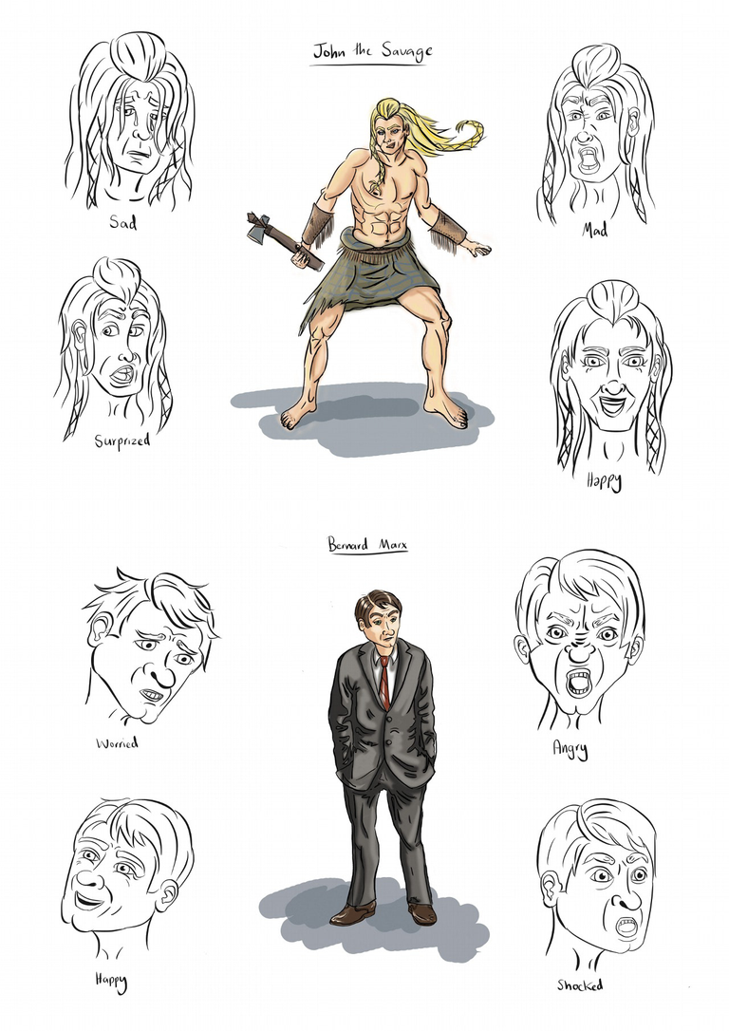

Platform Paragraph
  Gives students to include a world-building paragraph.
  This enables students to demonstrate their knowledge of the world in which the novel is set.
  For weaker students, it acts as a way to anchor themselves in an essay and demonstrate what they know.
  This should not be a pre-learned/pre-prepared paragraph but should demonstrate an engagement with the question.

Slide 12
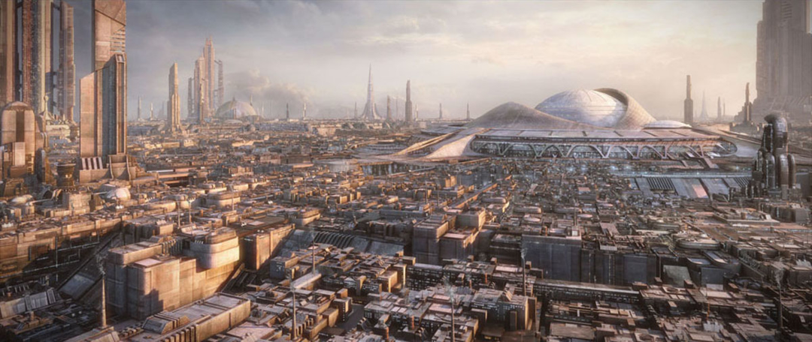
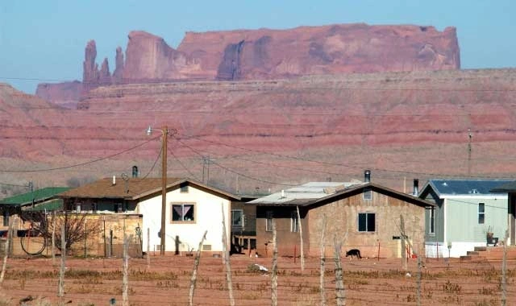
Setting of ‘Brave New World’
  There are two settings which are juxtaposed in the novel.
  London in A.F. 632 - a sanitised, civilised, mechanised, futuristic society.
  The Savage Reservation in New Mexico which is presented as uncivilised and is inhabited by Native Americans specifically the Zuni.

Slide 13
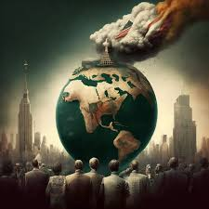
Inside ‘Brave New World’
  Assign groups a specific character and/or theme.
  Use a Google Doc/ shared presentation for each group to populate the specific details of that character/theme.
  This enables students to trace the character arc in a way that makes it accessible for them to remember.
  Ensure students underpin their ideas with substantiation and relevant quotations.
  If there is sufficient time, you could put students in different castes and ask them to write hypnopaedic scripts for their predetermined caste.

Slide 14
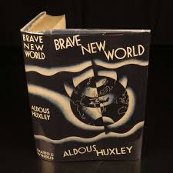
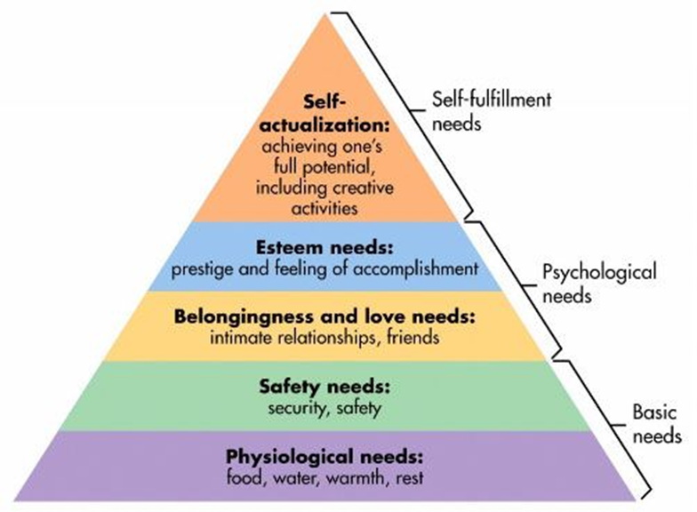
Inside ‘Brave New World’
To what extent are the psychological needs and the capacity for self-actualisation achieved in ‘Brave New World’ and the impact of this on the society of New London?
Adapted from Timothy Hui

Slide 15
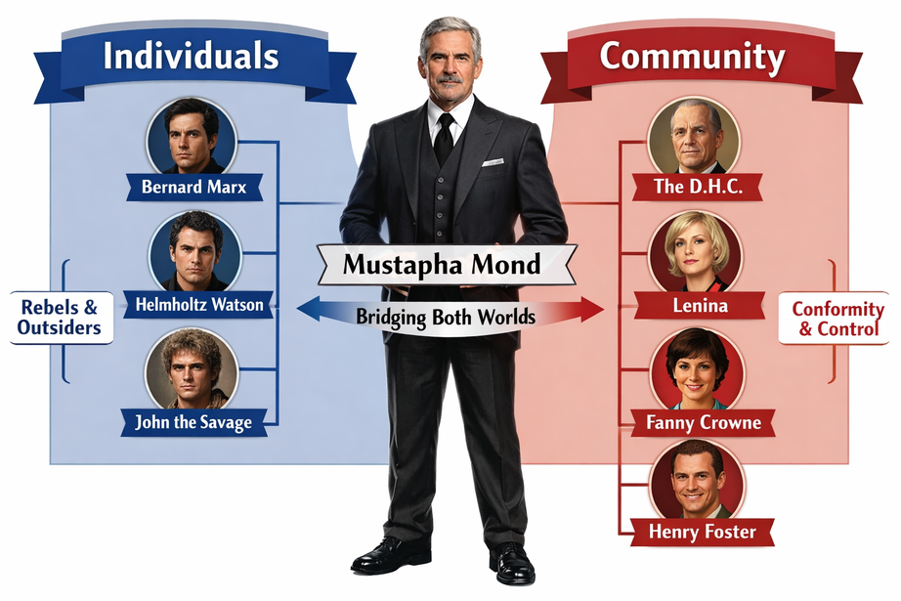
Individual vs Community
  Ensure that students know the characters and can demonstrate the nuances of each character.

Slide 16
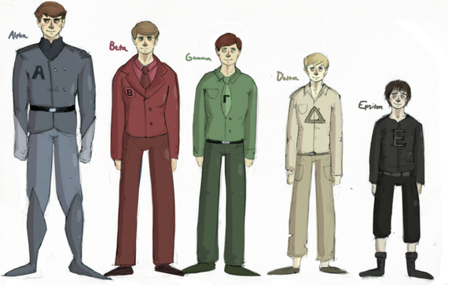
Social Hierarchy
  Social hierarchy is a feature of dystopian states.
  Current day concern with redressing inequality is absent because the different castes have been bred for a specific purpose.
  Citizens accept their caste because it is predetermined by eugenics.
  The cloning and names distinguishing each caste is juxtaposed to our belief in democracy and equality.
  The lowest caste does distinguish between race and consider how when this novel was written may have impacted upon this choice.

Slide 17
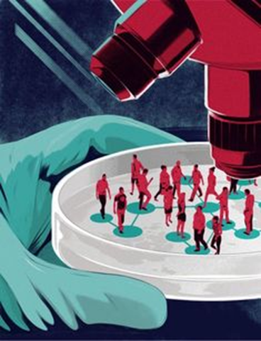
Social Engineering in a ‘Brave New World’
  Relies on Eugenics.
  Babies are created outside the womb in bottles.
  Babies are mass produced and this reflects the culture of mass production.
  Babies are produced according to the needs of society..
  The babies have a predestined future and are allocated according to their social caste.

Slide 18
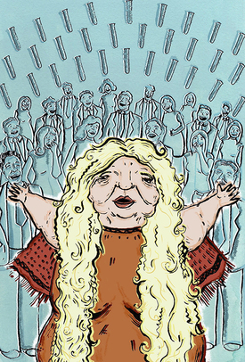
Role of the Family
  As a consequence of genetic engineering, the family unit has broken down completely.
  Community has replaced the nuclear family.
  The thought of physically birthing a baby is repulsive and cannot be contemplated in this sanitised society.
  The word, ‘mother’ has been outlawed.
  Emotional attachments threaten the stability and order of society.

Slide 19
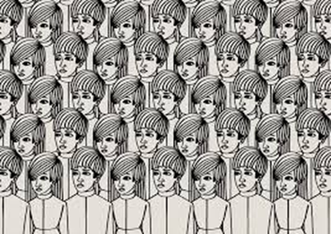
Social Conditioning
  In order to ensure a society of passive beings, social conditioning takes place.
  Neo-Pavlovian conditioning occurs where babies are given an electric shock to ensure they hate books and flowers.
  Hypnopaedia is used to inculcate ideas in children while they sleep such as Elementary Sex and Elementary Class Consciousness.
  The success lies in the repetition of statements which are presented as indisputable .

Slide 20
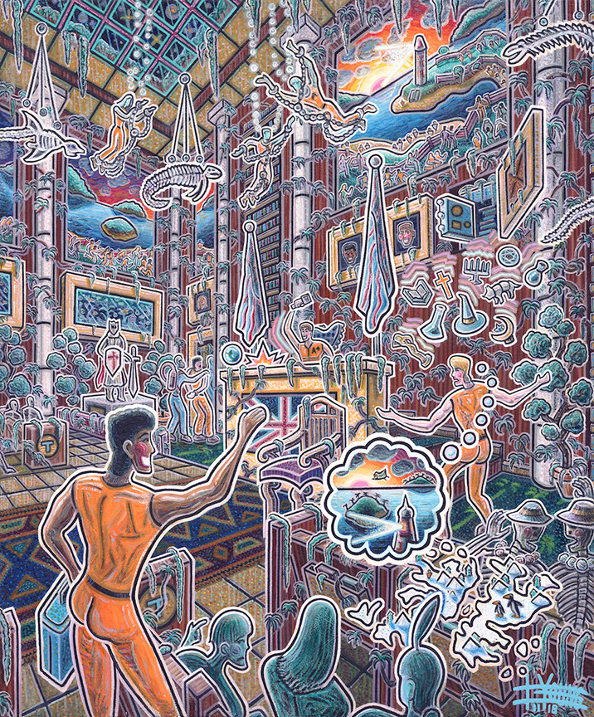
Promiscuous Behaviour
  The motto of this society is ‘Community. Identity. Stability.’
  Contentment ensures a stable society.
  Licentious sexual behaviour is not just encouraged but enforced.
  Erotic play is enocuraged from a very young age is encouraged.
  Children run naked in the garden and engage in ‘rudimentary sexual game[s].
  A child who is unwilling to participate is perceived as abnormal.
  People ar encouraged to have multiple sexual partners because ‘Everyone belongs to everyone else’.
  People who see the same person repeatedly are judged for becoming involved in ‘anything intense or long-drawn’.

Slide 21

Mass Production and Consumerism
  It is a society in which consumerism drives mass production.
  Clothes are not repaired because ‘Ending is better than Mending’.
  Games are devised to ensure that maximum equipment is needed.

Slide 22

Soma
  The World State encourages its citizens to take Soma as a way of maintaining social control and regulating emotions.
  Soma provides an escape mechanism from any feeling that is discomforting since ‘when the individual feels, the community reels’.
  It enables people to maintain a blissful existence as ‘a gram os better than a damn’.
  The totalitarian state uses Soma to suppress authentic emotion so they can maintain control.

Slide 23
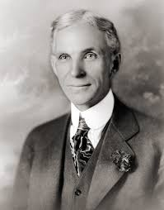
The Gospel of Consumption: Religion and Consumerism in Huxley's World
  Traditional religion and worship has been replaced by the worship of ‘Our Ford’.
  His intention was not to be blasphemous but to provide a warning of the consequences of mass production and consumerism.
  The subversion of Christian religious iconography highlights the slavish devotion of Consumerism.
  The rituals associated with the Solidarity Service ensure a contented community.

Slide 24

Technological Innovation in a ‘Brave New World’
  Genetic engineering
  Private helicopters
  Synthetic music
  Rockets that have replaced aeroplanes

Slide 25
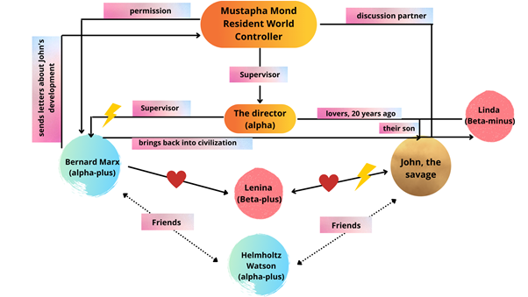




Characters

Slide 26
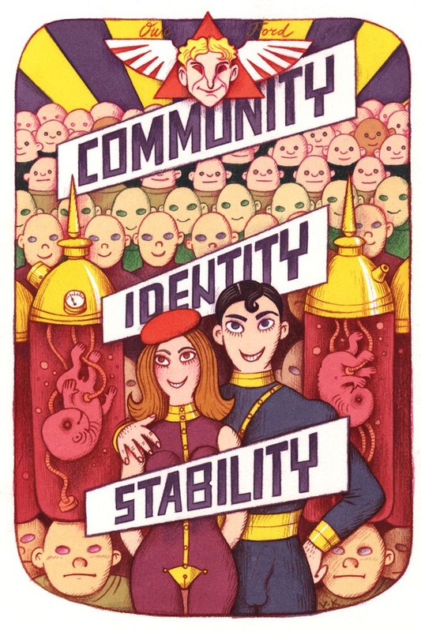
Individual vs Community
  The World State is based solely on Community.
  There can be no individuals or non-conformists to threaten the stability of society.
  Demonstrating individuality in society results in exile to one of the islands to avoid influencing or tainting the masses.

