Slide 1
Web Scraping with Python
Forbes: Global 2000
The World’s Largest Companies

Slide 2
Introduction:
The companies on this list come from 60 countries and collectively account for $39.1 trillion in sales, $3.2 trillion in profit, $189 trillion in assets and $56.8 trillion in market value.
My goal is to :
Illustrate the distribution of these companies across these countries
Find the most prevalent industries
Find the year which yielded the most of these companies
Explore the relationship between sales, profit, assets, and market value

Slide 3

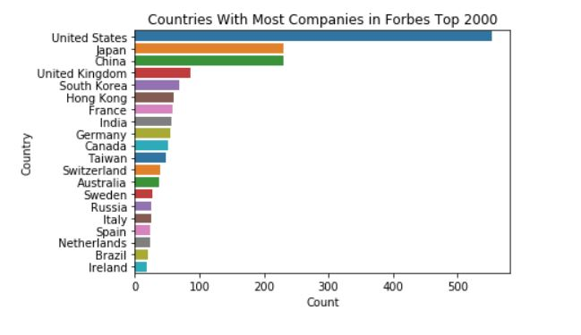
Top 20 Countries on the List

Slide 4
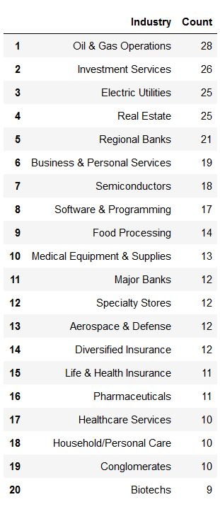
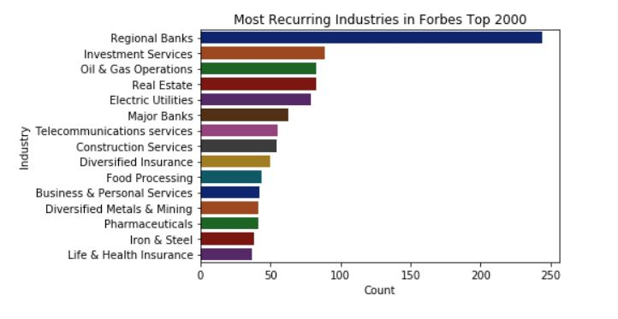
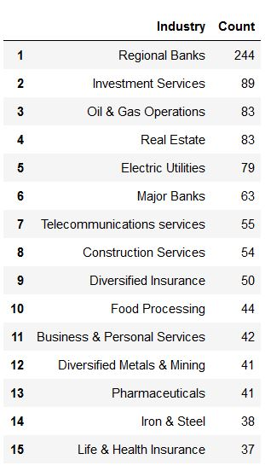
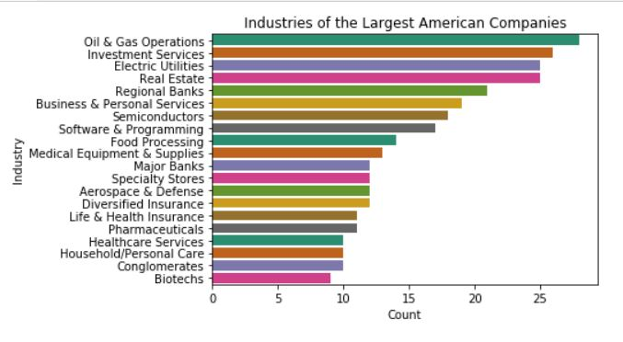
Industries: Global vs US

Slide 5
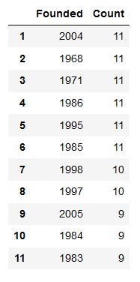
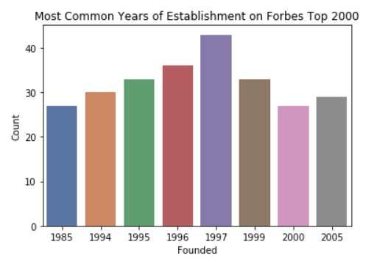
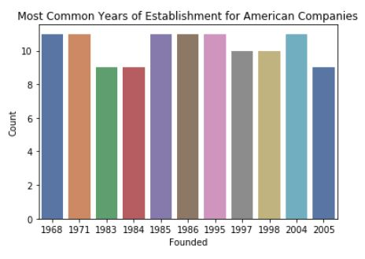
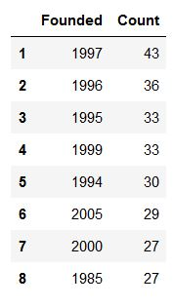
Years Founded
Global
US

Slide 6
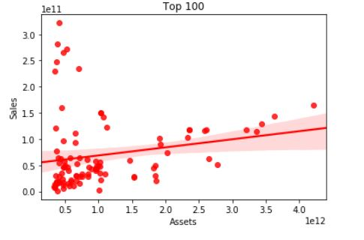
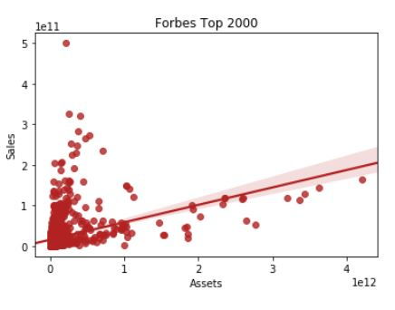
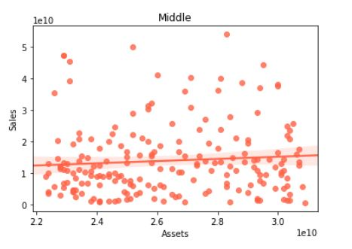
Assets vs Sales

Slide 7
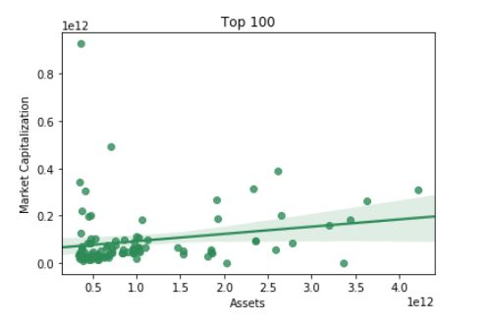
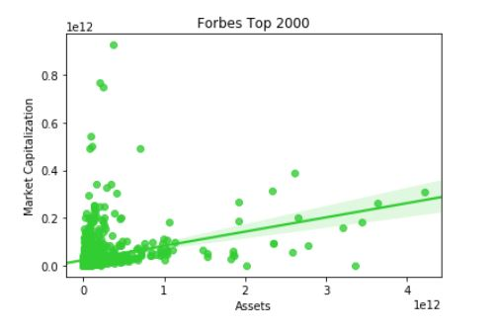
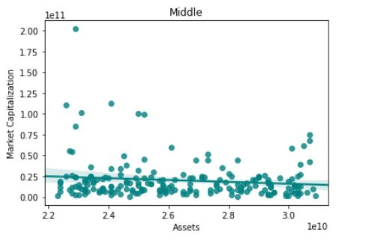
Assets vs Market Capitalization

Slide 8
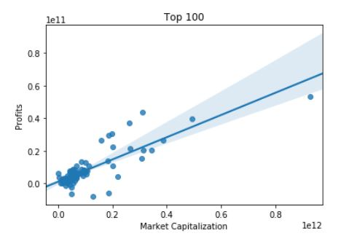
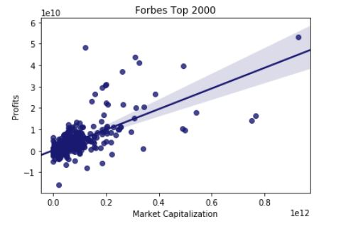
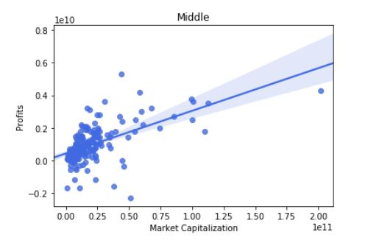
Market Capitalization vs Profit

Slide 9
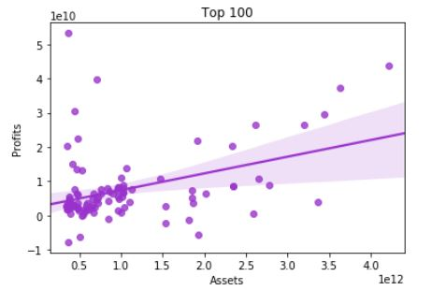
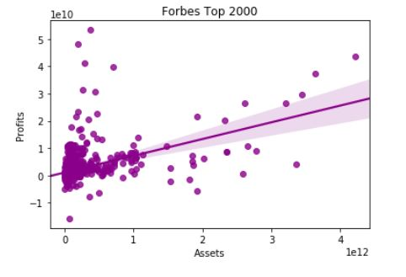
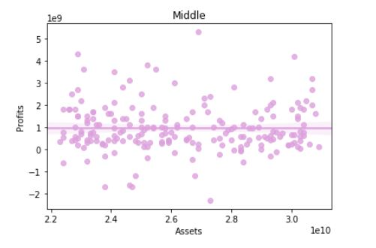
Assets vs Profit

Slide 10
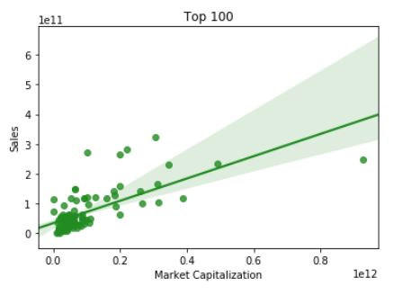
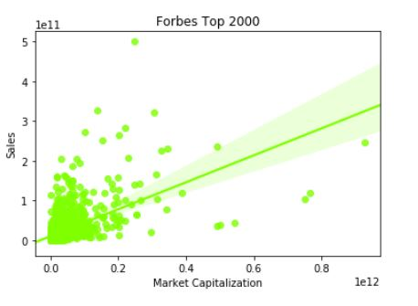
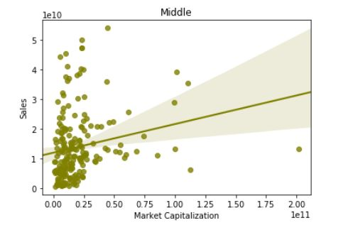
Market Capitalization vs Sales

Slide 11

We can conclude that there is a somewhat strong relationship between market capitalization and profits. This relationship is particularly strong for companies in the top 100 with respect to assets.

Slide 12


Correlation Comparison
Top 100
Middle

