Slide 1
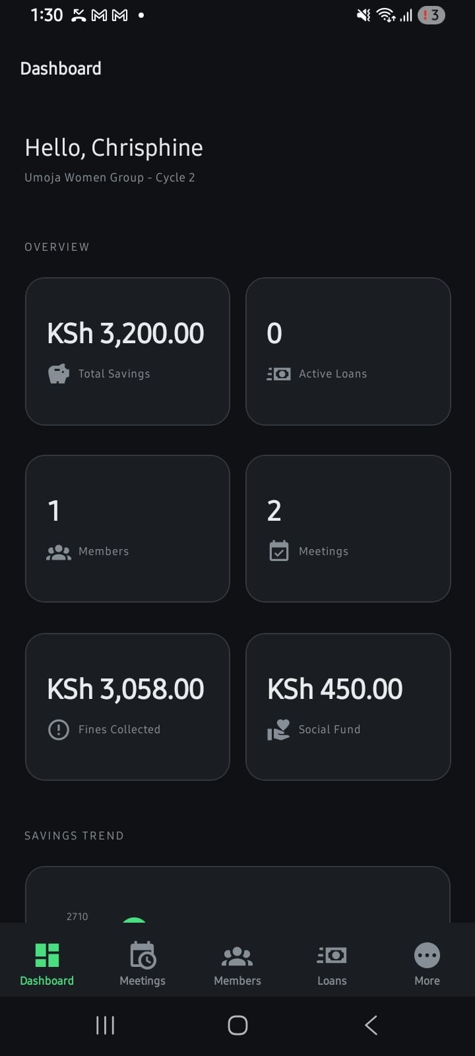



PRESENTS
Paperless · Transparent · Connected · Empowering
intelliwealth.org | info@intelliwealth.org | +254 723 242 701

Slide 2
WHAT IS INTELLI-CASH?
Your VSLA in Your Pocket
Intelli-Cash is a dedicated mobile-first digital platform designed to transform how Village Savings and Loan Associations (VSLAs) operate. It replaces manual registers and cash boxes with a secure, transparent, and real-time digital system that every group leader can manage directly from their smartphone.
Live Dashboard Overview
At a glance, group administrators can track Total Savings, Active Loans, Member Count, Meetings held, Fines Collected, and Social Fund balance — all in real time, with a Savings Trend chart for performance monitoring.

Slide 3
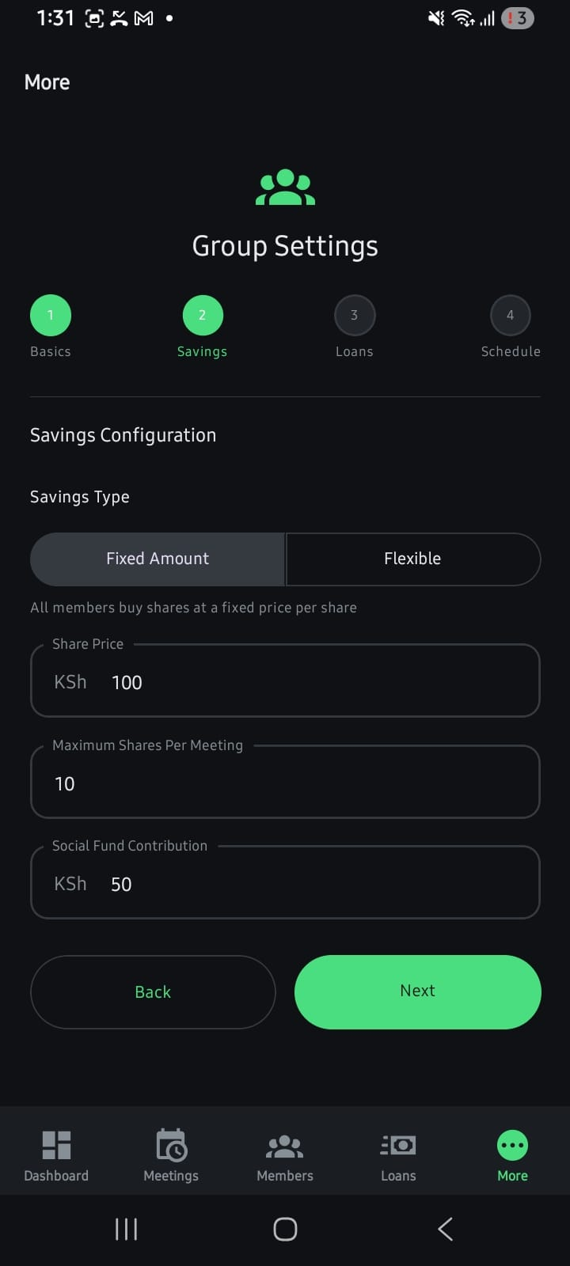
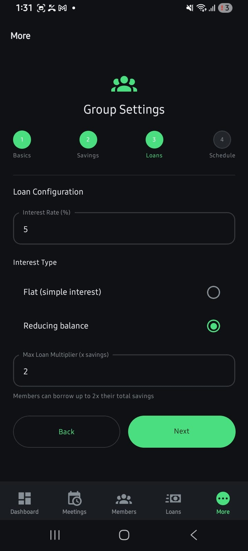
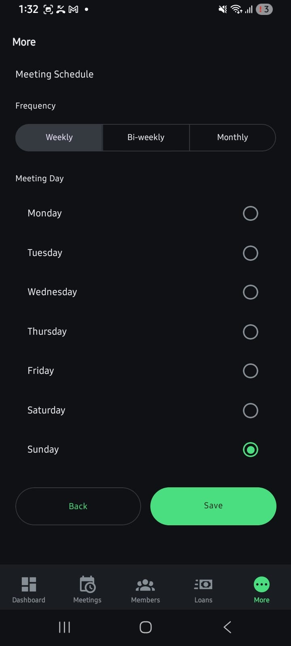
GROUP SETUP & CONFIGURATION
4-Step Group Wizard
1
Basics
Group name, cycle info, member setup
2
Savings
Fixed/Flexible shares, KSh 100/share, max 10 shares, KSh 50 social fund
3
Loans
5% interest rate, reducing balance, 2x savings max loan multiplier
4
Schedule
Weekly/Bi-weekly/Monthly, day of meeting (e.g. Sunday)
Step 2 – Savings Config
Step 3 – Loan Config
Step 4 – Meeting Schedule

Slide 4
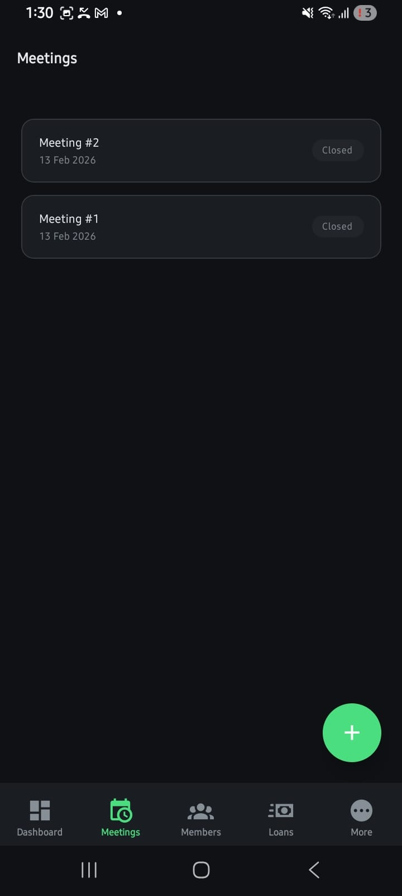
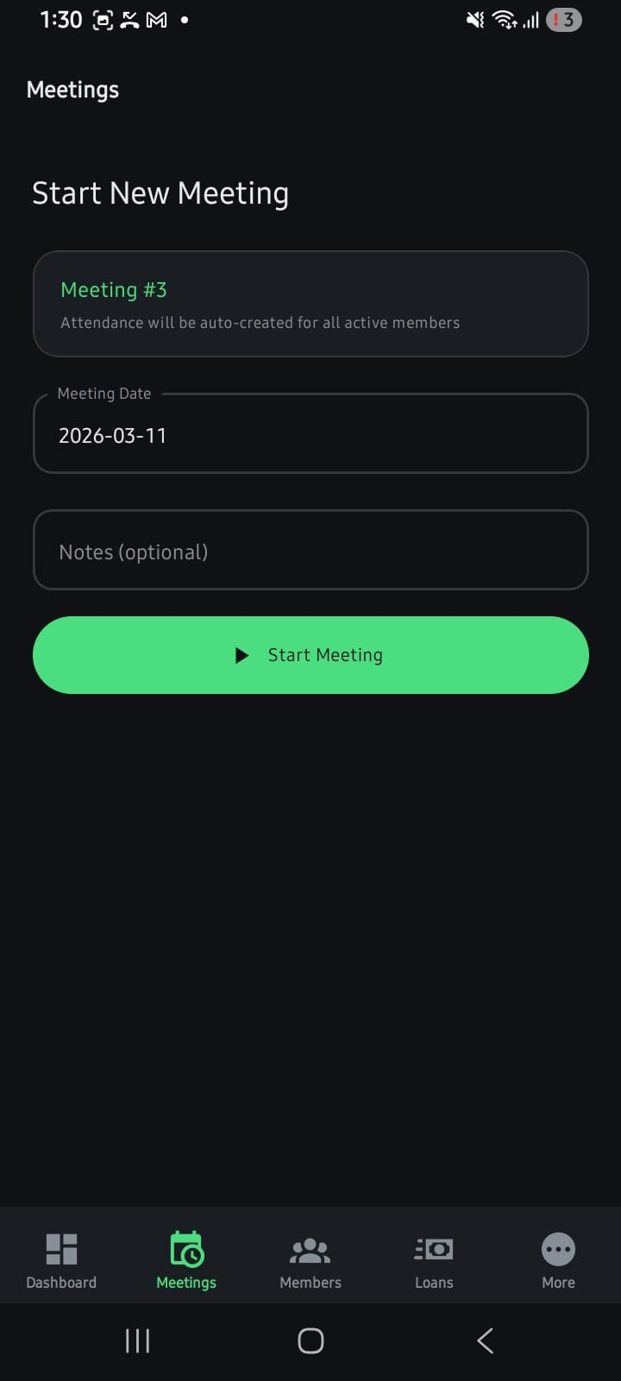
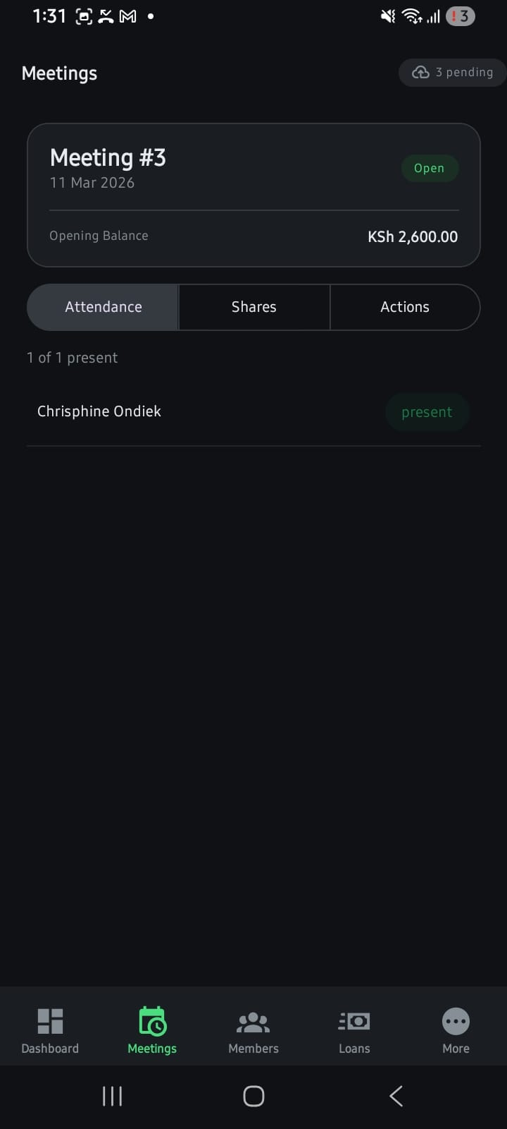
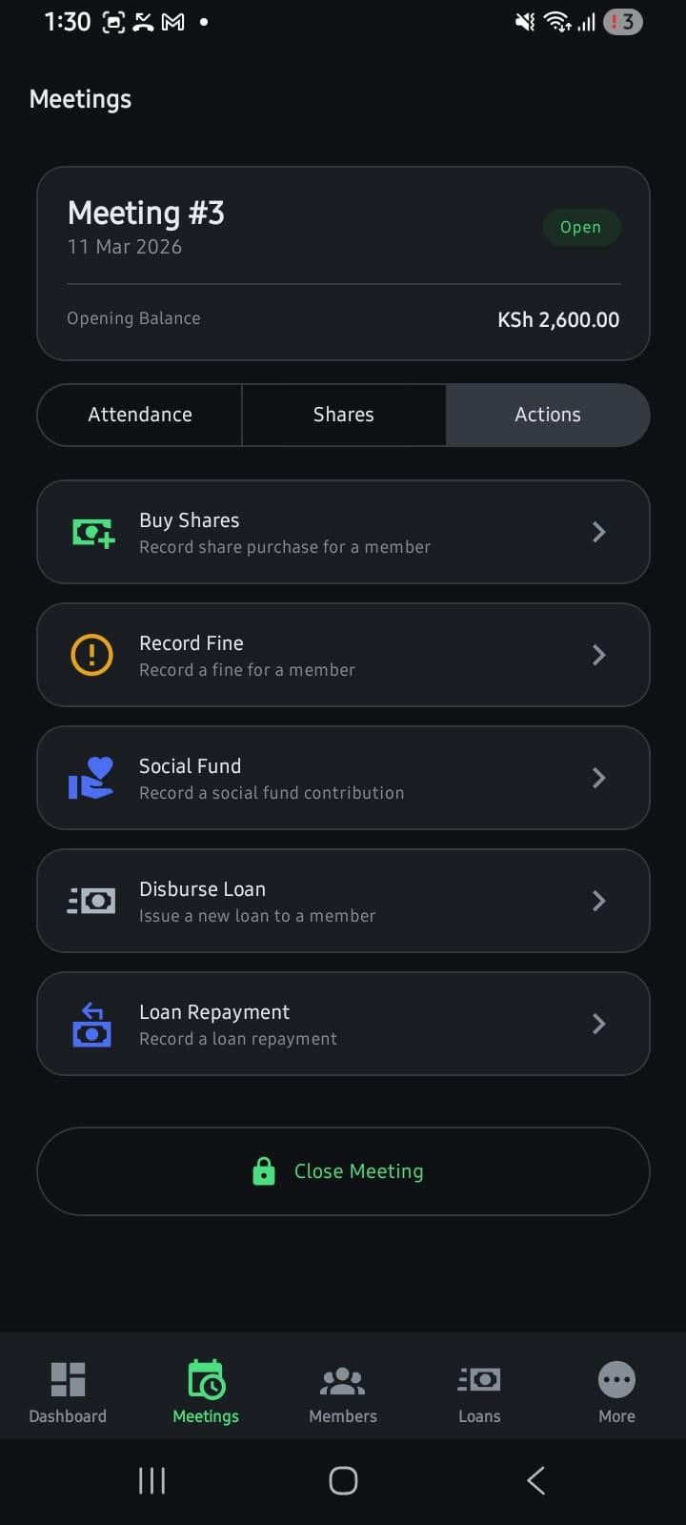





MEETING MANAGEMENT
Every Meeting,
Digitally Documented
Auto-numbered meeting sequence with date & opening balance
1-tap attendance marking for all active members
Record share purchases, fines, social fund contributions
Disburse loans & record repayments within the meeting
Close meeting to lock records — immutable
audit trail
Meetings List
Start Meeting
Attendance
Meeting Actions

Slide 5
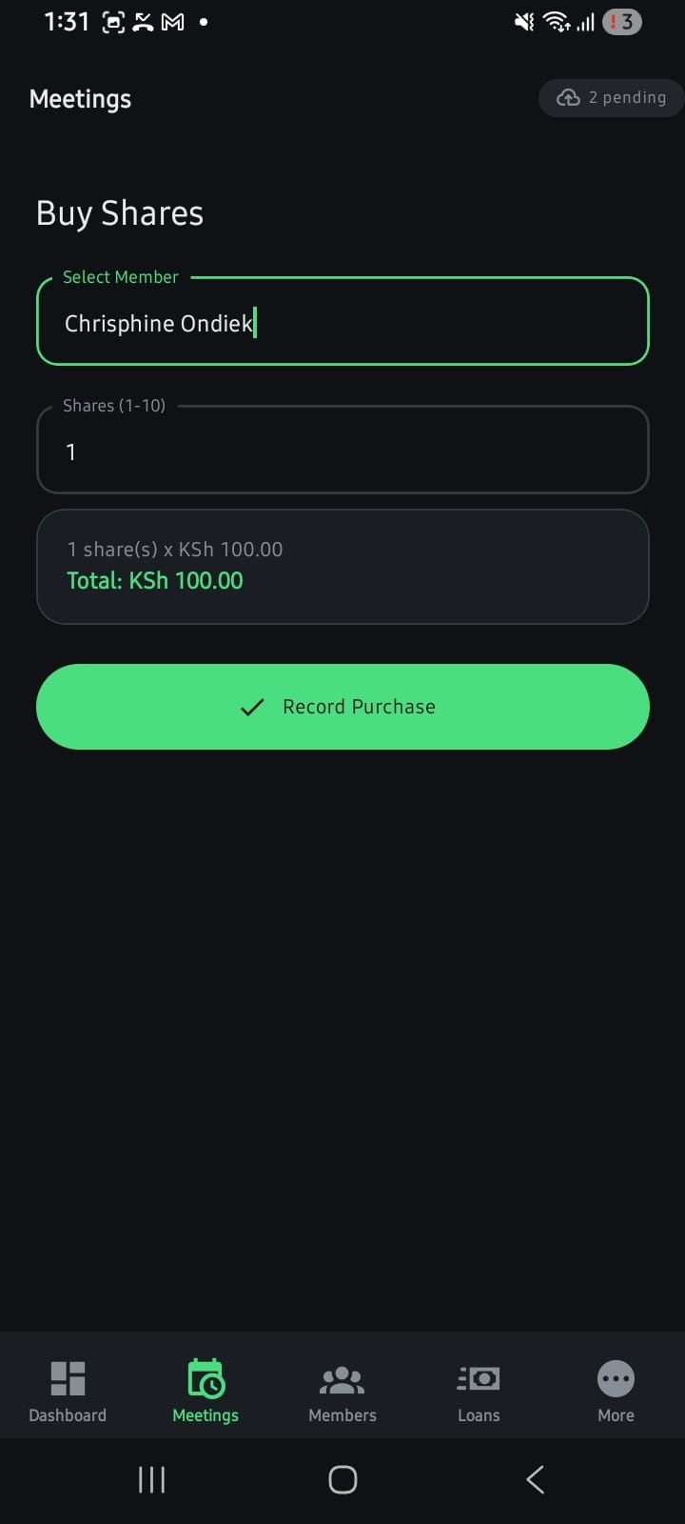
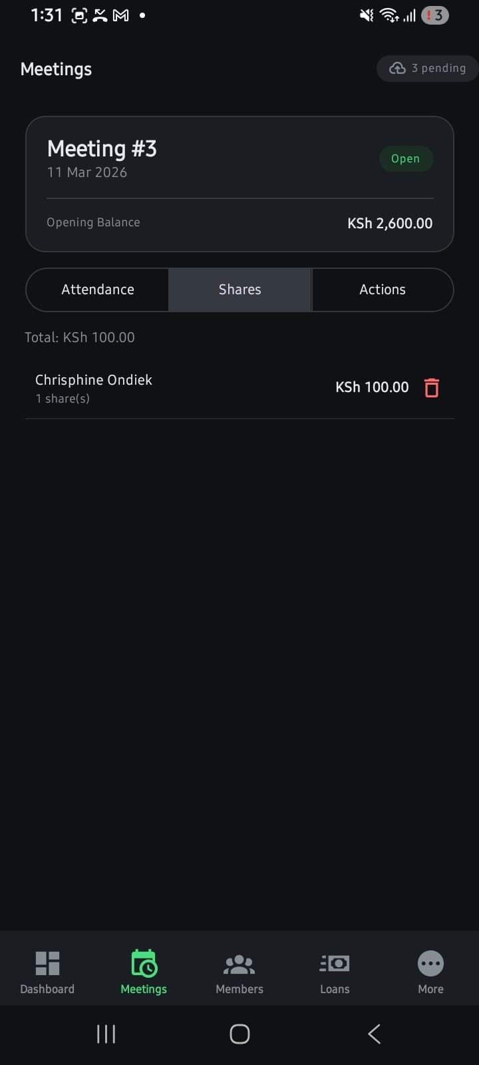

SAVINGS & SHARE MANAGEMENT
Disciplined Savings,
Transaction by Transaction
Fixed Amount Savings
All members buy shares at a fixed KSh 100 per share. Up to 10 shares per meeting = KSh 1,000 max per session.
Flexible Option Available
Groups can also opt for flexible savings amounts to accommodate varying member capacities.
Real-Time Share Ledger
Each share purchase is immediately recorded with member name, number of shares, and total value in the meeting ledger.
Social Fund Tracking
KSh 50 social fund contribution per meeting is separately tracked and reported on the dashboard.
Total Savings Computation
Cumulative savings are automatically computed and used to determine each member's loan eligibility (up to 2x savings).
Buy Shares
Shares Ledger

Slide 6
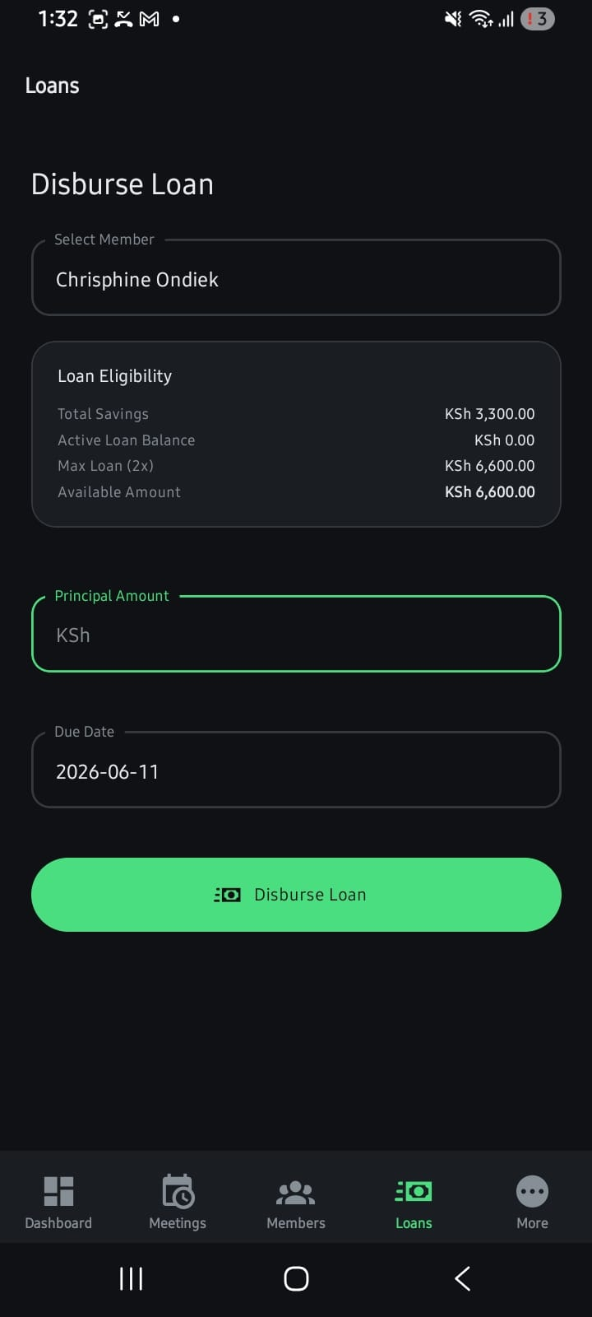
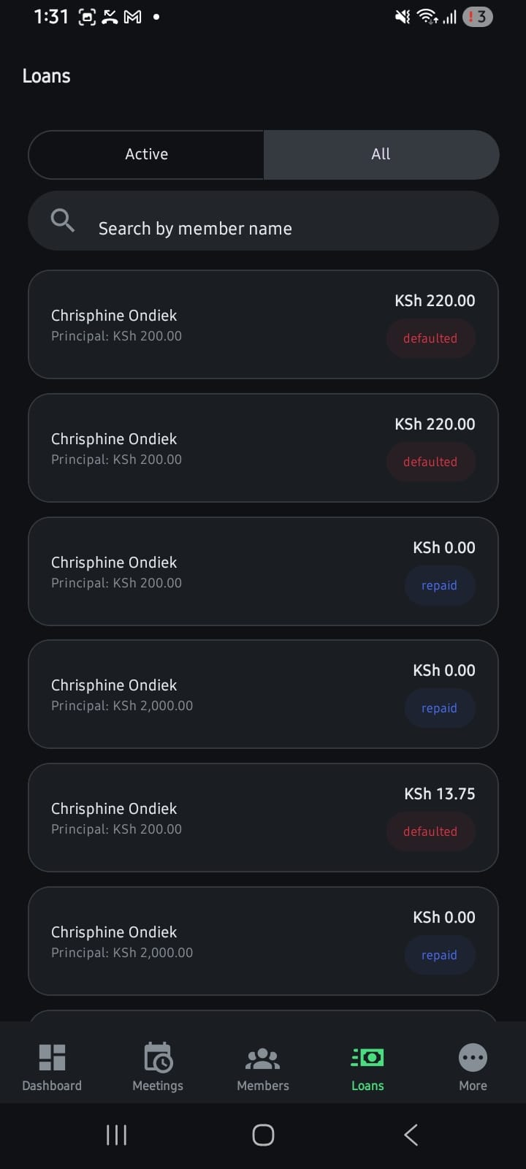


LOAN MANAGEMENT
Smart Lending,
Full Visibility
Auto-Calculated Loan Eligibility
Total Savings
KSh 3,300
Active Loan Balance
KSh 0.00
Max Loan (2×)
KSh 6,600
Available Amount
KSh 6,600
Instant Eligibility Check
System computes max loan from savings automatically before disbursement.
Loan Status Tracking
Each loan is tagged: Active, Repaid, or Defaulted — always visible.
Due Date Enforcement
Loan due dates are set at disbursement (default 3 months) to enforce discipline.
Disburse Loan
Loan Portfolio
Portfolio Management
Full loan history per member: principals, outstanding balances, and status.

Slide 7




KEY FEATURES AT A GLANCE
Member Management
Meeting Lifecycle
Share Purchases
Register and manage group members with individual savings and loan profiles.
Start, conduct, and close meetings with auto-attendance and sequential numbering.
Fixed or flexible savings with instant ledger entries and running totals.
Fines & Social Fund
Loan Disbursement
Loan Tracking
Record fines and social contributions separately for full financial transparency.
Eligibility-checked disbursements with due dates, reducing balance interest.
Real-time loan status: Active, Repaid, or Defaulted — full portfolio view.
Group Configuration
Savings Trend Chart
Offline-Ready Sync
4-step setup wizard: basics, savings rules, loan policy, and meeting schedule.
Visual savings growth chart on dashboard to monitor group financial health.
Pending transactions sync to cloud when connectivity is restored (cloud upload indicator).

Slide 8
WHY INTELLI-CASH?
Manual VSLA Management
With Intelli-Cash
VS
✗ Paper registers — lost, damaged, falsified
✓ Immutable digital ledger with cloud backup
✗ Manual loan eligibility calculation errors
✓ Auto-calculated eligibility from savings data
✗ No record of who attended meetings
✓ 1-tap attendance, archived by meeting
✗ Fines forgotten or disputed
✓ Fines and social fund tracked separately
✗ No visibility on loan repayment status
✓ Live status: Active / Repaid / Defaulted
✗ Savings trends unknown without review
✓ Real-time savings chart on dashboard

Slide 9
Empowering VSLAs. One Meeting at a Time.
Intelli-Wealth Limited | www.intelliwealth.org
📧 info@intelliwealth.org 📞 +254 723 242 701 📍 Ramco Courts, South C, Nairobi
Growing your business in Africa

