Slide 1
MTENDERE ADMIN MANAGEMENT PLATFORM
Events and Partners
Management System
Admin
Events, partners, reports, CRM
API
Enterprise operations module for event lifecycle control, registrations, stakeholder CRM, sponsorships, media, analytics, documentation, and executive reporting.
Validation, exports, notifications
Production-ready
RBAC protected
Public integrated
Public
Pages, registration, showcase
2
20+
1
new operational domains
enterprise workflows
unified platform
Mtendere Events and Partners Management Platform
01

Slide 2
VISION
From admin panel to operational ecosystem
The implementation changes the platform from content administration into a connected operating layer for programs, partners, participants, media, and reporting.
Event lifecycle
Partner CRM
Public conversion
Governance
Create, publish, register, approve, check in, report, archive
Profiles, tiers, agreements, activity, renewals, contributions
Events, registration, tickets, partners, opportunities
RBAC, validation, audit, media, documents, exports
Mtendere Events and Partners Management Platform
02

Slide 3
SYSTEM OVERVIEW
One control plane, two public growth loops
Admin operations, public pages, registrations, partner workflows, media, and reporting now use one data model and API layer.
Admin Events
Public Events
Lifecycle, registrations, check-in
Express + Drizzle API
Listing, detail, tickets
Validation, RBAC, storage, exports, notifications
Admin Partners
Public Partners
CRM, documents, contributions
PostgreSQL
Showcase, opportunities
Events, registrations, partners, sponsorships, media, permissions, webhooks
Mtendere Events and Partners Management Platform
03

Slide 4
ARCHITECTURE
The platform is layered for scale, governance, and future automation
Each layer owns a clear responsibility, making events and partner workflows extensible without breaking existing content systems.
Experience
Standalone Admin app, public React pages, responsive partner/event surfaces
Workflow API
REST endpoints, Zod validation, RBAC guards, exports, ticket and CRM actions
Data and media
Normalized tables, governed images, documents, analytics, webhook records
Automation
Email confirmations, status updates, onboarding, AI-ready reporting hooks
Cross-cutting: audit trail, security, observability, backup, CI/CD
Mtendere Events and Partners Management Platform
04

Slide 5
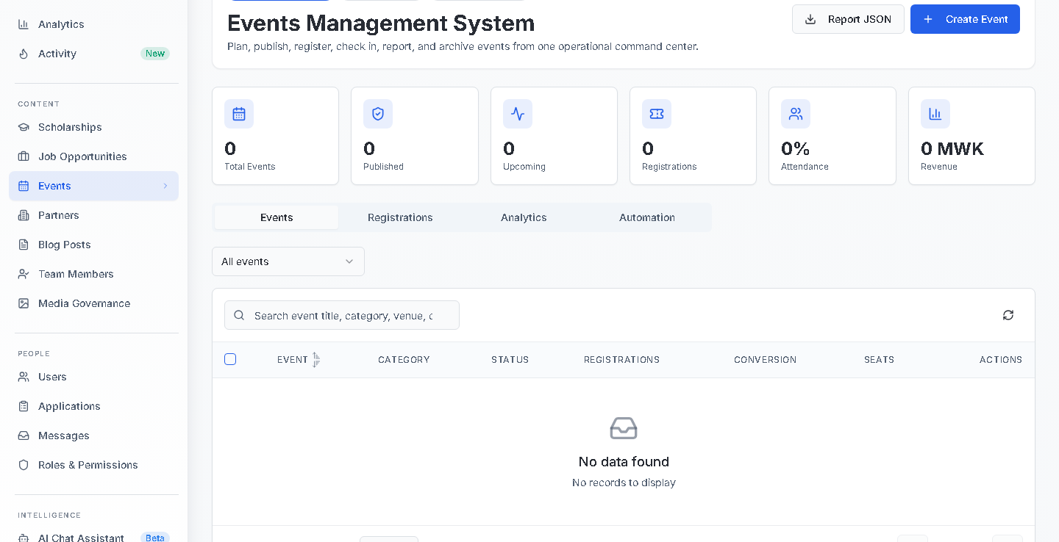
ADMIN EVIDENCE
Events operations are now controlled from one command center
The Admin module brings lifecycle status, registration workflow, analytics, automation, and export controls into a single responsive surface.
Lifecycle governance
Create, edit, duplicate, publish, archive, and safe delete.
Registration operations
Approval, waitlist, check-in/out, QR ticket and exports.
Reporting surface
JSON reports, KPIs, attendance and revenue readiness.
Admin Events Management System
Mtendere Events and Partners Management Platform
05

Slide 6
EVENTS MODULE
Event management covers content, commerce, people, media, and SEO
The form and APIs support the operational fields expected by conferences, NGOs, universities, and government programs.
Publishing
Venue
Registration
title, slug, content, category, tags, status, featured
physical/virtual, organizer, maps, dates, deadline
capacity, RSVP, approval, custom fields, QR tickets
Commerce
Program
Growth
ticket types, pricing, currency, revenue tracking
speakers, sponsors, partners, agenda, attachments
SEO metadata, social metadata, recommendations
Admin lifecycle
Public registration
Reporting readiness
Mtendere Events and Partners Management Platform
06

Slide 7
REGISTRATION WORKFLOW
Registrations move from public intent to verified attendance
The workflow supports custom fields, ticket types, waitlists, approval, email confirmations, QR tickets, and check-in/check-out operations.
Public form
Validation
Review
Ticket
Attendance
Dynamic fields + ticket type
Capacity, deadline, required data
Approve, waitlist, reject
Code, QR payload, email
Check-in and check-out
CSV/XLS
QR
Realtime
Registration export
Badge and ticket readiness
Attendance analytics
Mtendere Events and Partners Management Platform
07

Slide 8
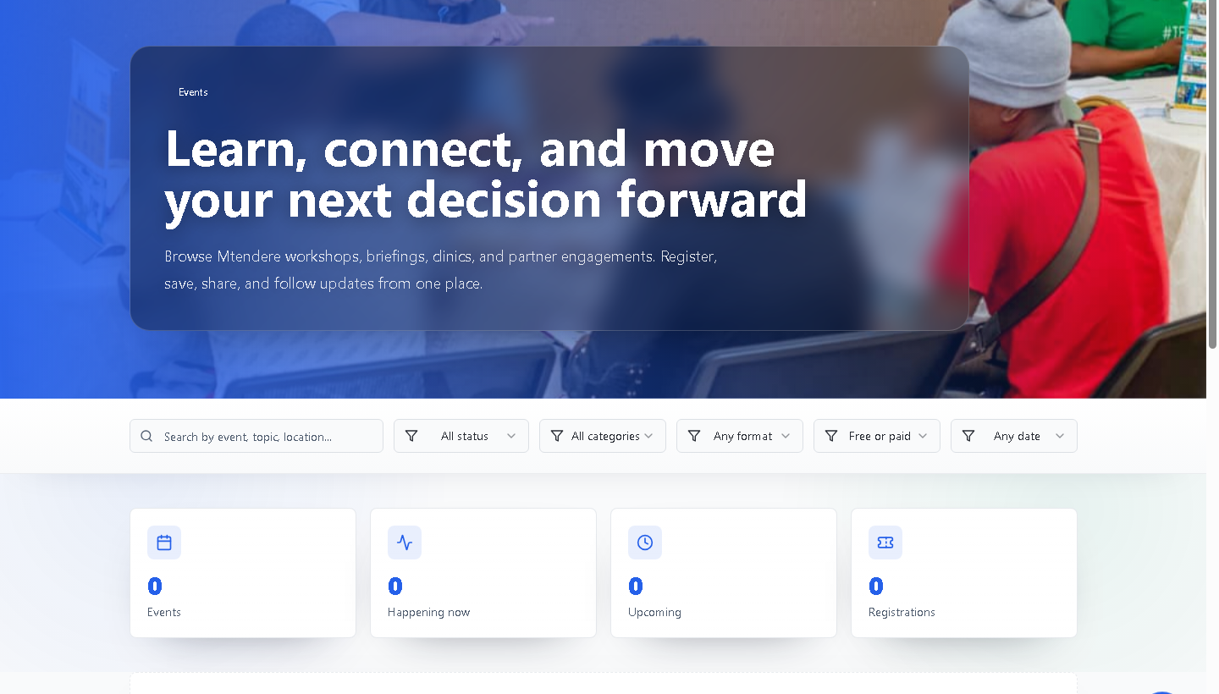
PUBLIC EVENTS
Public pages convert event content into registrations and engagement
Users can search, filter, register, save, share, view agenda, speakers, gallery, attachments, partners, and related events.
Registration dialog
Ticket-aware form with dynamic admin-defined custom fields and confirmation ticket URL.
Detail pages
Agenda, speakers, venue/map, ticket options, partners, gallery, attachments, discussion.
Engagement
Views, shares, likes, comments, saved items, recommendations, and related events.
Public events listing and filters
Mtendere Events and Partners Management Platform
08

Slide 9
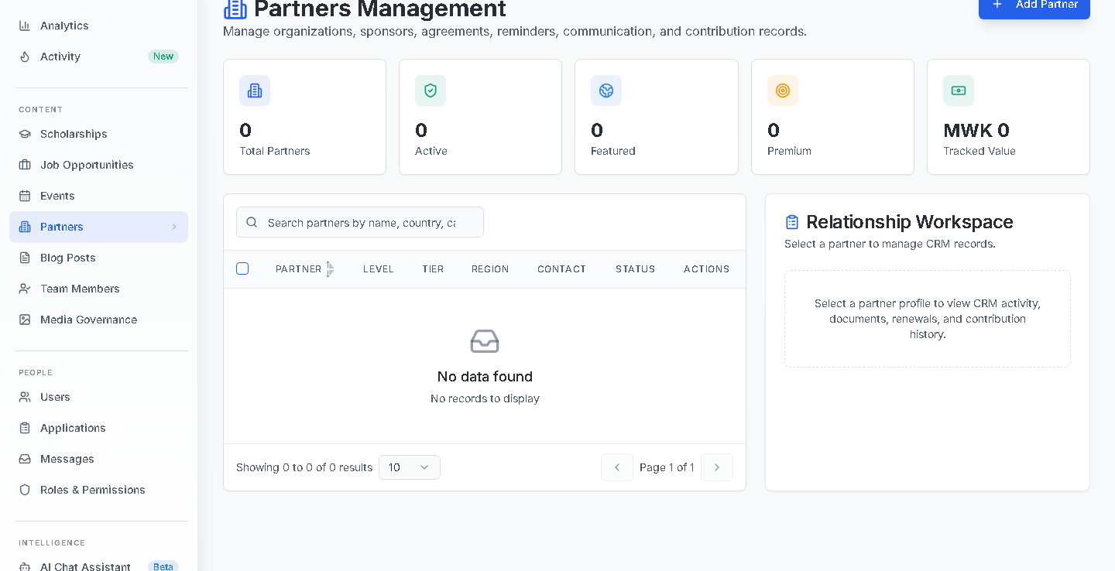
PARTNER CRM
Partner management now behaves like a stakeholder operating system
Profiles, contact data, sponsorship tiers, documents, activities, reminders, and contribution records are integrated in the Admin workspace.
Profile governance
Logo, cover, contact, status, country, category, tier and public visibility.
Relationship memory
Meeting logs, timeline, follow-up reminders, internal notes.
Commercial tracking
Sponsorship tiers, agreements, contribution records, renewal alerts.
Admin Partners CRM workspace
Mtendere Events and Partners Management Platform
09

Slide 10
PARTNER LIFECYCLE
The CRM loop turns relationships into governed collaborations
Each partner can move from prospect to agreement to activation to reporting to renewal without leaving the platform.
Prospect
Profile
Agreement
Qualified stakeholder
CRM identity and contacts
Contract and documents
Activation
Reporting
Renewal
Events and opportunities
Metrics and value
Expiry and expansion
Mtendere Events and Partners Management Platform
10

Slide 11
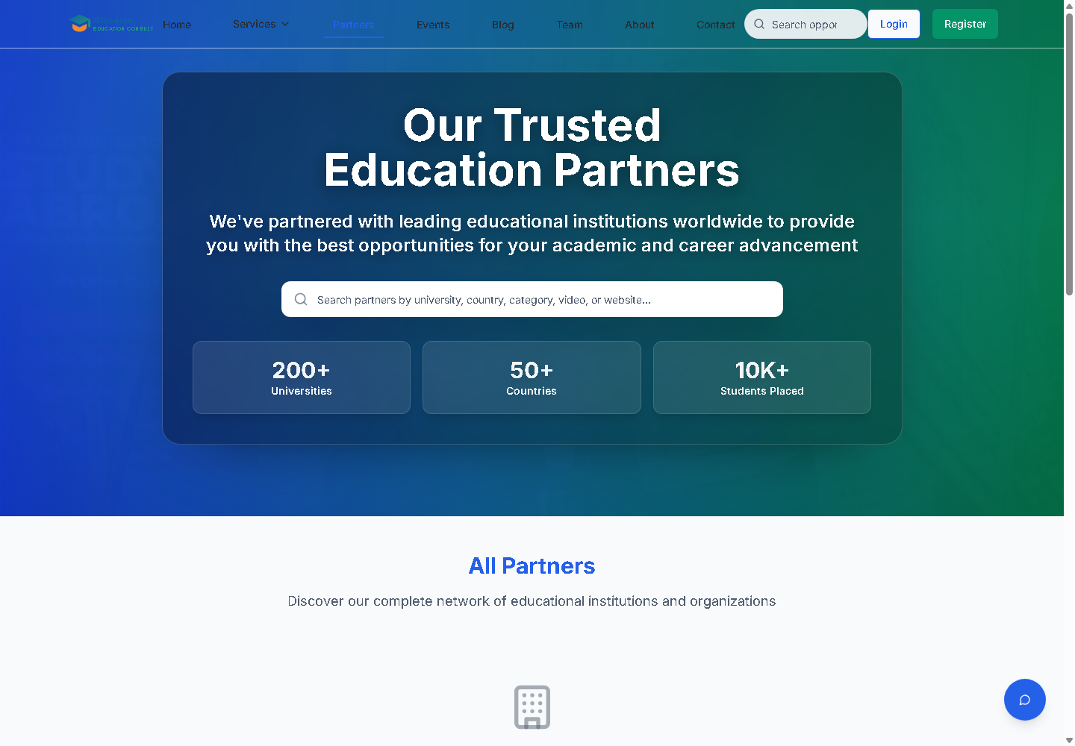
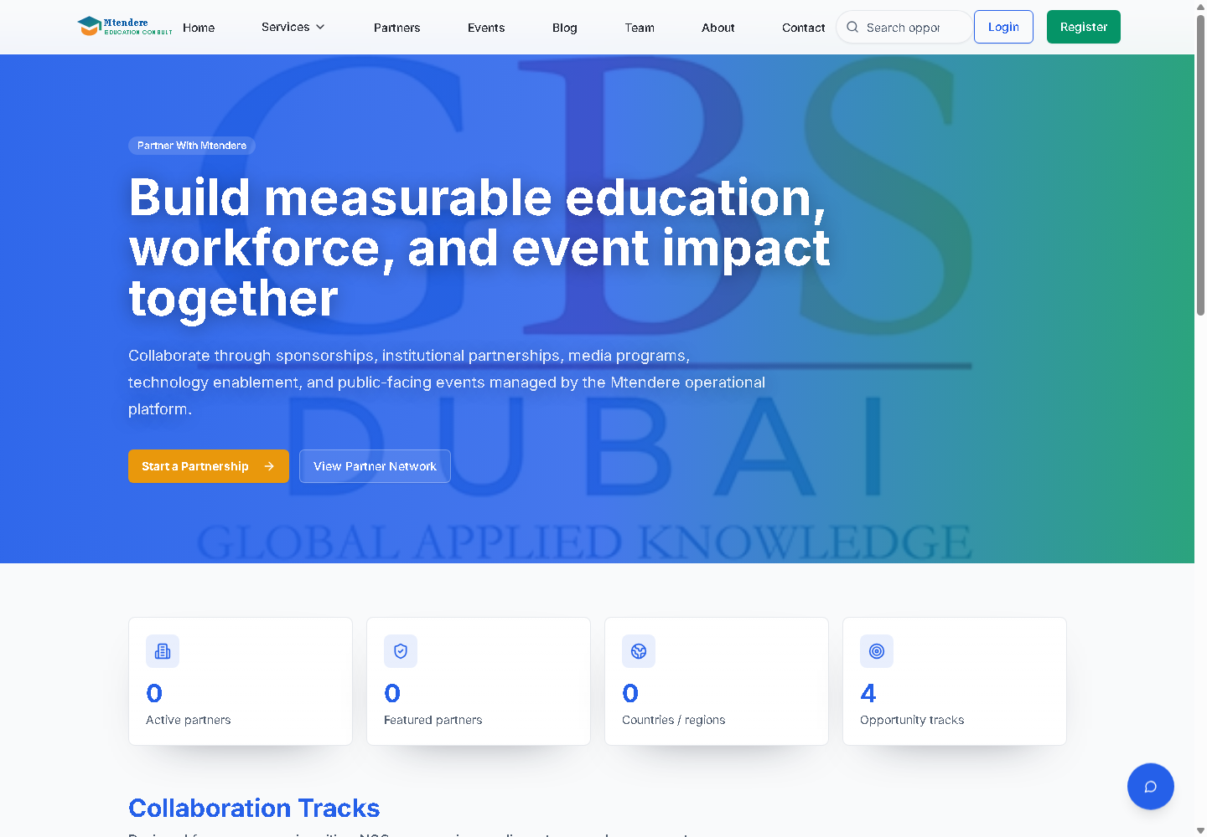
PUBLIC PARTNER EXPERIENCE
The partner network now has both showcase and collaboration demand capture
Public partner pages support discovery, credibility, detail exploration, and a dedicated partnership opportunities path.
Partner showcase
Partnership opportunities
Mtendere Events and Partners Management Platform
11

Slide 12
ANALYTICS
Dashboards connect content activity to operational outcomes
Events and partners contribute to global admin KPIs, content charts, registration analytics, sponsor visibility, and downloadable reports.
Events
Partners
Reports
Audit
Lifecycle and registration KPIs
Tier and contribution analytics
CSV, Excel, JSON summaries
Activity and engagement logging
Operational signal model
Views
Regs
Attend
Sponsors
Renewals
Mtendere Events and Partners Management Platform
12

Slide 13
SECURITY
Workflow power is protected by validation, RBAC, and auditability
The implementation adds security controls at input, route, storage, file, reporting, and notification boundaries.
RBAC
Validation
Files
API
Audit
viewer, editor, admin, super_admin route gating
Zod payload checks and typed schema boundaries
module uploads, asset governance, document access metadata
authenticated admin endpoints and safe public reads
analytics, admin activity, engagement and export traces
Production hardening path: HTTPS, CSRF for cookie sessions, WAF/rate limits, signed private document URLs, structured log redaction, backup drills.
Mtendere Events and Partners Management Platform
13

Slide 14
DATABASE AND APIS
Normalized schemas make the modules scalable beyond template CRUD
Events and partners use core tables plus normalized operational records for tickets, media, documents, activities, sponsorships, permissions, and webhooks.
events
partners
ticketTypes, customFields, agenda, speakers, sponsors, partners, gallery, SEO
profile, contact, tier, documents, agreements, linked events
operations
permissions, notifications, webhook subscriptions and deliveries
event_registrations
partner CRM
ticketType, answers, QR payload, status, check-in/out
activities, documents, sponsorships, opportunities, financial records
Mtendere Events and Partners Management Platform
14

Slide 15
COMMUNICATIONS AND AI READINESS
Automation hooks are built into the operating model
Email workflows ship now; SMS, WhatsApp, webhooks, recommendations, semantic tagging, and predictive reporting have clear data structures to attach to.
Now
registration confirmation, status update, partner onboarding
Ready
reminders, scheduled updates, renewal alerts, webhook delivery
AI next
smart search, event recommendations, renewal risk, sponsor visibility scoring
Mtendere Events and Partners Management Platform
15

Slide 16
OPERATIONS
Production posture spans deployment, monitoring, backup, and performance
The module is documented for deployment and maintainability, with explicit scale paths for high-volume registrations and partner portfolios.
CI/CD
Performance
Monitoring
Recovery
type checks, builds, smoke tests, controlled migrations
pagination, search filters, report endpoints, CDN-ready media
API errors, email delivery, uploads, exports, auth failures
daily backups, PITR, media retention, restore drills
Scale path
Materialized reports
Queue email/export jobs
Signed private documents
Mtendere Events and Partners Management Platform
16

Slide 17
ROADMAP
The next releases should deepen automation, integrations, and intelligence
The architecture is modular enough to add payment capture, partner portals, predictive analytics, and external integrations without reworking the core platform.
Now
Next
Later
Enterprise modules, docs, screenshots, reporting, public pages
Payment gateway, private document preview, scheduled reminders, webhook retries
AI recommendations, semantic search, sponsor scoring, partner self-service portal
Mtendere Events and Partners Management Platform
17

Slide 18
CONCLUSION
The platform is now positioned as a complete operational backbone for events and partnerships.
Delivered: integrated modules, secure workflows, normalized schemas, public pages, reporting, documentation, screenshots, and an executive deck for stakeholder delivery.
Enterprise SaaS posture
Ready for growth
Unified delivery
Operational depth for NGOs, universities, conferences, sponsors, and public programs.
Media governance, exports, webhooks, AI-ready data, scalability and operations documentation.
Admin and public experiences now work as one coherent product system.
Mtendere Events and Partners Management Platform
18

