Slide 1
Mtendere Admin Training
Operating the live Mtendere Education Consult platform securely and confidently.
Mtendere Education Consult · Admin Training · 1
Notes:
Trainer notes: Operating the live Mtendere Education Consult platform securely and confidently. Use this slide to connect the concept to Mtendere's daily operations. Ask trainees to identify what role is allowed to perform the action and what data-protection risk must be avoided.

Slide 2
Training objectives
Navigate the admin portal, protect data, manage content, review applications, handle communications and know when to escalate.
Mtendere Education Consult · Admin Training · 2
Notes:
Trainer notes: Navigate the admin portal, protect data, manage content, review applications, handle communications and know when to escalate. Use this slide to connect the concept to Mtendere's daily operations. Ask trainees to identify what role is allowed to perform the action and what data-protection risk must be avoided.

Slide 3
Platform purpose
The admin portal supports scholarships, work abroad opportunities, events, articles, users, applications, subscribers, messages, analytics and platform settings.
Mtendere Education Consult · Admin Training · 3
Notes:
Trainer notes: The admin portal supports scholarships, work abroad opportunities, events, articles, users, applications, subscribers, messages, analytics and platform settings. Use this slide to connect the concept to Mtendere's daily operations. Ask trainees to identify what role is allowed to perform the action and what data-protection risk must be avoided.

Slide 4
Administrator responsibilities
Keep information accurate, respond quickly, protect personal data, use the correct role and maintain an audit trail.
Mtendere Education Consult · Admin Training · 4
Notes:
Trainer notes: Keep information accurate, respond quickly, protect personal data, use the correct role and maintain an audit trail. Use this slide to connect the concept to Mtendere's daily operations. Ask trainees to identify what role is allowed to perform the action and what data-protection risk must be avoided.

Slide 5
Role boundaries
Super Admin owns users/settings; Admin runs operations; Writer manages content; Viewer reviews dashboard only.
Mtendere Education Consult · Admin Training · 5
Notes:
Trainer notes: Super Admin owns users/settings; Admin runs operations; Writer manages content; Viewer reviews dashboard only. Use this slide to connect the concept to Mtendere's daily operations. Ask trainees to identify what role is allowed to perform the action and what data-protection risk must be avoided.

Slide 6
Security rules
Use named accounts, strong passwords, least privilege, no shared credentials, no private data in screenshots, and re-enable MFA in the next authentication update.
Mtendere Education Consult · Admin Training · 6
Notes:
Trainer notes: Use named accounts, strong passwords, least privilege, no shared credentials, no private data in screenshots, and re-enable MFA in the next authentication update. Use this slide to connect the concept to Mtendere's daily operations. Ask trainees to identify what role is allowed to perform the action and what data-protection risk must be avoided.

Slide 7
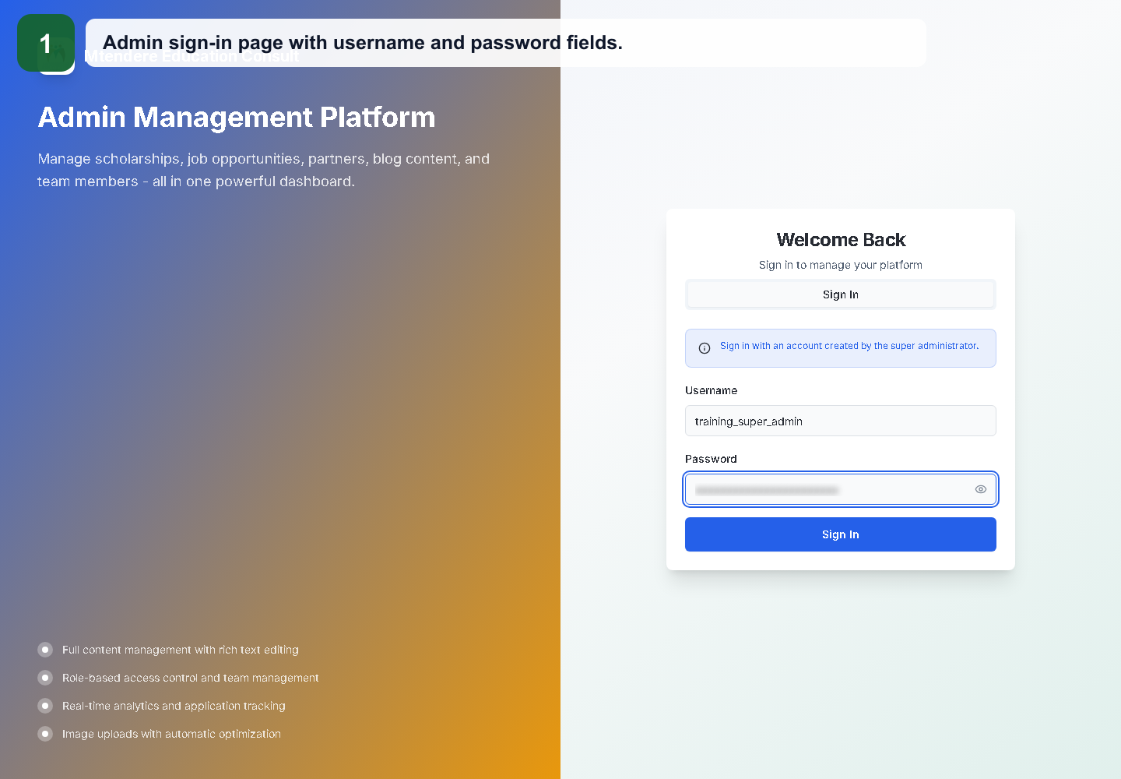
Login demonstration
Use the issued username and password. MFA is currently disabled for handoff but the setup workflow remains for future updates.
Mtendere Education Consult · Admin Training · 7
Notes:
Trainer notes: Use the issued username and password. MFA is currently disabled for handoff but the setup workflow remains for future updates. Use this slide to connect the concept to Mtendere's daily operations. Ask trainees to identify what role is allowed to perform the action and what data-protection risk must be avoided.

Slide 8
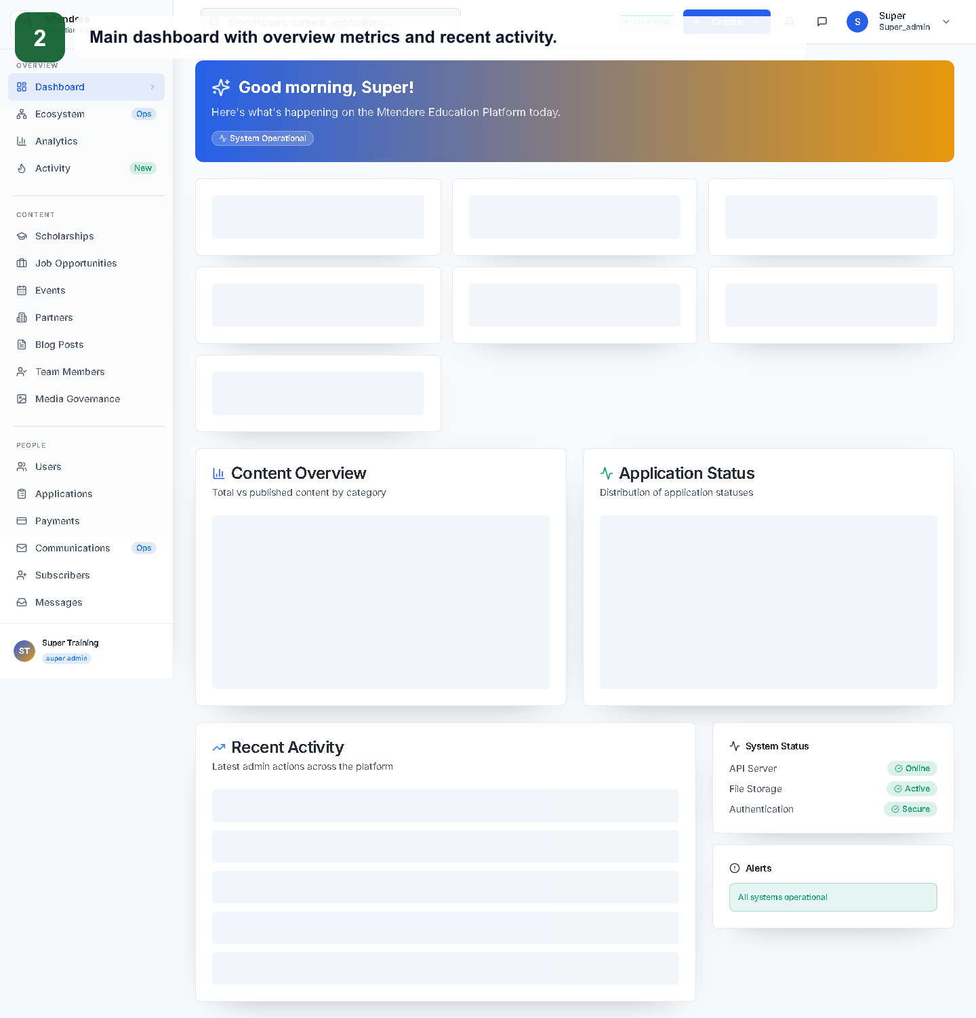
Dashboard tour
Start every admin session from the Dashboard and check current activity.
Mtendere Education Consult · Admin Training · 8
Notes:
Trainer notes: Start every admin session from the Dashboard and check current activity. Use this slide to connect the concept to Mtendere's daily operations. Ask trainees to identify what role is allowed to perform the action and what data-protection risk must be avoided.

Slide 9
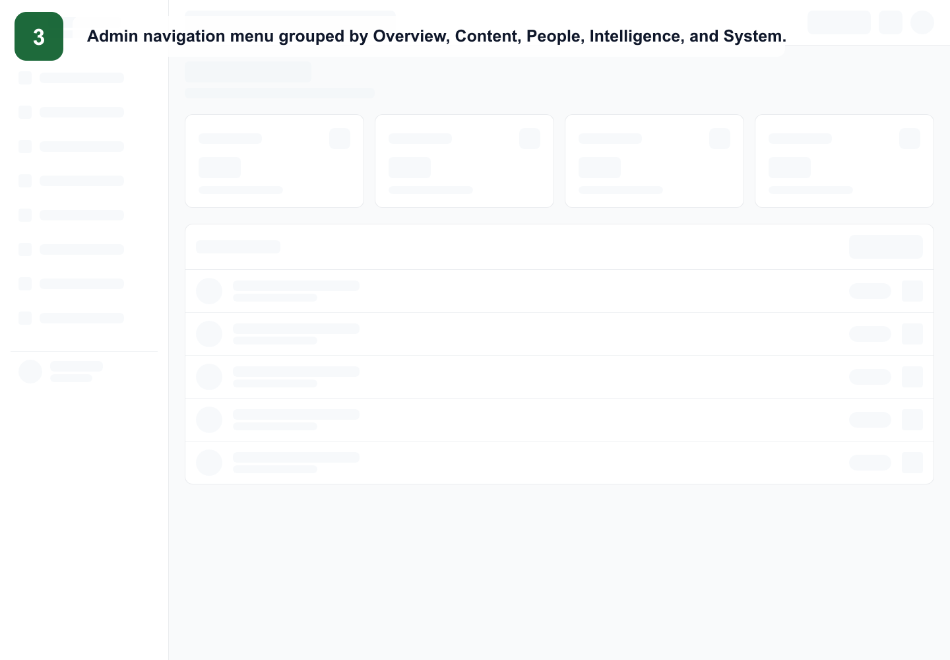
Navigation map
Use the left menu groups: Overview, Content, People, Intelligence and System.
Mtendere Education Consult · Admin Training · 9
Notes:
Trainer notes: Use the left menu groups: Overview, Content, People, Intelligence and System. Use this slide to connect the concept to Mtendere's daily operations. Ask trainees to identify what role is allowed to perform the action and what data-protection risk must be avoided.

Slide 10
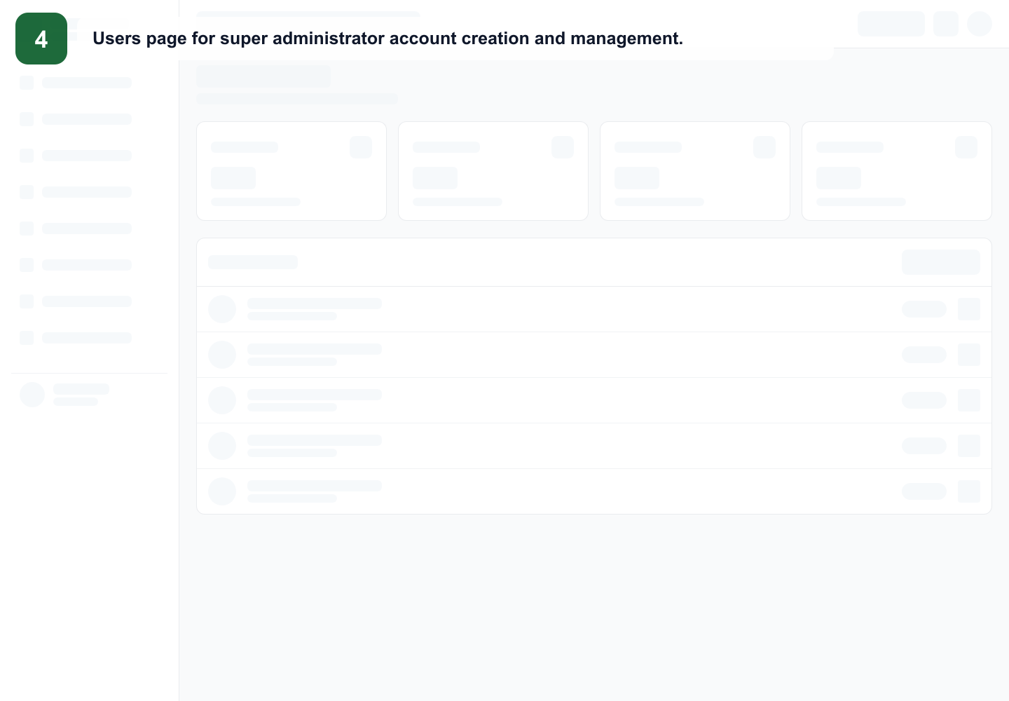
Users
Only Super Admins create, deactivate and update administrator accounts.
Mtendere Education Consult · Admin Training · 10
Notes:
Trainer notes: Only Super Admins create, deactivate and update administrator accounts. Use this slide to connect the concept to Mtendere's daily operations. Ask trainees to identify what role is allowed to perform the action and what data-protection risk must be avoided.

Slide 11
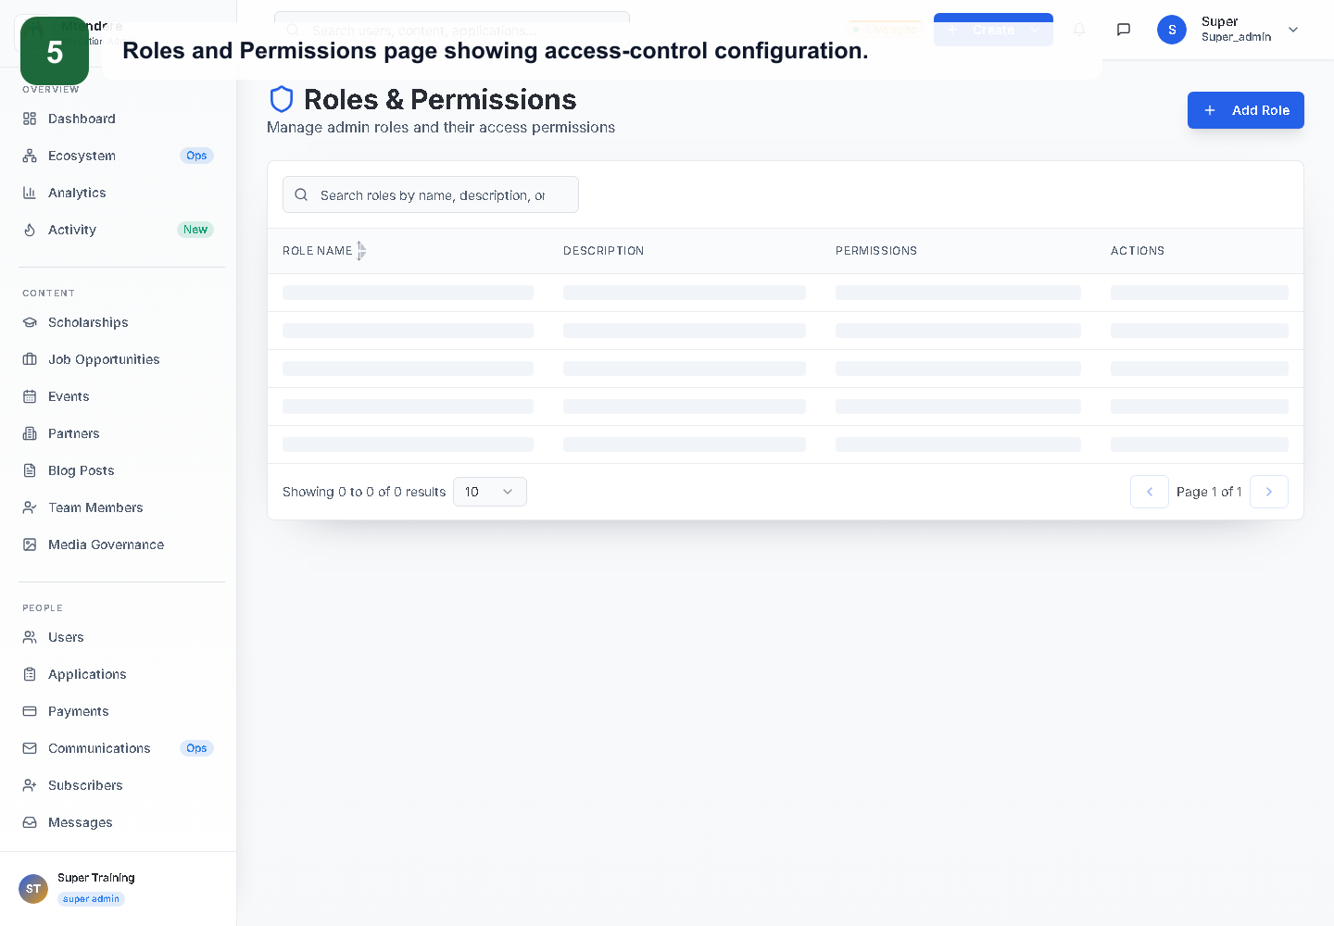
Roles & Permissions
Use the role matrix to confirm access before assigning privileges.
Mtendere Education Consult · Admin Training · 11
Notes:
Trainer notes: Use the role matrix to confirm access before assigning privileges. Use this slide to connect the concept to Mtendere's daily operations. Ask trainees to identify what role is allowed to perform the action and what data-protection risk must be avoided.

Slide 12
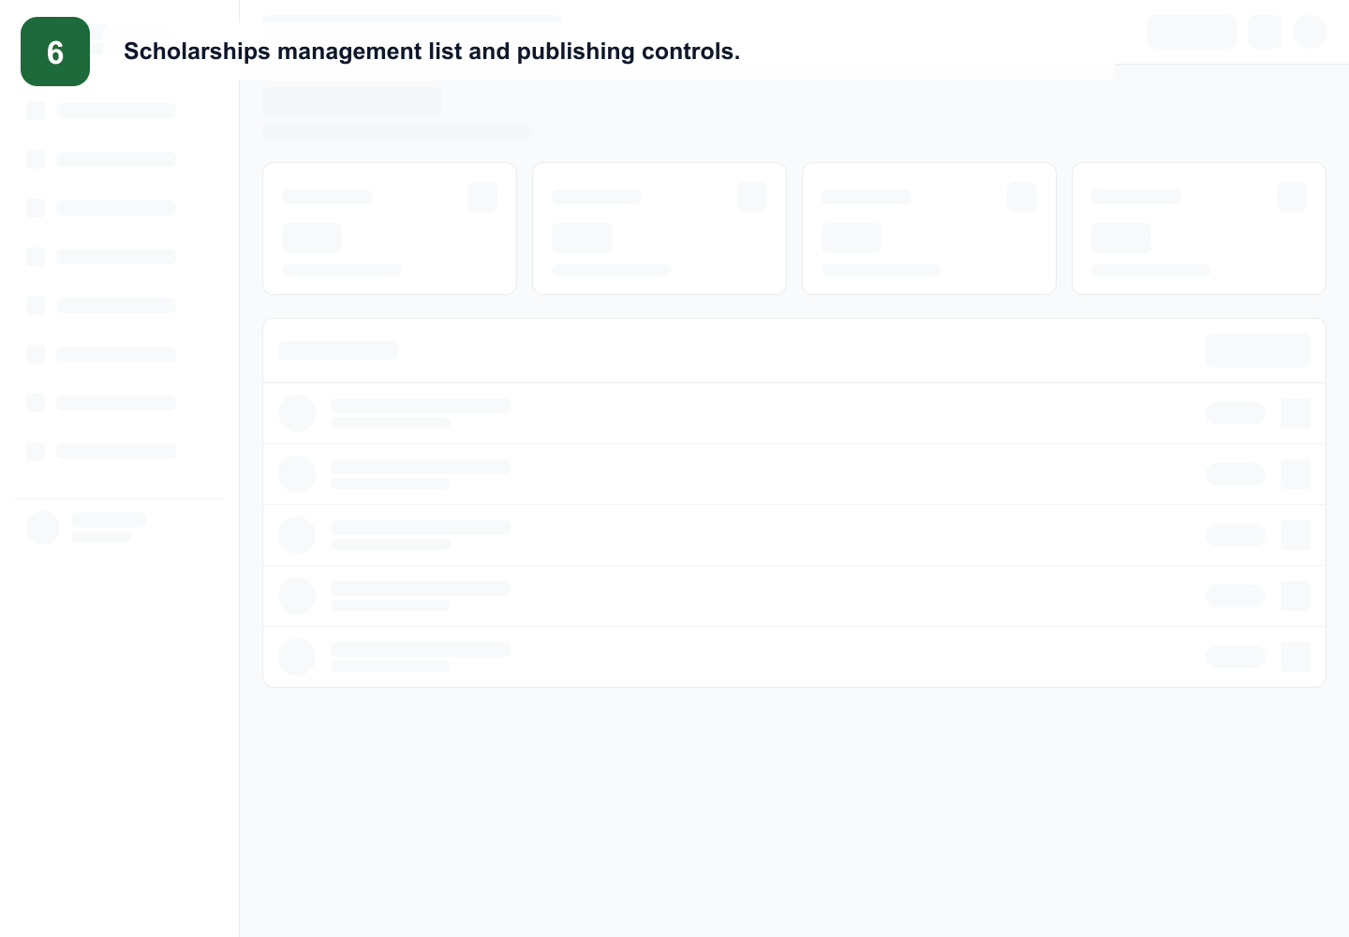
Scholarships workflow
Create draft, complete fields, review, publish, update, unpublish or delete carefully.
Mtendere Education Consult · Admin Training · 12
Notes:
Trainer notes: Create draft, complete fields, review, publish, update, unpublish or delete carefully. Use this slide to connect the concept to Mtendere's daily operations. Ask trainees to identify what role is allowed to perform the action and what data-protection risk must be avoided.

Slide 13
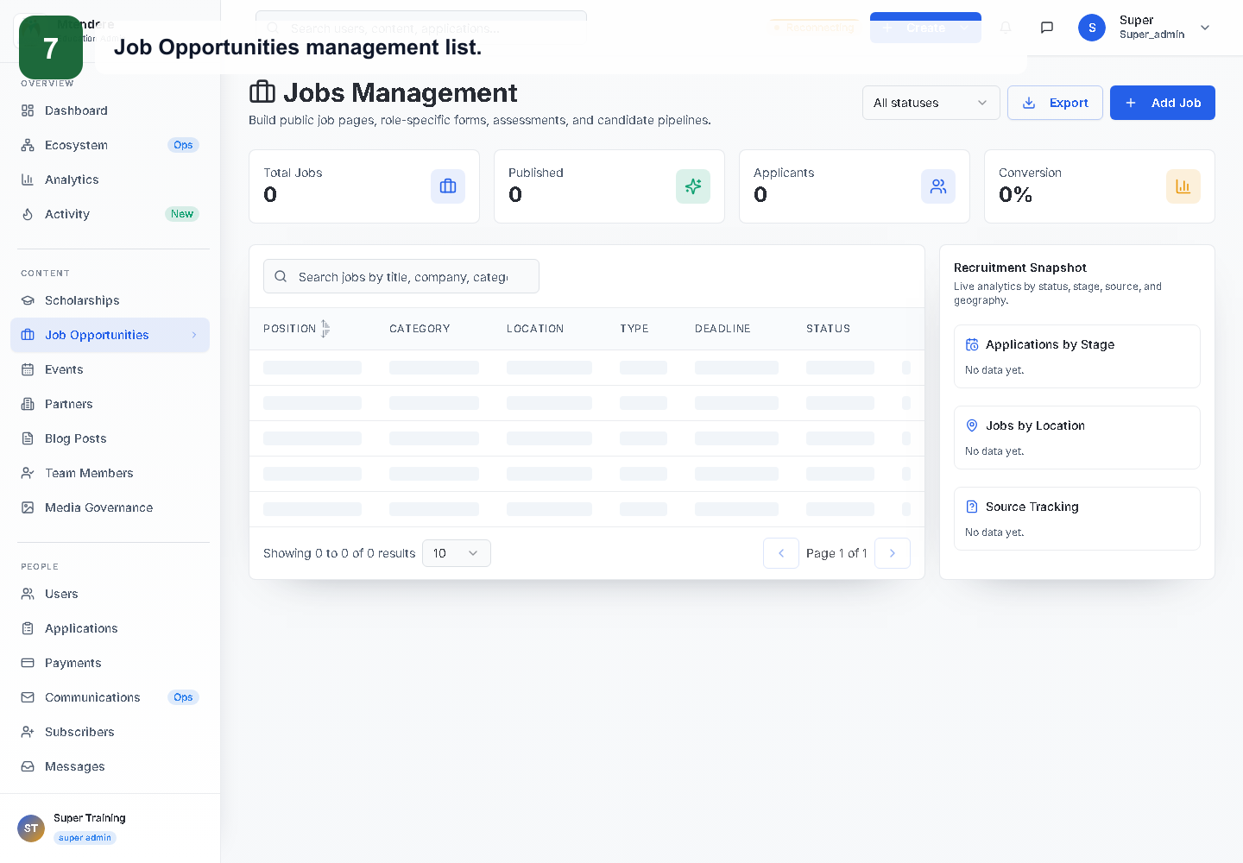
Job Opportunities workflow
Maintain work abroad listings with verified deadlines and external links.
Mtendere Education Consult · Admin Training · 13
Notes:
Trainer notes: Maintain work abroad listings with verified deadlines and external links. Use this slide to connect the concept to Mtendere's daily operations. Ask trainees to identify what role is allowed to perform the action and what data-protection risk must be avoided.

Slide 14
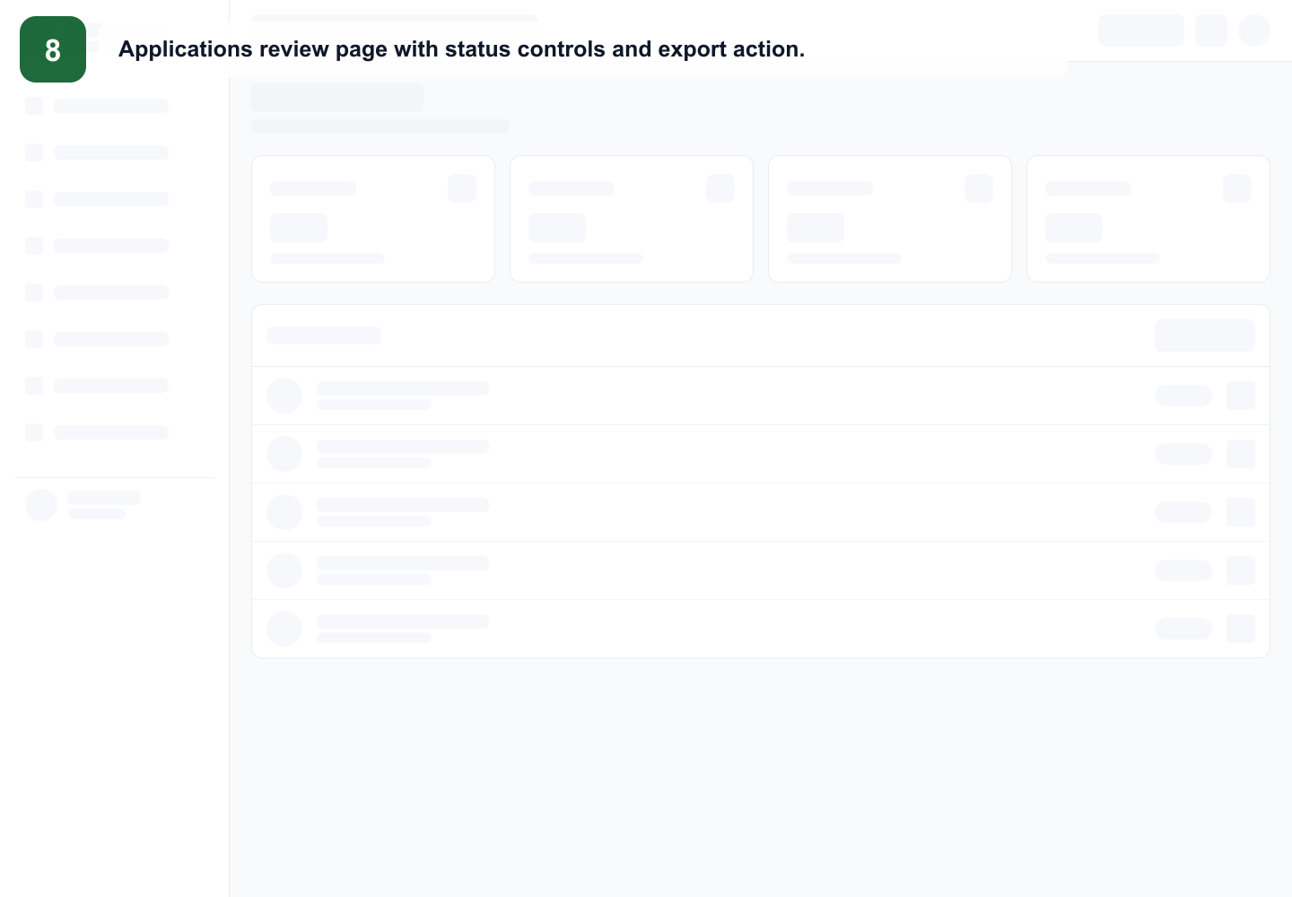
Application review
Admins and Super Admins review submissions, update status and record notes.
Mtendere Education Consult · Admin Training · 14
Notes:
Trainer notes: Admins and Super Admins review submissions, update status and record notes. Use this slide to connect the concept to Mtendere's daily operations. Ask trainees to identify what role is allowed to perform the action and what data-protection risk must be avoided.

Slide 15
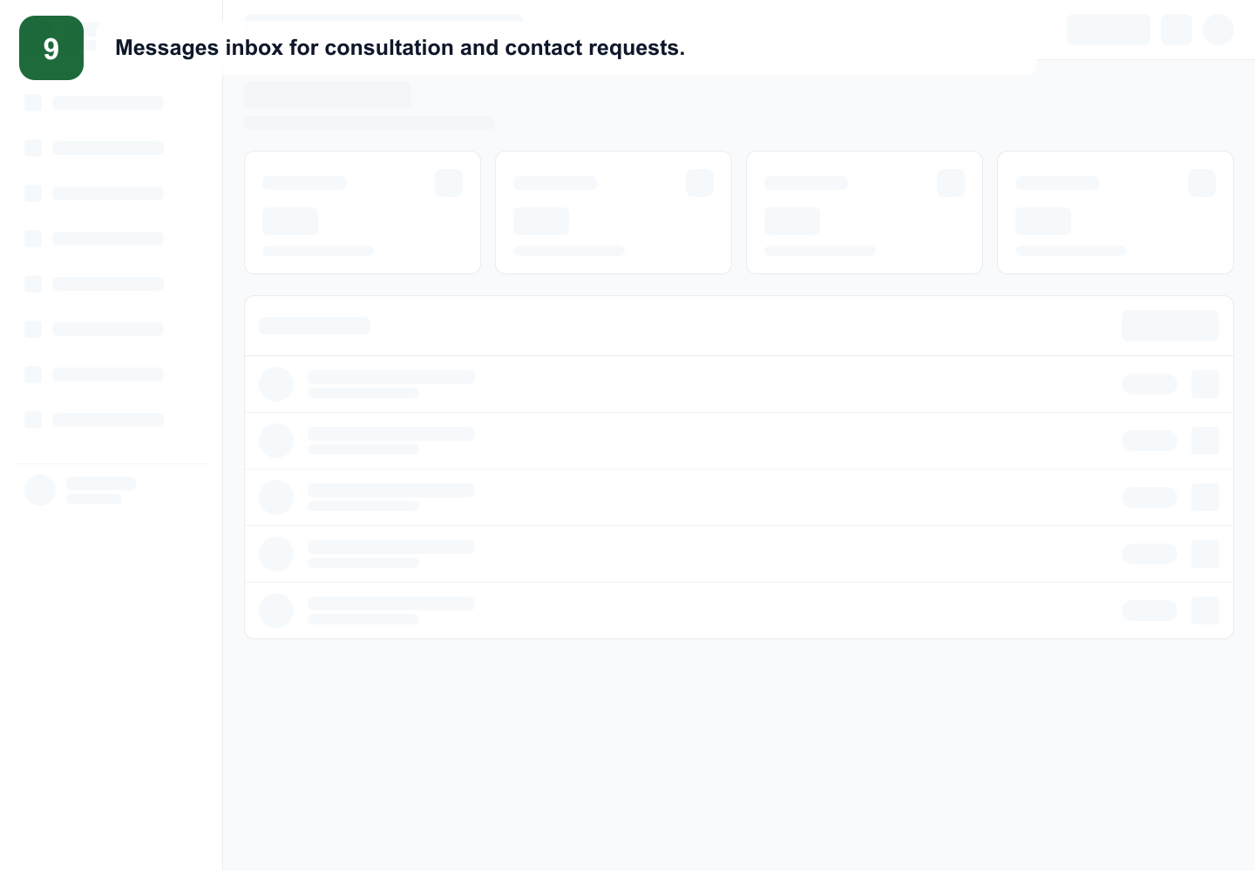
Messages and consultations
Review incoming enquiries, respond through verified channels and escalate sensitive cases.
Mtendere Education Consult · Admin Training · 15
Notes:
Trainer notes: Review incoming enquiries, respond through verified channels and escalate sensitive cases. Use this slide to connect the concept to Mtendere's daily operations. Ask trainees to identify what role is allowed to perform the action and what data-protection risk must be avoided.

Slide 16
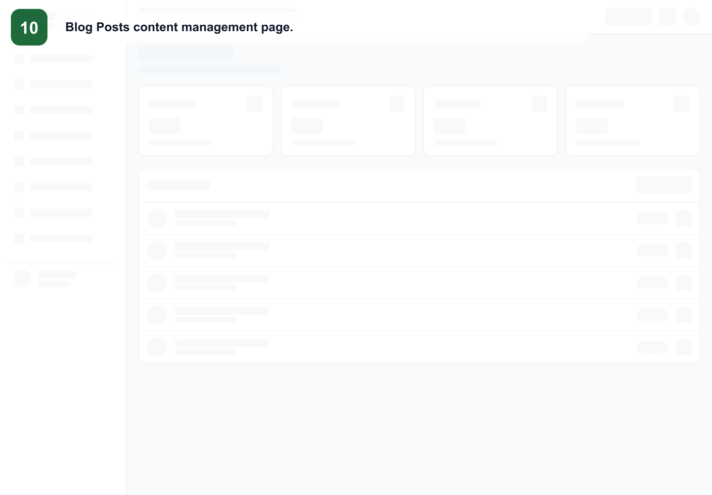
Blog and resources
Writers prepare articles; publish only after checking image, title, content and links.
Mtendere Education Consult · Admin Training · 16
Notes:
Trainer notes: Writers prepare articles; publish only after checking image, title, content and links. Use this slide to connect the concept to Mtendere's daily operations. Ask trainees to identify what role is allowed to perform the action and what data-protection risk must be avoided.

Slide 17
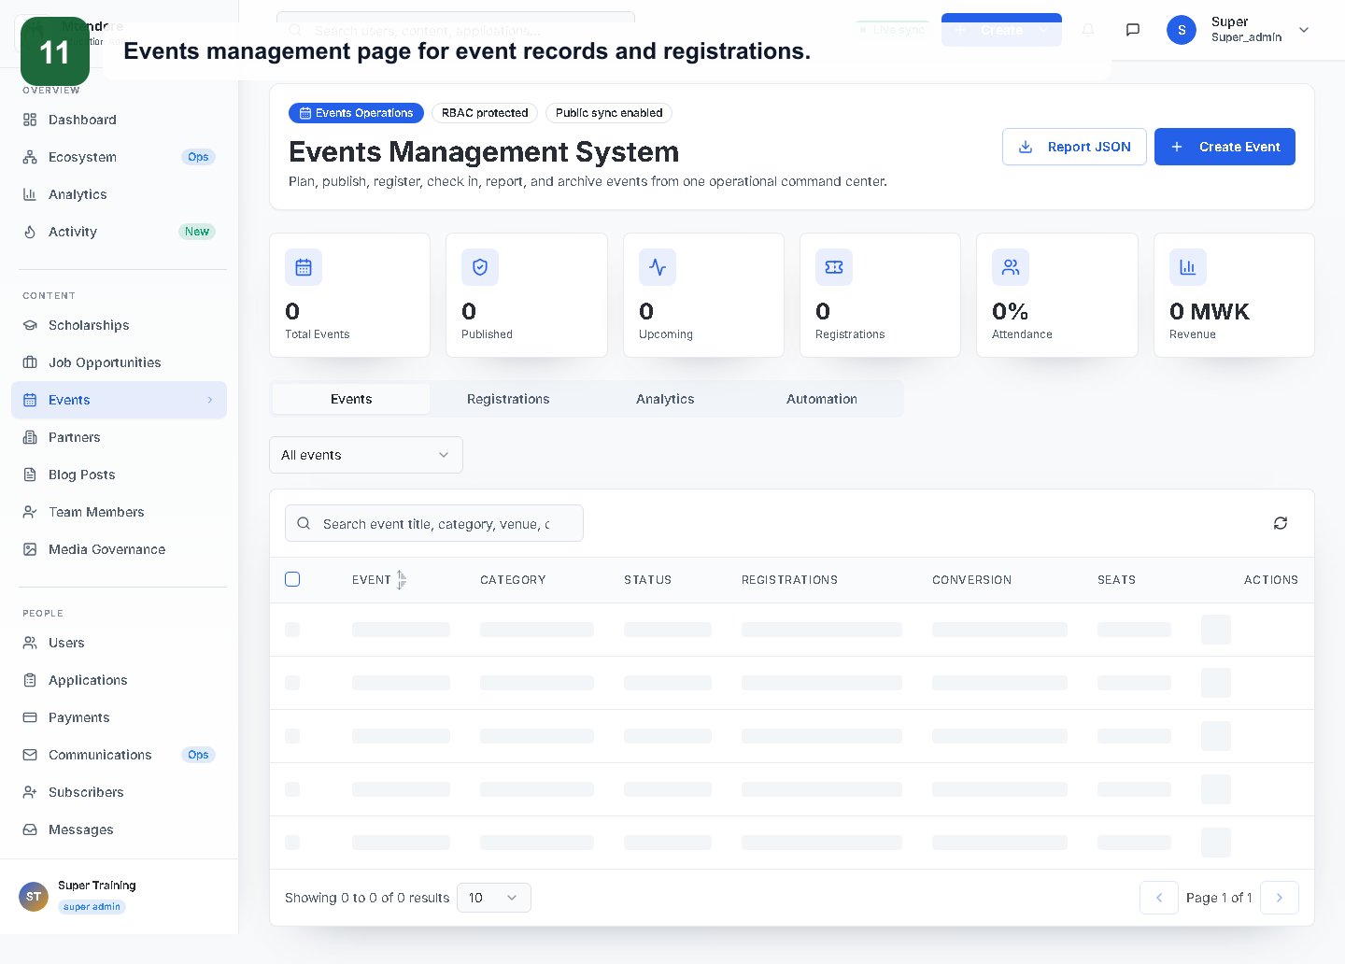
Events
Create and manage event records and registrations.
Mtendere Education Consult · Admin Training · 17
Notes:
Trainer notes: Create and manage event records and registrations. Use this slide to connect the concept to Mtendere's daily operations. Ask trainees to identify what role is allowed to perform the action and what data-protection risk must be avoided.

Slide 18
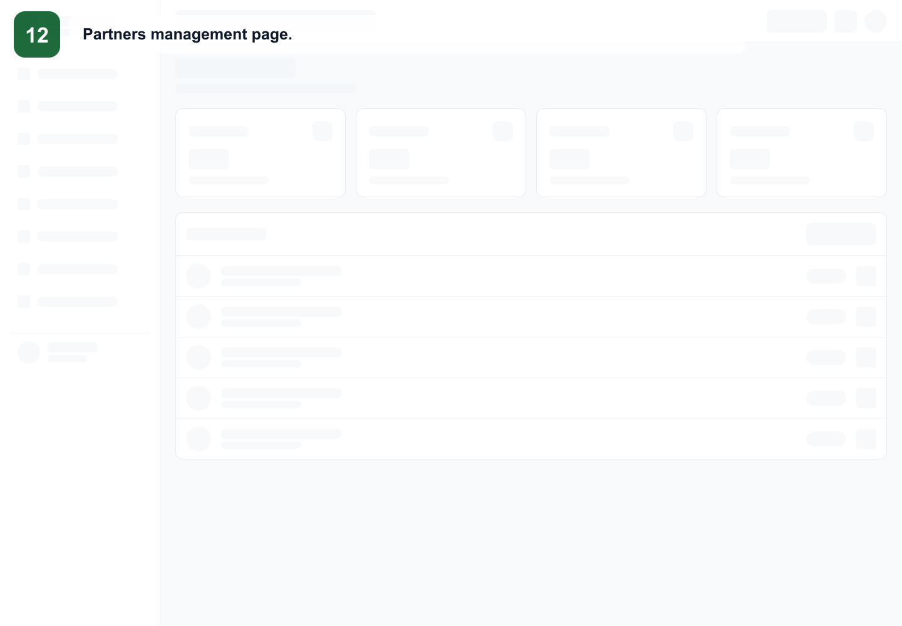
Partners
Maintain partner names, logos and public descriptions.
Mtendere Education Consult · Admin Training · 18
Notes:
Trainer notes: Maintain partner names, logos and public descriptions. Use this slide to connect the concept to Mtendere's daily operations. Ask trainees to identify what role is allowed to perform the action and what data-protection risk must be avoided.

Slide 19
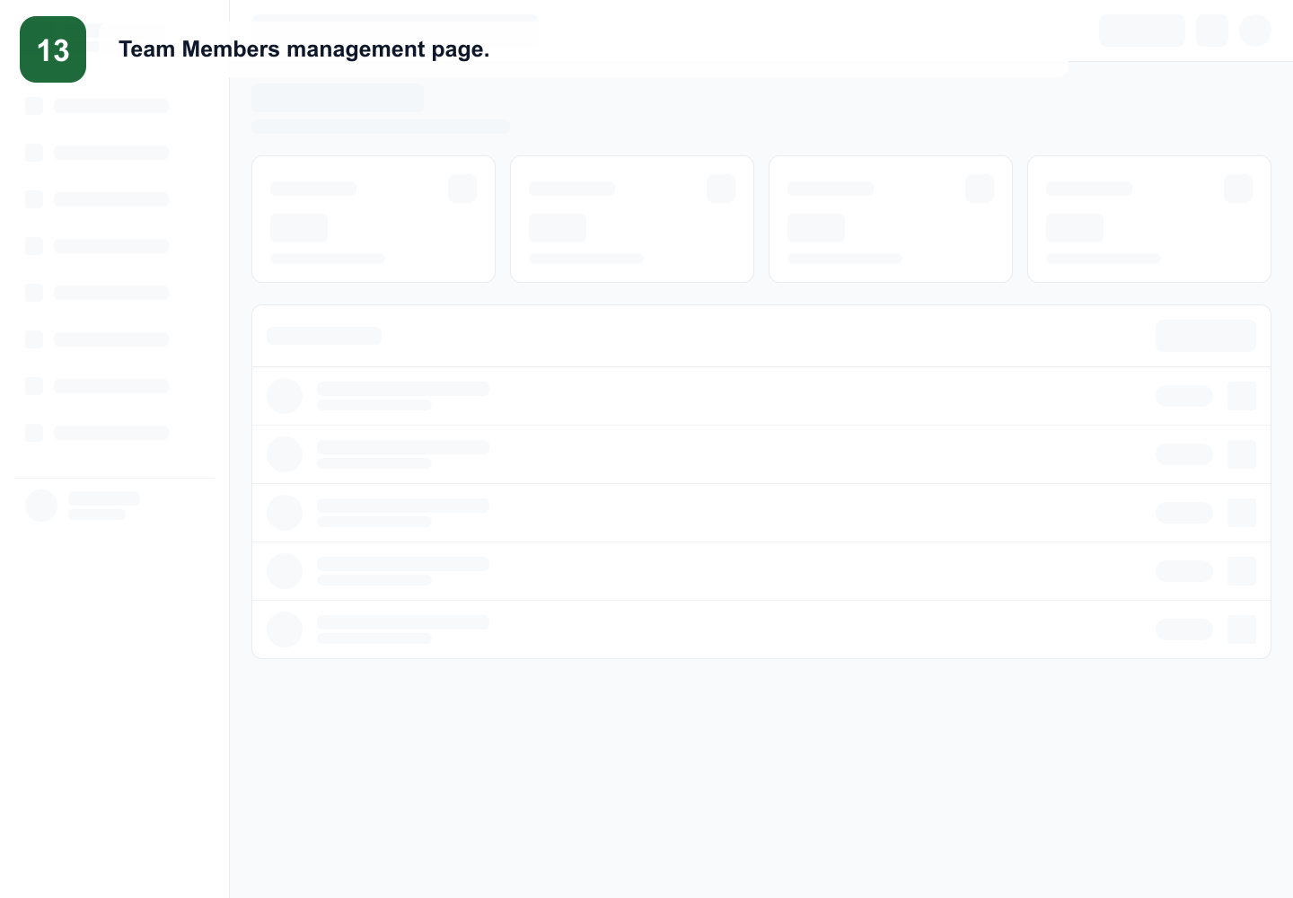
Team Members
Keep staff biographies and contact details accurate.
Mtendere Education Consult · Admin Training · 19
Notes:
Trainer notes: Keep staff biographies and contact details accurate. Use this slide to connect the concept to Mtendere's daily operations. Ask trainees to identify what role is allowed to perform the action and what data-protection risk must be avoided.

Slide 20
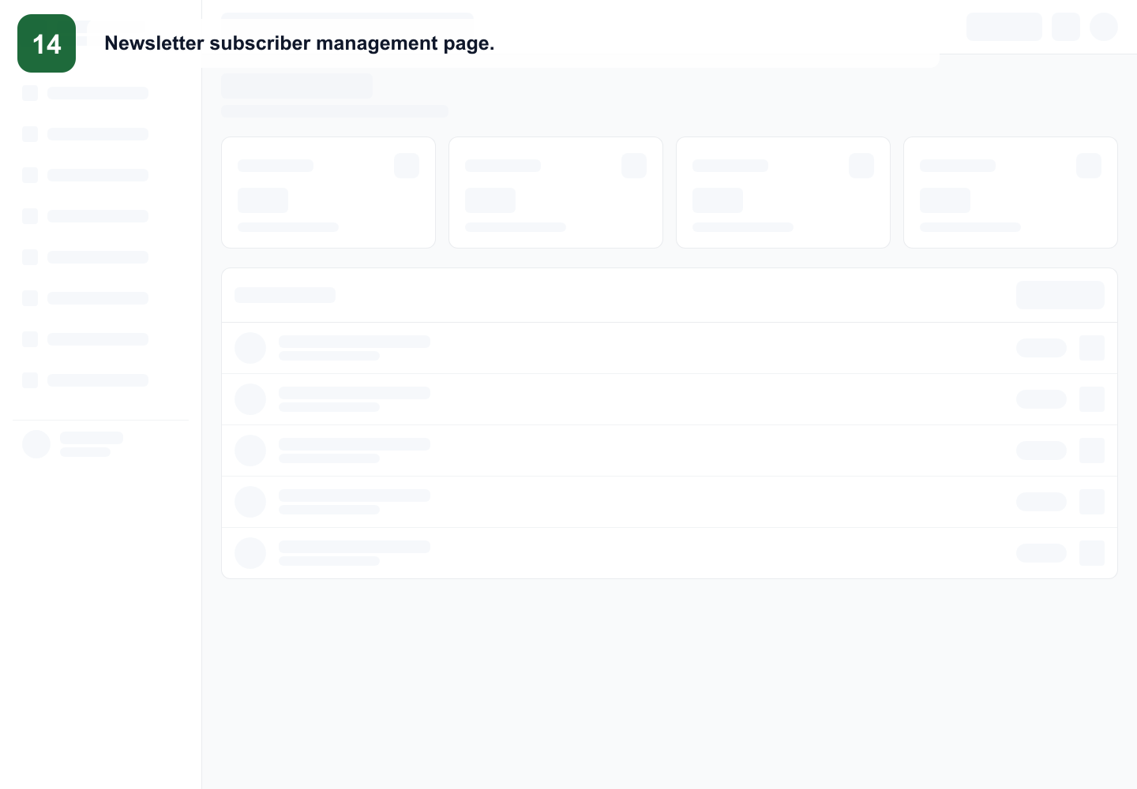
Subscribers
Respect consent, confirmation and unsubscribe requests.
Mtendere Education Consult · Admin Training · 20
Notes:
Trainer notes: Respect consent, confirmation and unsubscribe requests. Use this slide to connect the concept to Mtendere's daily operations. Ask trainees to identify what role is allowed to perform the action and what data-protection risk must be avoided.

Slide 21
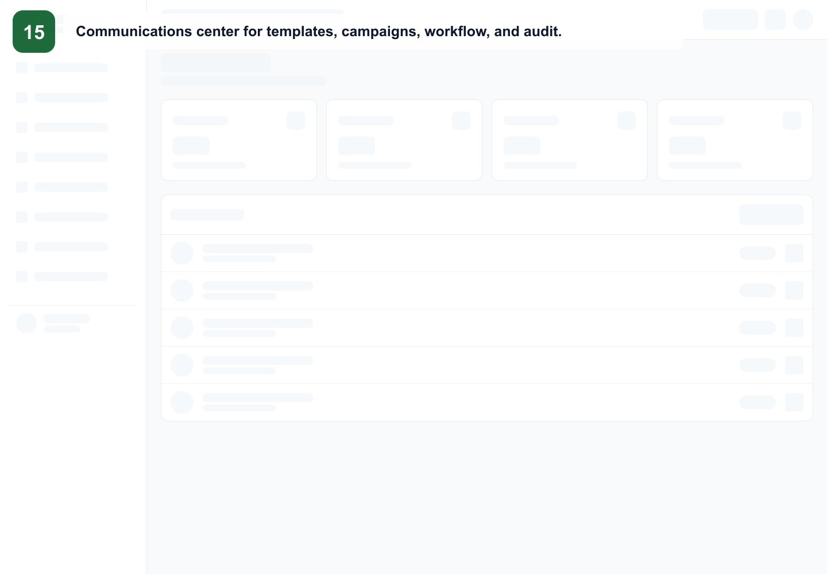
Communications
Templates, campaigns and email audit depend on correct public action links.
Mtendere Education Consult · Admin Training · 21
Notes:
Trainer notes: Templates, campaigns and email audit depend on correct public action links. Use this slide to connect the concept to Mtendere's daily operations. Ask trainees to identify what role is allowed to perform the action and what data-protection risk must be avoided.

Slide 22
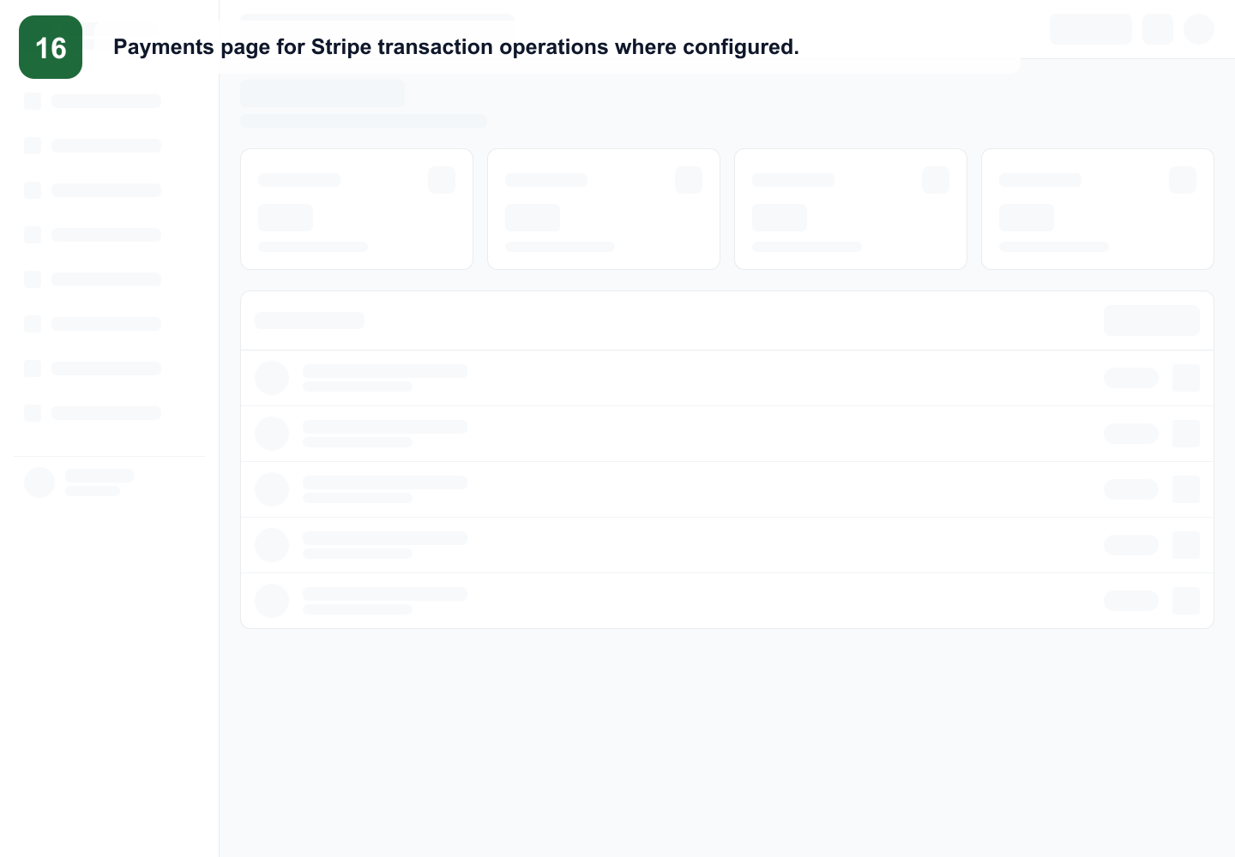
Payments
Payment operations are configuration-dependent and require careful escalation.
Mtendere Education Consult · Admin Training · 22
Notes:
Trainer notes: Payment operations are configuration-dependent and require careful escalation. Use this slide to connect the concept to Mtendere's daily operations. Ask trainees to identify what role is allowed to perform the action and what data-protection risk must be avoided.

Slide 23
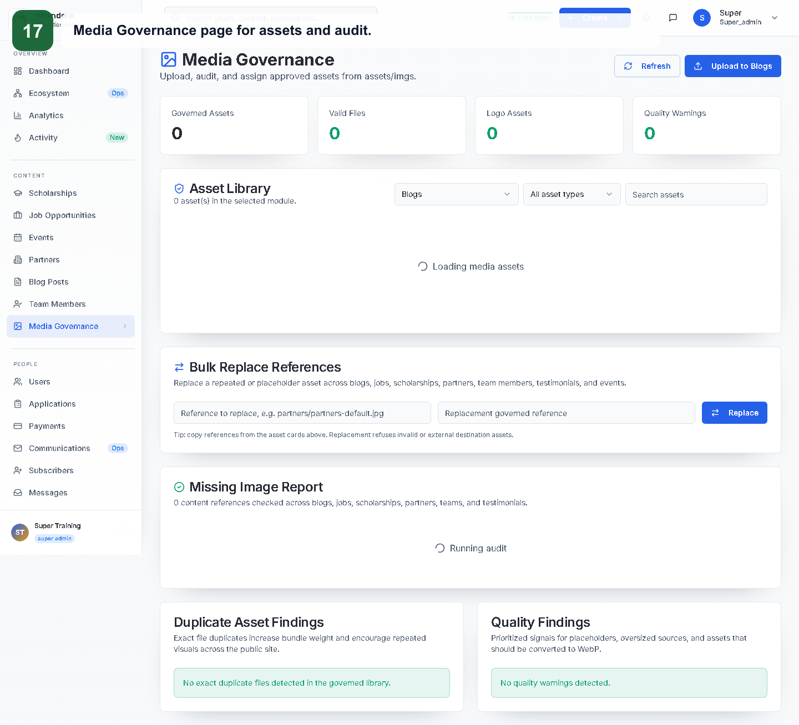
Media Governance
Use approved images, avoid duplicate records and protect sensitive assets.
Mtendere Education Consult · Admin Training · 23
Notes:
Trainer notes: Use approved images, avoid duplicate records and protect sensitive assets. Use this slide to connect the concept to Mtendere's daily operations. Ask trainees to identify what role is allowed to perform the action and what data-protection risk must be avoided.

Slide 24
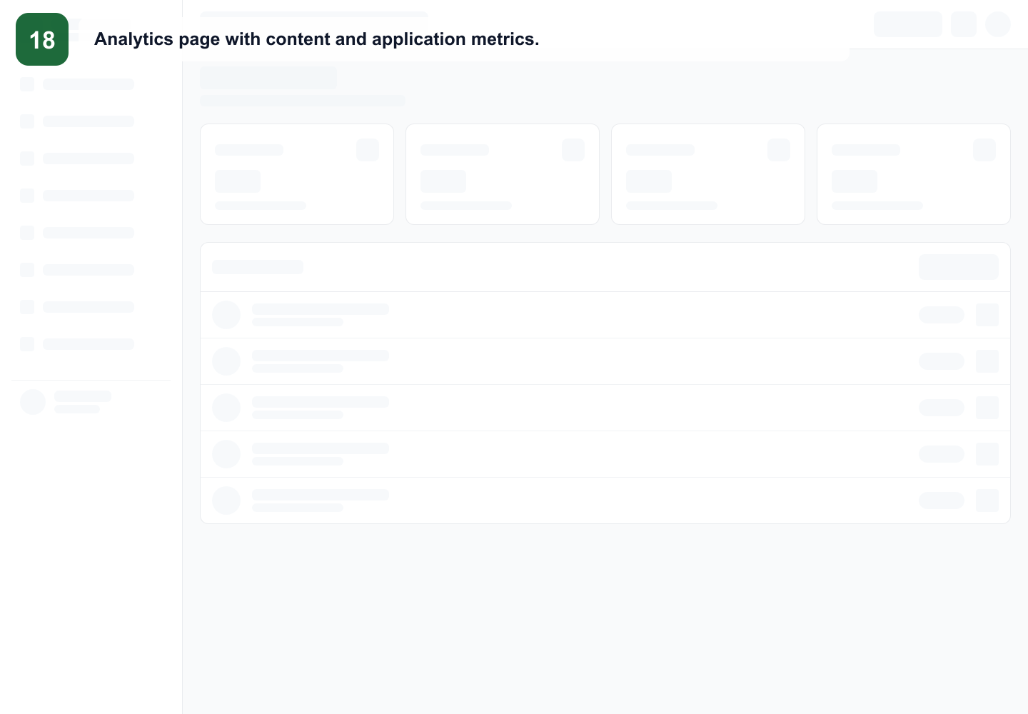
Analytics
Use analytics for operational trends, not formal financial statements.
Mtendere Education Consult · Admin Training · 24
Notes:
Trainer notes: Use analytics for operational trends, not formal financial statements. Use this slide to connect the concept to Mtendere's daily operations. Ask trainees to identify what role is allowed to perform the action and what data-protection risk must be avoided.

Slide 25
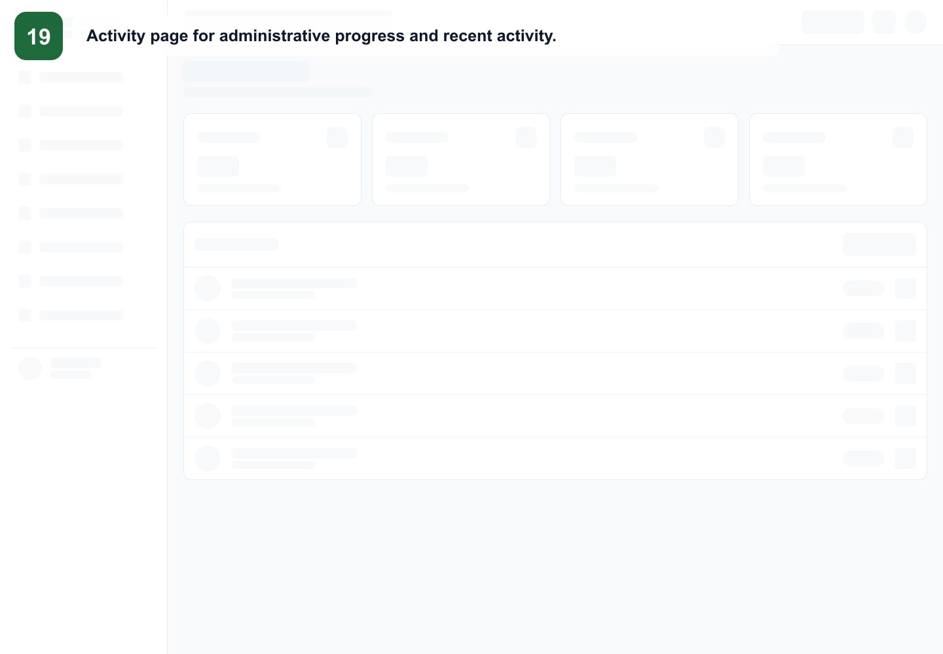
Activity and audit
Review actions for accountability and troubleshooting.
Mtendere Education Consult · Admin Training · 25
Notes:
Trainer notes: Review actions for accountability and troubleshooting. Use this slide to connect the concept to Mtendere's daily operations. Ask trainees to identify what role is allowed to perform the action and what data-protection risk must be avoided.

Slide 26

AI Chat Assistant
Beta monitoring feature. Treat as incomplete until production-ready policies are confirmed.
Mtendere Education Consult · Admin Training · 26
Notes:
Trainer notes: Beta monitoring feature. Treat as incomplete until production-ready policies are confirmed. Use this slide to connect the concept to Mtendere's daily operations. Ask trainees to identify what role is allowed to perform the action and what data-protection risk must be avoided.

Slide 27
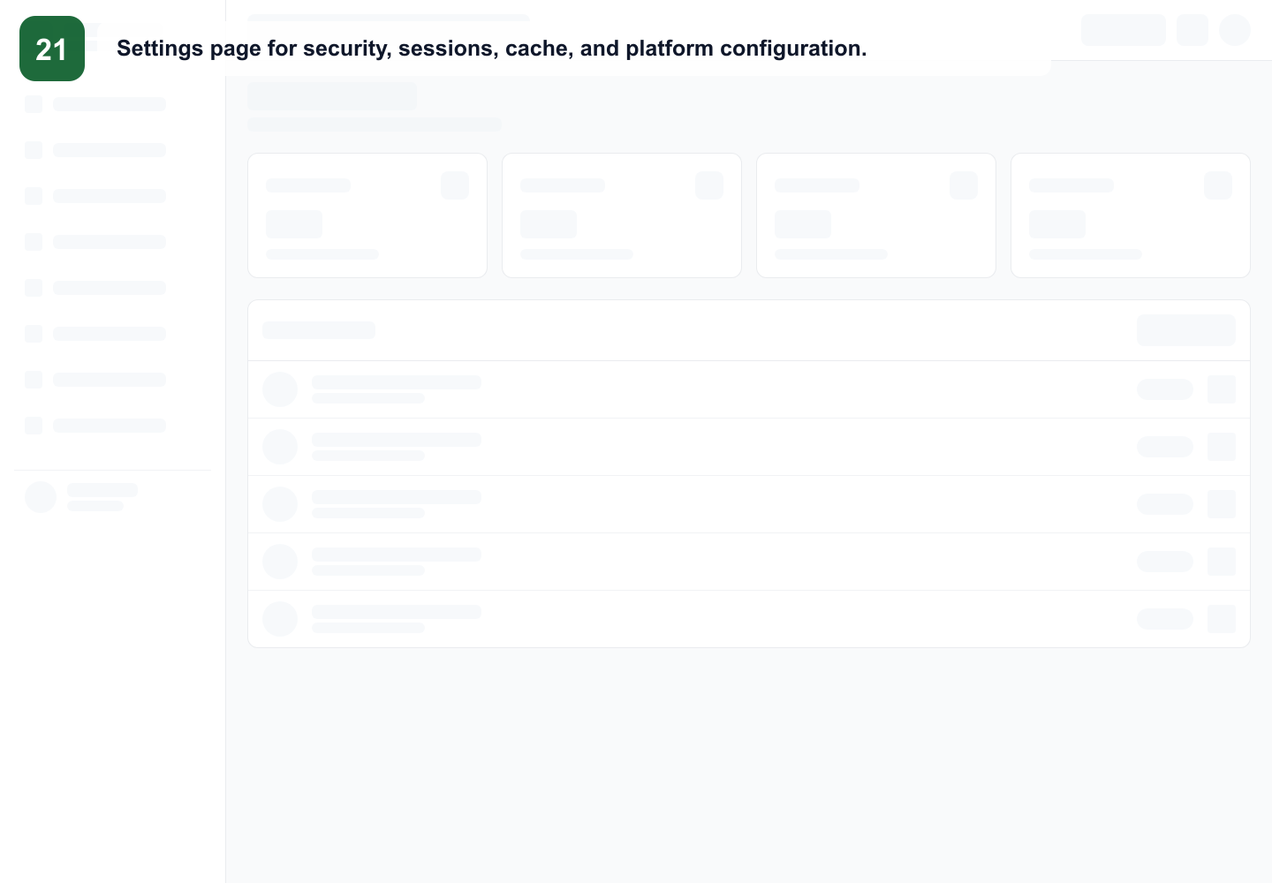
Settings
Super Admins manage security, session, cache and platform controls.
Mtendere Education Consult · Admin Training · 27
Notes:
Trainer notes: Super Admins manage security, session, cache and platform controls. Use this slide to connect the concept to Mtendere's daily operations. Ask trainees to identify what role is allowed to perform the action and what data-protection risk must be avoided.

Slide 28
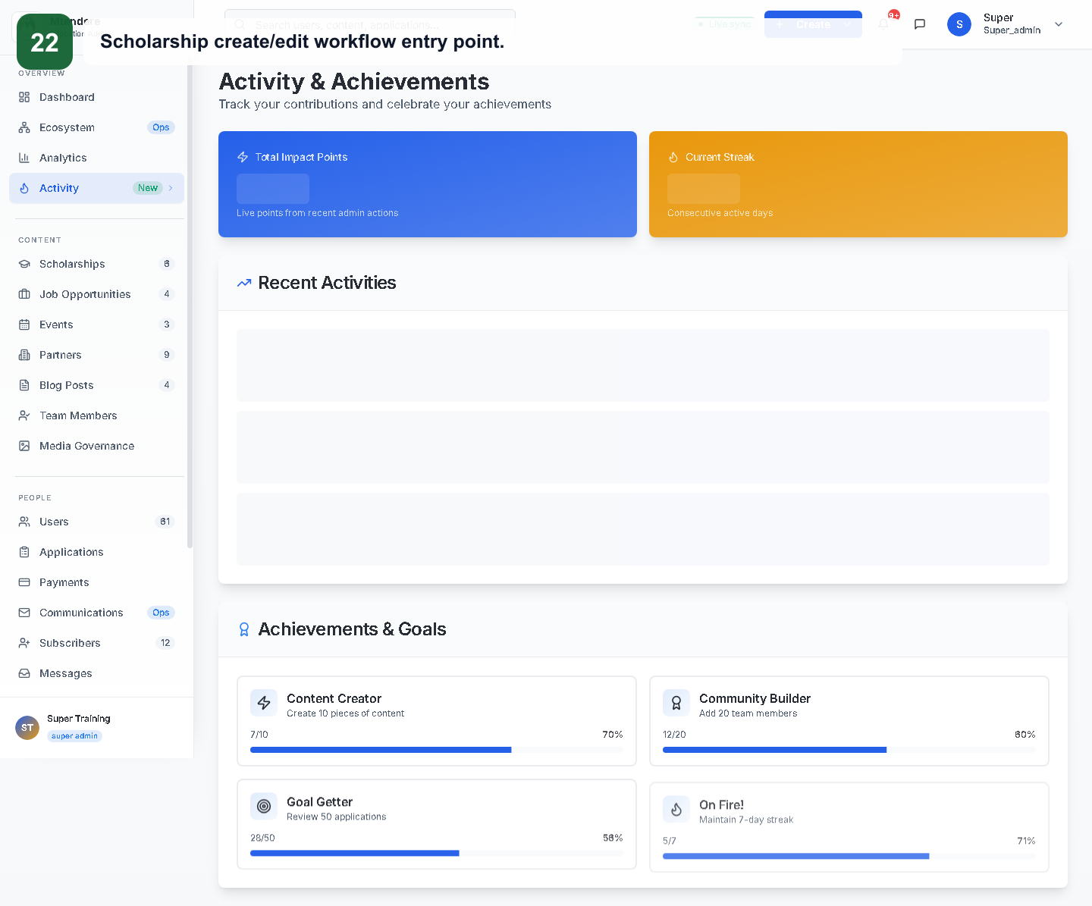
Create/edit entry points
Look for Add, Create or New buttons; complete required fields before saving.
Mtendere Education Consult · Admin Training · 28
Notes:
Trainer notes: Look for Add, Create or New buttons; complete required fields before saving. Use this slide to connect the concept to Mtendere's daily operations. Ask trainees to identify what role is allowed to perform the action and what data-protection risk must be avoided.

Slide 29
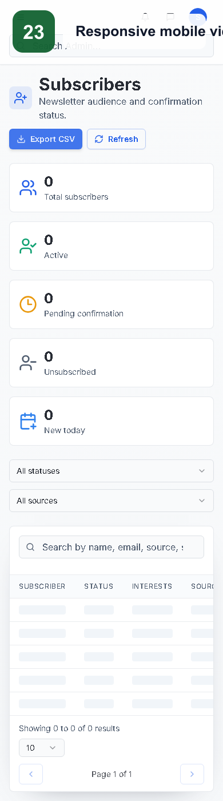
Responsive view
Administrators can review key information on mobile, but complex edits are safer on desktop.
Mtendere Education Consult · Admin Training · 29
Notes:
Trainer notes: Administrators can review key information on mobile, but complex edits are safer on desktop. Use this slide to connect the concept to Mtendere's daily operations. Ask trainees to identify what role is allowed to perform the action and what data-protection risk must be avoided.

Slide 30
Email link failures
If confirmation or unsubscribe links fail, stop campaigns and verify base URL, token route and deployed public page.
Mtendere Education Consult · Admin Training · 30
Notes:
Trainer notes: If confirmation or unsubscribe links fail, stop campaigns and verify base URL, token route and deployed public page. Use this slide to connect the concept to Mtendere's daily operations. Ask trainees to identify what role is allowed to perform the action and what data-protection risk must be avoided.

Slide 31
Application-processing workflow
Open record → review details → select status → add note → save → notify applicant.
Mtendere Education Consult · Admin Training · 31
Notes:
Trainer notes: Open record → review details → select status → add note → save → notify applicant. Use this slide to connect the concept to Mtendere's daily operations. Ask trainees to identify what role is allowed to perform the action and what data-protection risk must be avoided.

Slide 32
Content publishing workflow
Draft → complete required fields → preview/review → publish → verify public page → monitor expiry.
Mtendere Education Consult · Admin Training · 32
Notes:
Trainer notes: Draft → complete required fields → preview/review → publish → verify public page → monitor expiry. Use this slide to connect the concept to Mtendere's daily operations. Ask trainees to identify what role is allowed to perform the action and what data-protection risk must be avoided.

Slide 33
User access workflow
Identify duty → choose least-privilege role → create account → test access → deactivate when no longer needed.
Mtendere Education Consult · Admin Training · 33
Notes:
Trainer notes: Identify duty → choose least-privilege role → create account → test access → deactivate when no longer needed. Use this slide to connect the concept to Mtendere's daily operations. Ask trainees to identify what role is allowed to perform the action and what data-protection risk must be avoided.

Slide 34
Daily checklist
Dashboard, Applications, Messages, Subscribers, urgent deadlines and failed communications.
Mtendere Education Consult · Admin Training · 34
Notes:
Trainer notes: Dashboard, Applications, Messages, Subscribers, urgent deadlines and failed communications. Use this slide to connect the concept to Mtendere's daily operations. Ask trainees to identify what role is allowed to perform the action and what data-protection risk must be avoided.

Slide 35
Weekly checklist
Activity, Analytics, stale records, expired opportunities, access review and broken links.
Mtendere Education Consult · Admin Training · 35
Notes:
Trainer notes: Activity, Analytics, stale records, expired opportunities, access review and broken links. Use this slide to connect the concept to Mtendere's daily operations. Ask trainees to identify what role is allowed to perform the action and what data-protection risk must be avoided.

Slide 36
Monthly checklist
User audit, approved exports, media cleanup, data-protection review and platform improvement log.
Mtendere Education Consult · Admin Training · 36
Notes:
Trainer notes: User audit, approved exports, media cleanup, data-protection review and platform improvement log. Use this slide to connect the concept to Mtendere's daily operations. Ask trainees to identify what role is allowed to perform the action and what data-protection risk must be avoided.

Slide 37
Exercise 1
Log in, review Dashboard, identify one metric and one recent action.
Mtendere Education Consult · Admin Training · 37
Notes:
Trainer notes: Log in, review Dashboard, identify one metric and one recent action. Use this slide to connect the concept to Mtendere's daily operations. Ask trainees to identify what role is allowed to perform the action and what data-protection risk must be avoided.

Slide 38
Exercise 2
Create a draft scholarship, save it and explain what must be checked before publishing.
Mtendere Education Consult · Admin Training · 38
Notes:
Trainer notes: Create a draft scholarship, save it and explain what must be checked before publishing. Use this slide to connect the concept to Mtendere's daily operations. Ask trainees to identify what role is allowed to perform the action and what data-protection risk must be avoided.

Slide 39
Exercise 3
Review an application, change status and add an internal note.
Mtendere Education Consult · Admin Training · 39
Notes:
Trainer notes: Review an application, change status and add an internal note. Use this slide to connect the concept to Mtendere's daily operations. Ask trainees to identify what role is allowed to perform the action and what data-protection risk must be avoided.

Slide 40
Exercise 4
Create a blog article with a featured image and preview it before publishing.
Mtendere Education Consult · Admin Training · 40
Notes:
Trainer notes: Create a blog article with a featured image and preview it before publishing. Use this slide to connect the concept to Mtendere's daily operations. Ask trainees to identify what role is allowed to perform the action and what data-protection risk must be avoided.

Slide 41
Exercise 5
Create a user and assign the lowest role that fits the scenario.
Mtendere Education Consult · Admin Training · 41
Notes:
Trainer notes: Create a user and assign the lowest role that fits the scenario. Use this slide to connect the concept to Mtendere's daily operations. Ask trainees to identify what role is allowed to perform the action and what data-protection risk must be avoided.

Slide 42
Knowledge check
Who can manage roles? Who reviews applications? What should happen when unsubscribe links fail?
Mtendere Education Consult · Admin Training · 42
Notes:
Trainer notes: Who can manage roles? Who reviews applications? What should happen when unsubscribe links fail? Use this slide to connect the concept to Mtendere's daily operations. Ask trainees to identify what role is allowed to perform the action and what data-protection risk must be avoided.

Slide 43
Competency checklist
Trainee can navigate, protect data, complete workflows, troubleshoot and escalate.
Mtendere Education Consult · Admin Training · 43
Notes:
Trainer notes: Trainee can navigate, protect data, complete workflows, troubleshoot and escalate. Use this slide to connect the concept to Mtendere's daily operations. Ask trainees to identify what role is allowed to perform the action and what data-protection risk must be avoided.

Slide 44
Support and escalation
Capture page, timestamp, role, browser, exact error and sanitized screenshot; escalate to Chrispine Mndala / Aöthothe Technologies.
Mtendere Education Consult · Admin Training · 44
Notes:
Trainer notes: Capture page, timestamp, role, browser, exact error and sanitized screenshot; escalate to Chrispine Mndala / Aöthothe Technologies. Use this slide to connect the concept to Mtendere's daily operations. Ask trainees to identify what role is allowed to perform the action and what data-protection risk must be avoided.

Slide 45
Closing
Operate carefully, document decisions and protect client trust.
Mtendere Education Consult · Admin Training · 45
Notes:
Trainer notes: Operate carefully, document decisions and protect client trust. Use this slide to connect the concept to Mtendere's daily operations. Ask trainees to identify what role is allowed to perform the action and what data-protection risk must be avoided.

