Slide 1
MDD Assignment
By Min Kim (KMXMIN010) & Christopher Blignaut (BLGCHR003)
Notes:
Our target audience is UCT students who have internet access.

Slide 2
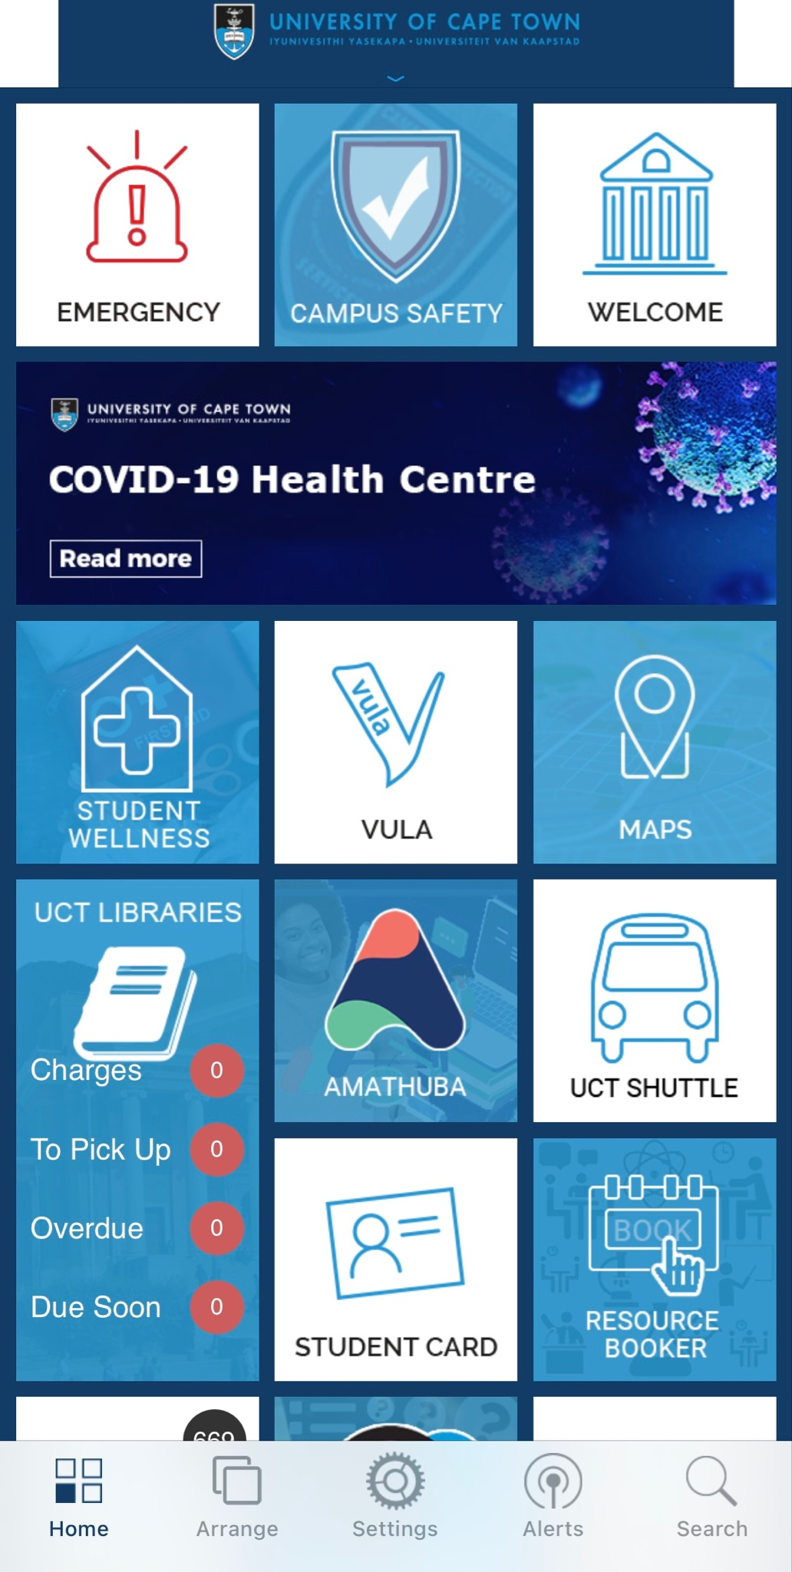
What it did right
Lots of options, but not too much
User can quickly find what they want
Mapping with symbols
Notes:
So while the design of the current UCT app is flawed, it has certain design aspects that follow design principles which are as follows:
The menu layout allows for a large number of options while keeping the signal to noise ratio low enough as to not degrade the viewer’s interest.
The top level view of the application is quite appealing and aesthetic as it allows for a large number of options (This was seen by our consulting of multiple students), allowing the user to choose a large number of functionalities, which is also aided by the addition of recognisable symbols in the blocks allowing the user to map the functionality and quickly choose and perform the action that they want
While the app has some positive design aspects, it also has quite a few negative aspects.

Slide 3
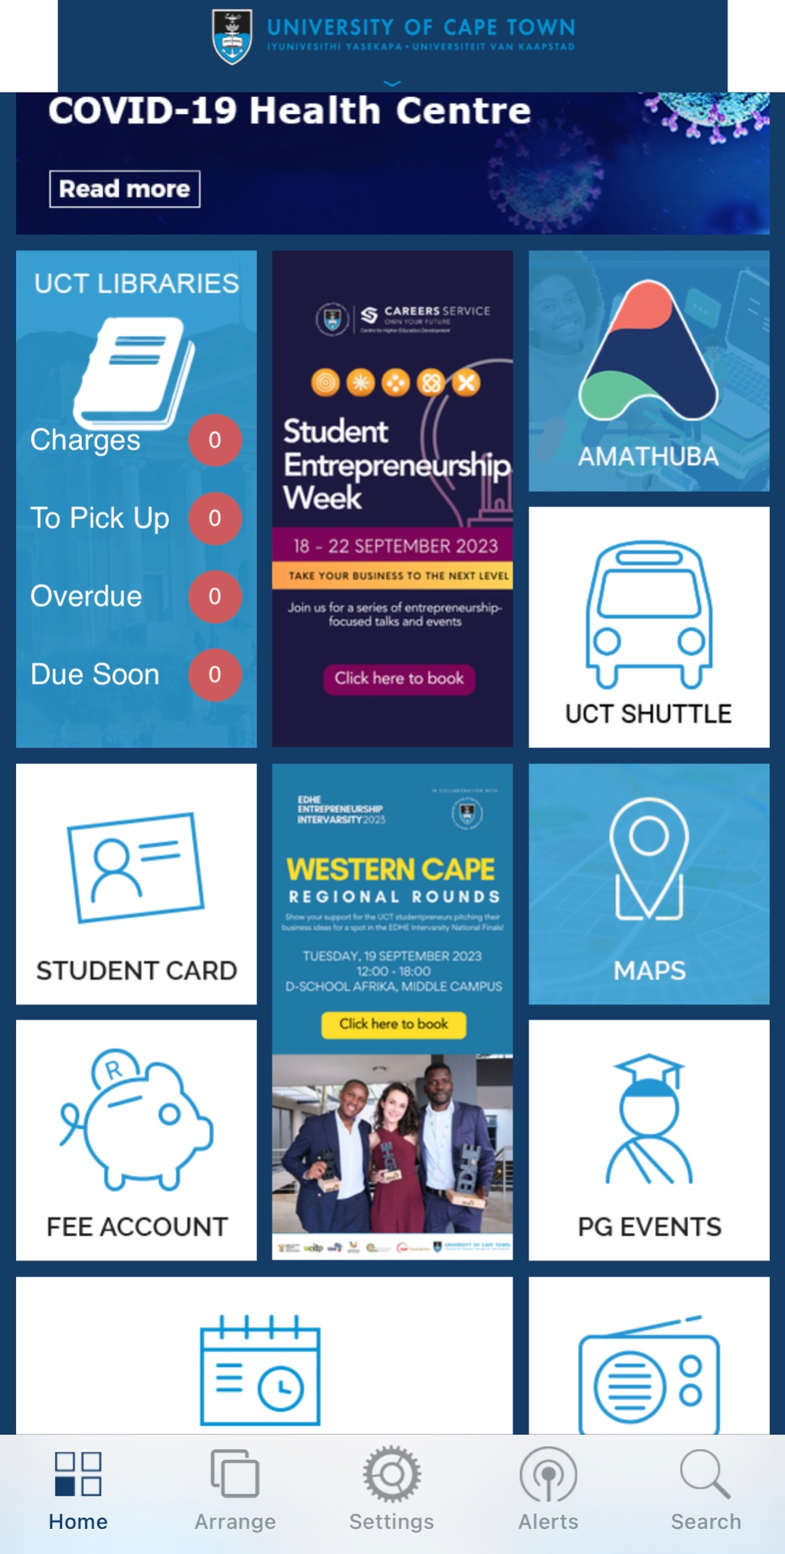
What it did wrong
Awkward banners
Out of date banners
Everything looks the same
Top banner looks clunky
Notes:
Now, you know that we wouldn’t be here with a prototype of a new app if the existing design didn’t have any flaws but unfortunately, here we are.
Some of the flaws with the app’s visual design are as follows:
The inability to remove certain banners results in a design that may not be aesthetically pleasing as to optimise the menu for the user’s specific requirements will typically result in an awkward menu layout.
Many of these awkward banners are out of date as well
Due to the colour scheme of the menu, a large number of the options blend in with one another. Nothing sticks out as the blue and while of all menu items symbols as well as their text blend in together making it difficult for the user to find the option that they wish to choose.

Slide 4


















New Design
EMERGENCY
VULA
AMATHUBA
STUDENT CARD
UCT SHUTTLE
EMAIL
UCT FORUM
SEARCH
VENUE
RESULT
TIME TABLE
SOCIETIES
UCT CHATBOT
Notes:
For our App, we decided to redo it with the look of Amathuba in mind. This allows for the student portals of UCT to be consistent.
We have fixed the logo banner as well as offering a sleak bottom banner with icons that are widely used among the industry.
We have decided to use the 80/20 rule and thus, the icons in red and green are displayed first to ensure that the user has quick access to these features.
We also have decided to make the icons of the services stand out with a dark outline to ensure that the user can quickly identify them. This has been taken to a further step with the Vula and Amathuba widgets which have their respective colours to jump out at students allowing them to quickly access those features (as those features are going to be some of the most used)
As there are only widgets, the user can not try select an option that is not available nor supported by the application which prevents error.

Slide 5
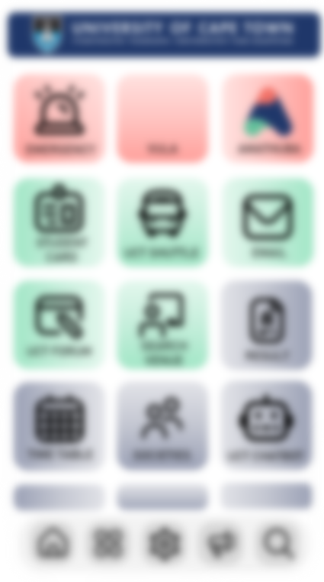

New Design
AMATHUBA
Red
Green
Blue
Remove
Notes:
Now as we said that we wanted to cater with the 80/20 rule, we can’t know exactly what every student will need, so we allow for an option for the users to customize their home screen. For this, they have the option of choosing a colour, red which is the most important and will be displayed at the top, green which is somewhat important and will be displayed in the middle, and finally blue which is the least important and will be displayed at the bottom.
They also have the option to remove some tiles to ensure that useless tiles are not overcrowding the menu ensuring that the noise of the menu is limited to not hindering the user’s attention.
These options keep the user in control of their menu while also keeping a consistent interface.
We also want to provide the user feedback for every action that they do, as you could see by how the widget pulsed when tapped on, this is the aim for all features of our app

Slide 6
New Features
Venue Finder
Student Forum
Notes:
When evaluating the UCT app, we also realized that it could be better as it was missing some key features.
After brainstorming for a while, we eventually settled on incorporating a messaging board (like stack overflow) and a venue finder.

Slide 7
New Features
EMERGENCY
VULA
AMATHUBA
STUDENT CARD
UCT SHUTTLE
EMAIL
UCT FORUM
SEARCH
VENUE
RESULT
TIME TABLE
SOCIETIES
UCT CHATBOT
Notes:
So to navigate to the first feature, lets start at the main menu

Slide 8
Venue Finder
Upper Campus
Building
Leslie Social
Period
09:00 – 09:45
Date
2023
April
15
Search
LS1A (Used)
LS1B (Used)
LS1C (Empty)
LS1D (Empty)
LS2A (Used)
LS2B (Used)
LS2C (Used)
LOAD MORE
Notes:
When deciding a second feature, we saw the library desks and some of the red tape stains still left from the pandemic. From this, we remembered the lines outside of the library while students waited for a tag to gain access to the study space.
We realised that UCT has a lot of classrooms, however, a lot of students struggle to find these empty venues as they need to check each and every classroom’s availability. We asked one of our fellow students (DNDMAN001) as to how long, in average, it takes them to find an empty classroom, and the answer was that it takes up to 20 minutes of their precious time.
To make use of these empty classrooms, we decided to implement a venue finder which shows students what venues are currently open and for how long they will be open. This in turn will allow students to make more efficient use of the University space and their time.
We have kept with the same consistency with blue and a green back arrow.
The user is presented with a list of the venues in the building that they have chosen which shows if it is occupied or not.
The LOAD MORE button is in all caps and larger text to ensure that the user will not have to struggle to find the feature.
The search button is also blue to grab the user’s attention so that they actually press the search button.

Slide 9
Venue Finder
Upper Campus
Building
Leslie Social
Period
09:00 – 09:45
Date
2023
April
15
Search
LS1A (Used)
LS1B (Used)
LS1C (Empty)
LS1D (Empty)
LS2A (Used)
LS2B (Used)
LS2C (Used)
LOAD MORE
Notes:
When deciding a second feature, we saw the library desks and some of the red tape stains still left from the pandemic. From this, we remembered the lines outside of the library while students waited for a tag to gain access to the study space.
We realised that UCT has a lot of classrooms, however, a lot of students struggle to find these empty venues as they need to check each and every classroom’s availability. We asked one of our fellow students (DNDMAN001) as to how long, in average, it takes them to find an empty classroom, and the answer was that it takes up to 20 minutes of their precious time.
To make use of these empty classrooms, we decided to implement a venue finder which shows students what venues are currently open and for how long they will be open. This in turn will allow students to make more efficient use of the University space and their time.
We have implemented the feedback here as well
The user is presented with a list of the venues in the building that they have chosen which shows if it is occupied or not.
The LOAD MORE button is in all caps and larger text to ensure that the user will not have to struggle to find the feature.
The search button is also blue to grab the user’s attention so that they actually press the search button.

Slide 10
Venue Finder
Upper Campus
Building
Leslie Social
AC Jordan
Period
Beattie
09:00 – 09:45
Centlivres
Date
April
Chris Hani
2023
15
Search
LS1A (Used)
LS1B (Used)
LS1C (Empty)
LS1D (Empty)
LS2A (Used)
LS2B (Used)
LS2C (Used)
LOAD MORE
Notes:
We also have a drop down menus so students can’t choose an incorrect option.
This ensures that no incorrect values may be entered.

Slide 11
Venue Finder
Upper Campus
Building
Leslie Social
Period
09:00 – 09:45
Date
2023
April
15
Search
LS1A (Used)
LS1B (Used)
LS1C (Empty)
LS1D (Empty)
LS2A (Used)
LS2B (Used)
LS2C (Used)
LOAD MORE
Notes:
We have kept with the same consistency with a green back arrow that will undo a user’s action which will also take them back to the menu.

Slide 12
New Features
EMERGENCY
VULA
AMATHUBA
STUDENT CARD
UCT SHUTTLE
EMAIL
UCT FORUM
SEARCH
VENUE
RESULT
TIME TABLE
SOCIETIES
UCT CHATBOT
Notes:
Now onto the second feature, the student forum!

Slide 13

Student Forum
(Like Stack overflow)
New
UCT FORUM
Looking for CSC2002S Tutor
By Anonymous
Posted 15th, Oct, 2023
Badminton buddies??
By Min K.
Posted 11th, Oct, 2023
Best lunch spot?
By Chris B.
Posted 10th, Oct, 2023
Anyone wanna carpool?
By Anonymous
Posted 10th, Oct, 2023
URGENT CS2 MDD TEAMMATE
By Anonymous
Posted 7th, Oct, 2023
How do you make friends
By Anonymous
Posted 5th, Oct, 2023
BEACH DAY???
By Anonymous
Posted 4th, Oct, 2023
Tips to pass the exams?
By Anonymous
Posted 3rd, Oct, 2023
LOAD MORE
Notes:
Looking at Inha University, we saw that they had a messaging board.
We believe that this is a feature that the University of Cape Town needs to input as it provides a platform for clubs and societies to be developed naturally.
This also will have the benefit of promoting events held at the university, significantly boosting attendance for said events.
Finally, with the pandemic as well as the digital world stifling interaction between students, this may provide an avenue for students to meet like minded people and make new friends
The green, white and blue keeps the app consistent with the Amathuba aesthetic that we have in mind for this redesign.
The title of each forum is large and bold so that it presents itself to the user and ensures that they pay attention to the important information on the screen.
The back button and new chat button are a green that catch the user’s eye to ensure that they are able to easily navigate to the home menu as well as create a new chat.

Slide 14
Student Forum
(Like Stack overflow)
Looking for CSC2002S Tutor
By Anonymous
Posted 15th, Oct, 2023
Hi, I’m looking for a tutor for CSC2002S
course, please pm me if you are interested.
Chris B.
x
Check your inbox.
Posted 20th, Oct, 2023
Anonymous
x
Why do you need a tutor??
Posted 16th, Oct, 2023
Anonymous
x
I really could use some help ☹
Posted 18th, Oct, 2023
Anonymous
x
Yea rather get help now ☹☹
Posted 18th, Oct, 2023
Notes:
Once the user has tapped on a message, they will be displayed with a screen including the title of the forum as well as the original message starting the forum.
They will then be presented with the messages of the forum including the messages of each person.
The owner of the forum will have the option to delete any of the messages on the post, which can be seen by the red x button there. (The X also follows conventions)

Slide 15
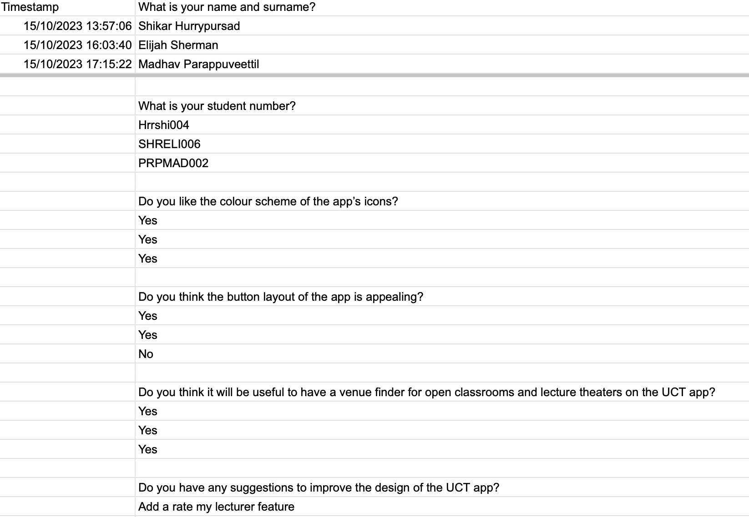
Appendix
Notes:
Here is the data collected from UCT students

