Slide 1
The Next Kung Fu Tea
A proposal for a potential Kung Fu Tea location in Alexandria, Virginia

Slide 2
Problem
Kung Fu Tea is an emerging bubble tea restaurant that is popular in the Northern Virginia Area. There are locations in the DC metro area including venues in Springfield, Centreville, and Arlington. Alexandria; however, does not have a Kung Fu Tea.

Slide 3
Solution
Determine a location in Alexandria based on similarities in the types of venues in zip codes.
Use a nearby zip code with an established Kung Fu Tea as a base for comparision (Springfield, Va)
Include both areas of Alexandria under city jurisdiction as well as Fairfax County jurisdiction.

Slide 4
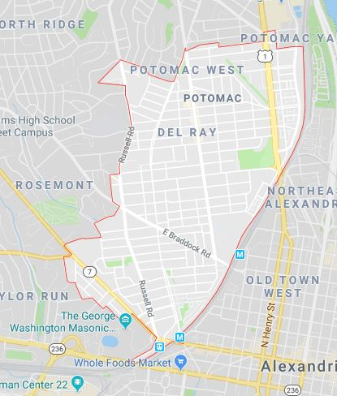
Zip Code 22301 (Del Ray)
Annual Art Festival attracts thousands
Mount Vernon Avenue experiences plenty of foot traffic due to shops and restaurants.

Slide 5
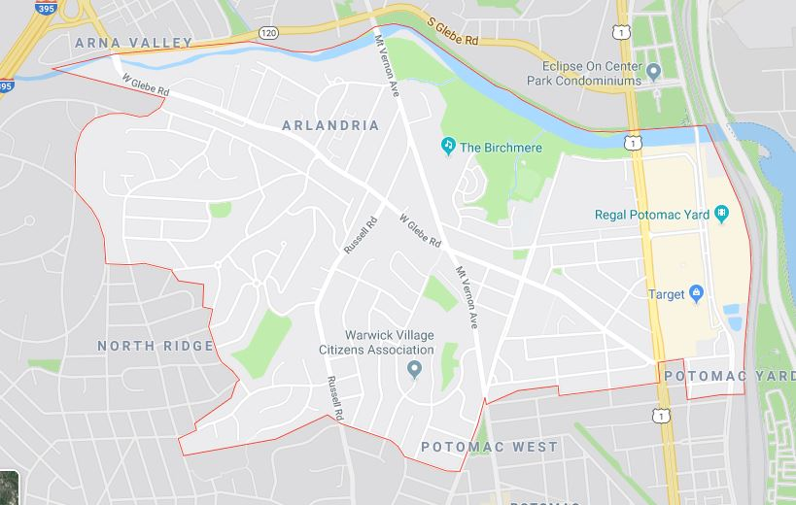
Zip Code 22305 (Potomac Yard)
Potomac Yard Shopping Center along side route 1.
Experience a lot of exposure due to route 1 and consumers around the shopping center.

Slide 6
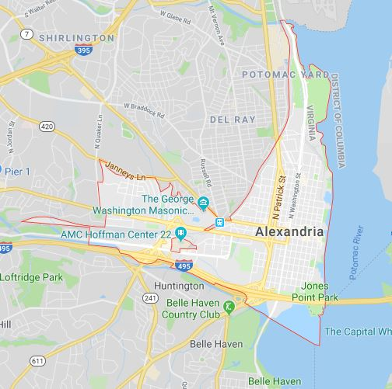
Zip Code 22314 (Old Town)
Old town has lots of attractions and venues.
Hangout hub for groups
Plethora of other restaurants

Slide 7
Closing Remarks
These locations offer their own hotspots
Route 1 runs through these particular zip codes
They are most similar to the zip code area of the Springfield KFT

