Slide 1
Shortest Paths
An Introduction to Routing Problems
Graphs / Lecture 2
Franck Chauvel
axbit & NTNU
Ask questions on menti.com
with code 6447 9648
franck.chauvel@ntnu.no

Slide 2
Weighted Graphs
Modle
220 km
Trondheim
82 km
154 km
Røros
What is the shortest path from
Hamar to Modle?
Ålesund
425 km
290 km
260 km
Bergen
Oppdal
Hamar
290 km
400 km
Oslo

Slide 3
Agenda
Weighted Graphs
Single Source to all
Dijsktra’s Algorithm
Bellman-Ford Algorithm
All pairs
Floyd-Warshall algorithm
Routing Problems

Slide 4

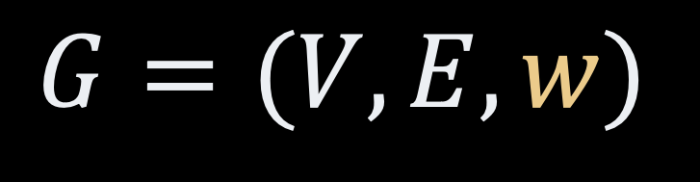

Weighted Graphs
weight function
$$w:E→ℝ$$
graph
$$G=(V, E, w)$$
Set of vertices
(nodes)
Set of edges
(links)
$$E∈V × V$$

Slide 5
With Adjacency List
public class Graph<T> {
private static class Edge<T> {
T source;
T end;
float weight;
Edge(T source, T end, float weight) {
this.source = source;
this.end = end;
this.weight = weight;
}
}
private HashMap<T, HashMap<T, Edge<T>>> vertices;
public Graph() {
this.vertices = new HashMap<T, HashMap<T, Edge<T>>>();
}
// …
represents a single weighted edge
adjacency “table” of edges

Slide 6
Breadth-first Search
4 edges
3 edges
If all edges weight 1
Breadth-first search
expands progressively
until it reaches the destination
Minimum path w.r.t. edge count
2 edges
1 edge
source
S
D
destination

Slide 7
Dijkstra’s Algorithm
When labels are not only “1”s…

Slide 8
The General Idea
Breadth-first Search
Dijkstra’s Algorithm
For all node in the queue
n = next node
mark n as known
for all neighbors of n
if n is unknown
add to the queue
process n
For all nodes in the priority queue
n = the closest
for all neighbors still in the queue
Adjust the distance

Slide 9
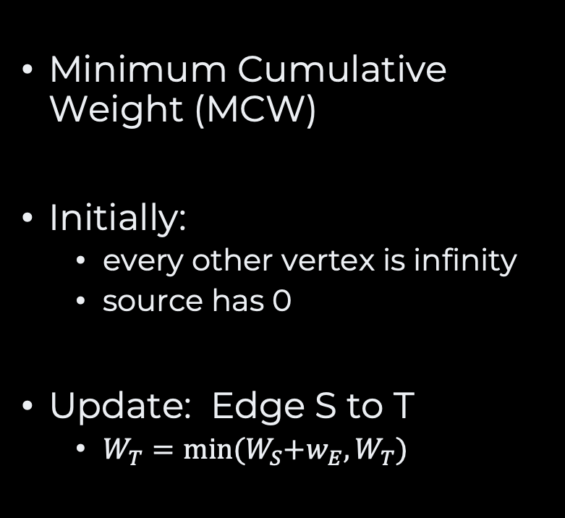
Tracking Weights
Minimum Cumulative Weight (MCW)
Initially:
every other vertex is infinity
source has 0
Update: Edge S to T
$W_{T}=\min{{(W}_{S}+w_{E},W_{T})}$
To
MCW
Bergen
∞
Hamar
∞
Modle
∞
Oppdal
400
∞
source
Oslo
0
Røros
∞
Trondheim
∞
Ålesund
∞

Slide 10







Update rule
Update:
Is reaching a through x better?
Prioritize the most promizing “unvisited” node so far
Update only links to new vertices
No negative weight!
visited
vertices
$$w_{a}$$
$$w_{x}≥w_{a}$$
$$⇒w_{x}+w_{x→a}>w_{a}$$
a
$$a$$
x
unknown
vertex
s
$$w_{x}$$
$$y$$
source
$$w_{y}$$
y
unknown
vertex

Slide 11
How to Store Paths?
To
From
Modle
Trondheim
Bergen
Ålesund
Hamar
Oppdal
Røros
Modle
Ålesund
Ålesund
Oppdal
Oslo
Oslo
Bergen
Oppdal
Hamar
Røros
Hamar
Trondheim
Modle
Ålesund
Oppdal
Oslo

Slide 12

Dijsktra’s Algorithm
Minimum Total
Weight
From
Modle
220 km
Modle
Trondheim
Modle
Trondheim
Trondheim
Bergen
∞
Ålesund
1115
690
Oppdal
Hamar
∞
82 km
154 km
∞
Røros
Modle
772
Ålesund
Røros
Røros
Ålesund
Ålesund
Ålesund
Oppdal
400
Oslo
∞
425 km
290 km
260 km
Oslo
Oslo
0
Bergen
Bergen
Oppdal
Hamar
∞
Hamar
Bergen
Oppdal
Hamar
Røros
950
Oppdal
Hamar
290 km
Trondheim
992
Modle
∞
1104?
400 km
690
Oppdal
Ålesund
∞
Oslo
Oslo
Oslo
Next, we pick the closeest unvisited vertex!
START

Slide 13
The Code Dijsktra’s Algorithm
private void initialize(HashMap<T, Float> weights,
HashMap<T, T> path) {
for (var anyVertex: vertices.keySet()) {
weights.put(anyVertex, Float.POSITIVE_INFINITY);
if (anyVertex == source) {
weights.put(source, 0f);
}
}
}
private T minimumWeight(List<T> candidates,
Map<T, Float> weights) {
if (candidates.size() == 1) {
return candidates.get(0);
}
var minimum = candidates.get(0);
for(int index=1 ; index<candidates.size() ; index++) {
var current = candidates.get(index);
if (weights.get(current) < weights.get(minimum)) {
minimum = current;
}
}
return minimum;
}
public Map<T, T> dijkstra(T source) {
var weights = new HashMap<T, Float>();
var path = new HashMap<T, T>();
initialize(weights, path);
var unknowns = new LinkedList<T>(vertices.keySet());
while (!unknowns.isEmpty()) {
var current = minimumWeight(unknowns, weights);
for (var anyNeighbour: neighboursOf(current)) {
if (unknowns.contains(anyNeighbour)) {
adjust(weights, path, current, anyNeighbour);
}
}
unknowns.remove(current);
}
return path;
}
private void adjust(HashMap<T, Float> weights,
HashMap<T, T> path
T current,
T neighbour) {
var newWeight = weights.get(current)
+ weightBetween(current, neighbour);
if (newWeight < weights.get(neighbour)) {
weights.put(neighbour, newWeight);
path.put(neighbour, current);
}
}

Slide 14
Takeaway
Dijkstra’s Algorithm computes the shortest paths to all other vertices!

Slide 15
What about Circuits?
A
Circuits yield an infinity of paths
Circuits are irrelevant
if weights are positive
The existence of a shortest path imply the absence of negative circuits
4
1
B
C
5
2
D
3
E

Slide 16
Negative Weights
MCW
From
-4
1
Vertex A
0
C
B
E
Vertex B
∞
A
No propagation!
2
C
-1
3
2
-5
1
-1
Vertex C
3
∞
A
D
4
D
A
Vertex D
4
A
∞
Vertex E
1
A
∞

Slide 17
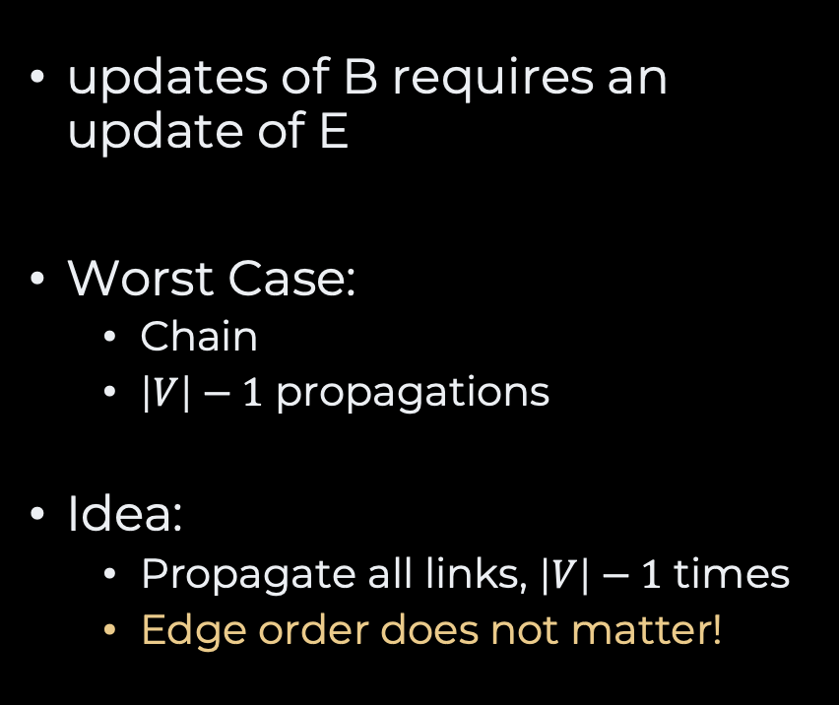
Propagation
updates of B requires an update of E
Worst Case:
Chain
$\left|V\right|−1$ propagations
Idea:
Propagate all links, $\left|V\right|−1$ times
Edge order does not matter!
-4
1
C
B
E
-5
D

Slide 18
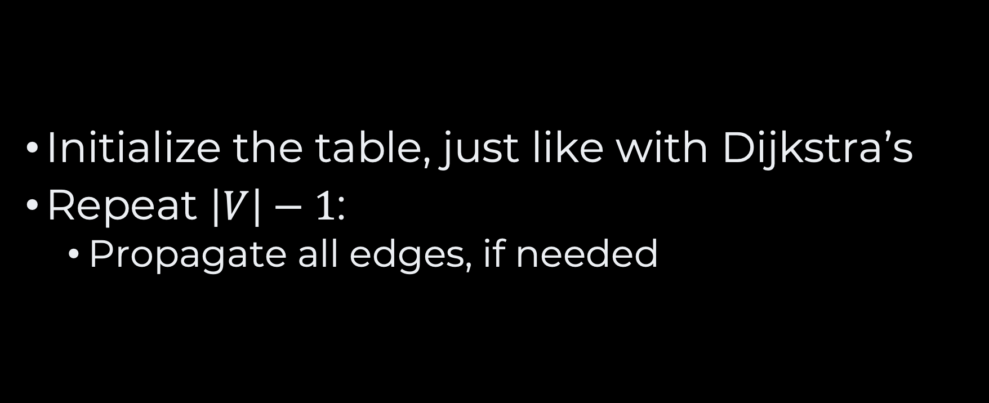
Bellman-Ford Algorithm
Initialize the table, just like with Dijkstra’s
Repeat $\left|V\right|−1$:
Propagate all edges, if needed

Slide 19







Slow Motion Bellman-Ford Algorithm
MCW
From
$$e_{2}:−4$$
$$e_{1}:1$$
Vertex A
0
C
B
E
-1
Vertex B
-5
∞
A
2
C
$$e_{4}:3$$
$$e_{6}:2$$
-1
Vertex C
3
∞
A
$$e_{3}:−5$$
D
$$e_{5}:4$$
$$e_{7}:1$$
D
A
Vertex D
∞
A
4
-4
Vertex E
1
A
∞
0
B
Iteration Count:
4
3
2
1

Slide 20
Detecting Negative Cycles
Iterate one more time, over all edges
If any edge still changes
There is a negative cycle

Slide 21
Code Bellman-Ford Algorithm
void propagate(Map<T, Float> weights,
Map<T, T> paths,
Edge<T> edge) {
var newWeight = weights.get(edge.source)
+ edge.weight;
if (newWeight < weights.get(edge.end)) {
weights.put(edge.end, newWeight);
paths.put(edge.end, edge.source);
}
}
void ensureNoNegativeCycle(List<Edge<T>> edges,
Map<T, Float> weights)
throws NoNegativeCycle {
for (var anyEdge: edges) {
var newWeight = weights.get(anyEdge.source)
+ anyEdge.weight;
if (newWeight < weights.get(anyEdge.end)) {
throw new NegativeCycleFound();
}
}
}
public Map<T,T> bellmanFord(T source) throws NegativeCycleFound {
var weights = new HashMap<T, Float>();
var paths = new HashMap<T, T>();
initialize(weights, paths);
for (int i=1 ; i<vertices.size() ; i++) {
for (var anyEdge: allEdges()) {
propagate(weights, paths, anyEdge);
}
}
ensureNoNegativeCycle(allEdges(), weights);
return paths;
}
Same as in Dijkstra’s algorithm

Slide 22
Takeaway
The Bellman-Ford Algorithm handles negative weights and detects negative cycles

Slide 23
What’s More?
How about finding shortest paths
between all pairs of vertices?
Floyd-Warshall Algorithm

Slide 24
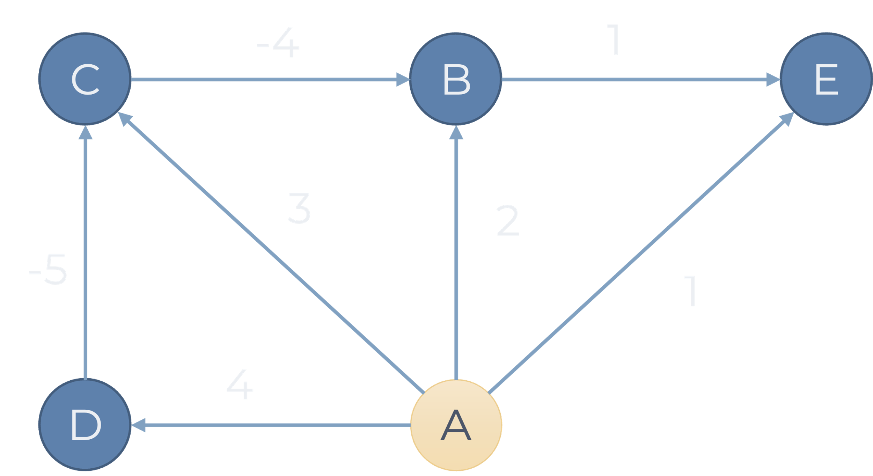

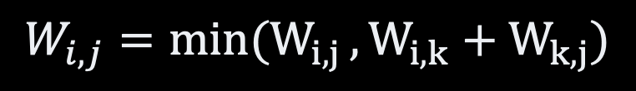


The Idea Floyd-Warshall Algorithm
adjacency matrix
k
A
B
C
D
E
$$W_{i,k}$$
$$W_{k,j}$$
A
0
2
3
4
1
B
∞
0
∞
∞
1
i
j
C
∞
-4
0
∞
∞
$$W_{i,j}$$
D
∞
∞
-5
0
∞
E
∞
∞
∞
∞
0
$$W_{i,j}=min(W_{i,j }, W_{i,k}+W_{k,j})$$

Slide 25
The algorithm
Initialize the adjacency matrix
For all source in Node
For all target in Node
For all stop in Node
if stop is a shortcut
Update matrix[target]

Slide 26
The Code Floyd-Warshall Algorithm
Map<Pair<T>, Float> floydWarhsall() {
var matrix = new HashMap<Pair<T>, Float>();
initialize(matrix);
for(var anyVertex: vertices()) {
for (var anySource: vertices()) {
for (var anyTarget: vertices()) {
adjust(matrix, anyVertex, anySource, anyTarget);
}
}
}
return matrix;
}
Adjacency matrix
void initialize(Map<Pair<T>, Float> matrix) {
for (var anySource: vertices) {
for (var anyTarget: vertices) {
matrix.put(new Pair<T>(anySource, anyTarget),
Float.POSITIVE_INFINITY);
}
}
for(var eachEdge: allEdges()) {
matrix.put(new Pair<T,T>(eachEdge.start, eachEdge.end),
eachEdge.weight);
}
for (var anyVertex: vertices) {
matrix.put(new Pair<T>(anyVertex, anyVertex),
0);
}
}
void adjust(Map<Pair<T>, Float> matrix,
T givenVertex, T source, T target) {
var newWeight = matrix.get(new Pair<T>(source, givenVertex)) +
matrix.get(new Pair<T>(givenVertex, target));
if (newWeight < matrix.get(new Pair<T>(source, target))) {
matrix.put(new Pair<T>(source, target),
newWeight);
}
}

Slide 27
Recap
Weighted Graphs
Edges have cost/weight
Single source Shortest paths
Dijkstra’s Algorithm
No negative weights
O(E + V)
Bellman-Ford Algorithm
No negative cycles
O(V * E)
All Sources Shortest Paths
Floyld-Warshall Algorithm
No negative cycles
O(V^3)

Slide 28
Questions, Comments, or Ideas?
Franck Chauvel
Axbit & NTNU
franck.chauvel@ntnu.no

