Slide 1
Trees
Terminology and Implementation
Trees / Lecture 1
Franck Chauvel
Axbit & NTNU
Ask questions on menti.com
with code 4780 3393
franck.chauvel@ntnu.no

Slide 2
Beyond Linked-Lists
What if each element could have multiple successors?

Slide 3
Why to Study That?
Pervasive Concept in CS
Set Implementation
HTML DOM Tree
AST (compilers)
JSON documents
Text Processing
DB Engines: “B Trees”
Kd-Trees (Computer Graphics)
etc.
java.util.TreeSet
java.util.TreeMap
java.util.PriorityQueue

Slide 4
Agenda
What is a “tree”?
Data Structures
Algorithms
Tree Traversals
Sample Algorithms
Recap
Photo by Felix Mittermeier from Pexels

Slide 5
Family Tree
Jenny
Roger
Suzanne
Bernard
Catherine
Bertrand
Franck

Slide 6
Containement
Box 1
Box 3
Box 5
Box 6
Box 2
Box 4
Box 1
Box 2
Box 3
Box 4
Box 5
Box 6

Slide 7
Files & Folders
Maze Project
setup.py
app
tests
solver.py
generator.py
storage.py
cli.py
test_solver.py
test_generator.py
test_storage.py

Slide 8
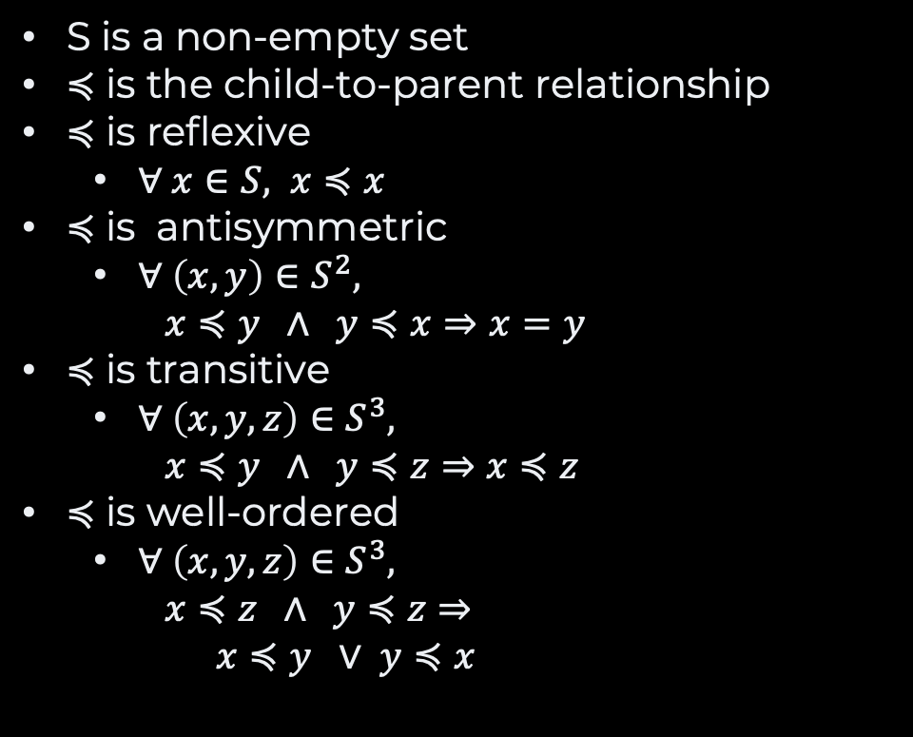
What is a Tree?
A
S is a non-empty set
$≼$ is the child-to-parent relationship
$≼$ is reflexive
$∀ x∈S, x≼x$
$≼$ is antisymmetric
$∀ \left(x,y\right)∈S^{2},$ $x≼y ∧ y≼x⇒x=y$
$≼$ is transitive
$∀ \left(x,y,z\right)∈S^{3},$ $x≼y ∧ y≼z⇒x≼z$
$≼$ is well-ordered
$∀ \left(x,y,z\right)∈S^{3},$ $x≼z ∧ y≼z⇒$ $x≼y ∨ y≼x$
E
B
NOT TRANSITIVE
D
C
E
B
NOT WELL-ORDERED
A
D
C

Slide 9
Terminology

Slide 10
Root and Leaves Terminology
A
A
root
B
C
D
Trees connect nodes
D
E
node
F
G
H
I
J
G
J
K
The node without parent is the root
leaves
L
M
M
O
P
Q
R
S
T
L
M
O
P
R
S
Nodes without child are the leaves
Y
Z
U
V
W
X
Y
Z
U
V
W
X

Slide 11
The Family Analogy Terminology
A
ancestors
A
parent
Nodes have a parent
B
C
D
E
E
E
Nodes have possibly many children
node
sibling(s)
F
G
H
I
J
J
K
K
Siblings are nodes with the same parents
L
M
M
O
P
Q
Q
R
Q
R
S
T
R
Ancestors are parents, grandparents, etc.
children
U
V
W
X
Y
Z
X
Descendants are children, grandchildren, etc.
descendants

Slide 12
Level, Depth, and Height Tree Terminology
A
Level 0
depth
Number of edge to the root is the depth
B
C
D
E
B
node
Level 1
The number of edges to the deepest downward leaf is the height
F
G
H
H
I
J
K
L2
height
L
M
M
M
O
P
Q
R
S
T
Levels are subsets of nodes with the same depth
L3
U
V
Y
Z
V
W
X

Slide 13
Paths & Subtrees Tree Terminology
A
A
A path is a sequence of edges between two nodes
B
C
D
E
B
C
E
A subtree is a node and all its descendants
F
G
H
I
K
H
I
J
K
The degree (or branching factor) is the number of children of a node
L
M
M
O
T
M
O
P
Q
R
S
T
U
V
W
X
Y
Z
U
V
W

Slide 14
Navigation Towards an ADT
parent(): Node
getChildren(): List<Node>
getRoot(Node): Node
degree(): Integer
isLeaf(): Boolean
isRoot(): Boolean
size(): Integer
depth(): Integer
height(): Integer
getDescendants(): List<Node>

Slide 15
Tree Traversal
Maze Project
setup.py
app
tests
solver.py
generator.py
storage.py
cli.py
test_solver.py
test_generator.py
test_storage.py

Slide 16
Breadth-first Traversal
1
Maze Project
2
3
4
setup.py
app
tests
5
6
7
8
9
10
11
solver.py
generator.py
storage.py
cli.py
test_solver.py
test_generator.py
test_storage.py

Slide 17
Depth-first / Pre-Order
1
Maze Project
2
3
8
setup.py
app
tests
4
5
6
7
9
10
11
solver.py
generator.py
storage.py
cli.py
test_solver.py
test_generator.py
test_storage.py

Slide 18
Depth-first / Post-Order
11
Maze Project
1
6
10
setup.py
app
tests
2
3
4
5
7
8
9
solver.py
generator.py
storage.py
cli.py
test_solver.py
test_generator.py
test_storage.py

Slide 19
Implementations

Slide 20
Node-based Implementation
Node A
List of children
Node B
Node C
Node D
Node E
Node F
Node G

Slide 21
Recap
Trees capture hierarchies
One parent
No cycle
Traversals
Depth-first
Breadth-first
Recursive Structure

Slide 22
Questions, Comments, or Ideas?
Franck Chauvel
Axbit & NTNU
franck.chauvel@ntnu.no

