Slide 1
Graphs
A gentle introduction to graph theory
Graphs / Lecture 1
Franck Chauvel
axbit & NTNU
Go to www.menti.com and use the code 1147 7932
franck.chauvel@ntnu.no

Slide 2
Beyond Lists and Trees
Lists
Trees
Node 1
Node 1
Node 2
Node 2
Node 3
Node 3
Node 4
Node 5
Node 6
Node 4
Node 7
Node 8
Node 9
Node 10

Slide 3
Graphs
Node 1
Node 2
Node 3
Node 10
Node 4
Node 5
Node 6
Node 9
Node 7
Node 8

Slide 4
Agenda
Examples
Definition & Terminology
Implementations
Traversals

Slide 5
1. Examples
Graphs in our daily lifes

Slide 6
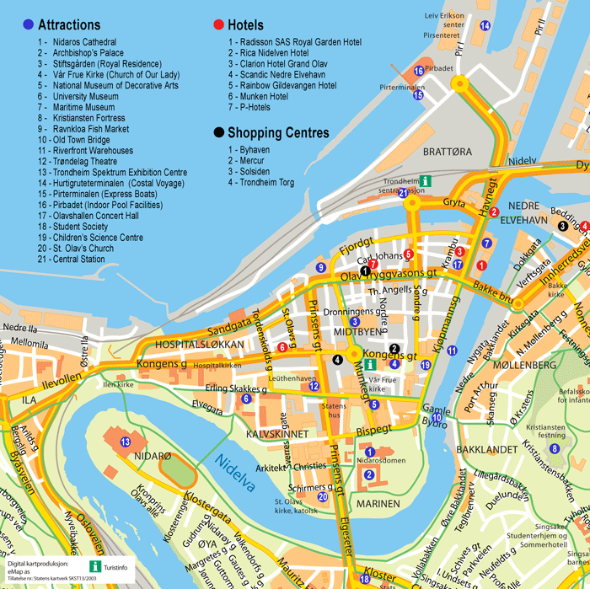
Roads
Places or crossroads
Connected by roads
Logistic & transportation

Slide 7

Social Network
People
Connected as ”friends”

Slide 8

Internet
Sites / Documents
Refer to one another through links

Slide 9
Flowcharts
start
Tasks / Jobs
Connected by sequencing
Computer Science :-)
sum ← 0
each ← 0
each ≤ limit
[no]
stop
[yes]
[no]
each ← each + 1
each % 2 = 0
[yes]
sum ← sum + each

Slide 10
2. Terminology
What makes a graph?

Slide 11

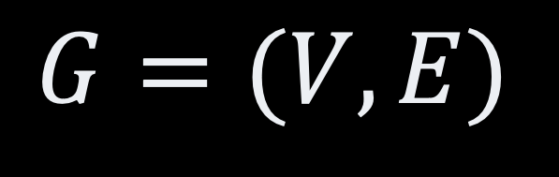
What is a graph?
graph
$$G=(V, E)$$
Set of vertices
(nodes)
Set of edges
(links)
$$E∈V × V$$

Slide 12
Example: Friendship
John
Lisa
Vertices = {Denis, Erik, Frank, John, Lisa, Mary, Olive, Peter, Thomas }
Mary
Frank
Thomas
Edges = {{D,F}, {D,F}, {E, O}, {F, L}, {F, T}, {J, L}, {J, M}, {M,P}, {M, O}}
Peter
Olive
Denis
Erik

Slide 13
Adjacency
John
Lisa
Adjacent vertices
Connected by an edge
John & Mary
Olive & Denis
etc.
Adjacent edges
Connected by a vertex
{J, M} & {M, O}
Mary
Frank
Thomas
Peter
Olive
Denis
Erik

Slide 14
Paths
John
John
Lisa
Sequence of adjacent vertices
Ex: [John, Mary, Olive, Denis]
Denis is reachable from John
Mary
Frank
Thomas
Mary
Olive
Peter
Olive
Denis
Denis
Erik

Slide 15
Cycles/Circuits
John
Lisa
John
John
Lisa
A path that starts and ends at the same vertex
[John, Mary, Olive, Denis, Franck, Lisa, John]
Loop: Vertex connected to itself
Frank
Thomas
Mary
Frank
Mary
Olive
Peter
Olive
Denis
Denis
Erik

Slide 16
Subgraphs & Components
John
Lisa
Kevin
Subgraph
Subset of the vertices
and Related edges
Component
Subgraph
Every vertex is reachable from every vertex
subgraph
Mary
Frank
Thomas
Peter
Olive
Denis
Robert
Erik
Anna
Hugo
component

Slide 17
Kind of Graphs
John
likes
Lisa
Modle
220 km
Trondheim
likes
82 km
Mary
Ålesund
likes
likes
425 km
290 km
likes
Peter
Olive
Denis
Bergen
Oppdal
Hamar
290 km
likes
400 km
Erik
Oslo

Slide 18
3. Implementations
Which data structure to best hold a graph?

Slide 19
Edge List
J
L
F
L
J
M
John
Lisa
T
F
Mary
Frank
Thomas
D
F
D
O
Peter
Olive
Denis
O
L
P
M
Erik
E
O

Slide 20
Adjacency List
vertices
D
F
O
John
Lisa
E
O
F
L
J
M
adjacent vertices
Mary
Frank
Thomas
L
M
Peter
Olive
Denis
O
M
P
M
Erik
T
F

Slide 21
Adjacency Matrix
John
Lisa
L
M
O
D
E
F
J
P
T
D
0
0
1
0
0
0
1
0
0
E
0
0
0
0
0
0
1
0
0
Mary
Frank
Thomas
F
0
0
0
0
1
0
0
0
0
J
0
0
0
0
0
1
0
0
0
L
0
0
0
0
0
0
0
0
0
M
0
0
0
0
0
0
0
0
0
Peter
Olive
Denis
O
0
0
0
0
0
1
0
0
0
P
0
0
0
0
0
1
0
0
0
T
0
0
1
0
0
0
0
0
0
Erik

Slide 22
4. Traversals

Slide 23
Depth First
To do
(stack)
Visited
Denis
Denis
Olive
John
Lisa
John
Lisa
Thomas
Frank
Frank
Peter
Lisa
Lisa
Mary
John
Erik
John
Olive
Frank
Thomas
Mary
Frank
Thomas
Mary
Mary
Olive
Peter
Olive
Denis
Peter
Olive
Denis
Erik
Peter
Erik
Erik
Thomas

Slide 24
Code
public void applyDepthFirst(T start, VertexOperator<T> operator) {
final Stack<T> next = new Stack<T>();
final var visited = new HashSet<T>();
next.push(start);
while (!next.isEmpty()) {
var current = next.pop();
if (!visited.contains(current)) {
operator.applyTo(current);
visited.add(current);
for (T eachNeighbour: neighboursOf(current) ){
next.push(eachNeighbour);
}
}
}
}

Slide 25
Breadth First
To do
(queue)
Visited
Denis
Denis
Olive
Frank
Olive
John
Lisa
John
Lisa
Mary
Frank
Erik
Mary
Frank
Thomas
Mary
Frank
Thomas
Mary
Erik
Lisa
Thomas
Lisa
Olive
Peter
Olive
Denis
Peter
Denis
Peter
Thomas
John
Peter
Erik
John
John
Erik

Slide 26
Code
public void applyBreadthFirst(T start, VertexOperator<T> operator) {
final Queue<T> next = new LinkedList<T>();
final var visited = new HashSet<T>();
next.add(start);
while (!next.isEmpty()) {
var current = next.remove();
if (!visited.contains(current)) {
operator.applyTo(current);
visited.add(current);
for (T eachNeighbour: neighboursOf(current) ){
next.add(eachNeighbour);
}
}
}
}

Slide 27
Recap
Graphs
G = (V, E)
Adjacency
Paths, Circuits,
Components
Directed Graphs
Weighted Graphs
Data structures
Adjacency lists
Adjacency matrix
Traversal
FIFO = Breadth-first
LIFO = Depth-first

Slide 28
Questions, Comments, or Ideas?
Franck Chauvel
Axbit & NTNU
franck.chauvel@ntnu.no

