Slide 1
Abstract Data Types
Beyond Symbols and Numbers
Sequences / Lecture 1
Franck Chauvel
Axbit & NTNU
Ask anything on menti.com
with code 3899 3324
franck.chauvel@ntnu.no

Slide 2
Where Are We?
Foundations
Sequences
Recursion
Sorting
Hashing
Trees
Graphs
Wrapping-up
correctness
big Oh
RAM
Searching
insertion / deletion
simple sorting
Calls & Recursions
Stacks & Queues
Recurrences
ADT
Quick sort
Merge sort
Radix sort
Chaining
Hash functions
Open addressing
Binary trees
Search trees
Self-balancing trees
Probing Further
directed graphs
cycles
spanning trees
A*
Sets
Parallel Computing
Quantum Computing
P vs. NP
Optimization
Pattern matching

Slide 3
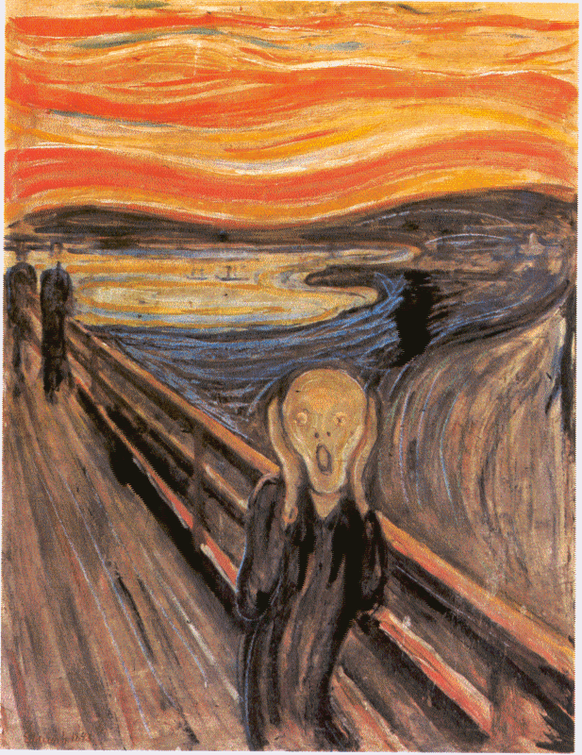
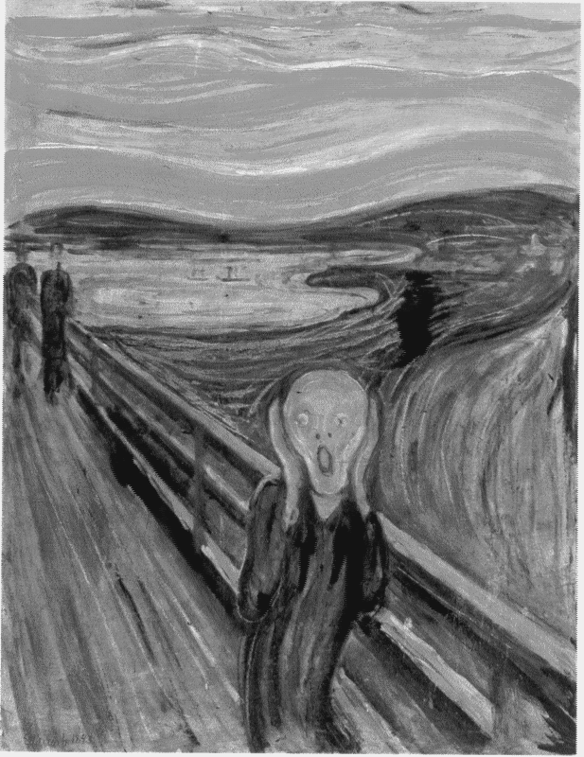
“Real-life” Data
Algorithm
Programming Language
Programming Language
RAM

Slide 4
Menu
What is a “Data Type”?
How to combine them?
Records
Arrays
Variants
What is an Abstract Data Type (ADT)?

Slide 5
Data Type?
A set of sequences of symbols
Programming Interface
Symbolic
Representation
How to manipulate them?
Which sequences

Slide 6
Symbolic Representation
Values
English text characters
decoding
Representation
Format
encoding
ASCII
Sequences of Symbols
7 bits

Slide 7
Conversions
4 bytes
Casting
Change the internal representation
0 (int) to ‘0’ (ASCII code 48),
Reinterpretation
Preserve the representation
0 (int) to NUL (ASCII ctrl)
4A
6F
68
6E
1 248 815 214 (32-bit int)
1 248 815 214 (32-bit int)
3 922 459.5 (32-bit float)
John (ASCII)
䩯桮 (UTF-16 text)
RGBA Color

Slide 8
Programming Interface
What do we want to do with these “values”?
Byte
>>, <<, &, |, etc.
Boolean
and, or, not
Integers, Float, Double
+, -, *, /, %, =, <, >=, …
Characters
toUpperCase
toLowerCase
isWhiteSpace
isLetter
isDigit
…

Slide 9
Still not enough
How can we combine these primitive data types and create our own types?

Slide 10
User-defined Data Types
Records
this and that
Arrays
many of these
Variants
this or that

Slide 11
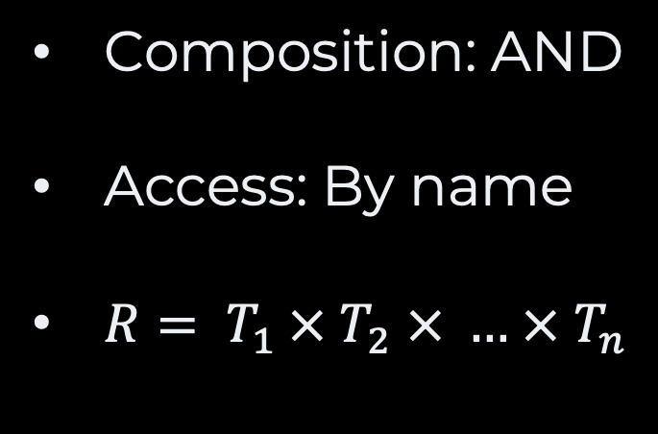
Records
program test;
type
Player = record name : string; score : integer; isCPU : boolean; end;
var
me : Player;
begin
me.name := 'Franck'; me.score := 0; me.isCPU := false; Writeln('Player Name: ',me.name); end.
Pascal
Composition: AND
Access: By name
$R= T_{1 }× T_{2} × … × T_{n}$

Slide 12


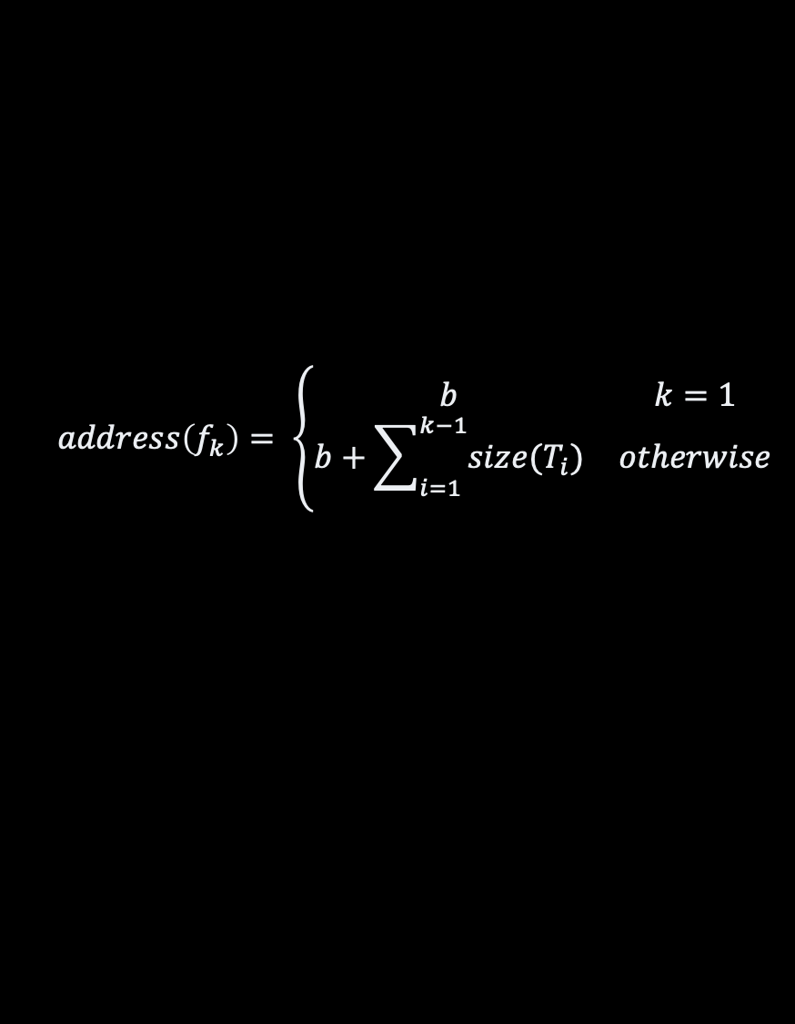

Records in Memory
type
Player = record name : string; score : integer; isCPU : boolean; end;
base address
00
…
b
b+1
b+2
b+3
b+4
b+5
b+6
b+7
b+8
…
∞
size of $T_{1}$
$$T_{2}$$
$$T_{3}$$
$$address\left(f_{k}\right)= \left\{\begin{matrix}b & k=1 \\ b+\sum_{i=1}^{k−1}{size(T_{i})} & otherwise\end{matrix}\right.$$

Slide 13
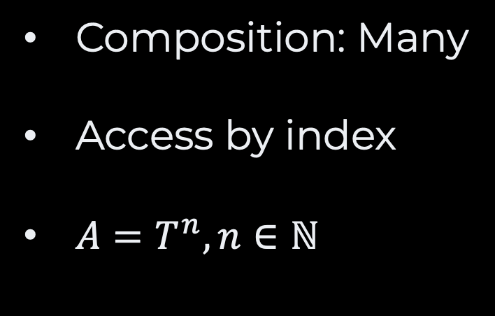
Arrays
Pascal
program test;
type Scores = array [1..10] of integer;
var myScores : Scores;
begin myScores[1] := 123; myScores[4] := 0; Writeln('Player 1 score: ', myScore[1]); end.
Composition: Many
Access by index
$A=T^{n}, n∈ℕ$

Slide 14
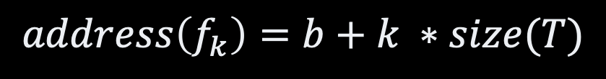

Arrays in Memory
scores = array [1..10] of integer;
base address
00
…
b
b+1
b+2
b+3
b+4
b+5
b+6
b+7
…
…
∞
size of $T$
$$address\left(f_{k}\right)=b+k ∗size(T)$$

Slide 15
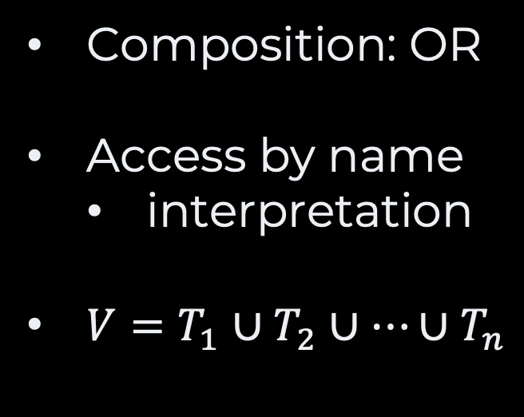
Variants/Union
#include <stdio.h>
union Data {
int asInt;
float asFloat;
};
int main() {
union Data data;
data.asFloat = 3.5;
printf("Value: %d\n", data.asInt);
}
C
Composition: OR
Access by name
interpretation
$V=T_{1}∪T_{2}∪…∪T_{n}$

Slide 16



Variants in Memory
base address
00
…
b
b+1
b+2
b+3
b+4
b+5
b+6
b+7
…
…
∞
size of $T_{1}$
size of $T_{2}$
size of $T_{3}$

Slide 17
Example: Color Images
Pascal
program colors;
type
GrayPixel = integer;
GrayImage = array [0, 9999] of GrayPixel;
RGBPixel = record
red: integer;
green: integer;
blue: integer;
end;
ColorImage = array [0, 9999] of RGBPixel;
var
colored: ColorImage;
grayed: GrayImage;
begin
for eachPixel := 0 to 9999 do
begin
var eachColorPixel : RGBPixel := colored[eachPixel];
with eachColorPixel do
begin
grayed[eachPixel] := (red + green + blue) / 3;
end
end;
end;

Slide 18
Symbolic Representation
How could we write algorithms inrespective of
symbolic representations?
Abstract Data Types

Slide 19
What’s in an ADT?
Domains
(types)
Axioms
(constraints)
Operations

Slide 20


Example: Boolean
Domains
Operations
Axioms
Creators:
$true:∅ →B$
$false:∅ →B$
Queries: None
Commands:
$or:B ×B→B$
$and:B × B→B$
$not:B × B→B$
$∀x∈B, and\left(x, false\right)=false$
$∀x∈B, and\left(x, true\right)=x$
$not\left(true\right)=false$
$not\left(false\right)=true$
$∀\left(x,y\right)∈B^{2}, or\left(x,y\right)$ $=not(and(not\left(x\right), not\left(y\right))$
Boolean

Slide 21
Takeaways
Data Types
Representation
Programming Interface
Casting vs. Reinterpretation
Composing
Record
Array
Variants
ADT
Domains
Operations
Axioms
Examples of ADTs
Sequence
Set
Ordered Set
Trees
Graphs

Slide 22
Questions, Comments, or Ideas?
Franck Chauvel
Axbit & NTNU
franck.chauvel@ntnu.no

Slide 23
Records
Memory:
0
Contiguous allocation of
Heterogenous items
Example,
item, count
name, lastname, age, status
etc.
Often a “type” definition
Given by the compiler
1
2
…
item: Integer
59
base
count: Integer
60
+ size of integer
…
∞

Slide 24
Takeaway
A record is a contiguous allocation
of “fields” of varying size,
which we access by name or index.

Slide 25
Records in C
typedef struct {
int item;
int count;
} Frequency;
Frequency frequency;
frequency.item = 12;
frequency.count = 0;

Slide 26
What is an Array?
item
count
Record:
1
1
But we need many!
capacity
(25 buckets)
Memory:
bucket 1
bucket 2
bucket 3
bucket 25
0
1
…
40
41
42
43
44
45
46
47
48
…
88
89
∞
1
1
45
1
23
2
??
??
base address
(index = 0)
bucket size
length
(3 buckets)

Slide 27
Takeaway
An array is a contiguous allocation
of items of similar size,
which we access by index.

Slide 28
Creation
#define CAPACITY 25
int array[CAPACITY] = {5, 4, 3, 5, 1};
int length = 5;

Slide 29
Operations
access(index: Integer): Value
Give the content at a given index
insert(value: Value index: Integer)
Insert an element at a given index
delete(index: Integer)
Delete an element at a given index
search(value: Value): Integer
Find which bucket contains a given value

Slide 30


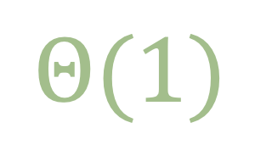

Access
$$Θ(1)$$
$$Θ(1)$$
address = ‘base address’ + (index * sizeof(bucket))
Memory:
bucket size
bucket 3
0
1
…
40
41
42
43
44
45
46
47
48
…
88
89
∞
1
1
45
1
23
2
base address
(index = 0)
40 + 2 * 2

Slide 31
Insertion (at the End) The idea
capacity = 25 buckets
length = 3 buckets
Memory:
bucket size
0
1
…
40
41
42
43
44
45
46
47
48
…
88
89
∞
1
1
45
1
23
2
new bucket
(index = 3)
7
1
new bucket

Slide 32



Insertion At the End The C code
void insert(int value) {
if (length >= CAPACITY) {
return -1;
}
array[length] = value;
length += 1;
}
$$Θ(1)$$
$$Θ(1)$$
This Photo by Unknown Author is licensed under CC BY-SA

Slide 33
Insertion (anywhere) The idea
capacity = 26 buckets
length = 3 buckets
Memory:
bucket size
0
1
…
40
41
42
43
44
45
46
47
48
…
90
91
∞
23
1
1
1
45
1
45
2
23
2
B1
B2
B3
7
1
new bucket
(index = 1)

Slide 34
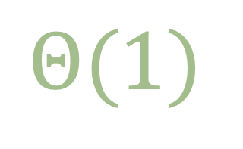
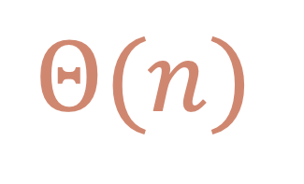
Insertion (anywhere) The C code
int insert (int value, int position) {
if (length >= CAPACITY) {
return -1;
}
length += 1;
for (int index=length-1; index>=position ; index--) {
array[index+1] = array[index];
}
array[position] = value;
}
$$Θ(n)$$
$$Θ(1)$$
This Photo by Unknown Author is licensed under CC BY-SA
This Photo by Unknown Author is licensed under CC BY-SA

Slide 35

Deletion The idea
capacity = 25 buckets
length = 4 buckets
length = 3 buckets
Memory:
bucket size
0
1
…
40
41
42
43
44
45
46
47
48
…
88
89
∞
7
23
23
1
1
45
2
2
1
1
7
1
B1
B2
B3
B4
delete(2)

Slide 36
Deletion (anywhere) The C code
int delete (int position) {
if (length >= CAPACITY) return -1;
int deleted = array[position];
length -= 1;
for (int index=position ; index<length ; index++) {
array[index] = array[index+1];
}
return deleted;
}
$$Θ(n)$$
$$Θ(1)$$
This Photo by Unknown Author is licensed under CC BY-SA

Slide 37
Search The idea
capacity = 26 buckets
length = 3 buckets
Memory:
bucket size
0
1
…
40
41
42
43
44
45
46
47
48
…
90
91
∞
E
M
2
A
2
2
2
V
2
B1
B2
B3
B4
Find “M”?
no!
no!
Yes!

Slide 38
Search The Code
int search(int value) {
for (int index = 0; index < length ; index++) {
if (array[index] == value) {
return index;
}
}
return -1;
}
$$Θ(n)$$
$$Θ(1)$$
This Photo by Unknown Author is licensed under CC BY-SA

Slide 39
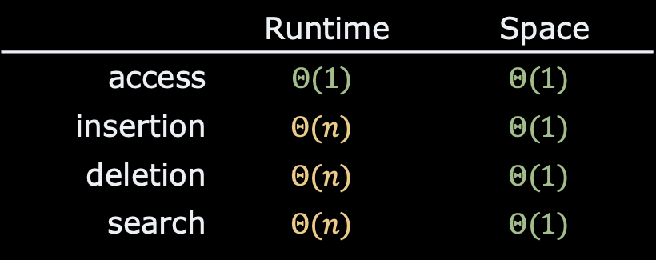
Recap
Records
Contiguous
Varying size
Arrays
Continuous allocation
Same size items
⚠️ Fast access to the i^{th} bucket
Compilers do the “heavy-lifting”
 | Runtime | Space
access | $$Θ(1)$$ | $$Θ(1)$$
insertion | $$Θ(n)$$ | $$Θ(1)$$
deletion | $$Θ(n)$$ | $$Θ(1)$$
search | $$Θ(n)$$ | $$Θ(1)$$

Slide 40
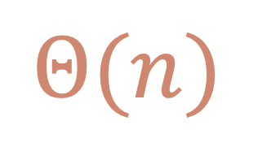
Lab Session
Pen & Paper
Look at the average runtime complexity of the “search”
$$Θ(n)$$

Slide 41
Questions, Comments, or Ideas?
Franck Chauvel
Axbit & NTNU
franck.chauvel@ntnu.no

