Slide 1
Self-balancing Trees
The Art of Rotation
Trees / Lecture 4
Franck Chauvel
axbit & NTNU
Ask questions on menti.com
with code 7273 1330
franck.chauvel@ntnu.no

Slide 2
Random Insertion In Binary Search Trees
23
71
54
8
61
17
67
23
71
81
64
11
36
64
89
89
54
99
36
8
17
39
61
67
81
99
39
11
44
38
38
44

Slide 3
Non-Random Insertion In Binary Search Trees
8
The tree degenerates into a list!
In the worst case,
search in O(n)!
11
17
23
36
38
39
44
54
61
64
67
71
Self-balancing Trees
81
89
99

Slide 4
Agenda
Self-balanced Trees
AVL Trees
Rotations
Insertion
Deletion
Recap

Slide 5
Tree Variations
58
12
23
23
23
12
58
12
58
58
12
12
23
58
12
58
23
23
5

Slide 6
Trees Rotations
rotation
rotation
58
12
23
23
23
12
58
12
58
rotation
rotation
12
58
58
rotation
12
23
23

Slide 7
Self-balanced Trees
AVL Trees
2 – 4 Trees
Splay Trees
Red-black Trees
etc.

Slide 8

AVL Tree By Georgy Adelson-Velsky & Evgenii Landis
Balance Factor
$balance\left(tree\right)=height\left(left\left(tree\right)\right)−height(right(tree))$
Invariant
$balance\left(tree\right)∈\{−1,0,1\}$
b=-1
23
b=0
b=-2
11
36
b=0
8
17
39
b=0
b=0
38
44
b=0
b=0

Slide 9
Code Tree Height
public int height() {
int leftHeight = hasLeftChild() ? left.height() : 0;
int rightHeight = hasRightChild() ? right.height() : 0;
return 1 + Math.max(leftHeight, rightHeight);
}

Slide 10
Code AVL Balance Factor
public int balanceFactor() {
int leftHeight = hasLeftChild() ? left.height() : 0;
int rightHeight = hasRightChild() ? right.height() : 0;
return leftHeight - rightHeight;
}

Slide 11
Insertion
X
b=2
L
R
X
b=1
L
R
X
b=0
X
b=0
L
R
L
R
X
b=-1
L
R
X
L
R
b=-2

Slide 12

When $balance(tree) =−2$ Insertion in AVL trees
rotation
rotation
b=0
58
b=-2
12
23
23
23
12
58
12
58
rotation
rotation
b=-2
12
58
58
rotation
12
23
23

Slide 13

When $balance(tree) =2$ Insertion in AVL trees
rotation
rotation
b=0
58
b=2
12
23
23
23
12
58
12
58
rotation
rotation
12
58
b=2
58
rotation
12
23
23

Slide 14





Rotation Left or right rebalancing
A
B
B
Z
X
A
X
Y
$$A<Z$$
Y
Z
$$B<Y<A$$
$$X<B$$
$$B<Y<A$$
$$A<Z$$
$$X<B$$

Slide 15
The Code Single Rotation
private Tree<Item> rotateLeft() {
Tree<Item> newRoot = right;
Tree<Item> tmp = right.left;
right.left = this;
right = tmp;
return newRoot;
}
private Tree<Item> rotateRight() {
Tree<Item> newRoot = left;
Tree<Item> tmp = left.right;
left.right = this;
left = tmp;
return newRoot;
}

Slide 16
The Code Insertion in AVL Trees
public Tree<Item> insert(Item givenItem) {
int difference = item.compareTo(givenItem);
if (difference > 0) {
return insertLeft(givenItem);
} else if (difference < 0) {
return insertRight(givenItem);
} else {
throw new RuntimeException("Duplicated item " + item);
}
}
Different for an AVL tree

Slide 17
The Code Left Insertion in AVL Trees
private Tree<Item> insertLeft(Item givenItem) {
if (hasLeftChild()) {
this.left = this.left.insert(givenItem);
if (this.balanceFactor() > 1) {
int side = this.left.item.compareTo(givenItem);
if (side > 0) {
return this.rotateRight();
} else if (side < 0){
this.left = this.left.rotateLeft();
return this.rotateRight();
}
}
} else {
this.left = new AVL(givenItem);
}
return this;
}
single rotation
on the outside
double rotation
on the inside

Slide 18
Deletion
X
b=-2
R
X
b=-1
L
R
b=0
X
b=-1
X
L
R
L
R
X
b=1
X
b=2
L
R
L

Slide 19
The Code The main delete operation
public Tree<Item> delete(Item givenItem) throws NoSuchElement {
int difference = this.item.compareTo(givenItem);
if (difference < 0) {
return this.deleteRight(givenItem);
} else if (difference > 0) {
return this.deleteLeft(givenItem);
} else {
return deleteThis();
}
}
Differente for an AVL tree

Slide 20
The Code Left deletion in AVL Trees
private Tree<Item> deleteLeft(Item givenItem) throws NoSuchElement {
if (hasLeftChild()) {
left = left.delete(givenItem);
if (hasRightChild() && balanceFactor() < -1) {
int side = right.item.compareTo(givenItem);
if (side < 0) {
return rotateLeft();
} else if (side > 0) {
right = right.rotateRight();
return rotateLeft();
}
}
return this;
}
throw new NoSuchElement();
}
single rotation
on the outside
double rotation
on the inside

Slide 21
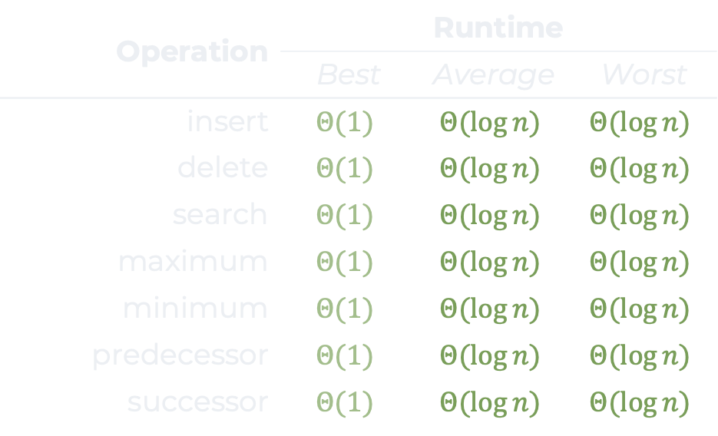
Recap
Binary trees
Not efficient when not random!
Degenerated trees
Self-balancing trees
AVL, Red black Trees, 2–4 trees, etc.
AVL
Balance factor
Rotation
inside: Double
outside: Single
Operation | Runtime
Operation | Best | Average | Worst
insert | $$Θ(1)$$ | $$Θ(\log{n})$$ | $$Θ(\log{n})$$
delete | $$Θ(1)$$ | $$Θ(\log{n})$$ | $$Θ(\log{n})$$
search | $$Θ(1)$$ | $$Θ(\log{n})$$ | $$Θ(\log{n})$$
maximum | $$Θ(1)$$ | $$Θ(\log{n})$$ | $$Θ(\log{n})$$
minimum | $$Θ(1)$$ | $$Θ(\log{n})$$ | $$Θ(\log{n})$$
predecessor | $$Θ(1)$$ | $$Θ(\log{n})$$ | $$Θ(\log{n})$$
successor | $$Θ(1)$$ | $$Θ(\log{n})$$ | $$Θ(\log{n})$$

Slide 22
Questions, Comments, or Ideas?
Franck Chauvel
axbit & NTNU
franck.chauvel@ntnu.no

