Slide 1
B-Trees
An introduction to I/O efficiency
Trees / Lecture 5
Franck Chauvel
axbit & NTNU
Ask questions on menti.com
with code 7273 1330
franck.chauvel@ntnu.no

Slide 2
Out of Memory
What if it does not fit into main memory?

Slide 3

Agenda
External Storages
DAM and I/O Efficiency
B-Trees
Sizing
Search
Insertion
Deletion
Recap
This Photo by Unknown Author is licensed under CC BY

Slide 4
External Storages
Vintage hard drives and tapes …

Slide 5
Hard disk drives
track sector
disk sector
spindle
actuator arm
platters
track
arm assembly
reading head

Slide 6
Access Time
access time = seek time + rotational delay + transfer time
Access time varies depending on where we access!
rotational
delay
seek time
6

Slide 7

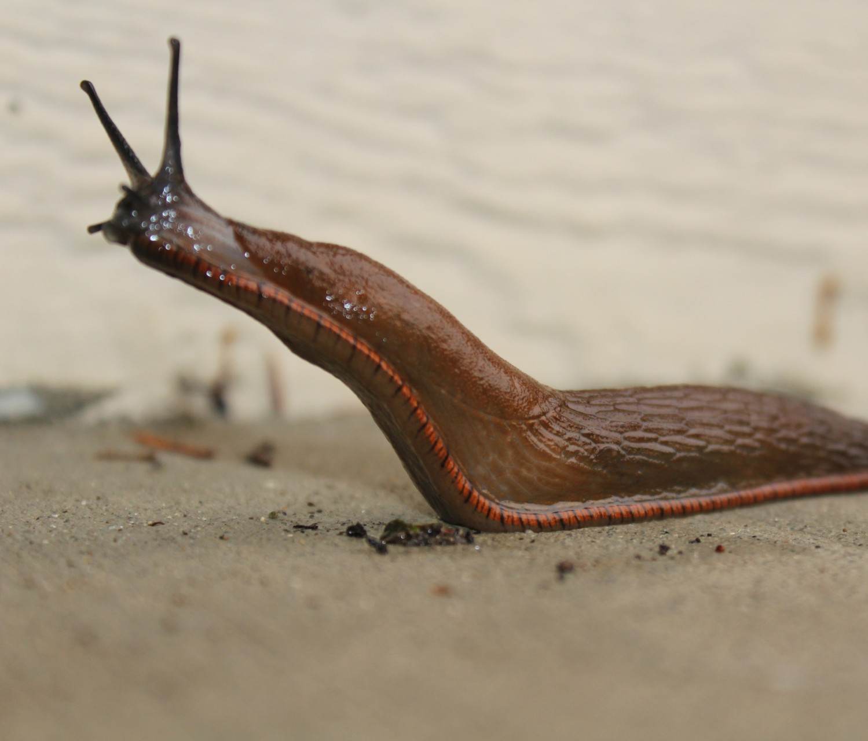
Main Memory vs. External Storage
RAM Memory
Access: 5 – 50 ns
F-18: 1915.119 km / h
Hard disks
Access: 5 – 50 ms
Slug: 10 m / h

Slide 8
What about RAM?
How can we express disk access with the RAM?

Slide 9
Disk Access Model
Random Access
Machine
input device
Memory
00
02
02
output device
03
CPU
ACC
04
External storage
IP
05
00
SRC
06
02
TGT
⇣
⇣
arithmetic and logic
operations
fixed
capacity
M
∞

Slide 10
Cost Model
Code | Mnemonic | Parameter | Semantic | Cost
1 | LOAD |  |  | 0
2 | ADD |  |  | 0
3 | SUBTRACT |  |  | 0
4 | STORE |  |  | 0
5 | JUMP |  |  | 0
6 | READ |  |  | 0
7 | PRINT |  |  | 0
8 | DISK_READ | cell_count | memory[TGT, TGT+Count]:= disk[SRC, SRC+count] | 1
9 | DISK_STORE | cell_count | disk[TGT, TGT+Count]:=Memory[SRC, SRC+count] | 1
* | HALT |  |  | 0

Slide 11
I/O Efficiency
minimize the number of disk accesses

Slide 12
Locality
Spatial locality
Data near the one currently in memory are more likely to process next.
Temporal locality
Data currently accessed is more likely to needed again in the near future

Slide 13
B-trees
A data structure for efficient disk usage
Often used for on-disk storage
DB engines …
node = disk block

Slide 14
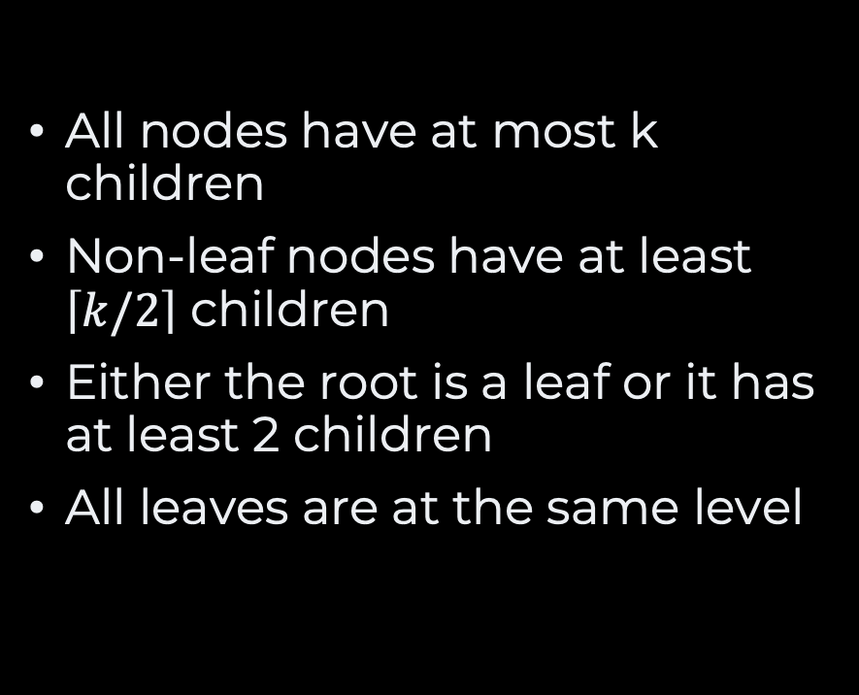

B-tree of order $k$
All nodes have at most k children
Non-leaf nodes have at least $\left\lceil k/2\right\rceil$ children
Either the root is a leaf or it has at least 2 children
All leaves are at the same level
55
99
10
25
31
49
65
71
78
92
2
12
25
32
49
56
65
71
80
92
4
19
28
33
51
58
66
73
82
93
9
20
30
34
54
59
67
74
84
94
21
35
75
85

Slide 15
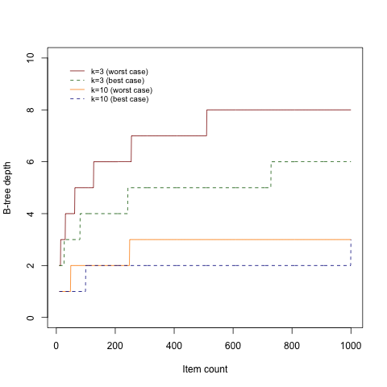
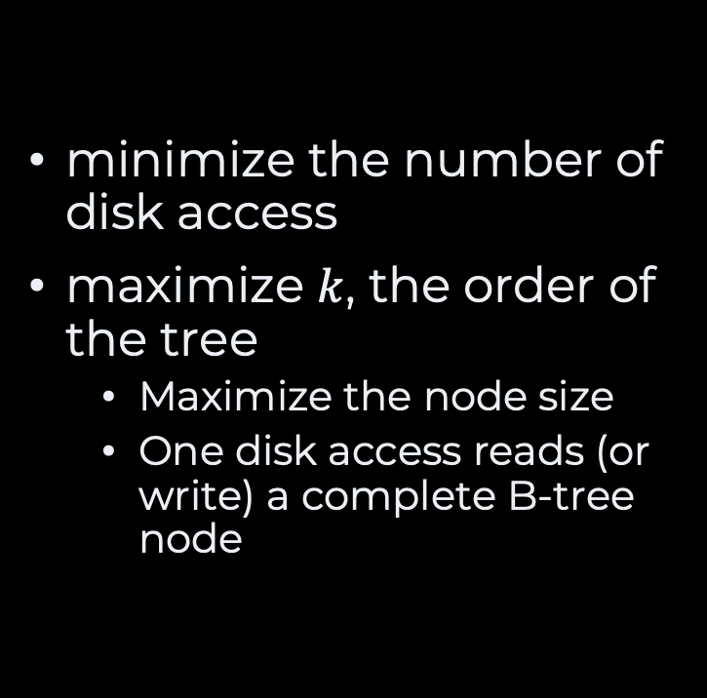
I/O Efficiency B-trees
minimize the number of disk access
maximize $k$, the order of the tree
Maximize the node size
One disk access reads (or write) a complete B-tree node

Slide 16
Search
search(67)
search
“local” search could be binary search
I/O Efficiency
local searches cost nothing
55
search
10
25
31
49
65
71
78
92
2
12
25
32
49
56
65
71
80
92
4
19
28
33
51
58
66
73
82
93
67
9
20
30
34
54
59
67
74
84
94
21
35
75
85
search

Slide 17
Insertion When the node is not full
insert(53)
55
10
25
31
49
65
71
78
2
12
25
32
49
56
65
71
80
4
19
28
33
51
58
66
73
82
9
30
34
53
59
67
74
84
20
54
21
35
75
85

Slide 18
Insertion When the node is full, but its parent is not
insert(90)
55
10
25
31
49
65
71
78
84
65
71
80
56
80
85
2
12
25
32
49
80
66
73
82
90
58
82
4
19
28
33
51
82
59
67
74
84
84
9
20
30
34
54
84
75
85
21
35
85
90
full!

Slide 19
Insertion When both node and parent are full
insert(40)
55
10
25
31
49
65
71
78
2
12
25
32
49
56
65
71
80
32
4
19
28
33
51
58
66
73
82
33
9
30
34
59
67
74
84
20
34
54
34
35
75
85
21
35
40
full!

Slide 20
Insertion When both node and parent are full
insert(40)
55
full!
31
10
25
31
34
49
65
71
78
2
12
25
32
35
49
56
65
71
80
4
19
28
33
40
51
58
66
73
82
9
20
30
54
59
67
74
84
21
75
85
split!

Slide 21
Insertion When both node and parent are full
insert(40)
31
55
10
25
34
49
65
71
78
2
12
25
32
35
49
56
65
71
80
4
19
28
33
40
51
58
66
73
82
9
20
30
54
59
67
74
84
21
75
85

Slide 22

Deletion of a leaf node
delete(67)
search
Find and remove the desired element
Rebalance the tree
55
search
10
25
31
49
65
71
78
92
2
12
25
32
49
56
65
71
80
92
4
19
28
33
51
58
66
73
82
93
67
9
20
30
34
54
59
67
74
84
94
21
35
75
85
Found

Slide 23
Deletion within an internal node
delete(78)
search
Pick either of
The maximum of the left subtree
The minimum of the right subtree
Sort of left/right rotation
55
search
31
49
78
92
78
10
25
65
71
80
65
71
80
2
12
25
32
49
56
80
92
4
19
28
33
51
58
66
73
82
93
9
20
30
34
54
59
67
74
84
94
75
21
35
75
85

Slide 24
Rebalancing Using Rotations
How to preserve invariants
Leaf must have at least k/2 entries
55
31
49
92
10
25
31
65
71
78
32
2
12
25
32
49
56
65
71
80
92
32
4
19
28
33
51
58
66
73
82
93
9
20
31
34
54
59
67
74
84
94
21
35
75
85

Slide 25
Rebalancing Using Merging
How to preserve invariants
Nodes must have at least k/2 children
55
10
25
31
49
65
71
78
92
2
12
25
32
49
56
65
71
80
92
4
19
33
51
58
66
73
82
93
9
54
59
67
74
84
94
75
85

Slide 26
Rebalancing Using Merging
How to preserve invariants
Leaf must have at least k/2 entries
Merging entries can cascade to the root node
55
10
25
49
65
71
78
92
2
12
25
49
56
65
71
80
92
4
19
31
51
58
66
73
82
93
9
32
54
59
67
74
84
94
33
75
85

Slide 27
B-tree Variants
B⁺ trees
B* trees
B^{+*} trees

Slide 28
Recap
External storage
Cheap
Huge
But so slow!
I/O efficiency
DAM = RAM + Hard-drive
block transfer
Cost model: Count transfer
B Trees
Tailored for external storage
Node ~ blocks on disks
Shallow
Less block transfer

Slide 29
Questions, Comments, or Ideas?
Franck Chauvel
Axbit & NTNU
franck.chauvel@ntnu.no

