Slide 1
Algorithm Design
Putting it all together
Beyond RAM/ Lecture 3
Franck Chauvel
axbit & NTNU
Ask anything on menti.com with code 2855-5096
franck.chauvel@ntnu.no

Slide 2
New Problems?
We have covered so many algorithms,
and yet, we just scratched the surface
What if we face a new problem?

Slide 3
Agenda
Algorithmic Ideas
Use Brute Force
Divide-and-Conquer
Be Greedy
Randomize
Towards a design method
Preparing for a Tech Interview

Slide 4
1. Algorithmic Ideas

Slide 5
Idea #1: Brute Force
Simply try out all possible solutions.

Slide 6
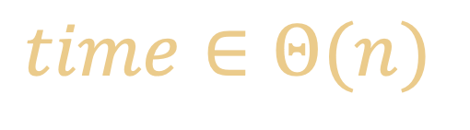
Linear Search Brute Force Examples
Find “67”
no
yes
no
no
no
no
no
no
0
1
2
3
4
5
6
7
8
9
10
11
23
35
8
11
213
86
37
67
55
54
27
39
$$time∈Θ(n)$$

Slide 7
Selection Sort Brute Force Examples
minimum
minimum
28
35
22
36
22
22
22
28
36
35
ok
swap
minimum
minimum
22
35
28
36
22
22
22
28
36
35
swap
swap

Slide 8





Combinatorial Search Brute Force Examples
empty solution
1st
choice
y
n
2nd
choice
y
n
y
n
3rd
choice
y
n
y
n
y
n
y
n
4th
choice
y
n
y
n
y
n
y
n
y
n
y
n
y
n
y
n

Slide 9
Idea #2: Divide-and-Conquer
Divide Break the problem into smaller self-similar problems, recursively
Conquer
Merging the solution of sub problems

Slide 10
Binary Search Divide-and-Conquer Examples
Find “67”
27 < 67
54 < 67
Found
86 > 67
0
1
2
3
4
5
6
7
8
9
10
11
8
11
23
27
35
37
39
54
55
67
86
213
1st pick
3rd pick
2nd pick
smaller
larger

Slide 11
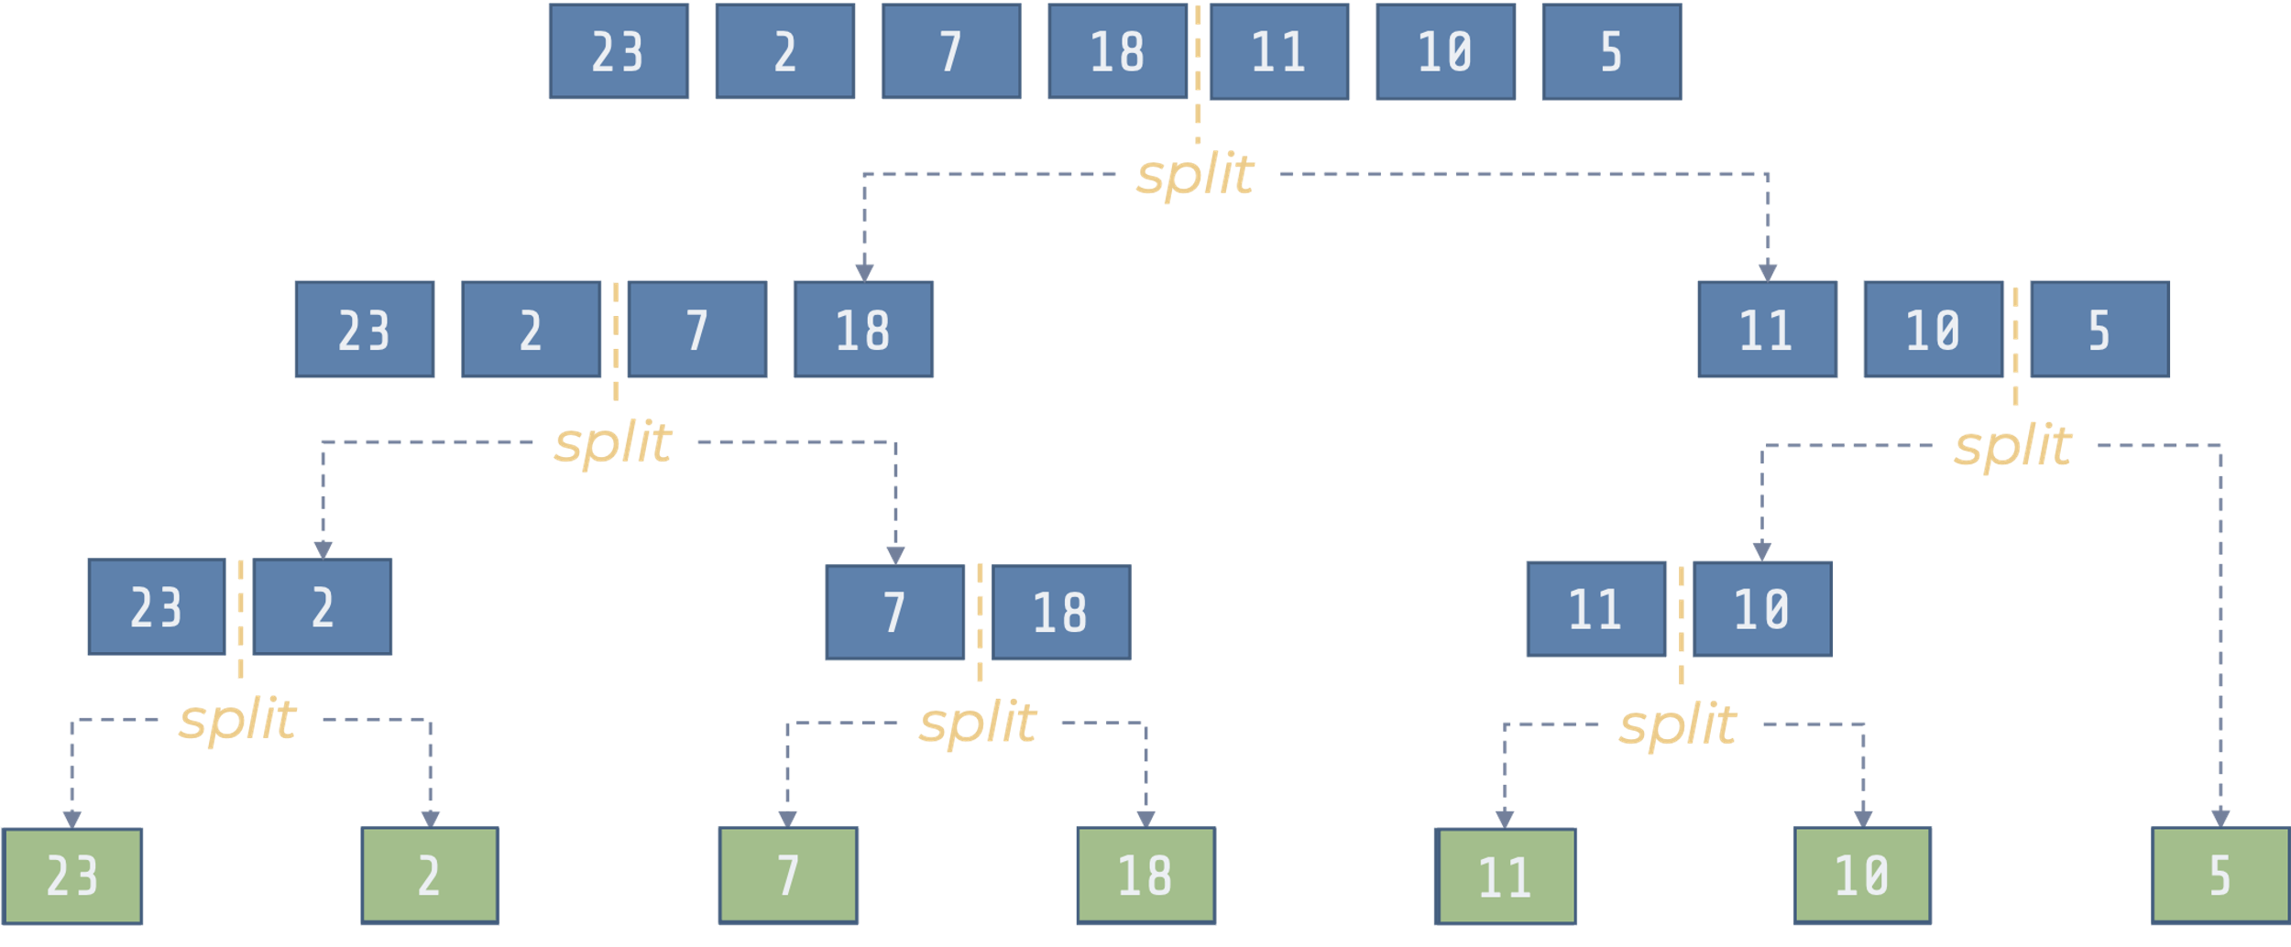
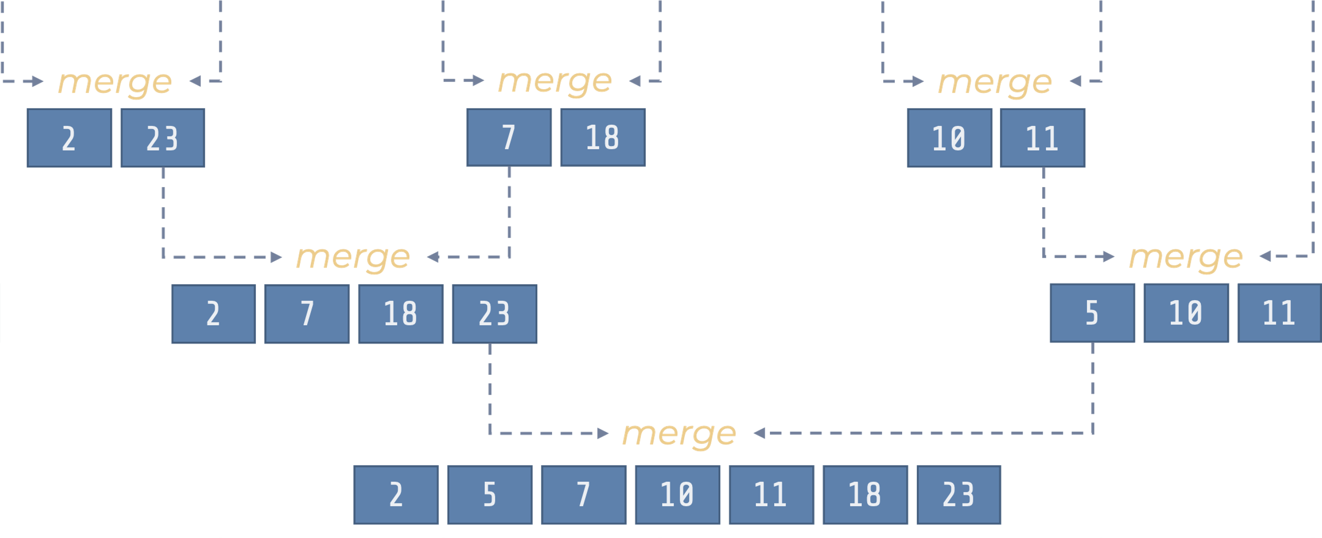
Merge Sort Divide-and-Conquer Examples
Recursive
left, right = split(array)
merge(sort(left), sort(right))

Slide 12
Idea #3: Be Greedy
What to do?
Make the best possible move,
at that point in time.

Slide 13
Prim’s Algorithm Greediness Examples
MST
under construction
A
D
C
-4
1
C
C
B
E
B
E
3
3
1
5
3
2
-5
1
8
G
E
4
D
D
A
B
A
F
unvisited vertices

Slide 14
Dijkstra’s Algorithm Greediness Examples
At each step,
Expand the most promizing path so far
3
1
4
2
1
1
5
1
3
5
4
3
1
1
8
6
7
1
9

Slide 15
Idea #4: Randomize
What to do?
Pick any possible move
at that point in time.

Slide 16
Quick Sort Randomization Examples
22
5
23
36
2
50
22
17
36
35
28
51
22
5
2
17
22
50
36
35
28
51
22
36
23
2
28
5
22
23
51
36
50
36
35
2
17
22
28
50
17
5
17
22
23
36
35
36
50
51
35
51
def quick_sort(array):
if len(array) < 2: return
pivot = partition(array)
quick_sort(array[:pivot])
quick_sort(array[pivot+1:])
35
36
36
36
36
36
36

Slide 17
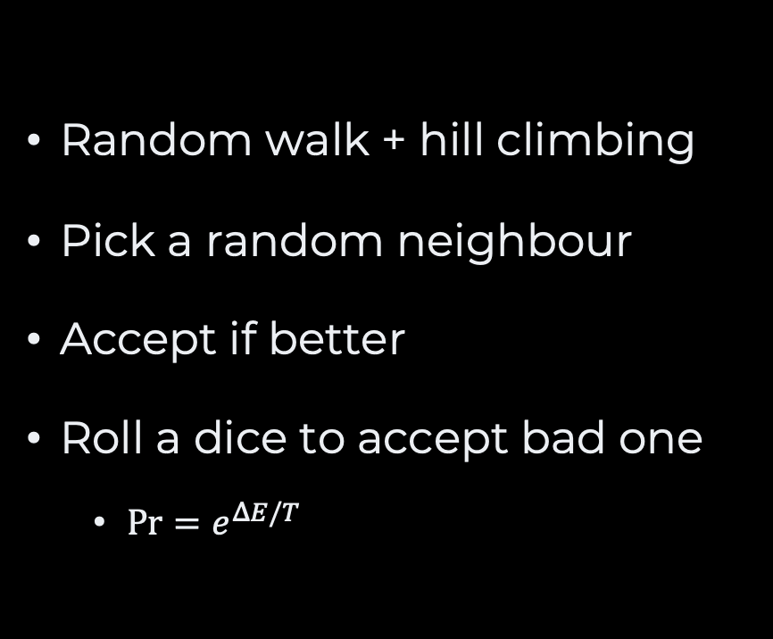
Simulated Annealing Greediness Examples
Random walk + hill climbing
Pick a random neighbour
Accept if better
Roll a dice to accept bad one
$\operatorname{Pr}{=e^{ΔE/T}}$
temperature
(time)
Unlikely
accepted
Very rarely
accepted
Possibly
accepted
Unlikely
accepted
Very Likely
accepted
Possibly
accepted
Not too bad
Very bad

Slide 18
2. Key Questions

Slide 19
What is the Problem?
What are the inputs?
How big is it
What is the output?
How good shall it be?
What type of problems?
How much resources do I have? runtime, memory, money?

Slide 20
Is it a Known Problem?
Have you studied it?
Have you “googled” it?
Can you reduce it to a known problem?

Slide 21
Looking for a Solution
Does it have a solution?
Can you reach a solution with brute force?
If not, would any algorithmic ideas help?
It works, but I have money left
Where does my solution struggle?
Can I improve on this very aspect?

Slide 22
2. Tech Interview

Slide 23
The Process
Screening
Interview 1
Interview 2
Interview 3

Slide 24


Screening
Programming fluency
To remove irrelevant candidates
Programming speed

Slide 25
Technical Interview
It is not an exam ☺
What do they want to know?
How do you communicate?
How do you think?
How do you solve a problem?
What they need?
A professional
Not a guru

Slide 26
Teaching Assistants?
Why?
What?
Get paid
Help your peers
Get new experience
Communication & Leadership skills
Make the course less boring
Grade lab sessions
Help during lab sessions
Propose new lectures/lab sessions
Review/Write lecture notes
Make Kahoot quizzes
Ideas are welcome

Slide 27
Questions, Comments, or Ideas?
Franck Chauvel
Axbit & NTNU
franck.chauvel@ntnu.no

